Slide 1
World University Ranking 2022

Slide 2
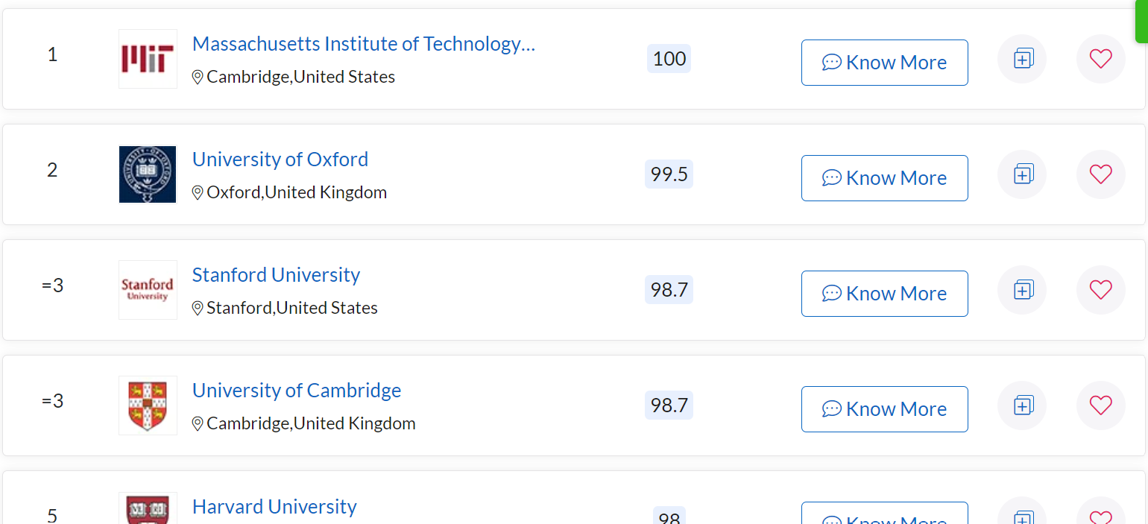
QS

Slide 3
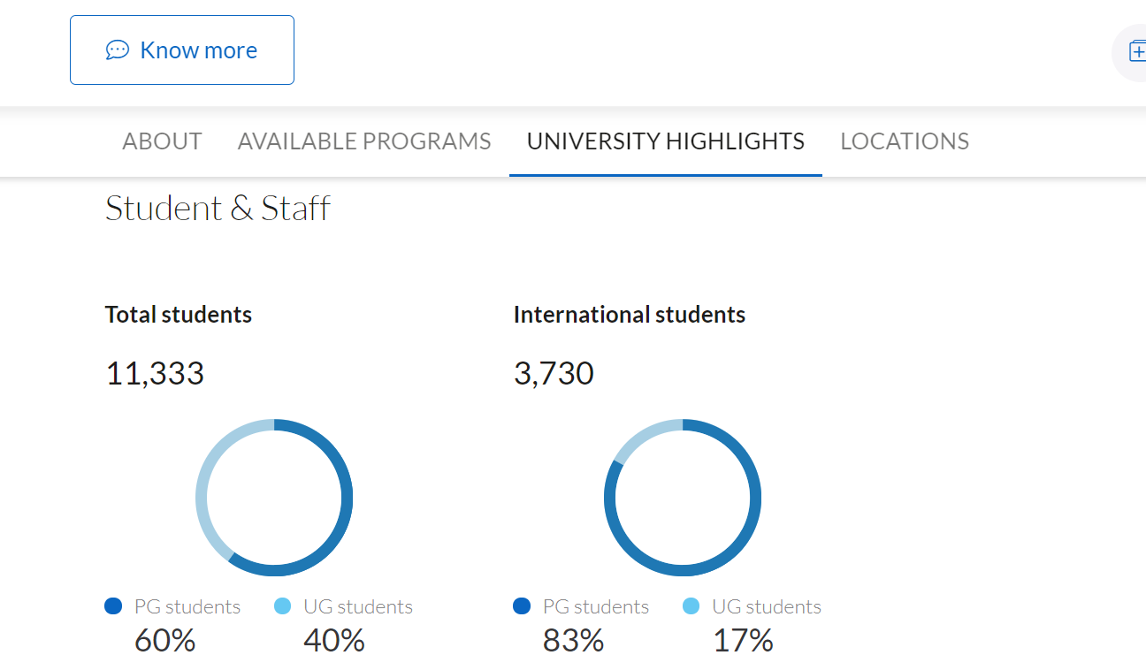
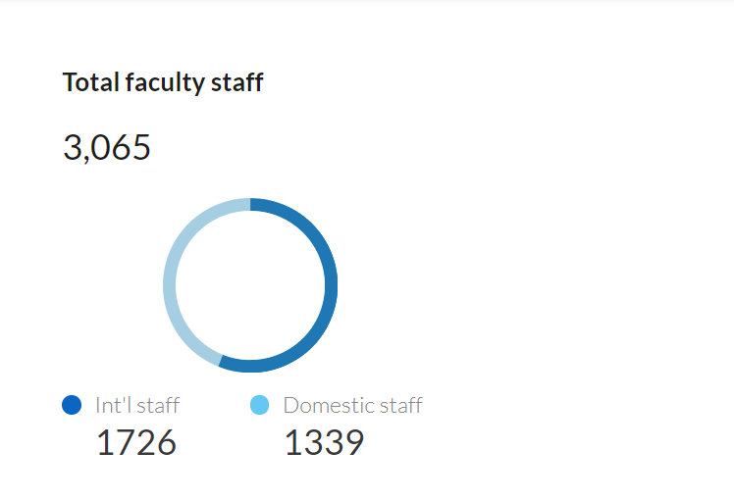

Slide 4
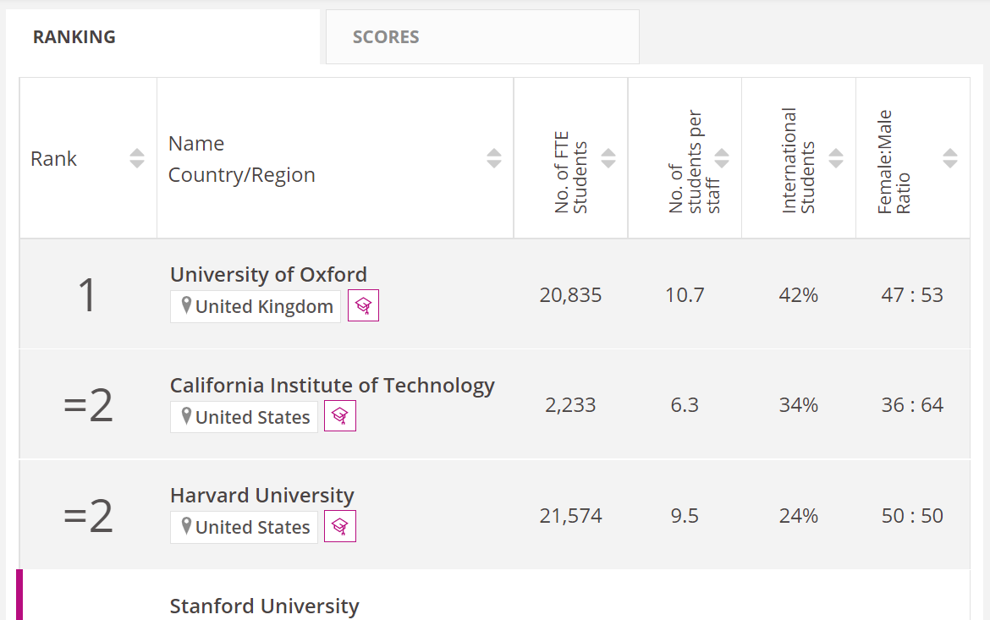
THE

Slide 5
格式
學校名稱
括號
"-"
人數資料格式
"%"
千分位
":"
Rank
"="
THE 200以後，"401–500"→450

Slide 6
merge
QS: 500 obs.
THE: 500 obs.
Merge: 270 obs.

Slide 7
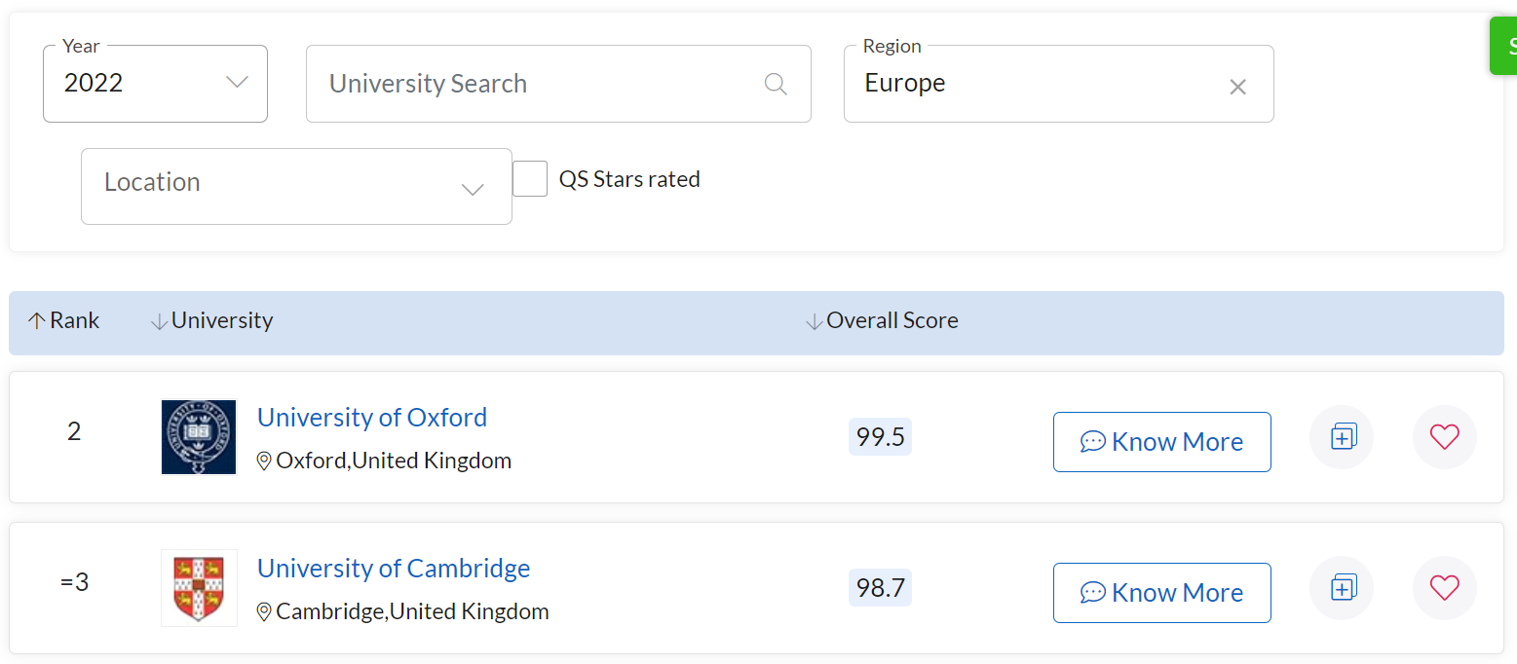
Continent

Slide 8
# of university at north america : 79 (104)
# of university at europe : 106 (222)
# of university at asia : 52 (125)
# of university at oceania : 22 (44)
# of university at africa : 2 (5)
# of university at latin america : 0 (31)

Slide 9
diff = THE - QS
mean of diff at north_america : -466.42
mean of diff at europe : 703.91
mean of diff at asia : 416.75
mean of diff at oceania : -1732.14
mean of diff at africa : -1112.5
mean of diff at all continent: 60.04

Slide 10
diff = THE - QS
std of diff at north_america : 2159.29
std of diff at europe : 3070.06
std of diff at asia : 1881.82
std of diff at oceania : 2068.85
std of diff at africa : 509.82
std of diff at all continent: 2581.65

Slide 11
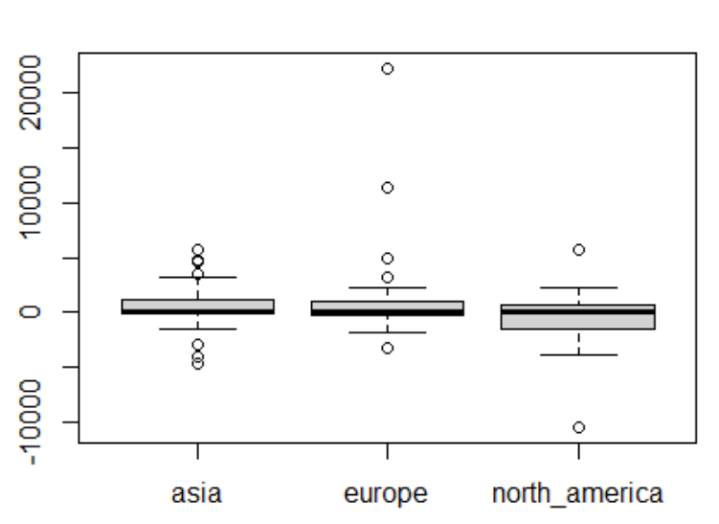

Slide 12
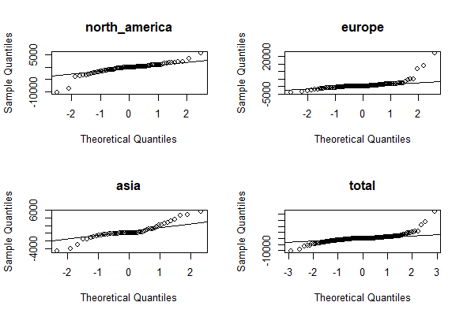

Slide 13
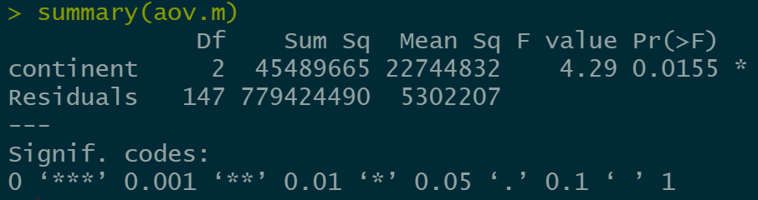

Slide 14
Outlier
排名內所有大學
大學名稱格式:
University of Missouri, Columbia(QS 476) vs Mizzou – University of Missouri(THE 501-) / University of Missouri-St Louis(THE 601-)

Slide 15
Old university vs young university(by ?)
Ranking group: 1~200, 201~400, 401~600 (by QS)
2021年排名下降 vs 上升

