Slide 1
World University Ranking 2022

Slide 2
修改部分
抓全部資料
以排名區間、排名上升下降、洲分組
transform

Slide 3
判斷方式
diff = No. of Students for QS - No. of Students for THE
pdiff = diff / average(No. of Students for QS + No. of Students for THE)
篩離群值、判斷有沒有作弊

Slide 4
排名區間
1-200
201-400
401-600
601-800
801-1000
1001-1200
1200+

Slide 5
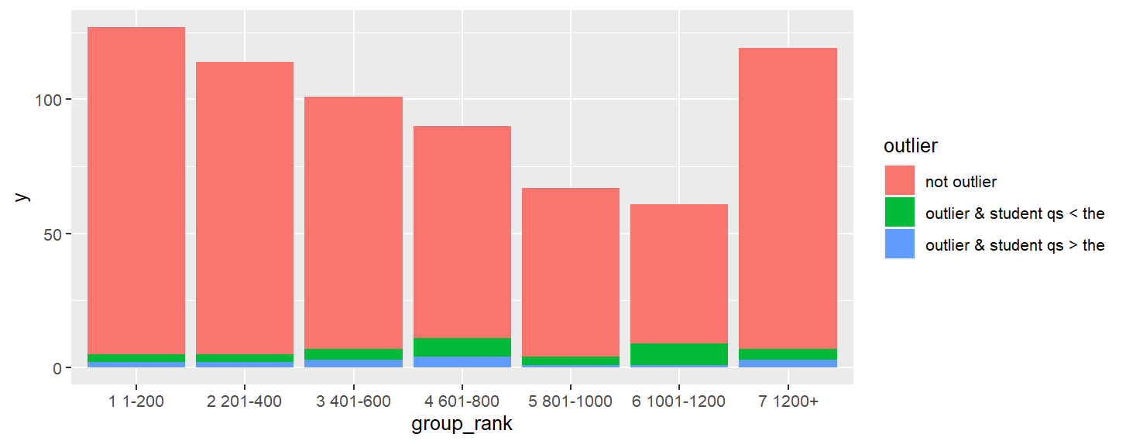

Slide 6
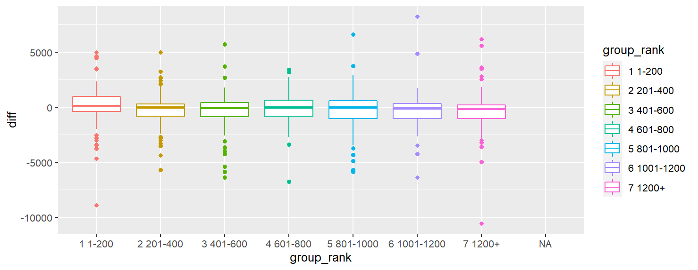
without outlier

Slide 7
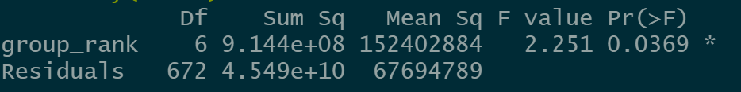
with outlier

Slide 8
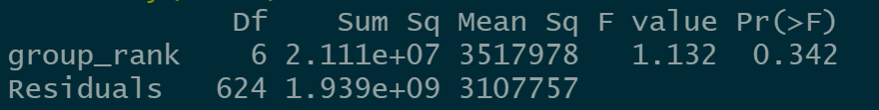
without outlier

Slide 9
--- 1 1-200 ---
Number of university: 127
Mean of "diff": 116.378
Number of students of qs > the
se of "diff": 207.2454
p-value of t test if diff of "1 1-200" = 0: 0.3414
p-value of t test if pdiff of "1 1-200" = 0: 0.2787
--- 2 201-400 ---
Number of university: 114
Mean of "diff": -190.7281
Number of students of qs < the
se of "diff": 203.7091
p-value of t test if diff of "2 201-400" = 0: 0.1428
p-value of t test if pdiff of "2 201-400" = 0: 0.1697
--- 3 401-600 ---
Number of university: 101
Mean of "diff": -141.4752
Number of students of qs < the
se of "diff": 314.7755
p-value of t test if diff of "3 401-600" = 0: 0.0515*
p-value of t test if pdiff of "3 401-600" = 0: 0.1905
--- 4 601-800 ---
Number of university: 90
Mean of "diff": -892.7556
Number of students of qs < the
se of "diff": 638.2833
p-value of t test if diff of "4 601-800" = 0: 0.6783
p-value of t test if pdiff of "4 601-800" = 0: 0.8994
--- 5 801-1000 ---
Number of university: 67
Mean of "diff": -3100.597
Number of students of qs < the
se of "diff": 2605.947
p-value of t test if diff of "5 801-1000" = 0: 0.2576
p-value of t test if pdiff of "5 801-1000" = 0: 0.1428
--- 6 1001-1200 ---
Number of university: 61
Mean of "diff": -2953.279
Number of students of qs < the
se of "diff": 1509.533
p-value of t test if diff of "6 1001-1200" = 0: 0.2869
p-value of t test if pdiff of "6 1001-1200" = 0: 0.1132
--- 7 1200+ ---
Number of university: 119
Mean of "diff": 64.7395
Number of students of qs > the
se of "diff": 341.2634
p-value of t test if diff of "7 1200+" = 0: 0.0663*
p-value of t test if pdiff of "7 1200+" = 0: 0.0102*

Slide 10
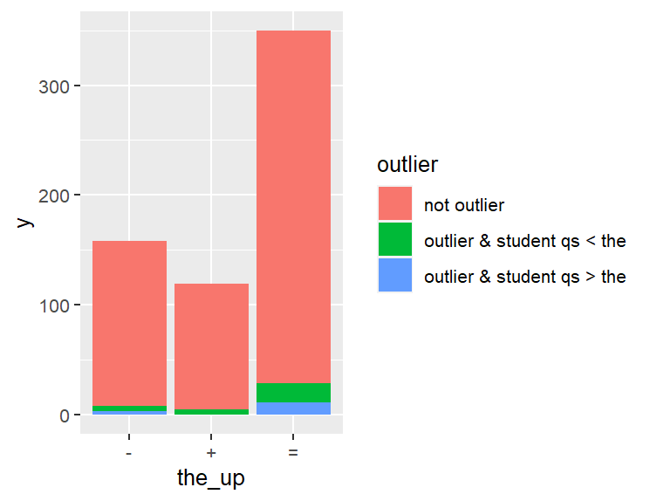
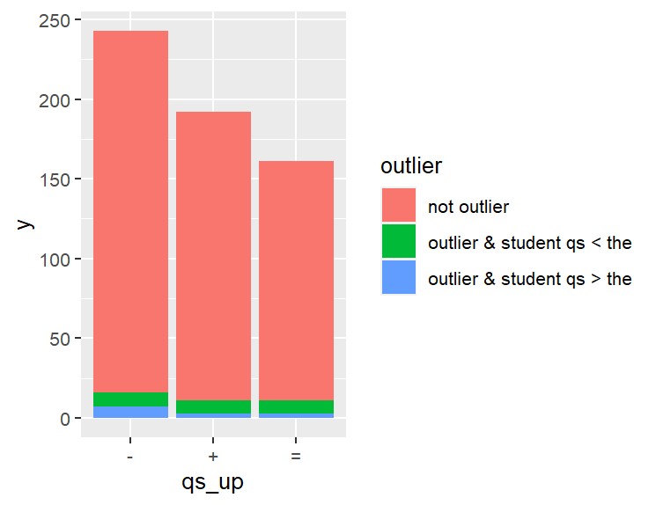
排名上升或下降

Slide 11
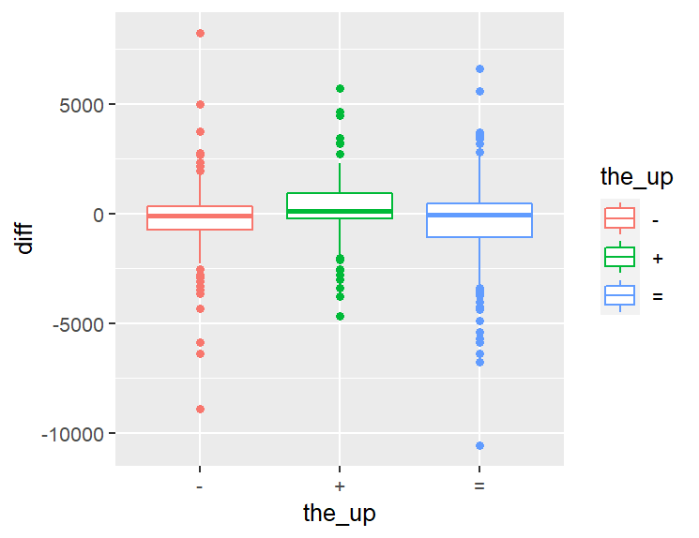
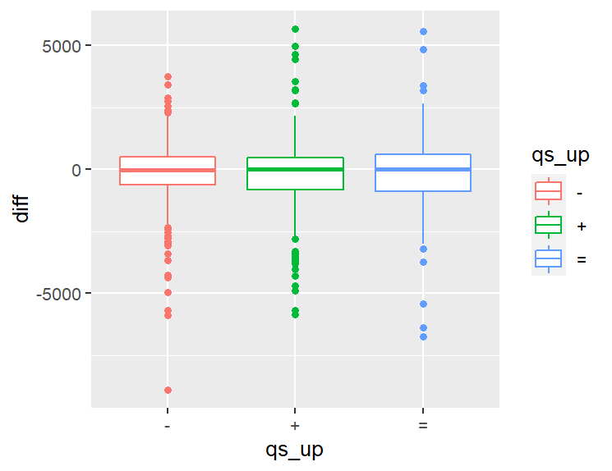
without outlier

Slide 12
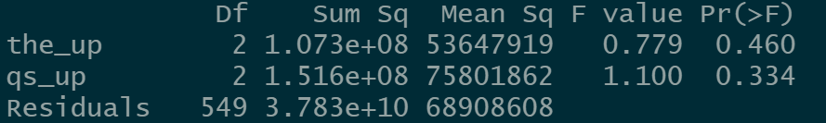
with outlier

Slide 13
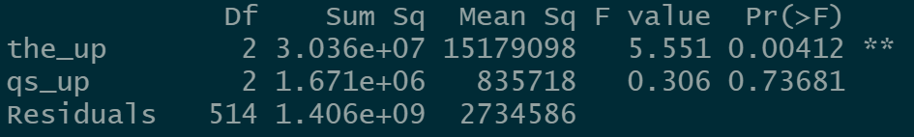
without outlier

Slide 14
--- + ---
Number of university: 192
Mean of "diff": -294.8229
Number of students of qs < the
se of "diff": 200.3048
p-value of t test if diff of "+" = 0: 0.143
p-value of t test if pdiff of "+" = 0: 0.0458*
--- - ---
Number of university: 243
Mean of "diff": -507.5597
Number of students of qs < the
se of "diff": 265.1523
p-value of t test if diff of "-" = 0: 0.0329*
p-value of t test if pdiff of "-" = 0: 0.1865
--- = ---
Number of university: 161
Mean of "diff": -1589.876
Number of students of qs < the
se of "diff": 1124.421
p-value of t test if diff of "=" = 0: 0.204
p-value of t test if pdiff of "=" = 0: 0.2025

