Slide 1
Implement of 2 layers backpropagation model
711033123 商巧昀

Slide 2
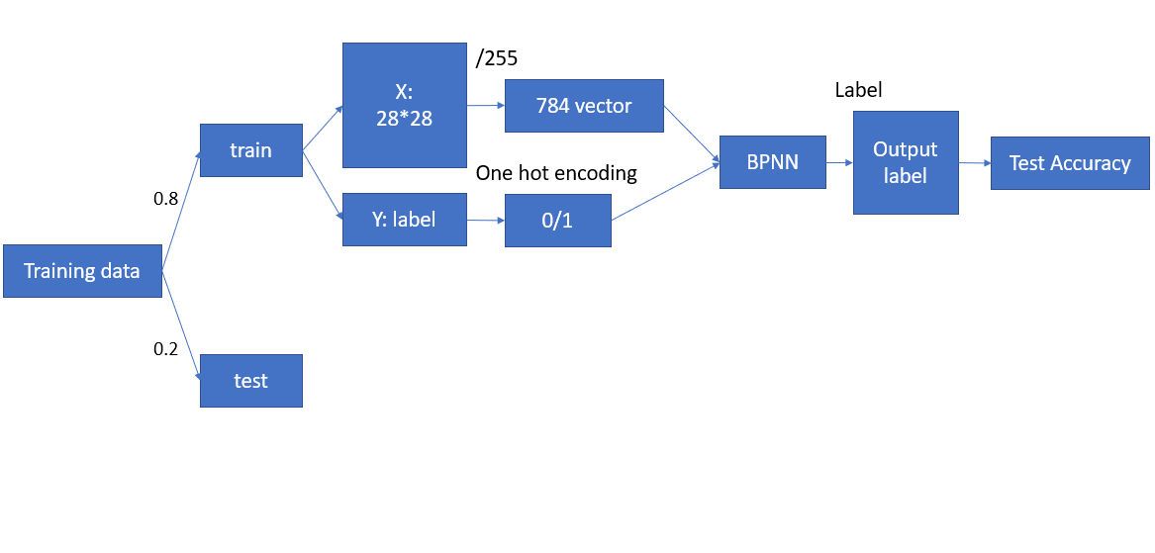
Learning Process

Slide 3
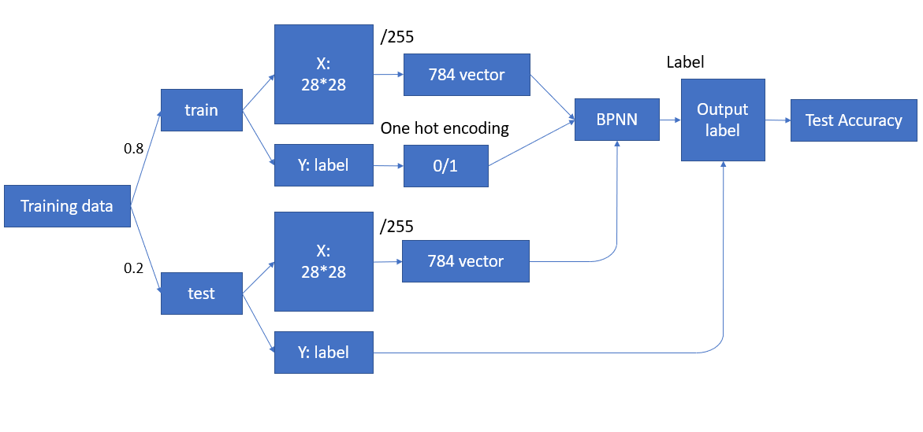
Learning Process

Slide 4
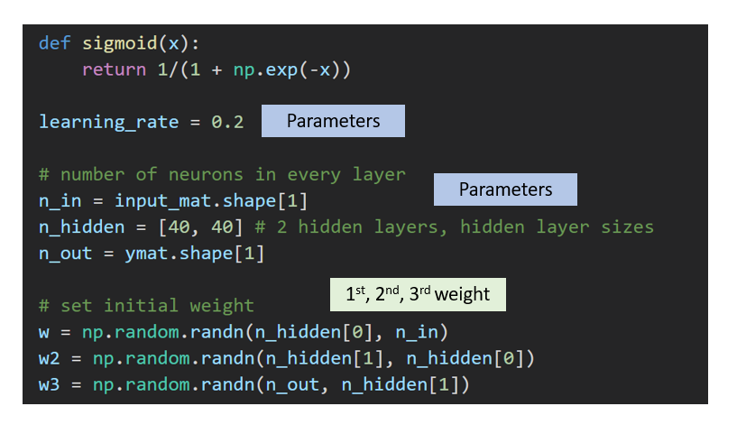

Slide 5
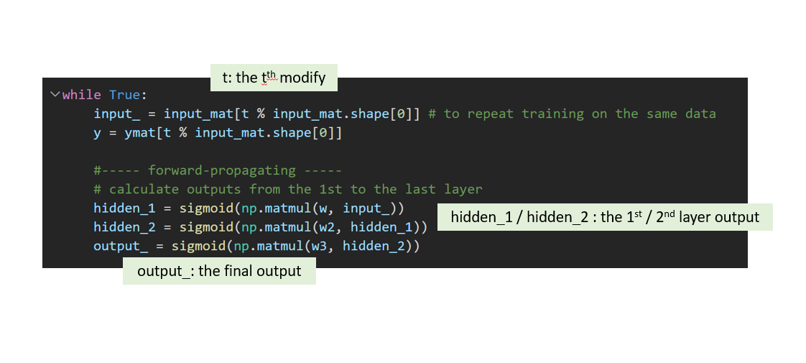

Slide 6
