Slide 1
Learning Process
X:
28*28
/255
784 vector
Label
Output label
train
BPNN
Test Accuracy
One hot encoding
0.8
Y: label
0/1
Training data
0.2
test

Slide 2
Learning Process
X:
28*28
/255
784 vector
Label
Output label
train
BPNN
Test Accuracy
One hot encoding
0.8
Y: label
0/1
Training data
X:
28*28
/255
784 vector
0.2
test
Y: label

Slide 3
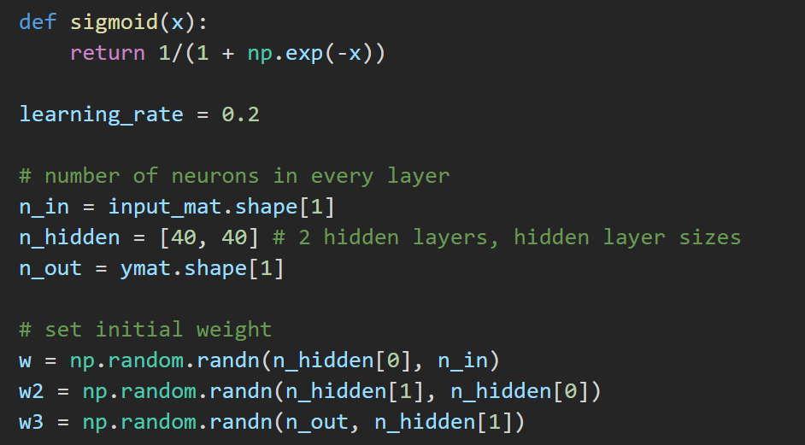
Parameters
Parameters
1st, 2nd, 3rd weight

Slide 4
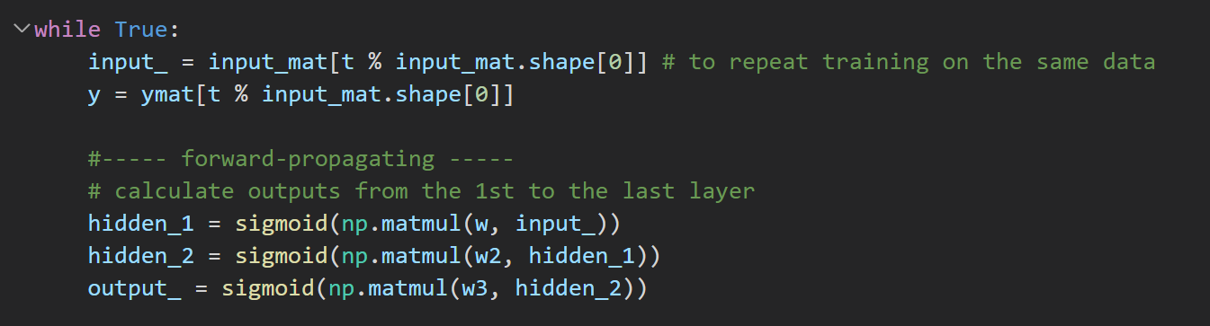
t: the t^{th} modify
hidden_1 / hidden_2 : the 1st / 2nd layer output
output_: the final output

Slide 5
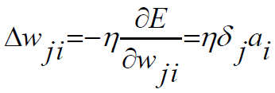
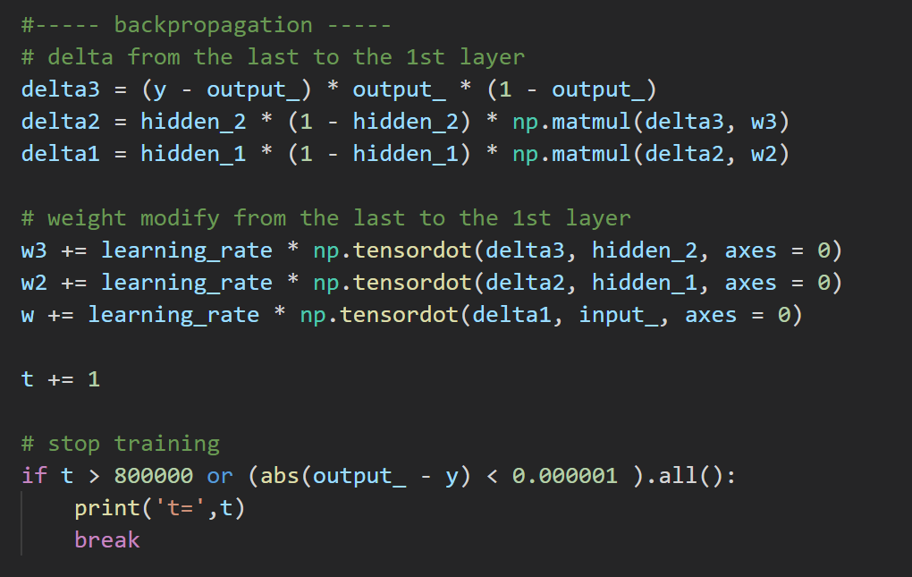
Use tensor product to get all Δw
Parameters

