Slide 1
BYOL
Self-Supervised Learning for
Hyperspectral Road Damage Detection
Bootstrap Your Own Latent
Implemented via the Lightly Framework
Takunda | Road Network Remote Sensing Research

Slide 2
OVERVIEW
Research Overview
What we set out to achieve and how
🎯 Objective
📡 Data
Detect road damage from hyperspectral imagery without any human labels using self-supervised learning.
8,008 hyperspectral .tif images of tarred road networks with 944 spectral bands per image.
🧠 Method
📊 Evaluation
BYOL (Bootstrap Your Own Latent) implemented via the Lightly framework on a ResNet backbone.
Feature Std tracking, Silhouette Score, and linear evaluation to prove representations are useful.

Slide 3
METHODOLOGY
How BYOL Works
Bootstrap Your Own Latent — no negative pairs needed
1
Two Views
Each image is augmented into two slightly different versions — different crops, brightness, colour jitter.
2
Online Network
The active learner processes view 1 through backbone → projection → prediction head.
3
Target Network
The slow mentor processes view 2 through backbone → projection only. Frozen — no backprop.
4
Symmetric Loss
NegativeCosineSimilarity computed both ways and averaged. Loss → -1.0 means perfect alignment.
5
EMA Update
Target absorbs online weights slowly via momentum schedule (0.996→1.0). Prevents collapse.

Slide 4
DATA CHALLENGE
The Hyperspectral Challenge
944 bands per image — ResNet only accepts 3
Your hyperspectral camera captures 944 spectral bands — from visible light to near-infrared.
ResNet18/50 expects exactly 3 channels (RGB). We tested 4 band selection strategies.
Baseline
Strategy A
Strategy B
Strategy C
Bands 0, 471, 943
First / Middle / Last
Top 3 variance bands
Max information per image
Bands 236, 471, 708
Evenly spaced spectrum
PCA synthesis
3 optimal components
Feature Std
Feature Std
Feature Std
Feature Std
36.26
37.84
40.00 ★
36.00
★ Best performer — used for all subsequent experiments

Slide 5
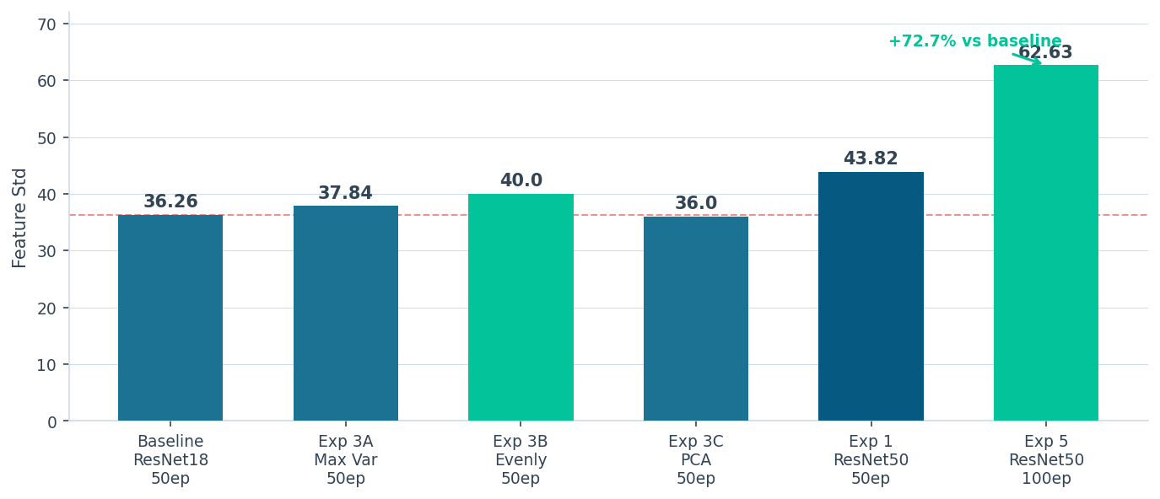
RESULTS
Feature Std Across All Experiments
Rising Feature Std = richer, more diverse representations — no collapse detected

Slide 6
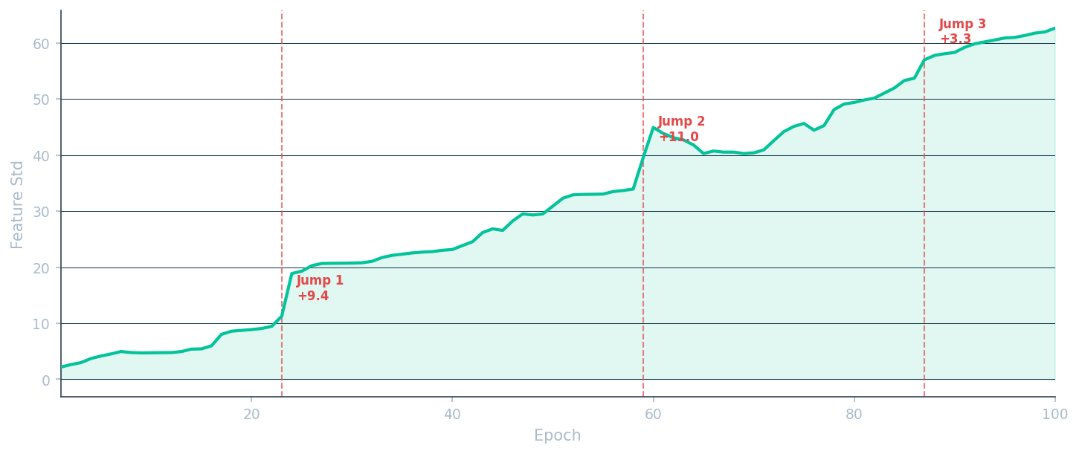
EXP 5 — 100 EPOCHS
ResNet50 — 100 Epoch Training Curve
Three reorganisation events drive progressive representation improvements

Slide 7
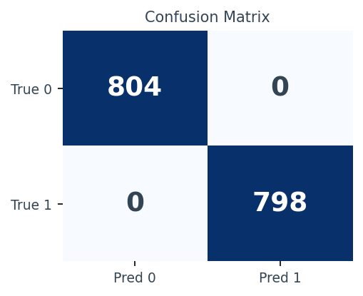
EXP 6 — LINEAR EVALUATION
Linear Evaluation — Do Representations Work?
Frozen BYOL backbone + single linear layer = the real test
100%
0.9998
2
6,406
Classification
Accuracy
Silhouette
Score
Surface Types
Perfectly Separated
Training
Images Used
What this proves
BYOL learned genuinely useful road surface representations without any labels.
Zero classification errors on 1,602 test images — perfect precision and recall.
Silhouette Score of 0.9998 ≈ theoretical maximum — clusters are perfectly separated.
Dataset dominated by 2 surface types — consistent with real-world road networks.
Rare damage classes (surfaces 2–4) need more training data for full detection.

Slide 8
SUMMARY
All Experiments — Complete Comparison
Experiment
Backbone
Band Strategy
Epochs
Final Loss
Feature Std
Key Finding
Baseline
ResNet18
First/Mid/Last
50
-0.9994
36.26
Solid starting point
Exp 3A
ResNet18
Max Variance
50
-0.9997
37.84
Epoch 20 reorganisation
Exp 3B ★
ResNet18
Evenly Spaced
50
-0.9996
40.00
Best ResNet18 result
Exp 3C
ResNet18
PCA
50
-0.9981
36.00
Most potential, needs more epochs
Exp 1
ResNet50
Evenly Spaced
50
-0.9954
43.82
Deeper = richer features
Exp 5 ★★
ResNet50
Evenly Spaced
100
-0.9998
62.63
3 jumps, +72.7% vs baseline
Exp 6
ResNet50
Evenly Spaced
—
—
—
100% accuracy, Silhouette 0.9998
★ Best band strategy ★★ Best overall model

Slide 9
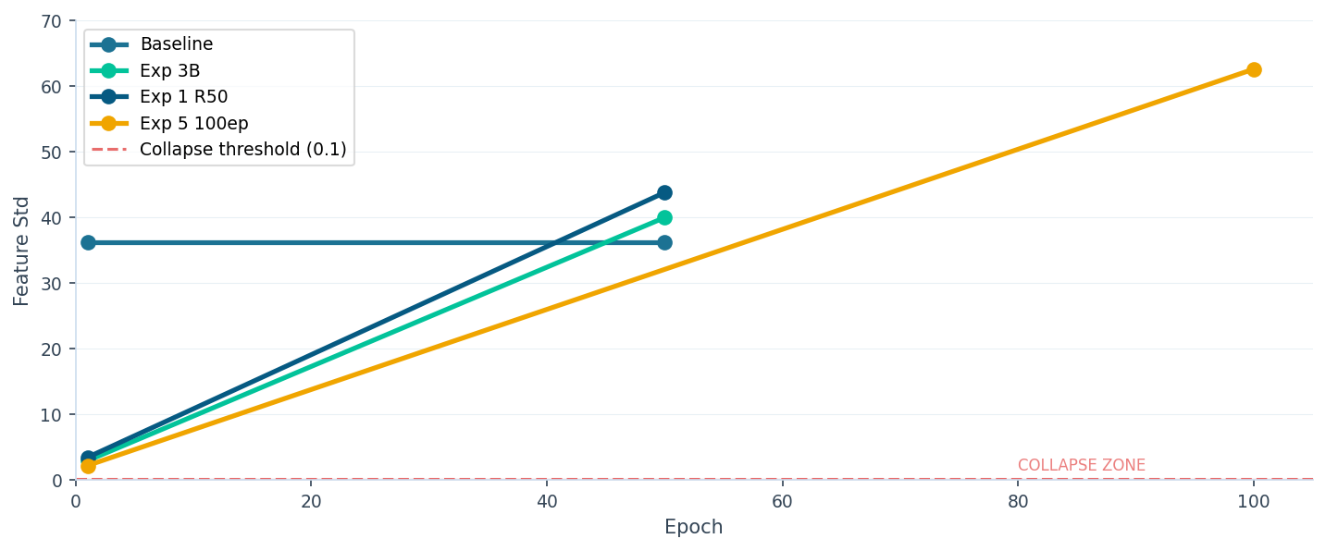
COLLAPSE PREVENTION
No Collapse Detected — Across All Experiments
Feature Std consistently rising = diverse, non-trivial representations

Slide 10
CONCLUSIONS
Key Findings & Future Work
✓ No Collapse
Future Work
Feature Std grew consistently across all experiments — never once triggered the 0.1 collapse warning.
Collect more balanced road damage classes — particularly severe and very severe damage examples.
✓ Band Selection Matters
Evenly spaced bands outperformed arbitrary first/mid/last selection by 10.3% Feature Std on ResNet18.
Apply weighted loss functions to handle class imbalance in damage detection.
✓ Deeper Backbone Helps
ResNet50 exceeded ResNet18 by 20.7% Feature Std with the same band strategy and epoch count.
Run road-specific band selection using the analyse_bands.py script for domain-optimised input.
✓ More Epochs = Better
Extend to pixel-level segmentation for precise road damage mapping.
100 epochs produced 3 distinct reorganisation events, growing Feature Std to 62.63 — +72.7% vs baseline.
✓ Representations Are Useful
Compare BYOL against other self-supervised methods — SimCLR, MoCo — on hyperspectral road data.
Linear evaluation achieved 100% accuracy and Silhouette Score 0.9998 — proving BYOL learned real road structure.

Slide 11
Thank You
BYOL for Hyperspectral Road Damage Detection
Feature Std: 62.63 | Linear Accuracy: 100% | Silhouette: 0.9998
Questions?

