Slide 1
Optimization of a Truck-and-Drone Delivery System
Presentation of Algorithms
Group 8
Yiming LUO, Feiyu SHAO, Wangzhi WANG, Ruizhong QIU

Slide 2
01
Introduction
02
Details in Algorithms
03
Completeness
04
Evaluation of Results
CONTENS
05
Innovation

Slide 3
Introduction
01
Background
Notations
Relationship with IES
Generating Data

Slide 4
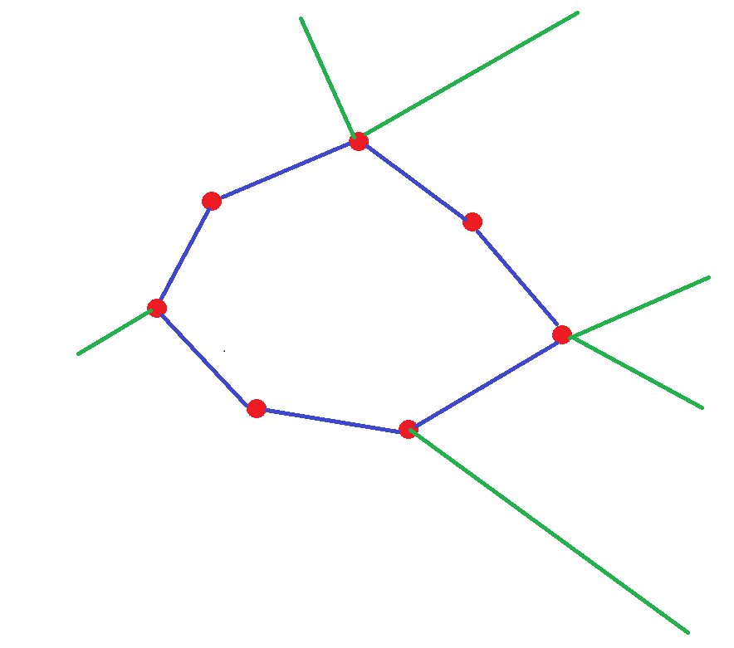
Background
A truck-and-drone system of delivery.
Drones are stored on trucks and take off in need.
Customers are picky. They have time windows.
How to minimize our cost?

Slide 5
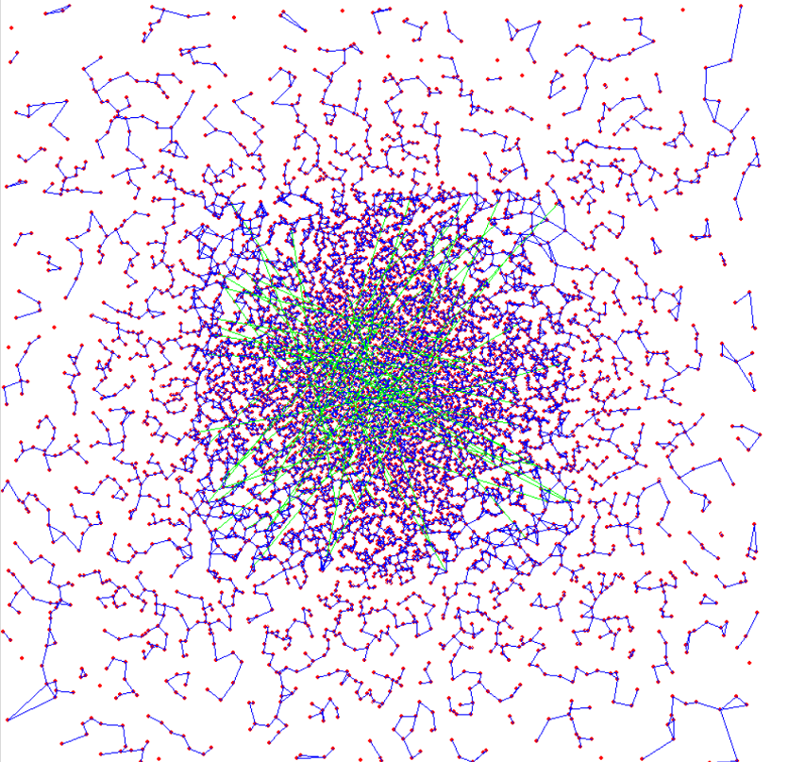
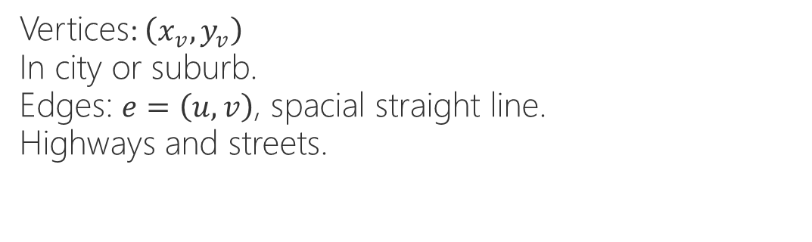
Notations (Map)
Vertices: $\left(x_{v},y_{v}\right)$
In city or suburb.
Edges: $e=\left(u,v\right)$, spacial straight line.
Highways and streets.

Slide 6
Notations (Vehicles)
Trucks: M trucks. Maximum # goods: L.
Leave from warehouse and return to it.
Can load more goods or take a rest when come back to the warehouse.
Take exactly one drone.
Drones: Maximum # goods: 1.
Trucks have to stop to take if off and wait until it comes back.
More expensive but a lot faster.

Slide 7
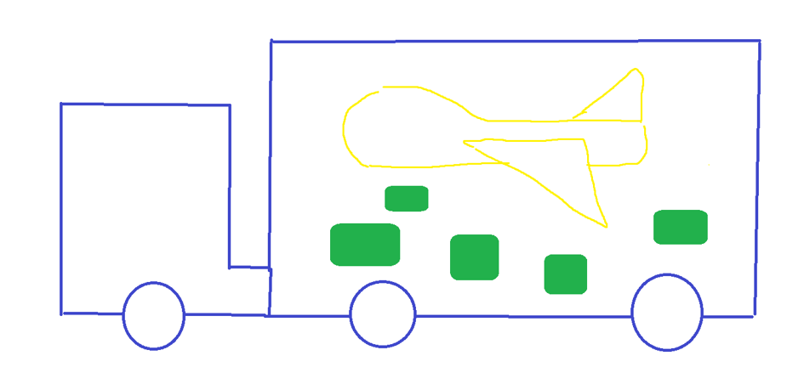
Notations (Vehicles)

Slide 8

Relationship with IES
Delivery system is quite an important part in engineering systems.
The last step to customer
Competitive factor
A big part in cost
This is the last step of producing.
It interacts with customers
straightly.
The delivery speed is an important
factor when customer choosing companies
Delivery cost is a big part
In our producing cost.
If we can cover it, the customer
will be satisfied.

Slide 9
Generating Data
City vs Suburb
Different Time Windows
Streets and Highways
Customer Distribution

Slide 10
Details in Algorithms
02
Our algorithms
Details in SA
Details in GA

Slide 11
Details in Algorithms
02
Our algorithms
Details in SA
Details in GA

Slide 12
Outline of SA
Generating Initial Solution
Sorting by time windows and polar angles
Annealing Schedule
Exponential cooling
Finding adjacent solutions
Crossing-based
Modification-based
Solution Representation & Computing Cost
Only represents paths
Finding starting time and drone assignment is computed
in cost phase
SA in SA.

Slide 13


Finding adjacent solutions
Crossing-based
Crossing paths of the same truck
Crossing paths of different trucks
Modification-based
Adding/Removing trucks/drones/nodes

Slide 14
Computing cost
Complex
Finding optimal starting time and drone assignment is complex
SA in SA
Use another SA to find optimal starting time and drone assignment
Initial solution by customer permutation
Optimizing the permutation of customers to compute the cost

Slide 15
Outline of GA
Generating Initial Solution
Parent Selection
Crossover
Mutation

Slide 16
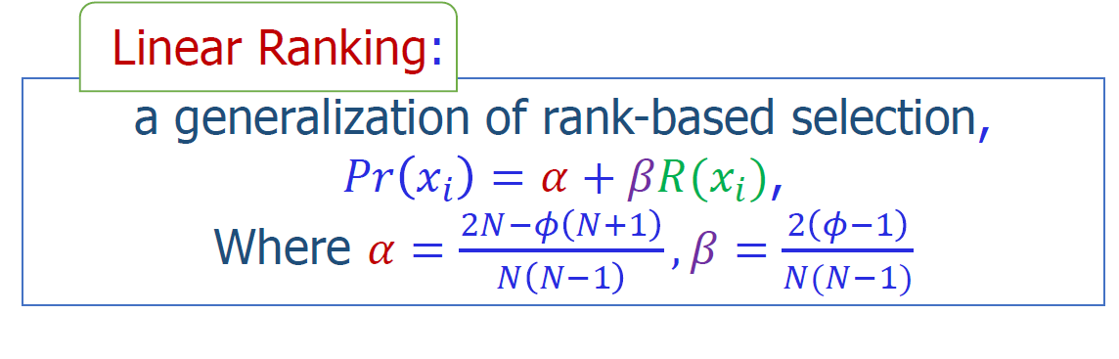
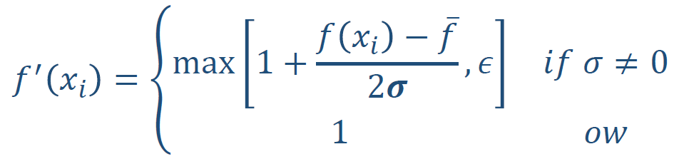
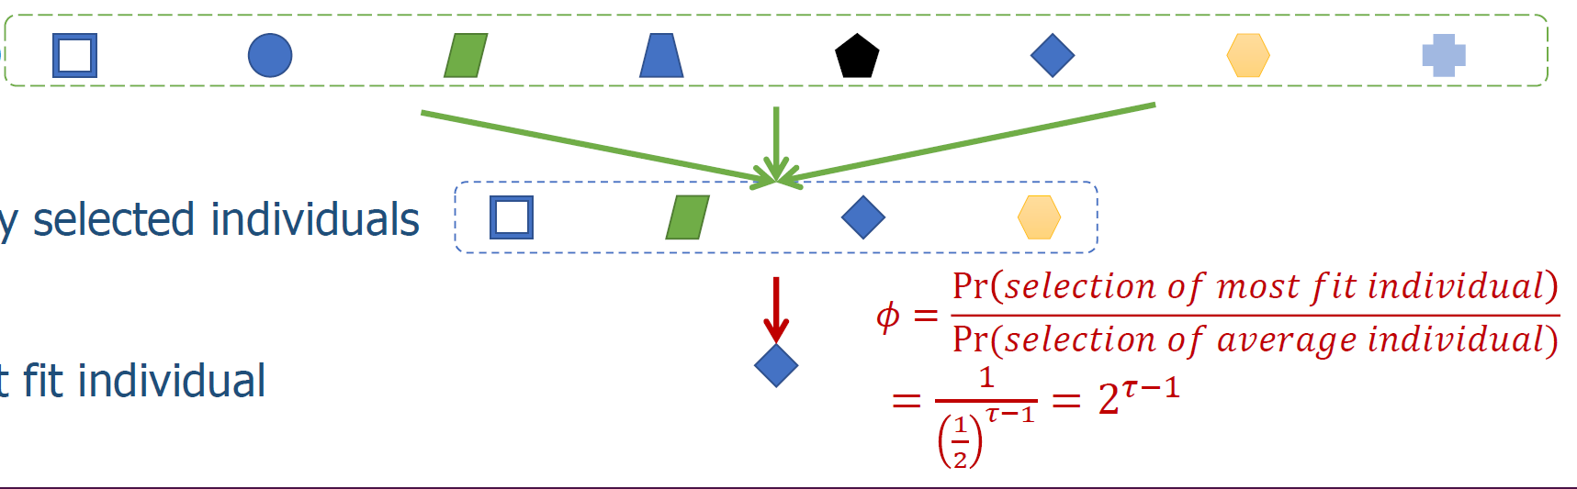
Parent Selection
Linear
Ranking
Sigma
Scaling
Sigma Scaling
Tournament
Selection

Slide 17
Crossover
Step1:Order Crossover + Point Crossover
Parent 1
Truck1 | Truck2 | Trcuk3 | Truck4 | Truck5 | Truck6 | Truck7 | Truck8 | Truck9 | Truck0
Parent2
Truck1 | Truck2 | Truck3 | Truck4 | Truck5 | Truck6 | Truck7 | Truck8 | Truck9 | Truck0
Truck
Turn1 | Turn2 | Turn3 | …… | Turn i

Slide 18












Crossover
Step1:Order Crossover + Point Crossover
Parent1
Truck1
Truck2 ……
Truck0
$$X_{1}^{(1)}$$
……
$$X_{i1}^{(1)}$$
$$X_{1}^{(2)}$$
……
$$X_{i2}^{(2)}$$
……
$$X_{1}^{(0)}$$
……
$$X_{i0}^{(0)}$$
Choose a random cut point A in parent 1
Choose a random cut point B in parent 2
Sort the shorter part based on the sequence of longer part
Parent2
Truck1
Truck2 ……
Truck0
$$X_{1}^{(1)}$$
……
$$X_{i1}^{(1)}$$
$$X_{1}^{(2)}$$
……
$$X_{i2}^{(2)}$$
……
$$X_{1}^{(0)}$$
……
$$X_{i0}^{(0)}$$

Slide 19
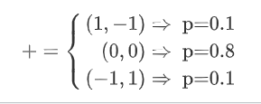
Crossover
Step1:Order Crossover + Point Crossover
Parent1
Truck1 | Truck2 | Truck3 | Truck4 | Truck5 | Truck6 | Truck7 | Truck8 | Truck9 | Truck0
i1 | i2 | i3 | i4 | i5 | i6 | i7 | i8 | i9 | i0
# of Turns
Randomly Commbination to 5 groups
$$(i_{m},i_{n})$$
For each group, we use the following conversion:
$$(i_{m},i_{n})$$

Slide 20
Crossover
Step2:Cycle Crossover + Point Crossover
Parent 1
Turn1 | Turn2 | Turn3 | …… | Turn i
Parent2
Turn1 | Turn2 | Turn3 | …… | Turn j
Turn
Customer1 | Customer2 | Customer3 | …… | Customer k

Slide 21












Crossover
Step2:Cycle Crossover + Point Crossover
Parent1
Truck1
Truck2 ……
Truck0
$$C_{1}^{(1)}$$
……
$$C_{i1}^{(1)}$$
$$C_{1}^{(2)}$$
……
$$C_{i2}^{(2)}$$
……
$$C_{1}^{(0)}$$
……
$$C_{i0}^{(0)}$$
Parent2
Truck1
Truck2 ……
Truck0
$$C_{1}^{(1)}$$
……
$$C_{i1}^{(1)}$$
$$C_{1}^{(2)}$$
……
$$C_{i2}^{(2)}$$
……
$$C_{1}^{(0)}$$
……
$$C_{i0}^{(0)}$$

Slide 22
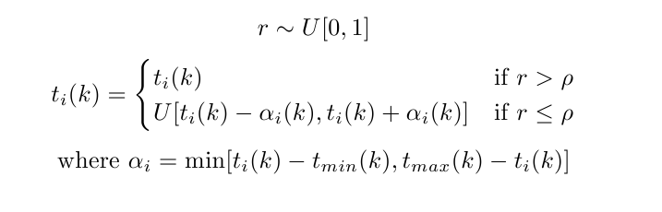
Mutation
For a child, its has M trucks with M routes, we mutate each route:
Uniform mutation centered at vector t:
Inversion mutation at vector p and vector f for each route:
The vertices at two sides are chosen to be same to ensure connectivity
Reciprocal exchange for vector c for each route.

Slide 23
Completeness
03
SA
GA

Slide 24
Completeness of SA
Getting a initial solution
Maintenance of solution set
Get adjacent solution
Use Drones

Slide 25
Completeness of SA
Different ways
Like greedy algorithm, K-means algorithm and small SA
02
Different ways like
Swap routes
New nodes
Reverse routes
Combination
04
Initialization
Solution set
Get Adjacent solution
Drone Planning
01
One current solution only
Versus
Solution set
with beam width
03
Greedy Algorithm
Heuristic Algorithm
Turn to a TSP

Slide 26
Completeness of GA
Different ways
Like greedy algorithm, K-means algorithm
02
Order crossover
Point crossover
Cycle crossover
04
Initialization
Selection methods
Crossover
mutation
01
Linear Ranking
Sigma Scaling
Tournament
Selection
03
Gaussian mutation centered at the middle of the search domain for t
Uniform mutation at t
Inversion mutate for p and f
Reciprocal exchange for c

Slide 27
Evaluation of Results
04
Evaluation Methods
Visualization

Slide 28
Evaluation Methods
03
Number of iterations can be quite big. This isn’t quite an important part in our evaluation
01
Different method have different time complexity
in our completeness test
Number of
Iterations
Time Complexity
Results
04
Result of different methods
Diversity
Of
Solutions
02
Diversity of solution is an important part. We estimate each method’s diversity theoretically.

Slide 29
Visualization
We use WINAPI to generate a visualization model
Better result have more “beautiful” visualization
Less crossing in routes
Fly to faraway customers

Slide 30
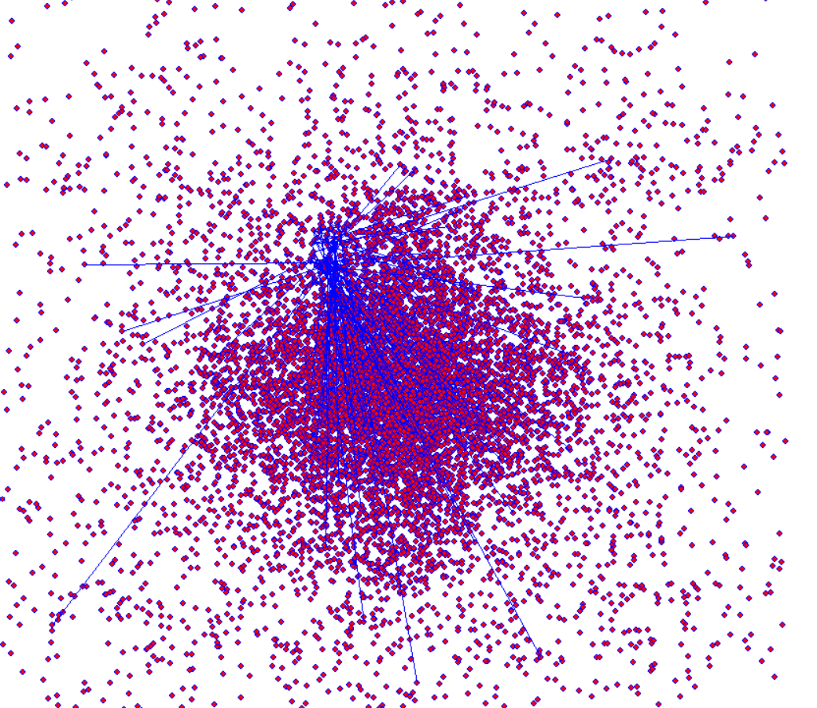
Visualization

Slide 31
Innovation
05
Algorithm
Programming

Slide 32
Innovation on Algorithms
Two-stage heuristic algorithm
More tryout of each part
New crossover method in GA
New mutation method in GA
New way of maintaining solution set in SA
More Competence
Two-stage
Innovation
New Crossover
More iterations times

Slide 33
Innovation on Programming
Object-Oriented Programming
More Convenience in Tryouts
Encapsulation
Inheritance
Polymorphism
Using Several
Data Structures
Program
Using C++
With High Efficiency

Slide 34
Thanks for Your Time
Questions are welcomed

