Slide 1

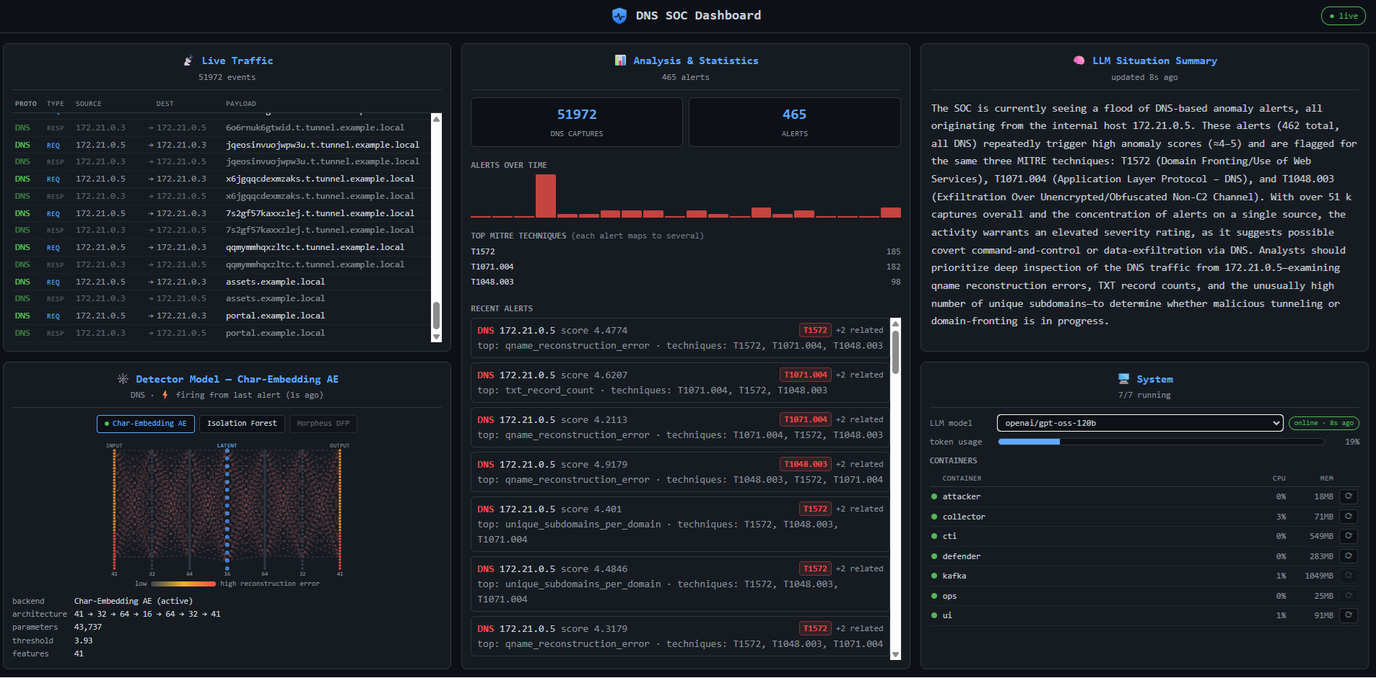
AI-Driven Cyber-Security | DNS CTI Pipeline Tal Berkovitch 2026 · Semester B
Andrei Kojukhov
Introduction
• DNS is rarely blocked, so attackers abuse it for covert exfiltration, tunneling and command-and-control (C2) — while generic detectors drown SOCs in false positives.
• Goal: a real-time, multi-agent AI SOC that detects DNS abuse unsupervised (no attack labels) and explains each alert as CTI mapped to MITRE ATT&CK.
• Objectives: learn benign DNS; flag abuse at <0.1% FPR; auto-generate grounded CTI; run safely air-gapped.
Method & System Architecture
• Isolated 3-container plane (Attacker → Collector → Defender), internal-only, no internet; passive tap on the collector.
• Char-embedding autoencoder (lexical, per query): Embedding→GRU→latent→GRU; reconstruction error scores each query name. Benign-only training.
• Isolation Forest (behavioural, per window): query rate, subdomain entropy, qtype mix, NXDOMAIN.
• CTI: per-feature attribution → MITRE RAG → AG2 LLM (Threat-Analyst + Report-Writer, Groq) → report.
• Apache Kafka spine; live FastAPI/SSE SOC dashboard.
Evaluation & Results
• Real corpus: CIC-Bell-DNS-EXF-2021, replayed through the live feature parser.
• Char-AE: ROC-AUC 1.000, PR-AUC 1.000, recall 1.000 @ 0.1% FPR — vs ~0.91 ROC for the window-aggregate Isolation Forest.
• Domain-shift false positive fixed: reverse-DNS PTR 4.89 → 1.04 via benign augmentation.
• Honest limit: high-entropy exfil caught; word-encoded payloads handled by the behavioural detector.
• MITRE mapping top-3 = 1.000 (T1572 / T1048.003 / T1071.004); air-gap verified (no internet).
Conclusions
• Label-free DNS abuse detection at ROC-AUC 1.000 on real data, <0.1% FPR, each alert mapped to MITRE ATT&CK, in a safe isolated lab.
• The per-query lexical representation beats window-aggregate behaviour — representation matters more than the algorithm.
• Defence-in-depth: lexical + behavioural detectors cover each other's blind spots.
Discussions
• Extend to more covert-channel protocols; add adaptive thresholds and online learning.
• Demo video: [QR code placeholder].
Live SOC dashboard (egress): traffic feed · detector model · MITRE stats · LLM situation summary

