Slide 1

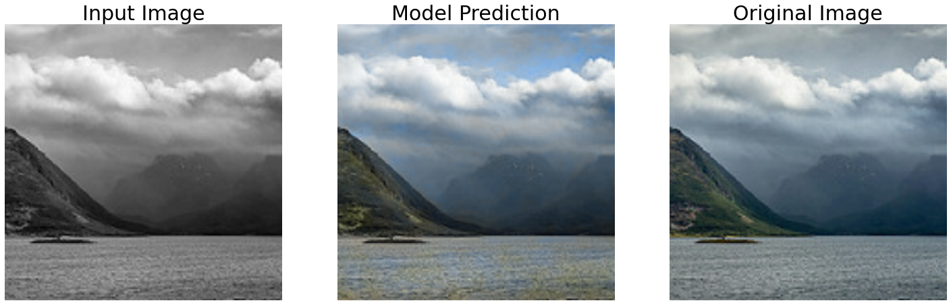
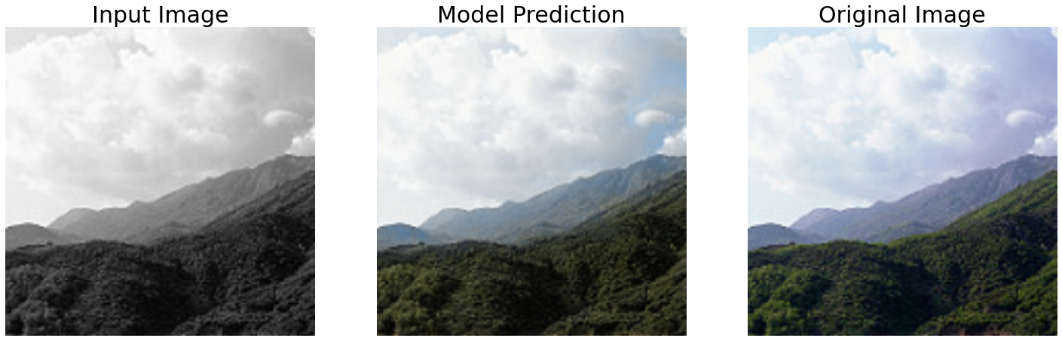
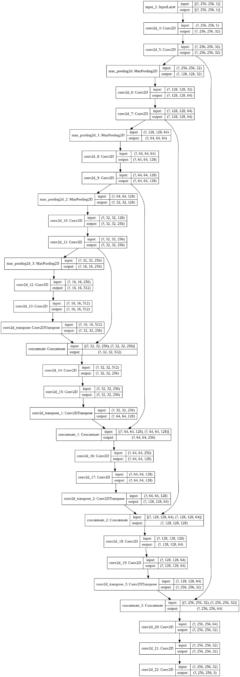
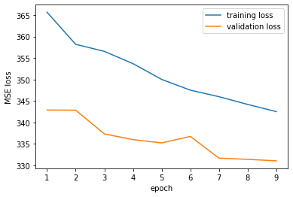
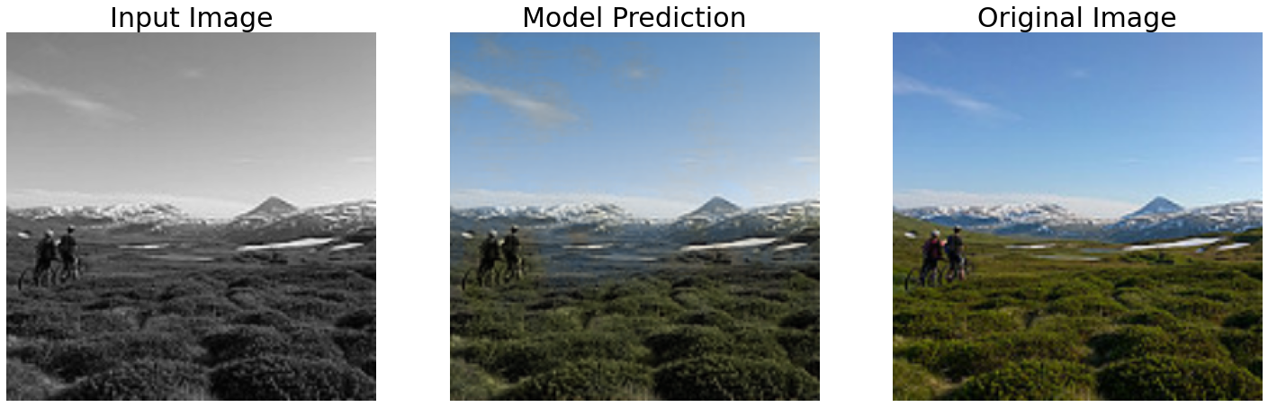
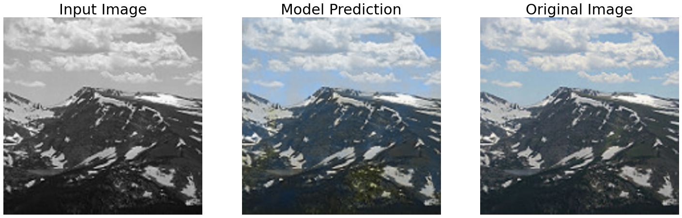
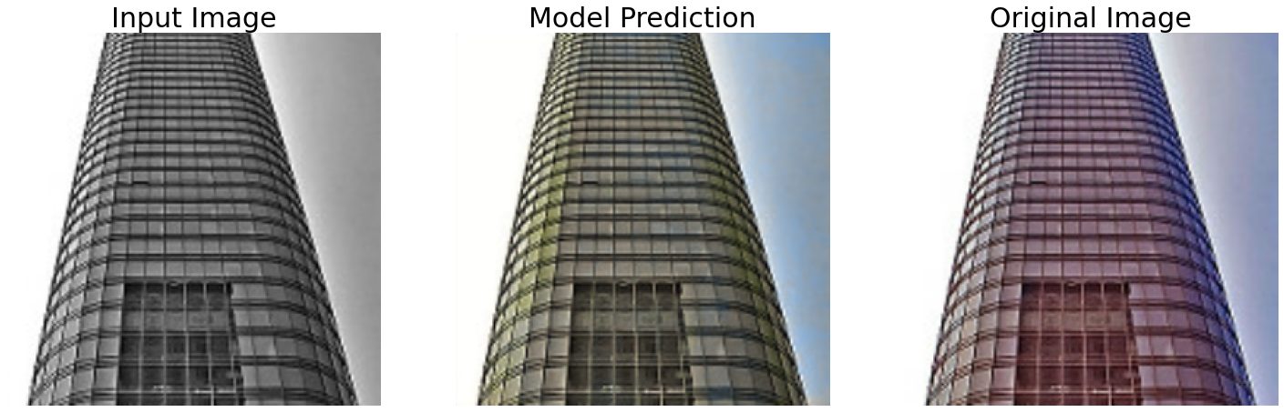
Deep Learning | Colorization of grayscale images Tal Ladijinsky , Lior Danon
Teddy Lazebnik
Introduction
Coloring grayscale photos today is done by photoshop professionals and takes many hours.
We wish to achieve better result.
We intend to shorten the time needed.
Method
We split the data to train and test data by 80% and 20% respectively.
We created an end to end solution by creating Neural Network inspired by U-Net which functioned as encoder and decoder with using skip connections to complete the loss data created by the pooling layers which contains 32 layers and 7,760,355 trainable params.
We used ReLU as activation function, MSE as cost function and Adam as optimizer.
The model was trained for 9 epochs.
Results
We achieved 331.0627 loss in MSE.
The model works well with sea, sky and clouds.
U shaped net unique architecture enhanced the performance of the model.
Conclusions
U shaped network as encoder and decoder improves the CNN performance.
Image coloring is possible using deep learning techniques.
Miss-colorizations of objects may occur.
The main drawback is it is slow to train.
The secondary drawback is there is a trade-off between localization accuracy and the use of context.
Further research is necessary.
Discussions
Future research may include:
Changing model hyper-parameters.
Exploring different architectures.
Expanding the image dataset.
Further training of the CNN.
Our
Model
architecture

