Slide 1
OWASP TOP-10 Security Risks For Developers

Slide 2
What is it?
Survey of top security bugs
Based on Common Weakness Enumeration (Better)
https://cwe.mitre.org/
https://cwe.mitre.org/top25/archive/2023/2023_top25_list.html
Based on CVEs
Focused on Web

Slide 3
Related Resources
CVE: Catalog of publicly disclosed vulnerabilites
CVSS: Standard severity score of CVEs

Slide 4
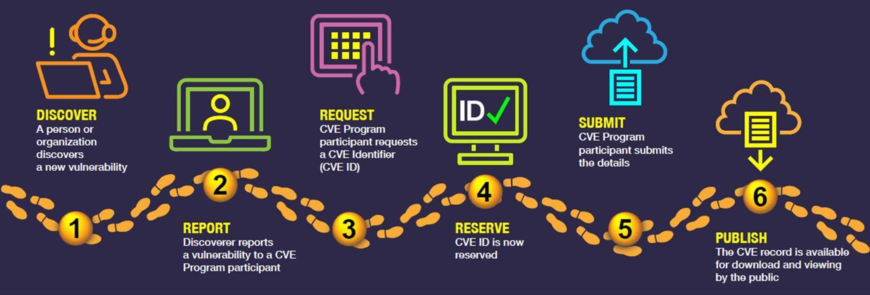
Lifecycle of CVE

Slide 5
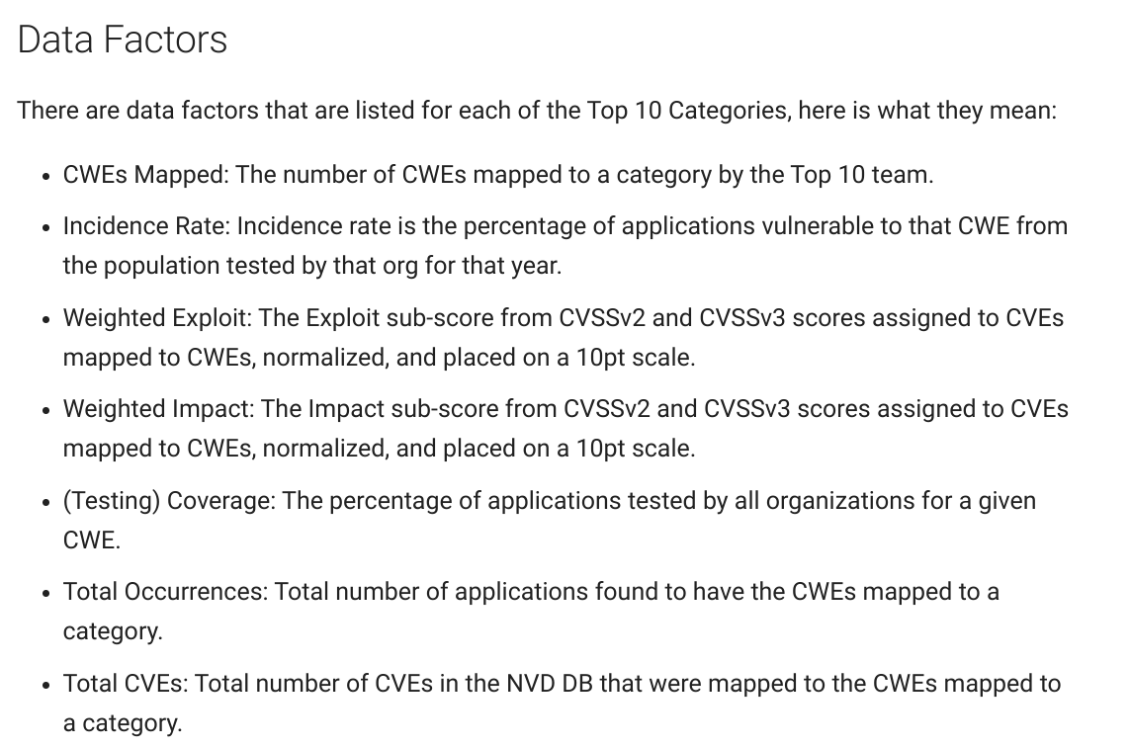
OWASP Risk Factors

Slide 6
A01:2021 – Broken Access Control
Violation of the principle of least privilege
Bypassing access control checks by modifying the URL (parameter tampering or force browsing)
Permitting viewing or editing someone else's account, by providing its unique identifier (insecure direct object references)
Notes:
https://owasp.org/Top10/A01_2021-Broken_Access_Control/

Slide 7
A01:2021 – Broken Access Control
Accessing API with missing access controls for POST, PUT and DELETE.
Elevation of privilege. Acting as a user without being logged in or acting as an admin when logged in as a user.
Metadata manipulation:
Replaying or tampering with a JSON Web Token (JWT)
Manipulating Cookie or hidden field to elevate privileges
Notes:
https://owasp.org/Top10/A01_2021-Broken_Access_Control/

Slide 8
A01:2021 – Broken Access Control
CORS misconfiguration allows API access from unauthorized/untrusted origins.
Force browsing to authenticated pages as an unauthenticated user or to privileged pages as a standard user
Notes:
https://owasp.org/Top10/A01_2021-Broken_Access_Control/

