Slide 1

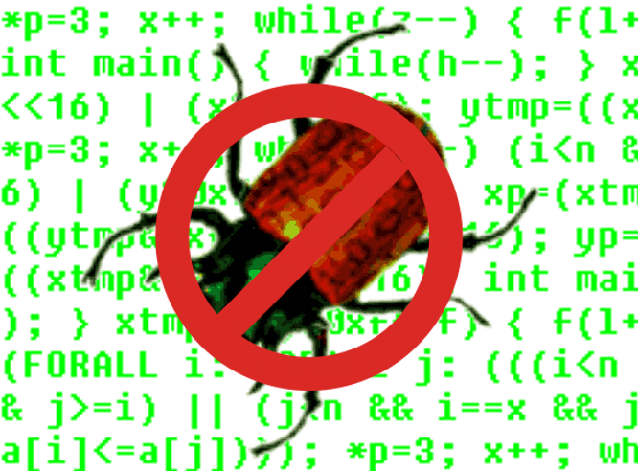
SMV Versions
Ed Clarke
Daniel Kroening
Carnegie Mellon University

Slide 2
Overview
Cadence
SMV
NuSMV
CMU
SMV
Strong abstraction functions
GUI
New language
Two Versions:
2.x: more features
1.x: comes with GUI
Oldest Version
No GUI

