Slide 1
Software Model Checking
Andrey Rybalchenko
Slides partly by Rupak Majumdar
Notes:
Finish Transition Invariants part: proof rule

Slide 2
Why verify software?
Most complicated artifact routinely built today – difficult to get right
Horror stories
Notes:
Show horror stories, some of them highlighted.

Slide 3
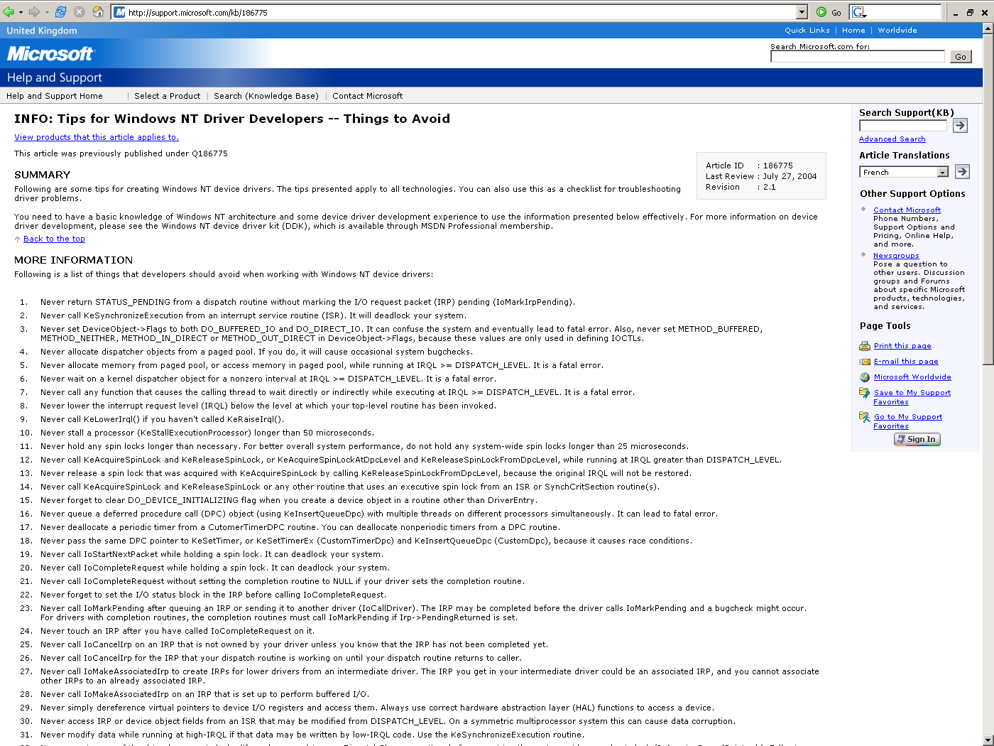

Slide 4
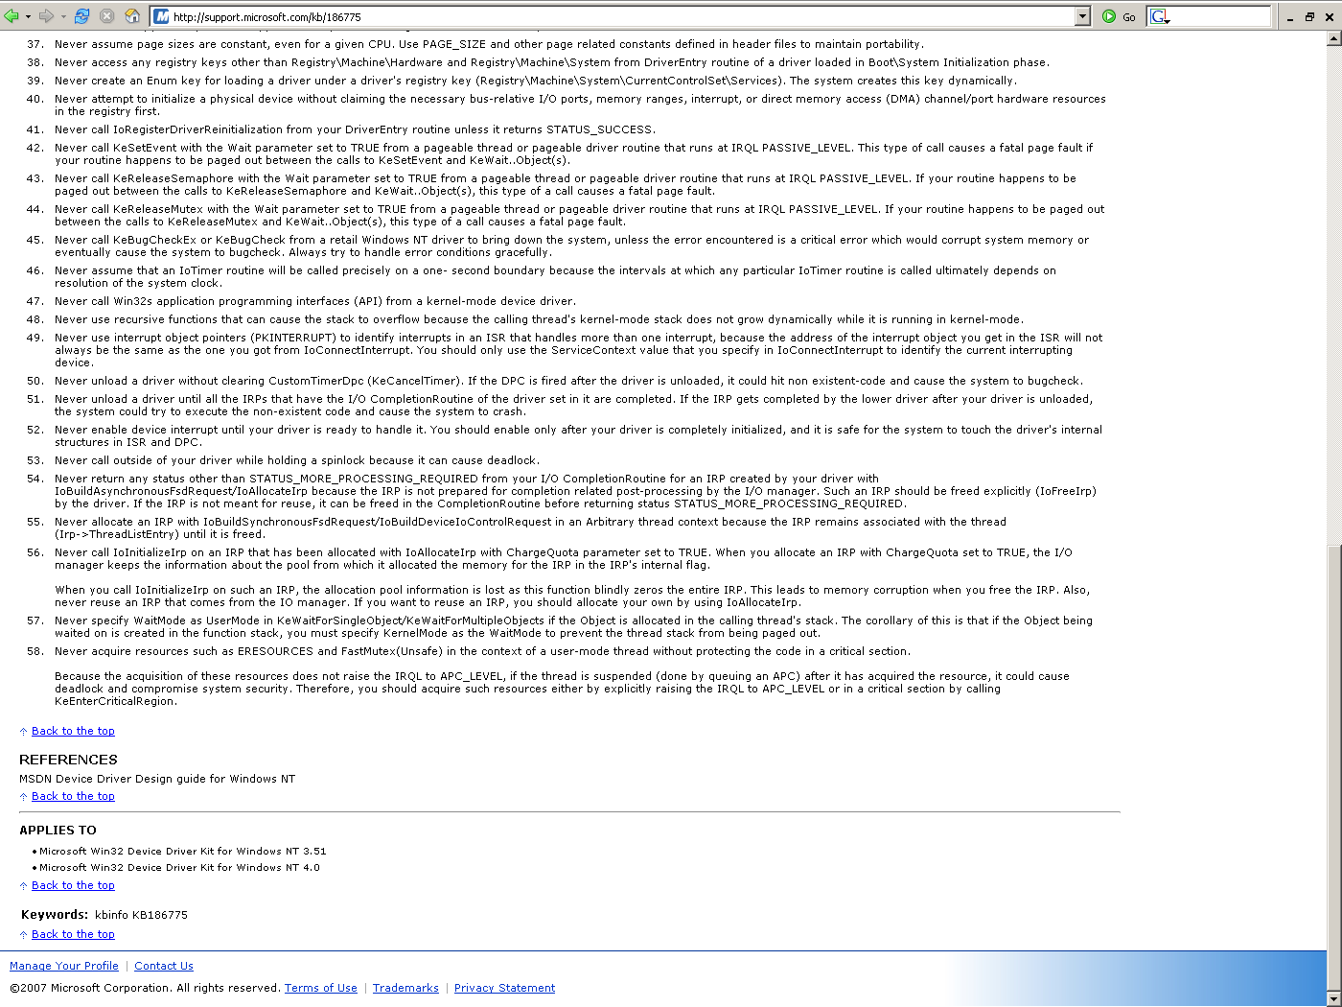

Slide 5
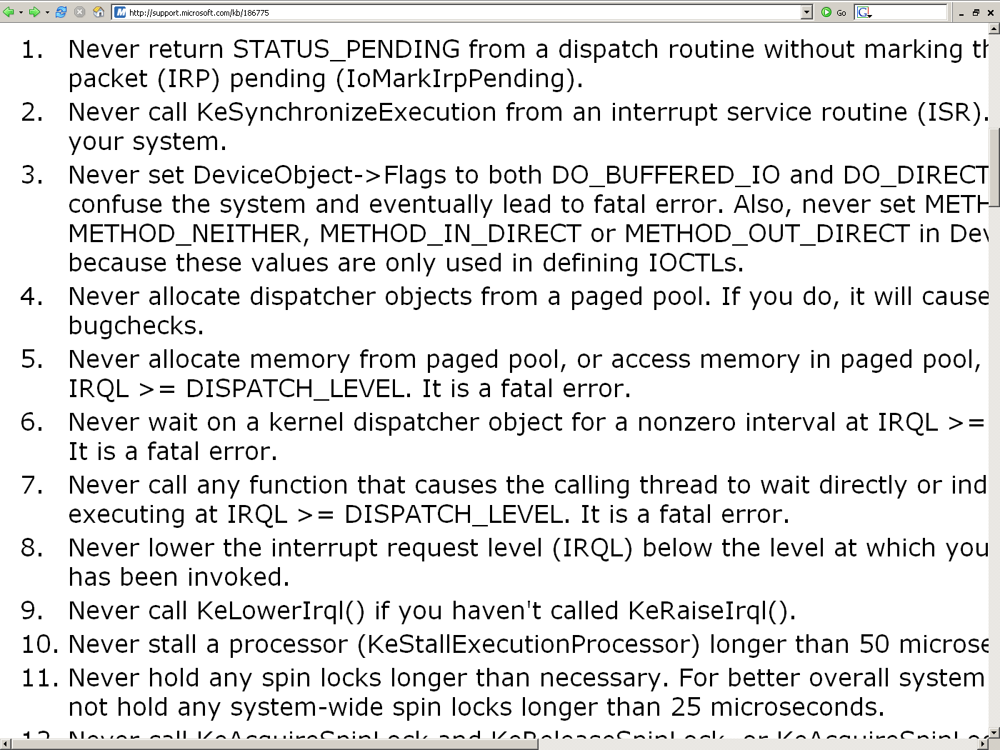

Slide 6
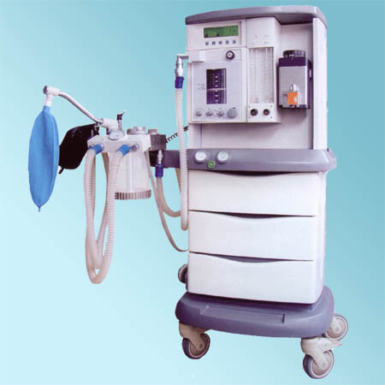
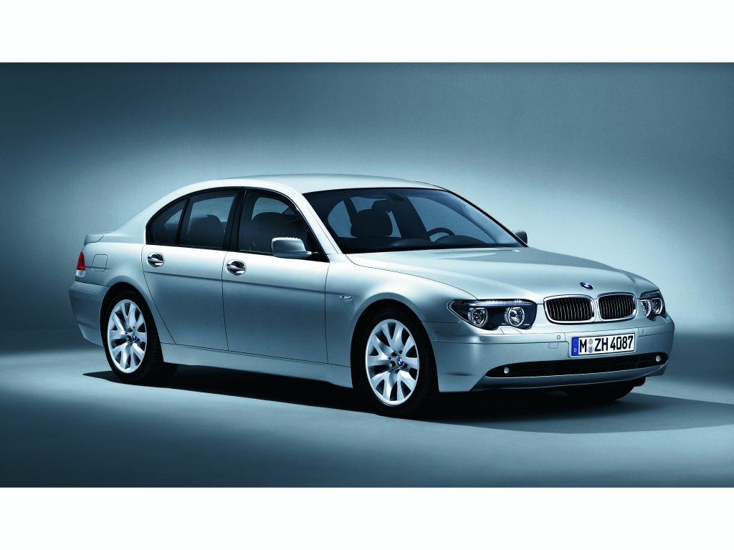
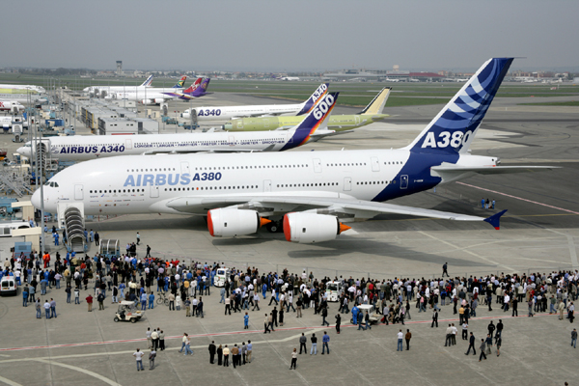
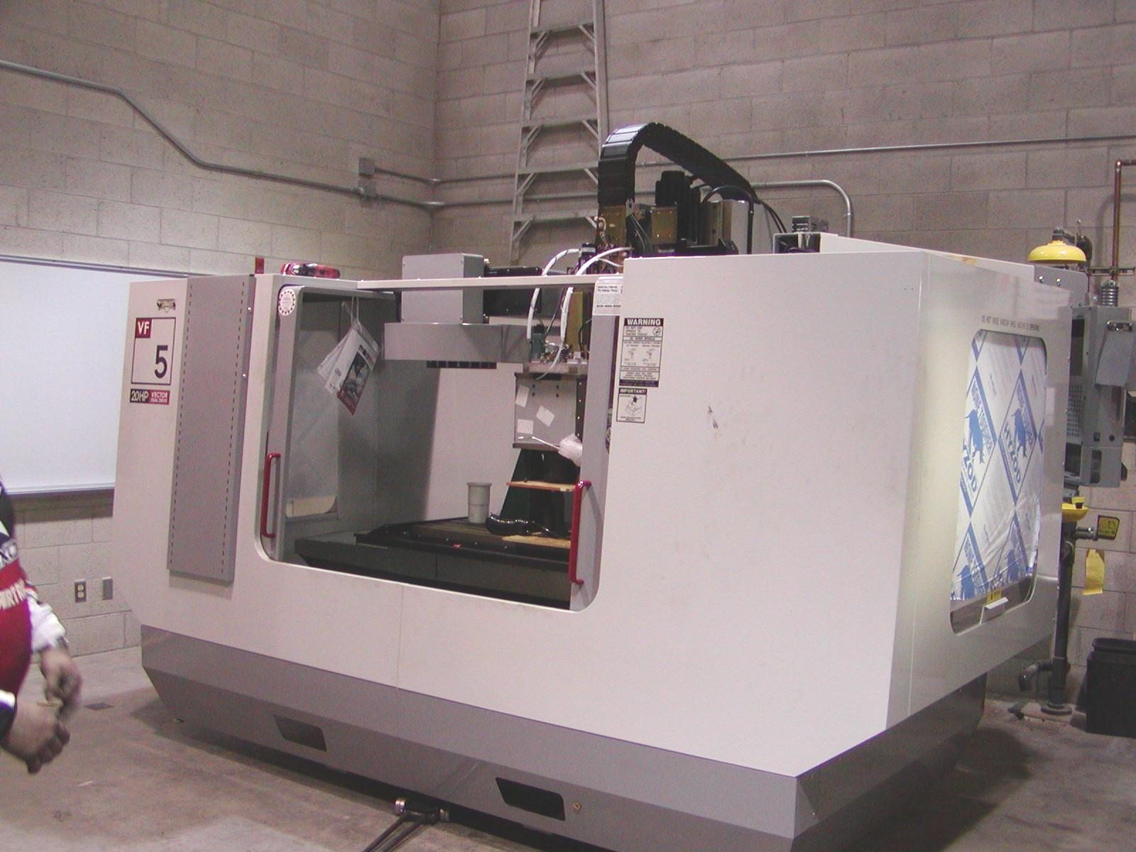
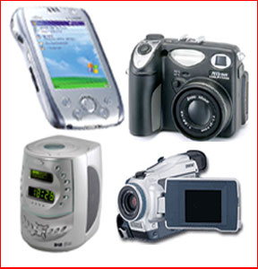
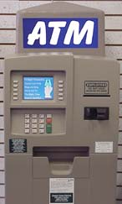
Why verify software?
Most complicated artifact routinely built today – difficult to get right
Employed everywhere
Failures are costly
cost $59.5 billion annually (US)
» 0.6% gross domestic product (US)
80% of development costs on identifying and correcting defects
[NIST, 2002]
Notes:
Show horror stories, some of them highlighted.

Slide 7
Formal Verification
Formal verification means to apply mathematical arguments to prove the correctness of systems
Systems have bugs
  Formal verification aims to find and correct such bugs

Slide 8
What is formal verification?
Build a mathematical model of the system:
  what are possible behaviors?
Write correctness requirements in a specification language:
  what are desirable behaviors?
Analysis: (Automatically) check that model satisfies specification
Formal ) Correctness claim is a precise mathematical statement
Verification ) Analysis either proves or disproves the correctness claim
Notes:
Check => proof system to decide when a property holds

Slide 9
Alternative Approaches
Testing: Run the system on select inputs
Simulation: Simulate a model of the system on select inputs
Interactive theorem proving: Formulate system correctness as a theorem in a suitable logic

Slide 10
Algorithmic Analysis
Algorithmic analysis (computer-aided verification)
  Analysis is performed by an algorithm (tool)
  Analysis gives counterexamples for debugging
  Typically requires exhaustive search of state-space
  Limited by high computational complexity
Interactive verification
  Analysis reduces to proving a theorem in a logic
  Uses interactive theorem prover
  Requires more expertise

Slide 11
Model Checking
Coined by Clarke and Emerson (1981) to mean checking a concurrent finite state model with respect to properties in CTL
More generally, denotes algorithmic analysis to check that a model (not necessarily finite state) satisfies a specified property
  In logic, “model” denotes a structure over which formulas are interpreted
  “Model checking” checks (preferably automatically) whether a given formula holds in a given model
Notes:
Highlighted three main aspects we shall study: modeling, specifications, and algorithms

Slide 12
Why study verification?
General approach to improving reliability of systems
  Hardware, systems software, embedded control systems, network protocols, networked embedded systems, …
Increasing industrial interest
  All major hardware companies employ in-house verification groups: Intel, Motorola, AMD, Lucent, IBM, Fujitsu, …
  Tools from major EDA players: Synopsys Magellan, FormalCheck
  Bunch of start-ups: Calypto, Jasper, 0-In
  SDV tool from Microsoft http://research.microsoft.com/slam

Slide 13
Why study verification?
Interesting theoretical issues
  Automata theory and formal languages
  Logics and decidability
  Algorithms and data structures
  Mathematical foundations for concurrency and semantics
Interesting practical and engineering issues
  Better heuristics to combat high complexity
  Scale to “real systems”
  Integrating reliability with design

Slide 14
Where is Verification Used?
Hardware verification
  Success in verifying microprocessor designs, ISAs, cache coherence protocols
  Fits in design flow
  Tools: SMV, nuSMV, VIS, Mocha, FormalCheck
Protocol verification
  Network/Communications protocol implementations
  Tools: Spin
Software verification
  Apply directly to source code (e.g., device drivers)
  Tools: SLAM, Blast, Magic
Embedded and real time systems
  Tools: Uppaal, HyTech, Kronos, Charon
Notes:
Used effectively as a debugging tool

Slide 15
ARMC
(Abstraction Refinement Model Checker)
Experimental prototype at MPI for Software Systems
Termination proofs for arithmetic programs
Used in industrial/academic projects:
  termination of Vamos kernel functions
  (bmbf Verisoft)
  termination of list/tree manipulating programs
  (Paris 7, Verimag)

Slide 16
ARMC
(Abstraction Refinement Model Checker)
Experimental prototype at MPI for Software Systems
Safety proofs for arithmetic programs
Used in industrial/academic projects:
  memory safety of heap-manipulating programs
  (CMU, MSR Cambridge)
  collision avoidance in European Train Control System
  (SFB AVACS)
  parameterized hardware designs
  (Brno Tech. University)

Slide 17
Limitations of Software Verification Tools
Appropriate for control-intensive applications with interesting interaction among components
  Data remains a problem
Decidability and complexity remains an obstacle
Falsification rather than verification
  Model, and not system, is verified
  Only stated requirements are checked: how to capture correctness in a formal language?
  Bugs in the model checker
Finding suitable abstractions require expertise

Slide 18
The “Methodology” Answer
Formal verification does not aim to produce mathematical certainty of correctness, but to provide a methodology that, when followed, produces more reliable and robust systems

Slide 19
A Brief History of FV
1930s: Formal verification of programs is undecidable. Oops…
1960s: [Floyd,McCarthy] Program verification
  Partial vs total correctness
1970s: [Hoare, Dijkstra] Logics for programs, axiomatic semantics (connect programs to logic), logical transformations for program constructs
  Small tricky programs, manually annotated and proved

Slide 20
A Brief History of FV
1970s: Progress in automated deduction related to program verification
  Boyer Moore Computational Lisp
  Nelson Oppen: Decision procedures for combination theories
  Higher Order Logic theorem proving (LCF)

Slide 21
A Brief History of FV
1977: Pnueli introduces (linear) temporal logics as a formalism to reason about reactive programs
1981: Clarke, Emerson and Quielle Sifakis independently discover finite state temporal logic model checking
  Applied to digital circuits
Vardi and Wolper develop automata theoretic techniques
Mid 1980s: Gerard Holzmann writes SPIN to check telecommunication protocols

Slide 22
A Brief History of FV
Then came State Explosion
1987 Ken McMillan suggests symbolic model checking using BDDs
  10⁷ -> 10²⁰ states and more
Late 80s and early 90s:
  Deal with state explosion
  BDD hacks
  Abstraction, modularity, symmetry

Slide 23
A Brief History of FV
By 1990s: Basic theoretical questions (but one!) worked out
1990s: Emphasis on infinite state
  Real time systems (timed automata)
  Embedded systems (hybrid automata)
  Models with stacks, queues, …
2000s: Emphasis on abstraction, implementation level checking
  Back to software (SLAM, Blast)
  But without or with few annotations

Slide 24
What has changed?
Ambitions are lower
  Look at simpler properties
  Use model checking as a “better testing” tool
Computers are faster

Slide 25
Model Checking, simplified
Programs and properties: defects and effects
safety violation:
path to defect
liveness violation:
path w/o effects
effect
defects
program transition:
x’ = x+1
program state:
x = 10, y = 20,
a[0] = 1, a[1] = 3, ...
Notes:
add pictures

Slide 26
Model Checking, Simplified
Model checking » Graph traversal
What makes it interesting:
  The graph is huge, possibly infinite
  Properties can be complicated
Central Theme: Make it symbolic

Slide 27
Outline of Topics
Representative software analysis and verification tools.
Testing, symbolic execution, bug finding.
Verification conditions, extended static checking.
Invariant and ranking function generation.
Abstract interpretation.
Data flow analysis over finite domains.
Pointer and alias analysis.
Decision procedures. Predicate abstraction.
Counterexample-guided abstraction refinement. Interpolation.
Termination checking.
Context-free reachability, summarization.
Concurrency, race detection, atomicity.

Slide 28
Lecture notes
Algorithms will be presented on the
blackboard (+slides)
Pointers to relevant papers will
appear online

Slide 29
Prerequisites and Grading
Prerequisites: Familiarity with basic algorithms and data structures, finite automata
Grading based on homework project (30%),
paper presentation (10%) and
final exam (60%)

Slide 30
Projects
Implementation of various components ! software model checker
Implementation environment:
OCaml – functional language
Prolog – declarative language with constraint solving support
Try to see if formal verification has a role in your research!

