Slide 1
Cyber Puzzles
Oded Margalit & Gera Weiss

Slide 2





Model Checker: Analyzing all possible schedules
active proctype A() {
byte x;
again:
x++;
goto again;
}
active proctype A() {
byte x;
again:
x++;
goto again;
}
active proctype B() {
byte y;
again:
y++;
goto again;
}
x:0
x:1
x:2
x:255
x:0,y:0
x:0,y:1
x:0,y:255
x:1,y:0
x:1,y:1
x:1,y:255
x:2,y:0
x:2,y:1
x:2,y:255
x:255,y:0
x:255,y:1
x:255,y:255

Slide 3
The Spin Model Checker
System Spec
In Promela
SPIN
pan.c
C compiler
a.out
Requirements in LTL
Counter example
OK
A few characteristics of Spin
Promela allows only a finite state model
Asynchronous execution
Interleaving semantics for concurrency
2-way process communication
Non-determinism
Promela provides (comparatively) rich set of constructs such as variables and message passing, dynamic creation of processes, etc

Slide 4
Overview of the Promela
Global variables
(including channels)
Similar to C syntax but simplified
No pointers
No real or float datatypes
No functions
Processes are communicating with each other using
Global variables
Message channels
Processes can be dynamically created
Scheduler executes one process at a time using interleaving semantics
byte x;
chan ch1= [3] of {byte};
active[2] proctype A() {
byte z;
printf(“x=%d\n”,x);
z=x+1;
ch1!z
}
Process (thread)
definition and
creation
proctype B(byte y) {
byte z;
ch1?z;
}
Another
process
definition
System
initialization
init {
run B(2);
}

Slide 5
Process Creation Example
active[2] proctype A() {
byte x;
printf(“A%d\n”);
}
proctype B() {
printf(“B\n”);
}
init {
run B();
}
run() operator creates a process and returns a newly created process ID
There are 6 possible outcomes due to non-deterministic scheduling :
A0.A1.B, A0.B.A1, A1.A0.B, A1.B.A0, B.A0.A1, B.A1.A0
Process creation may not immediately start process execution
Notes:
[root@moonzoo ~]# spin test.pml
A0 B A1
4 processes created
[root@moonzoo ~]# spin test.pml
A0 A1 B
4 processes created
[root@moonzoo ~]# spin test.pml
B A0 A1
4 processes created
[root@moonzoo ~]# spin test.pml
A1 B A0
4 processes created
[root@moonzoo ~]# spin test.pml
A1 A0 B
4 processes created

Slide 6
Variables and Types
Basic types
bit
bool
byte (8 bit unsigned integer)
short (16 bits signed integer)
int (32 bits signed integer)
Arrays and records
bool x[10];
typedef R { bit x; byte y;}
Default initial value of variables is 0
Most arithmetic (e.g.,+,-), relational (e.g. >,==), logical, and bitshift operators of C are supported

Slide 7
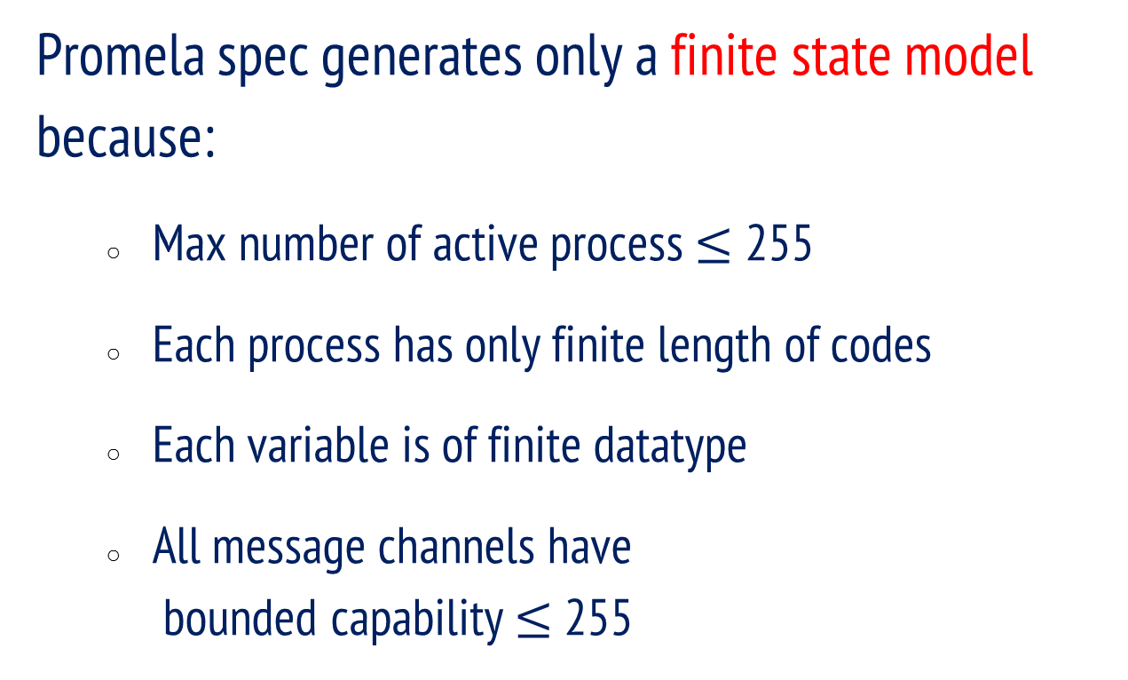
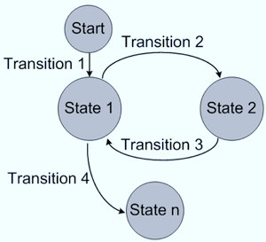
Finite State Model

Slide 8
Example: Peterson’s Algorithm
do :: true )
skip; /* Noncritical Section */
atomic { b₁ := true; x := 2 };
if :: (x==1) Ç :b₂ ) crit₁ := true fi;
skip; /* Critical Section */
atomic { crit₁ := false; b₁ := false }
od

Slide 9
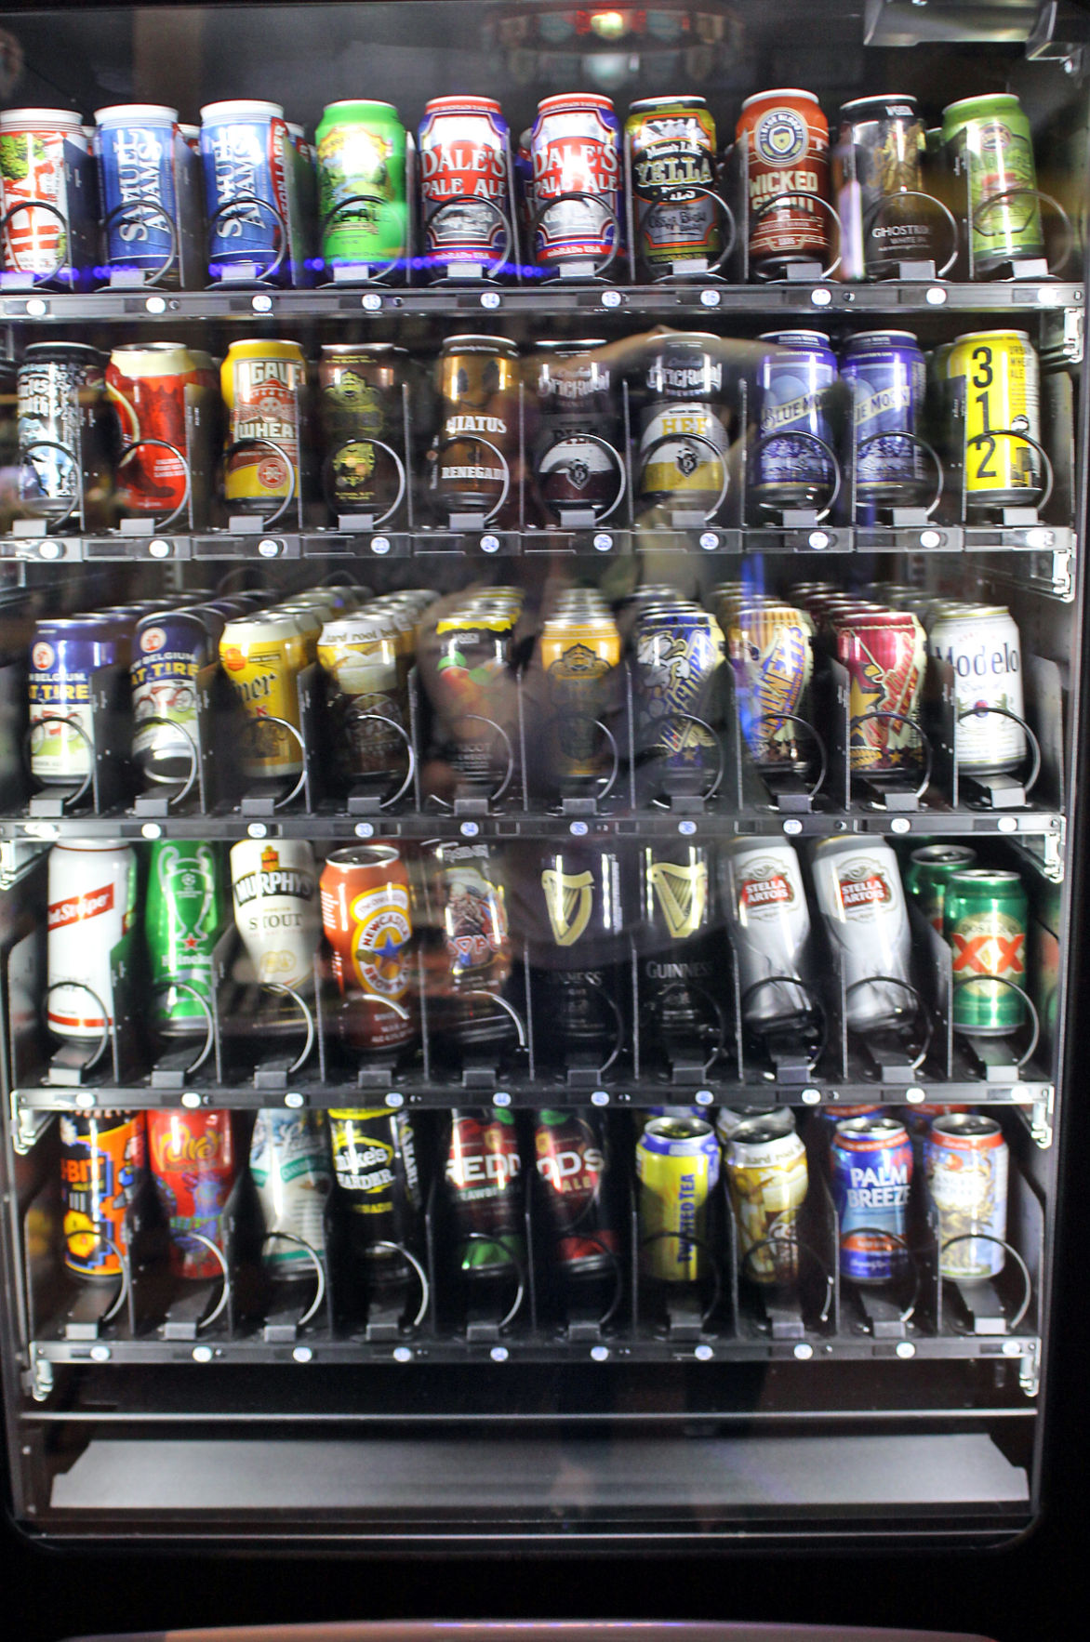
A Vending Machine
do :: true ) skip; /* Coin Insertion */
if :: nsprite > 0 ) nsprite := nsprite - 1
:: nbeer > 0 ) nbeer := nbeer - 1
:: nbeer = nsprite = 0 ) skip
fi
:: true ) atomic { nbeer := max; nsprite := max }
od

Slide 10
A hidden bug in a mutual exclusion protocol
boolean array b(0;1) integer k,
process i, with i either 0 or 1;
C0: b(i) := false;
C1: if k != i then begin
C2: if not (b(1-i)) then go to C2;
else k := i; go to C1 end;
else critical section;
b(i) := true;
remainder of program;
go to C0;
int cnt, k, b[2]; /* all variables are initially 0 */
active [2] proctype P() {
assert(_pid == 0 || _pid == 1);
C0: b[_pid] = 0;
C1: if
:: (k != _pid) ->
C2: (b[1 - _pid]); /* wait for nonzero */
k = _pid;
goto C1
:: else ->
cnt = cnt+1;
assert(cnt == 1); /* critical section */
cnt = cnt-1;
b[_pid] = 1;
fi;
goto C0
}
The protocol proposed in 1966
A Promela code for the protocol

Slide 11
The bug was found automatically!
1: proc 1 (P) line 5 "hy66" (state 1) [assert(((_pid==0)||(_pid==1)))]
2: proc 1 (P) line 7 "hy66" (state 2) [b[_pid] = 0]
3: proc 1 (P) line 9 "hy66" (state 3) [((k!=_pid))]
4: proc 0 (P) line 5 "hy66" (state 1) [assert(((_pid==0)||(_pid==1)))]
5: proc 0 (P) line 7 "hy66" (state 2) [b[_pid] = 0]
6: proc 0 (P) line 14 "hy66" (state 7) [else]
7: proc 0 (P) line 15 "hy66" (state 8) [cnt = (cnt+1)]
8: proc 0 (P) line 16 "hy66" (state 9) [assert((cnt==1))]
9: proc 0 (P) line 17 "hy66" (state 10) [cnt = (cnt-1)]
10: proc 0 (P) line 19 "hy66" (state 11) [b[_pid] = 1]
11: proc 1 (P) line 10 "hy66" (state 4) [(b[(1-_pid)])]
12: proc 0 (P) line 7 "hy66" (state 2) [b[_pid] = 0]
13: proc 0 (P) line 14 "hy66" (state 7) [else]
14: proc 1 (P) line 11 "hy66" (state 5) [k = _pid]
15: proc 1 (P) line 14 "hy66" (state 7) [else]
16: proc 1 (P) line 15 "hy66" (state 8) [cnt = (cnt+1)]
17: proc 1 (P) line 16 "hy66" (state 9) [assert((cnt==1))]
18: proc 0 (P) line 15 "hy66" (state 8) [cnt = (cnt+1)]
spin: line 16 "hy66", Error: assertion violated
19: proc 0 (P) line 16 "hy66" (state 9) [assert((cnt==1))]
spin: trail ends after 19 steps
#processes: 2
cnt = 2
k = 1
b[0] = 0
b[1] = 0
19: proc 1 (P) line 17 "hy66" (state 10)
19: proc 0 (P) line 17 "hy66" (state 10)
2 processes created
Reliable Design of Concurrent Software / Gerard Holzmann

Slide 12
Basic Statements
Each Promela statement is either executable or blocked
There are six types of statement
Assignment: always executable x=3+x, x=run A()
Print: always executable printf(“Pid %d.\n”,_pid);
Assertion: always executable assert(x+y == z)
Expression: depends on its value x+3>0, skip, true
Send: executable if not full ch1!m
Receive: executable if not full ch1?m2

Slide 13
Expression Statements
An expression is also a statement
It is executable if it evaluates to non-zero
1 : always executable
1<2:always executable
x<0: executable only when x < 0
x-1:executable only when x != 0
If an expression statement in blocked, it remains blocked until other process changes the condition
An expression e is equivalent to while(!e); in C

Slide 14
Assert statements
assert is always executable:
assert(expr)
If expr is 0, SPIN detects this violation
Usually used as a form of invariance:
active proctype inv() { assert( x==0); }
This is equivalent to “always(x==0)“ thanks to interleaving semantics

Slide 15
Program Execution Control
Promela provides low-level control mechanism, i.e., goto and label as well as if and do
Note that non-deterministic selection is supported
else is a predefined variable which becomes true if all guards are false; false otherwise
proctype A() {
byte x;
starting:
x= x+1;
goto starting;
}
proctype A() {
byte x;
do
:: x<=0 ->x=x+1;
:: x==0 ->x=1;
:: else -> break
od
}
proctype A() {
byte x;
if
::x<=0 -> x=x+1
::x==0 -> x=1
fi
}
int i;
for (i : 1 .. 10) {
printf("i =%d\n",i)
}

Slide 16




A Bridge Crossing Puzzle
Four soldiers are ordered to cross a bridge.
Their speeds are: 5,10,20,25 minutes per bridge, respectively.
Only two can be on the bridge at the same time.
They must use the torch (its night time) when walking.
There is only one torch.
Can they be on the west bank in an hour?

Slide 17
Solving the puzzle using Spin
#define FINISHED
(where[0] == 1 && where[1] == 1 && where[2] == 1 && where[3] == 1)
byte now = 0; byte time[4]; bit where[4]; bit torch;
active proctype bridge() {
byte i,j;
time[0] = 5; time[1] = 10; time[2] = 20; time[3] = 25;
do
:: now <= 60 ->
assert(!FINISHED);
if
:: where[0] == torch -> i = 0 :: where[1] == torch -> i = 1
:: where[2] == torch -> i = 2 :: where[3] == torch -> i = 3
fi;
if
:: where[0] == torch -> j = 0 :: where[1] == torch -> j = 1
:: where[2] == torch -> j = 2 :: where[3] == torch -> j = 3
fi;
where[i] = 1 - torch;
where[j] = 1 - torch;
torch = 1 - torch;
now = now + MAX(time[i], time[j])
od
}

Slide 18

Critical Section Example
bool lock;
byte cnt;
active[2] proctype P() {
!lock -> lock=true;
cnt=cnt+1;
printf("%d in CS\n",_pid);
cnt=cnt-1;
lock=false;
}
active proctype Inv () {
assert(cnt <= 1);
}
crit.pml
> ls
crit.pml
> spin -a crit.pml
> ls
crit.pml pan.b pan.c pan.h pan.m pan.t
> gcc pan.c
> a.out
pan: assertion violated (cnt<=1) (at depth 8)
pan: wrote crit.pml.trail
Full statespace search for:
never claim - (none specified)
assertion violations +
acceptance cycles - (not selected)
invalid end states +
State-vector 36 byte, depth reached 16, errors: 1
119 states, stored
47 states, matched
166 transitions (= stored+matched)
0 atomic steps
hash conflicts: 0 (resolved)
4.879 memory usage (Mbyte)
> ls
a.out crit.pml crit.pml.trail pan.b pan.c pan.h pan.m pan.t
console

Slide 19
Critical Section Example (cont.)
> spin -t -p crit.pml
Starting P with pid 0
Starting P with pid 1
Starting Invariant with pid 2
1: proc 1 (P) line 5 "crit.pml" (state 1) [(!(lock))]
2: proc 0 (P) line 5 "crit.pml" (state 1) [(!(lock))]
3: proc 1 (P) line 5 "crit.pml" (state 2) [lock = 1]
4: proc 1 (P) line 6 "crit.pml" (state 3) [cnt = (cnt+1)]
1 is in the crt sec!
5: proc 1 (P) line 7 "crit.pml" (state 4) [printf(‘%d in CS\\n’,_pid)]
6: proc 0 (P) line 5 "crit.pml" (state 2) [lock = 1]
7: proc 0 (P) line 6 "crit.pml" (state 3) [cnt = (cnt+1)]
0 is in the crt sec!
8: proc 0 (P) line 7 "crit.pml" (state 4) [printf('%d in CS\\n',_pid)]
spin: line 13 "crit.pml", Error: assertion violated
spin: text of failed assertion: assert((cnt<=1))
9: proc 2 (Invariant) line 13 "crit.pml" (state 1) [assert((cnt<=1))]
spin: trail ends after 9 steps
#processes: 3
lock = 1
cnt = 2
9: proc 2 (Invariant) line 14 "crit.pml" (state 2) <valid end state>
9: proc 1 (P) line 8 "crit.pml" (state 5)
9: proc 0 (P) line 8 "crit.pml" (state 5)
3 processes created

Slide 20
Revised Critical Section Example
bool lock;
byte cnt;
active[2] proctype P() {
atomic{!lock -> lock=true;}
cnt=cnt+1;
printf("%d in CS\n",_pid);
cnt=cnt-1;
lock=false;
}
active proctype Inv () {
assert(cnt <= 1);
}
crit.pml
> a.out
Full statespace search for:
never claim - (none specified)
assertion violations +
acceptance cycles - (not selected)
invalid end states +
State-vector 36 byte, depth reached 14, errors: 0
62 states, stored
17 states, matched
79 transitions (= stored+matched)
0 atomic steps
hash conflicts: 0 (resolved)
4.879 memory usage (Mbyte)
console

Slide 21
Deadlocked Critical Section Example
deadlocked_crit.pml
bool lock;
byte cnt;
active[2] proctype P() {
atomic{!lock -> lock==true;}
cnt=cnt+1;
printf("%d in CS\n",_pid);
cnt=cnt-1;
lock=false;
}
active proctype Inv () {
assert(cnt <= 1);
}
> a.out
pan: invalid end state (at depth 3)
(Spin Version 4.2.7 -- 23 June 2006)
Warning: Search not completed
+ Partial Order Reduction
Full statespace search for:
never claim - (none specified)
assertion violations +
acceptance cycles - (not selected)
invalid end states +
State-vector 36 byte, depth reached 4, errors: 1
5 states, stored
0 states, matched
5 transitions (= stored+matched)
2 atomic steps
hash conflicts: 0 (resolved)
4.879 memory usage (Mbyte)
console

Slide 22
Deadlocked Critical Section (cont.)
> spin -t -p deadlocked_crit.pml
Starting P with pid 0
Starting P with pid 1
Starting Invariant with pid 2
1: proc 2 (Invariant) line 13 "deadlocked_crit.pml" (state 1) [assert((cnt<=1))]
2: proc 2 terminates
3: proc 1 (P) line 5 "deadlocked_crit.pml" (state 1) [(!(lock))]
4: proc 0 (P) line 5 "deadlocked_crit.pml" (state 1) [(!(lock))]
spin: trail ends after 4 steps
#processes: 2
lock = 0
cnt = 0
4: proc 1 (P) line 5 "deadlocked_crit.pml" (state 2)
4: proc 0 (P) line 5 "deadlocked_crit.pml" (state 2)
3 processes created

Slide 23
Communication Using Message Channels
Spin provides communications through various types of channels
Buffered or non-buffered (handshaking communication)
Various message types
Various message handling operators
Syntax
chan ch1 = [2] of { bit, byte};
Sender: ch1!0,10;ch1!1,20
Receiver: ch1?b,bt;ch1?1,bt
Sender (1,20) (0,10) Receiver

Slide 24
Operations on Channels
Basic channel inquiry
len(ch), empty(ch), full(ch), nempty(ch), nfull(ch)
Additional message passing operators
ch?[x,y]: polling only
ch?<x,y>: copy a message without removing it
ch!!x,y: sorted sending (increasing order)
ch??5,y: ra ndom receiving
ch?x(y) == ch?x,y (for user’s understandability)
Be careful not to use these operators inside expressions
They have side-effects, which spin may not allow

Slide 25
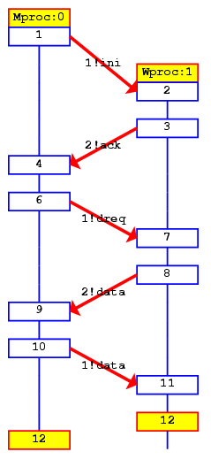
Faulty Data Transfer Protocol (data switch model proposed at 1981 at Bell labs)
mtype={ini, ack, dreq, data, shutup, quiet, dead}
chan M = [1] of {mtype};
chan W = [1] of {mtype};
active proctype Mproc()
{
W!ini; /* connection */
M?ack; /* handshake */
timeout-> /* wait */
if /* two options: */
:: W!shutup; /* shutdown */
:: W!dreq; /* or req data */
do
:: M?data -> W!data
:: M?data-> W!shutup;break
od
fi;
M?shutup;
W!quiet;
M?dead
}
active proctype Wproc() {
W?ini; /* wait for ini*/
M!ack; /* acknowledge */
do /* 3 options: */
:: W?dreq-> /* data req. */
M!data
:: W?data-> /* rec. data */
skip
:: W?shutup->
M!shutup; /* shutdown*/
break
od;
W?quiet;
M!dead
}
Channel W
Mproc
Wproc
Channel M

Slide 26
The Sieve of Eratosthenes
proctype sieve(chan c; int prime) {
chan child = [0] of { mtype, int };
bool haschild; int n; printf("%d is prime\n", prime);
end: do
:: c?number(n) ->
if
:: (n%prime) == 0 -> printf("%d = %d*%d\n", n, prime, n/prime)
:: else ->
if
:: !haschild -> /* new prime */
haschild = true;
run sieve(child, n)
:: else ->
child!number(n)
fi
fi
:: c?eof(0) -> break
od;
if
:: haschild -> child!eof(0)
:: else
fi
}
/*
The Sieve of Eratosthenes (c. 276-196 BC)
Prints all prime numbers up to MAX
*/
#define MAX 25
mtype = { number, eof };
chan root = [0] of { mtype, int };
Init {
int n = 2;
run sieve(root, n);
do
:: (n < MAX) -> n++; root!number(n)
:: (n >= MAX) -> root!eof(0); break
od
}

Slide 27
Simulation Run
Simulation
> spin sieve-of-eratosthenes.pml
2 is prime
3 is prime
4 = 2*2
5 is prime
6 = 2*3
8 = 2*4
7 is prime
9 = 3*3
10 = 2*5
12 = 2*6
14 = 2*7
11 is prime
15 = 3*5
13 is prime
16 = 2*8
18 = 2*9
20 = 2*10
2
3
5
7
11
13

Slide 28
Usages of Do-statement
do
:: (x == y) -> break
:: else -> skip
od
Loop: if
:: (x == y) -> skip
:: else -> goto Loop
fi
(x == y)
else
else
x==y
x==y
skip
x==y
Note that break or goto are statements, but control-flow modifiers

Slide 29
More Usages of Various Operators
The standard C preprocessors can be used
#define, #if, #ifdef, #include
To overcome limitation of lack of functions
#define add(a,b,c) c = a + b
inline add(a,b,c) { c = a + b }
Note that these two facilities still do not return a value
Build multi-dimensional array
typedef array {byte y[3];}
array x[2];
x[2].y[1] = 10;
(cond->v1:v2) is used as (cond?v1:v2) in C

Slide 30
More Usages of Various Operators
else: true iff no statement in the current process is executable
timeout: 1 iff no statement in the model is executable
_: a predefined, global, write-only, integer variable.
_pid: an ID of the current process
_nr_pr: a total # of active processes
_last: an ID of the process executed at previous step
STDIN: a predefined channel used for simulation
active proctype A(){chan STDIN;STDIN?x;printf(“x=%c\n”,x);}
Remote reference
name[pid]@label_name
name[pid]:var_name

Slide 31
Atomic
atomic {g1; s1;s2;s3;s4}
A sequence of statements g1;s1;s2;s3;s4 is executed without interleaving with other processes
Executable if the guard statement (g1) is executable
g1 can be other statement than expression
If any statement other than the guard blocks, atomicity is lost.
Atomicity can be regained when the statement becomes executable

Slide 32
d_step
d_step { g1; s1; s2; s3}
g1,s1, s2, and s3 must be deterministic (non-determinism is not allowed)
g1,s1,s2, and s3 must not be blocked
Used to perform intermediate computations as a single indivisible step
If non-determinisim is present inside of d_step, it is resolved in a fixed and deterministic way
For instance, by always selecting the first true guard in every selection and repetition structure
Ex. Sorting, or mathematical computation
Goto-jumps into and out of d_step sequences are forbidden

Slide 33
atomic v.s. d_step
Atomic and d_step are often used in order to reduce the size of a target model Both sequences are executable only when the guard statement is executable
atomic: if any other statement blocks, atomicity is lost at that point; it can be regained once the statement becomes executable later
d_step: it is an error if any statement other than the guard statement blocks
Other differences:
d_step: the entire sequence is executed as one single transition.
atomic: the sequence is executed step-by-step, but without interleaving, it can make non-deterministic choices
Caution:
infinite loops inside atomic or d_step sequences are not detected
the execution of this type of sequence models an indivisible step, which means that it cannot be infinite

Slide 34
Examples: atomic v.s. d_step
A
B
s1
t1
s2
t1
s1
t2
s1
t1
t1
s2
t2
s1
s2
t2
d_step{s1;s2}
t2
s2
s1
t1
t1
s1;s2
s2
s1
t2
t2
s1;s2
t1
s2
s1
t1
s1;s2
t2
s2
t2
atomic{s1;s2}

Slide 35
Rendezvous Comm. within atomic Sequences
A sender performs a sending operation and a receiver performs a receiving operation at the same time for rendezvous communication
If a sender has ch!msg in the atomic clause, after the rendezvous handshake, the sender loses its atomicity
If a receiver has ch?msg in the atomic clause, after the rendezvous handshake, the receiver continues its atomicity
Therefore, if both operations are in atomic clauses, atomicity moves from a sender to a receiver in a rendezvous handshake

Slide 36
unless
{guard1; <stmts1>} unless {guard2; <stmts2>}
To provide exception handling, or preemption capability
The unless statement is executable if either
the guard statement of the main sequence is executable, or
the guard statement of the escape sequence is executable
<stmts1> can be executed until guard2 becomes true. If then, <stmts2> becomes executable and <stmts1> is not executable anymore
Unless clause (<stmts2>) preempts a main clause (<stmts1>) if guard2 is executable, i.e., main clause is stopped.
Once unless clause becomes executable, no return to the main clause
Resembles exception handling in languages like Java and ML

Slide 37
Embedded C Code
Spin versions 4.0 and later support the inclusion of embedded C code into Promela model
c_expr : a user defined boolean guard
c_code : a user defined C statement
c_decl : declares data types
c_state: declares data objects
c_track: to guide the verifier whether it should track the value of data object or not
Embedded C codes are trusted blindly and copied through from the text of the model into the code of pan.c

Slide 38
Example 1
c_decl {typedef struct Coord {int x, y; } Coord;}
c_state “Coord pt” “Global” /* goes inside state vector */
int z = 3; /* standard global declaration */
active proctype example() {
c_code { now.pt.x = now.pt.y = 0;};
do
:: c_expr {now.pt.x == now.pt.y } ->
c_code {now.pt.y++}
:: else -> break
od;
c_code {
printf(“values %d:%d,%d,%d\n”,
Pexample-> _pid, now.z, now.pt.x, now.pt.y); };
assert(false);
}

Slide 39
Communication between Embedded C and Promela
c_state primitive introduces a new global data object pt of type Coord into the state vector
The object is initialized to zero according to the convention of Promela
A global data object in a Promela model can be accessed through now.<var> in embedded C codes
A local data object in a Promela model can be accessed through P<procname>-><var>

Slide 40
Example 2
c_decl {typedef struct Coord {int x, y; } Coord;}
c_code {Coord pt;} /* Embedded declaration goes inside state vector */
int z = 3; /* standard global declaration */
active proctype example() {
c_code { pt.x = pt.y = 0;};
do
:: c_expr {pt.x == pt.y } ->
c_code {pt.y++}
:: else -> break
od;
c_code {
printf(“values %d:%d,%d,%d\n”,
Pexample-> _pid, now.z, pt.x, pt.y); };
assert(false);
}

Slide 41
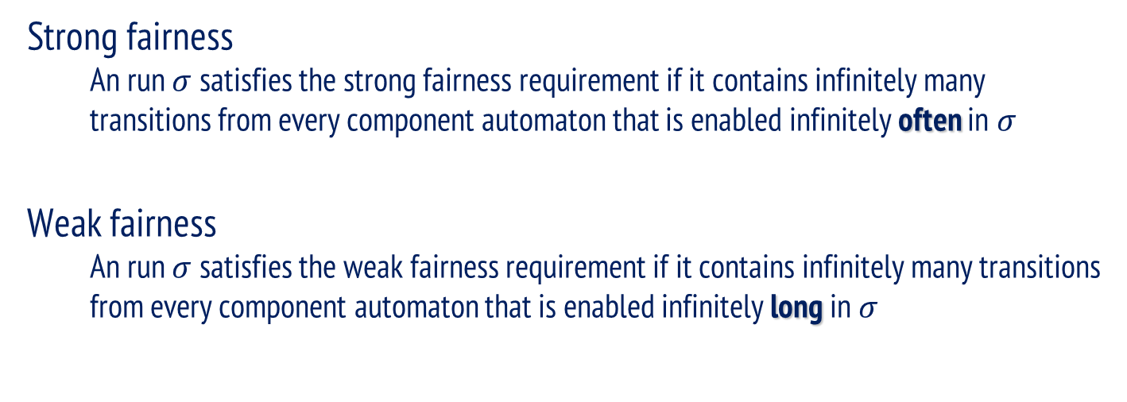


Weak Fairness v.s. Strong Fairness
Process A
Process A
Process B
Process B
ProcessC
ProcessC

Slide 42
Examples
byte x;
active proctype A() {
do
:: x=2
:: x=3
od
}
/* [] <> x==2
F: no fairness
F: weak fairness */
byte x;
active proctype A() {
do
:: x=2
od
}
active proctype B() {
do
:: atomic{x==2 -> x=1}
od
}
/* [] <> (x==1)
F: no fairness
T: weak fairness, thus T
with strong fairness */
byte x;
active proctype A() {
do
:: x=2
:: x=3
od
}
active proctype B() {
do
:: atomic{x==2 -> x=1}
od
}
/* [] <> (x==1)
F: if weak fairness is applied
*/

