Slide 1


Doodlebot
The Lost Kingdom
How do robots find their way?
Grade 5 · 30 minutes · Autonomous navigation
Notes:
SAY: "Today we are going to help a robot called Doodlebot. Its friend Princess-Bot is lost in a maze, and Doodlebot has to find her all by itself. By the end of the lesson you will know how robots like Doodlebot find their way."
DO: Have the game open on the projector at the welcome page. Students sit in pairs with one device per pair (or watch the projector if devices are limited).

Slide 2



What makes a robot smart?
Warm-up · 6 min
Sense
Think
Act
It notices the world around it
It decides what to do
It moves or does something
Turn to your partner
How does a robot vacuum know where your couch is?
Remember: AI systems sense, think and act.
Notes:
SAY: "You already know what AI is. What three things does an AI system like a robot need to do?" (sense, think, act). "Turn to your partner: how does a robot vacuum know where your couch is?" Give 1 minute, take 2 answers.
LOOK FOR: "it bumps into it", "it has sensors", "it has a camera". Say: "Exactly: it has to SENSE it. It can't just know."

Slide 3
Mystery Map · turn 1
Warm-up · 6 min
Doodlebot only sees the squares next to it. Where should it go?
Vote: up, down, left or right?
Black = Doodlebot hasn't sensed it yet
Dark blue = wall it has sensed
Notes:
SAY: "You are Doodlebot's brain! Doodlebot can only sense the squares right next to it. Everything black is unknown. Where should it go?" Let the class vote by pointing. Then click: "Let's see what Doodlebot senses after one step to the right."

Slide 4
Mystery Map · turn 2
Warm-up · 6 min
A wall! New squares appeared. Which way now?
Vote: up, down, left or right?
Black = Doodlebot hasn't sensed it yet
Dark blue = wall it has sensed
Notes:
SAY: "Doodlebot found a wall above. What do we know now that we didn't before?" (the map is growing). Take a vote again, then click.

Slide 5
Mystery Map · turn 3
Warm-up · 6 min
Look who appeared!
How did Doodlebot find her?
Its sensor reached her square!
Black = Doodlebot hasn't sensed it yet
Dark blue = wall it has sensed
Notes:
SAY: "There she is! Doodlebot didn't SEE the whole maze. It found Princess-Bot because she came inside its sensor range. That's exactly how the real game works." Move on: this activity is 4 minutes max.

Slide 6
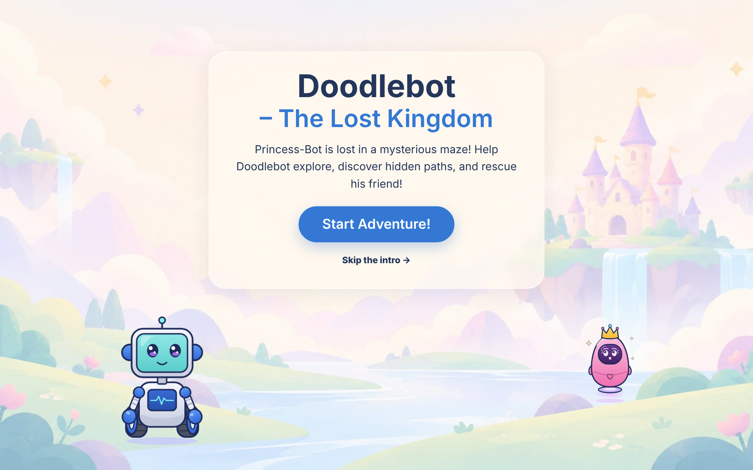
Princess-Bot is lost!
Learn & play · 18 min
Doodlebot can't see the whole maze.
Just like you in the Mystery Map, it has to explore, discover the maze square by square, and then find the way to its friend.
Notes:
SAY: "This is Doodlebot's world. Doodlebot is an autonomous robot: it decides how to move by itself, nobody drives it. Let's find out HOW it does that."
DO: Show the game welcome page on the projector, click Start Adventure! to open "How Doodlebot Thinks".

Slide 7

How Doodlebot explores
Learn & play · 18 min
PART 1 · Explore
1
2
3
→
→
Sense
Map
Move
Look around!
Remember what I see!
Head to the closest new place I can reach!
I sensed her! Yay! But I keep exploring.
↻ Repeat until there are no unexplored places left that I can reach.
Notes:
DO: Play "How Doodlebot Thinks" steps 1 and 2 on the projector, pausing on each step.
SAY: "Doodlebot can't see the whole maze. So it does three things again and again. SENSE: it looks around inside its sensor circle, like a flashlight in a dark room. MAP: it remembers what it saw on its own map. MOVE: it heads to the closest place it hasn't explored yet, the orange ring, using only paths it already knows."
POINT at the pink card: "When Princess-Bot comes inside the sensor circle, Doodlebot gets excited, but it keeps exploring until there are no unexplored places left that it can reach."
TRANSITION: "Doodlebot has finished exploring! Now it knows enough to plan the rescue."

Slide 8


Time to rescue!
Learn & play · 18 min
PART 2 · After exploring
4
5
6
→
→
Go home
Plan
Rescue
No path? I ask you to help open one.
Go back to the start.
Find a shortest path on my map.
Follow the path to Princess-Bot!
Doodlebot plans only with its own finished map, never with the real maze.
Notes:
SAY: "Doodlebot has finished exploring! Now it knows enough to plan the rescue."
DO: Play "How Doodlebot Thinks" steps 3 and 4.
SAY: "First it goes back to the start. Then it PLANS: it searches its own map for the shortest path, the yellow squares, and draws it as a green line. Then it follows the path to rescue Princess-Bot, and it is happy."
POINT at the pink card: "If walls block every way, there is no path. Doodlebot is sad and asks for help. In the game you can open a path for it."
ASK: "Which map does Doodlebot plan with?" (its own map).

Slide 9
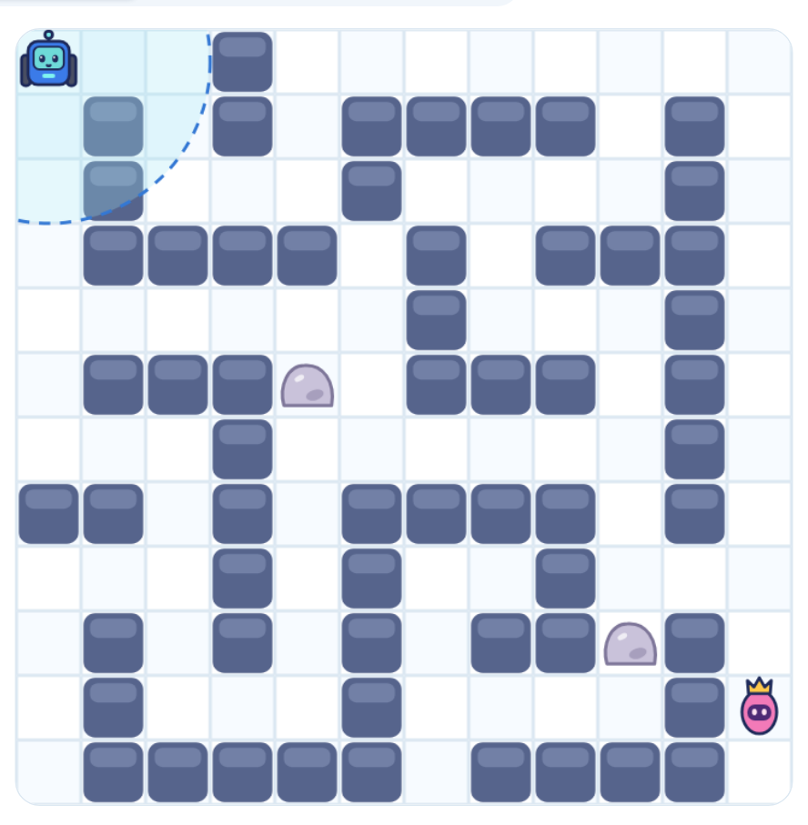
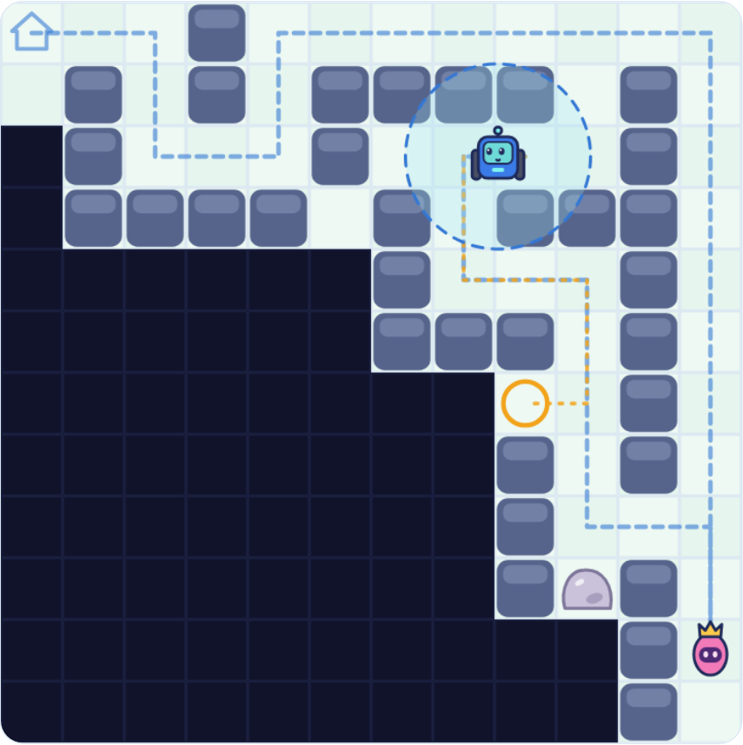
Two maps
Learn & play · 18 min
Black squares
Not sensed yet: Doodlebot doesn't know what's there
Dashed blue circle
The sensor: everything inside it gets added to the map
Orange ring
The nearest unknown place Doodlebot can reach
The real world
Doodlebot's map
Notes:
SAY: "The left map is what YOU built. Doodlebot can't see it! The right map is what Doodlebot knows. At the start it is almost all black."
ASK: "Which map does Doodlebot use to plan its path?" (its own map).
DO: In the game, show the Real world / Doodlebot's map / Both buttons above the maze.

Slide 10
Predict before you test!
Learn & play · 18 min
What if Doodlebot's sensor could see much farther, 4 squares instead of 1?
A. Steps to finish mapping will be…
more
fewer
the same
B. The shortest path to Princess-Bot will be…
more
fewer
the same
Circle your answers on the worksheet
Notes:
SAY: "Scientists predict before they test. Circle your answers in part 1 of the worksheet. There is no wrong prediction!" Give 1 to 2 minutes.
DO NOT reveal the answer. Many students will predict a shorter path; that is the misconception the experiment will fix.

Slide 11
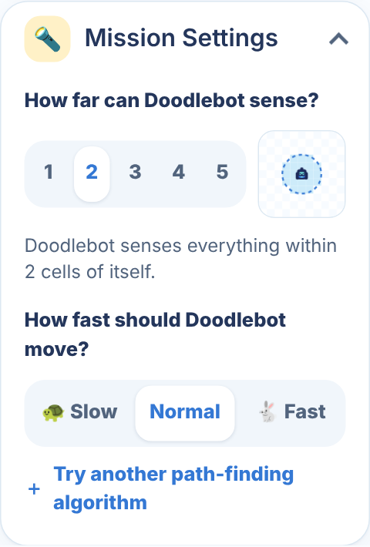
Robot scientist experiment
Learn & play · 18 min
1
Build Tools → Ready-made mazes → Lesson maze
2
Check the Maze ID says 1X6Y (top right of the maze)
3
Mission Settings → sensor 1 · speed Fast
4
Press Start Exploring and watch
5
Record steps to finish mapping and path length
6
Change ONLY the sensor to 4, then run again
Fair test: same maze, change only ONE thing.
Notes:
DO: Pairs run the experiment (9 minutes). Walk around and check that both runs show the SAME Maze ID.
SUPPORT: If a pair is stuck, point to the steps on the slide. If the chat or voice is not needed, keep it closed.
FAST FINISHERS: try sensor 2 and 3 (surprise: 3 is a little slower than 2!), or load "Princess walled in" and predict what Doodlebot will do.

Slide 12
What did we find?
Learn & play · 18 min
 | Sensor range 1 | Sensor range 4
Steps to finish mapping
Shortest path length
Pairs: call out your numbers. Do they match?
Notes:
DO: Write the numbers pairs call out in the table (type into the empty cells, or use the whiteboard). Everyone should get 78 and 29 steps to finish mapping, and 21 and 21 for the path. If a pair is different, check their Maze ID.
ASK: "Which number changed? Which number stayed the same?" Then go to the next slide.

Slide 13
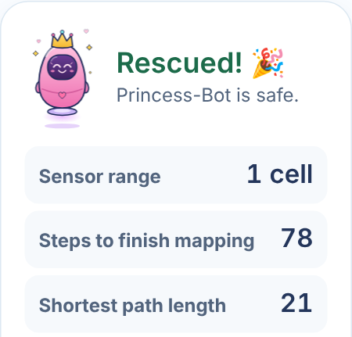
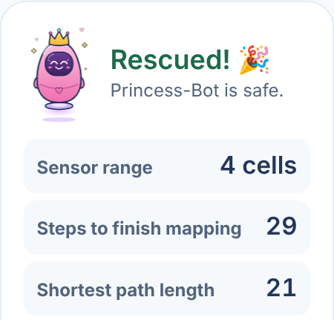
One number changed. One didn't.
Learn & play · 18 min
Run 1 · sensor 1
Run 2 · sensor 4
In this maze, the bigger sensor finished mapping in 49 fewer steps. The shortest path stayed 21.
Notes:
SAY: "Who predicted the path would be shorter? Great prediction, and now we know more! A bigger sensor helped Doodlebot discover THIS maze in fewer moves. But the shortest route to Princess-Bot stayed the same, because the maze itself did not change."
NOTE: these are the reference results for the Lesson maze (1X6Y) with BFS. Praise students for reporting what they actually measured. Avoid saying a bigger sensor ALWAYS helps: on this maze, sensor 3 needs a few more steps than sensor 2.
CHECK: ask 2 students to explain in their own words before moving on.

Slide 14
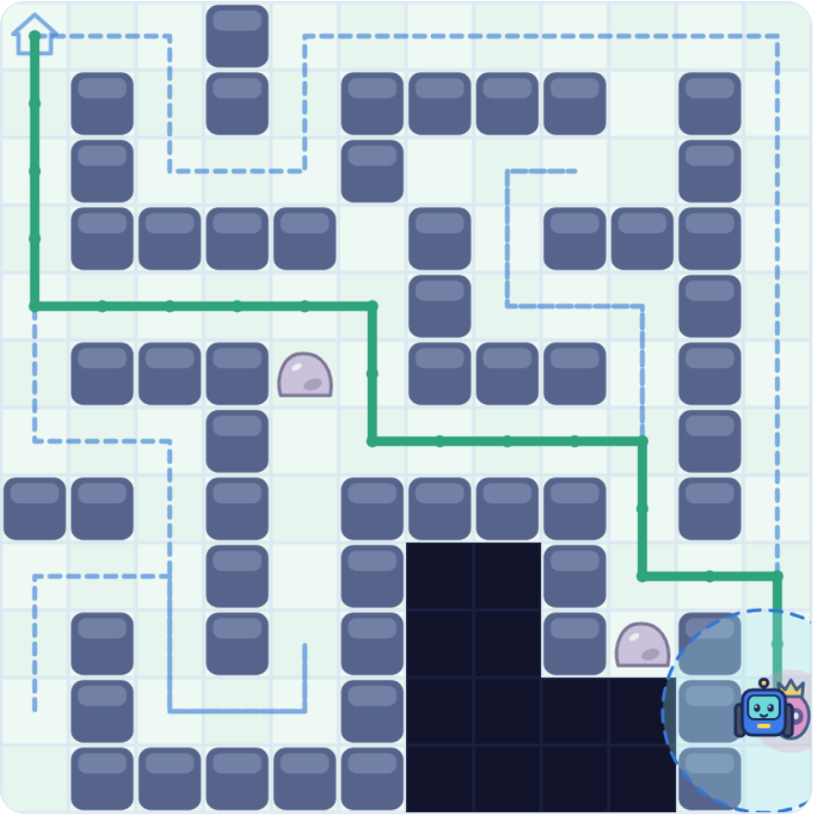
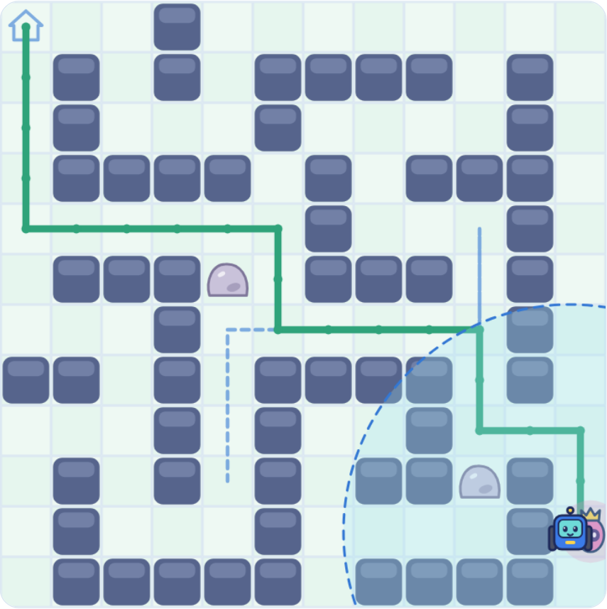
The big idea
Learn & play · 18 min
A robot can only plan with what it has sensed.
Same finished map, so the same shortest path.
Dotted blue: exploring trail
Solid green: shortest rescue path
Sensor 1: 78 steps to map
Sensor 4: 29 steps to map
Notes:
SAY: "Look at the solid green lines. They are the same rescue path! The dotted blue line is Doodlebot's trail while EXPLORING, not its rescue path. With sensor 1 the trail is much longer, because Doodlebot had to drive closer to everything to sense it."
This is autonomous navigation: explore (sense, map, move), then plan and rescue, with no human driving.

Slide 15
Reflect
Wrap-up · 6 min
Which run finished mapping in fewer steps? Why?
1
Was the shortest path different? Why or why not?
2
Think of a real robot. What are its "black squares", the things it can't know until it senses them?
3
Write on your worksheet
Notes:
DO: Students write answers to the 3 questions on the worksheet (4 minutes). These answers and the recorded numbers are the evidence of learning.
SENTENCE STARTERS for students who need them: "Sensor 4 needed fewer steps because…", "The path was the same because…".

Slide 16
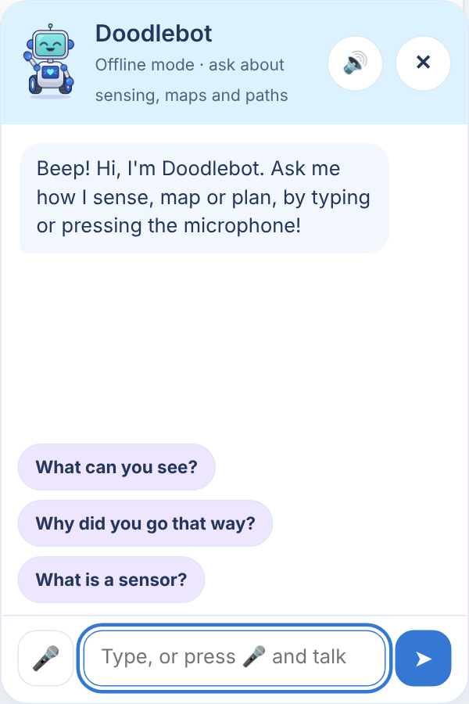



Robots like Doodlebot are real
Wrap-up · 6 min
Robot vacuum
Senses walls and furniture as it cleans a new room
Mars rover
Maps rocks and craters on a planet no one has mapped
Delivery robot
Senses people, cars and new obstacles on the way
Ask Doodlebot!
Notes:
SAY: "Every one of these robots does what Doodlebot does: sense, map, plan, move."
DO (2 minutes): Click Doodlebot in the game, press the microphone, and let one student ask: "Why did a bigger sensor help you?" Doodlebot answers out loud.
CLOSE: "Today you were robot scientists. You found out that a robot can only plan with what it has sensed."

