Slide 1

Sprocket Central Pty Ltd
Data analytics approach
[Division Name] - [Engagement Manager], [Senior Consultant], [Junior Consultant]

Slide 2
Agenda
Introduction
Data Exploration
Model Development
Interpretation

Slide 3
Introduction
Outline to the Problem
Sprocket Center is a big company that does business in branded bikes and bicycles related accessories
They are planning to boost their sales by analyzing given datasets
Using 3 datasets they want to find out those 1000 customers they should target to increase their sales
This will be done in 3 phases
Data Exploration
Model Development
Interpretation
Content of Data Analysis
New and Old Customers age distribution
Bike Related Purchases over the last 3 years by gender
Job Industry distribution
Wealth Segmentation by age category
Numbers of cars owned by states
RFM analysis and customer classification

Slide 4
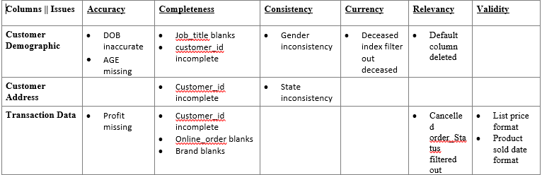
Introduction
Data Quality Assessment (Clean-up phase)
Key Issues
Accuracy : Correct Values
Completeness : Data Fields with Values
Consistency : Values Free from Contradiction
Currency : Values up to date
Relevancy : Data items with Values metadata
Validity : Data Containing Allowable Values
Summary Table

Slide 5
Data Exploration
New and Old Customer’s Age Distribution
Age group 40-49 is most populated in both New and Old datasets
There is a steep rise in 80 and 90 age groups
Group 30 also has rise in percentage as compared to Old customer list
There is a fall in weightage of age group 40
Age group 30,50,80,90 must be targeted
Age group 40’s fall should be under attention

Slide 6
Data Exploration
Last 3 years bike purchases by gender distribution
In the last three years, women made up 51% of bicycle-related purchases, while men made up 47%, and 2% were of unknown gender.
Women's purchases outnumbered men's purchases by almost 10,000 units during this period.
Therefore, females were the primary drivers of sales in the bicycle market.

Slide 7
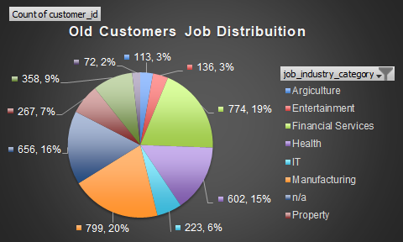
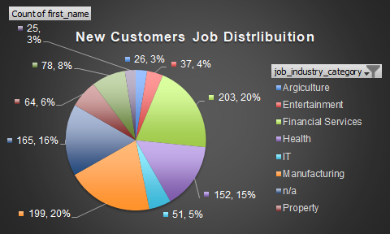
Data Exploration
Distribution by Job Industry
Top three industries: Financial Services, Health, and Manufacturing are the top three industries in both the old and new customer lists. However, their percentages have changed as follows:
Financial Services: Decreased from 19.35% to 20.50% (+1.15%)
Health: Decreased from 15.05% to 15.35% (+0.30%)
Manufacturing: Decreased from 19.98% to 20.10% (+0.12%)
Lower customer counts: Agriculture, Entertainment, IT, Property, Retail, and Telecommunications have relatively lower customer counts in both old and new customer lists, with varying percentages.

Slide 8
Data Exploration
Customer Wealth Distribution By Age
OLD CUSTOMERS WEALTH INSIGHTS
Mass customers make up the largest percentage of customers at 50%, followed by high net worth (26%) and affluent customers (24%).
The high net worth and affluent customer groups are nearly equal in size at 26% and 24% respectively.
The 50-59 age group represents the largest percentage of customers at 33%, followed by 40-49 (18%) and 60-69 (18%) age groups.
The 90+ age group represents the smallest percentage of customers at only 0.05% of the total count.
NEW CUSTOMERS WEALTH INSIGHTS.
Mass customers represent 50% of total customers, followed by high net worth (25%) and affluent customers (24%).
The high net worth and affluent customer groups are nearly equal in size at 25% and 24% respectively.
The 50-59 age group has the largest percentage of customers at 22%, followed by 60-69 (18%) and 30-39 (16%) age groups.
The 90+ age group represents the smallest percentage of customers at only 5% of the total count.

Slide 9
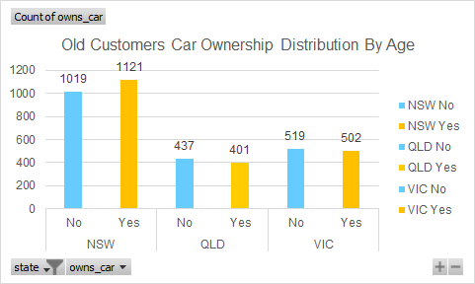
Data Exploration
Customer States And Cars Distribution
NSW has the highest count of customers who own a car in both the old and new customer data, followed by VIC and QLD.
The percentage of customers who own a car in each state is consistent in both the old and new customer data, with the majority of the customers owning a car in all three states, ranging from 58% to 62%.
QLD has a lower percentage of customers who own a car in the new customer data compared to the old customer data, with a decrease from 52% to 49%.
VIC has a slightly higher percentage of customers who own a car in the new customer data, with an increase from 49% to 51%.

Slide 10
Data Exploration
Customer Wealth Distribution By Age
Place any information about this point here.

Slide 12
Note: The data and information in this document is reflective of a hypothetical situation and client. This document is to be used for KPMG Virtual Internship purposes only.
Model Development
Place headline insight or information here. This should be the most important point for this slide.
Place any information about this point here.
Place any supporting images, graphs, data or extra text here.

Slide 13
Note: The data and information in this document is reflective of a hypothetical situation and client. This document is to be used for KPMG Virtual Internship purposes only.
Interpretation
Place headline insight or information here. This should be the most important point for this slide.
Place any information about this point here.
Place any supporting images, graphs, data or extra text here.

Slide 14
Note: The data and information in this document is reflective of a hypothetical situation and client. This document is to be used for KPMG Virtual Internship purposes only.
Appendix

Slide 15
Note: The data and information in this document is reflective of a hypothetical situation and client. This document is to be used for KPMG Virtual Internship purposes only.
Appendix
This is an optional slide where you may place any supporting items.

