Slide 1

Sprocket Central Pty Ltd
Data analytics approach
[Division Name] - [Engagement Manager], [Senior Consultant], [Junior Consultant]

Slide 2
Agenda
Introduction
Data Exploration
Model Development
Interpretation

Slide 3
Introduction
Outline to the Problem
Sprocket Center is a big company that does business in branded bikes and bicycles related accessories
They are planning to boost their sales by analyzing given datasets
Using 3 datasets they want to find out those 1000 customers they should target to increase their sales
This will be done in 3 phases
Data Exploration
Model Development
Interpretation
Content of Data Analysis
New and Old Customers age distribution
Bike Related Purchases over the last 3 years by gender
Job Industry distribution
Wealth Segmentation by age category
Numbers of cars owned by states
RFM analysis and customer classification

Slide 4
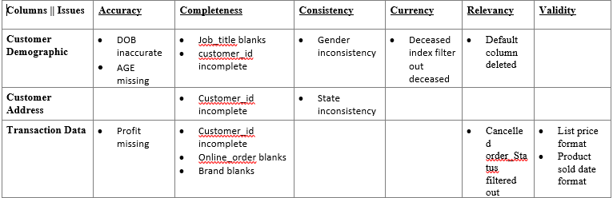
Introduction
Data Quality Assessment (Clean-up phase)
Key Issues
Accuracy : Correct Values
Completeness : Data Fields with Values
Consistency : Values Free from Contradiction
Currency : Values up to date
Relevancy : Data items with Values metadata
Validity : Data Containing Allowable Values
Summary Table

Slide 5
Data Exploration
New and Old Customer’s Age Distribution
Age group 40-49 is most populated in both New and Old datasets
There is a steep rise in 80 and 90 age groups
Group 30 also has rise in percentage as compared to Old customer list
There is a fall in weightage of age group 40
Age group 30,50,80,90 must be targeted
Age group 40’s fall should be under attention

Slide 6
Data Exploration
Last 3 years bike purchases by gender distribution
In the last three years, women made up 51% of bicycle-related purchases, while men made up 47%, and 2% were of unknown gender.
Women's purchases outnumbered men's purchases by almost 10,000 units during this period.
Therefore, females were the primary drivers of sales in the bicycle market.

Slide 7
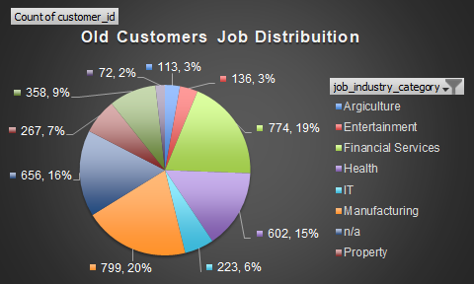
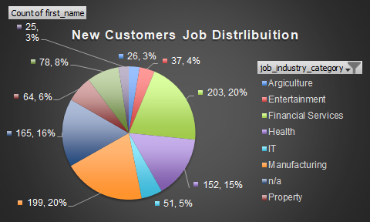
Data Exploration
Distribution by Job Industry
Top three industries: Financial Services, Health, and Manufacturing are the top three industries in both the old and new customer lists. However, their percentages have changed as follows:
Financial Services: Decreased from 19.35% to 20.50% (+1.15%)
Health: Decreased from 15.05% to 15.35% (+0.30%)
Manufacturing: Decreased from 19.98% to 20.10% (+0.12%)
Lower customer counts: Agriculture, Entertainment, IT, Property, Retail, and Telecommunications have relatively lower customer counts in both old and new customer lists, with varying percentages.

Slide 8
Data Exploration
Customer Wealth Distribution By Age
OLD CUSTOMERS WEALTH INSIGHTS
Mass customers make up the largest percentage of customers at 50%, followed by high net worth (26%) and affluent customers (24%).
The high net worth and affluent customer groups are nearly equal in size at 26% and 24% respectively.
The 50-59 age group represents the largest percentage of customers at 33%, followed by 40-49 (18%) and 60-69 (18%) age groups.
The 90+ age group represents the smallest percentage of customers at only 0.05% of the total count.
NEW CUSTOMERS WEALTH INSIGHTS.
Mass customers represent 50% of total customers, followed by high net worth (25%) and affluent customers (24%).
The high net worth and affluent customer groups are nearly equal in size at 25% and 24% respectively.
The 50-59 age group has the largest percentage of customers at 22%, followed by 60-69 (18%) and 30-39 (16%) age groups.
The 90+ age group represents the smallest percentage of customers at only 5% of the total count.

Slide 9
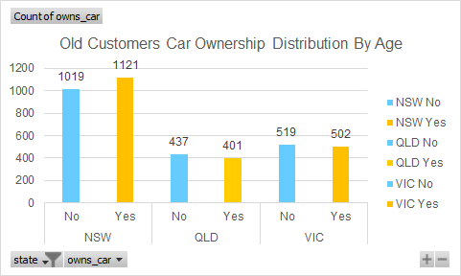
Data Exploration
Customer States And Cars Distribution
NSW has the highest count of customers who own a car in both the old and new customer data, followed by VIC and QLD.
The percentage of customers who own a car in each state is consistent in both the old and new customer data, with the majority of the customers owning a car in all three states, ranging from 58% to 62%.
QLD has a lower percentage of customers who own a car in the new customer data compared to the old customer data, with a decrease from 52% to 49%.
VIC has a slightly higher percentage of customers who own a car in the new customer data, with an increase from 49% to 51%.

Slide 10
Model Formation
Customer’s Segmentation
Customer are segmented into 5 parts on base of their Recency, Frequency and Monetary score
Rank01 are most valuable customers with 2.5 weeks recency, 7-14 products bought and almost 5k+$ profit
Rank04 has very less number of customers we should target them with Rank05 and Rank01

Slide 11
Model Formation
Customer’s buying behavior
Customers with recency from 0-100 are most beneficial to company
Recent customers are giving most profit
As recency increases monetary decreases (Linear Relation)
More recency turns out into be customer lost

Slide 12
Appendix

