Slide 1
Fake Instagram ID Detection
Machine Learning Project
Naser Muhammad – 261936735
Talal Akhtar -261937182

Slide 2
Project Objective
The objective of this project is to build a machine learning model that can detect fake Instagram profiles.
It uses features like username patterns, bio content, and profile statistics to classify accounts as fake or real.

Slide 3
Dataset Description
• Source: Kaggle dataset with 5000 Instagram profiles
• Features include: profile pic, followers, follows, posts, bio, username patterns
• Binary label: 1 = Fake, 0 = Real
• Clean and numeric data in CSV format

Slide 4
Data Preprocessing & Model
• Features scaled using StandardScaler
• Dataset split 80% train, 20% test
• Model: Random Forest Classifier
• Chosen for robustness and accuracy

Slide 5
Model Results
• Accuracy: 99%
• Precision (Fake): 1.00
• Recall (Fake): 0.98
• Misclassified: 11 out of 1000 profiles
• Very strong binary classification performance

Slide 6
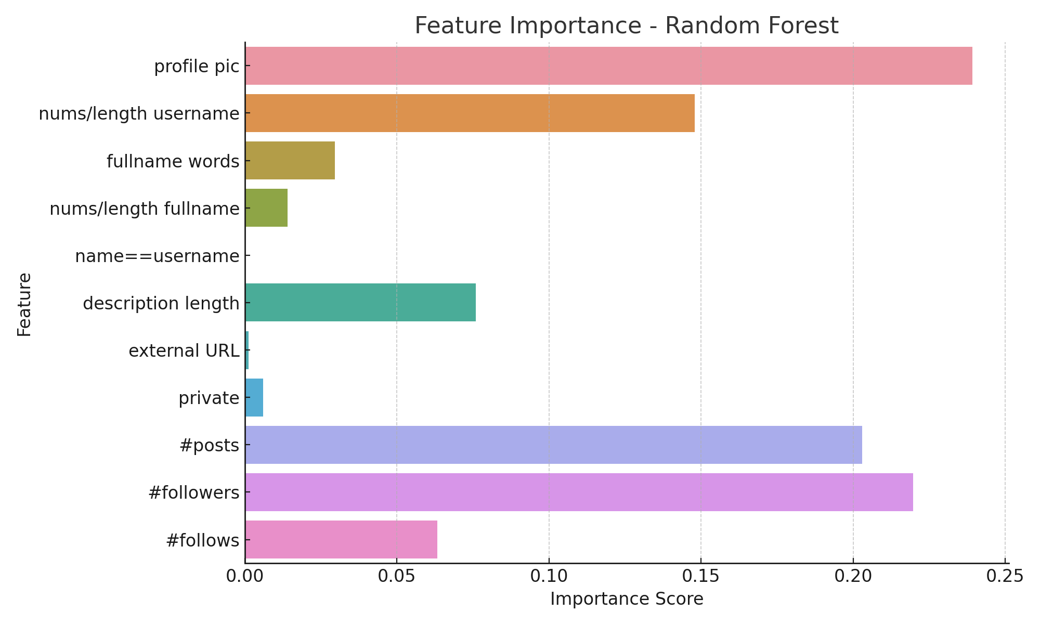
Feature Importance

Slide 7
Conclusion
• The model effectively detects fake accounts with 99% accuracy
• Important features: profile pic, followers, posts, username format
• Results saved in CSV with prediction confidence
• Future: add bio NLP, user behavior, or deep learning

