Slide 1
An AI-Driven Major Decision Support Tool for Students
Laboratory Instructor:
Mr. Marwan El-Haj
Presented by:
Talal Al-Qahtani – 218036092
Ahmed Al-Nuwaihel - 221425928

Slide 2
Introduction
Problem Statement:
There are hundreds of college majors available, with the exact number varying by institution. Generally, universities oﬀer a wide range of disciplines.
So, many students struggle to choose the right college major, which can impact their future career and satisfaction.
Goal:
To provide students with a personalized major recommendation.
Simplify the decision-making process for academic pathways.
Integrate machine learning with a user-friendly web application.

Slide 3
Our Suggested Solution
Student Major Predictor is a decision-support tool designed to help students choose their academic major based on:
- High School GPA
- Entrance Exam Scores
- Personal Preferences (Gender, Learning Style, etc.)
This system leverages machine learning to provide tailored recommendations.

Slide 4
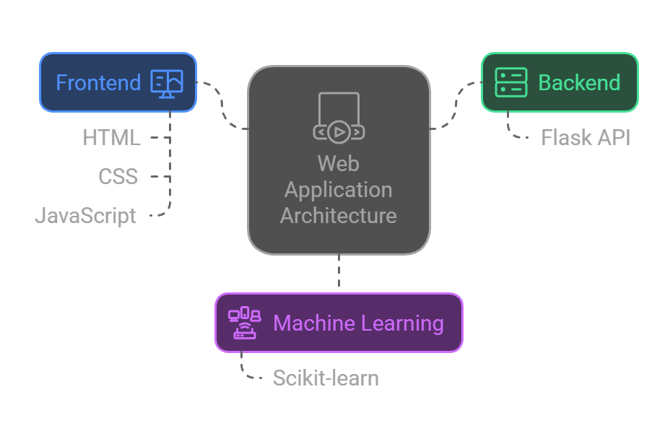
Implementation
Frontend: HTML, CSS, and JavaScript for a user-friendly interface.
Backend: Flask API to handle predictions and transfer data.
Machine Learning: Scikit-learn for model training and prediction.

Slide 5
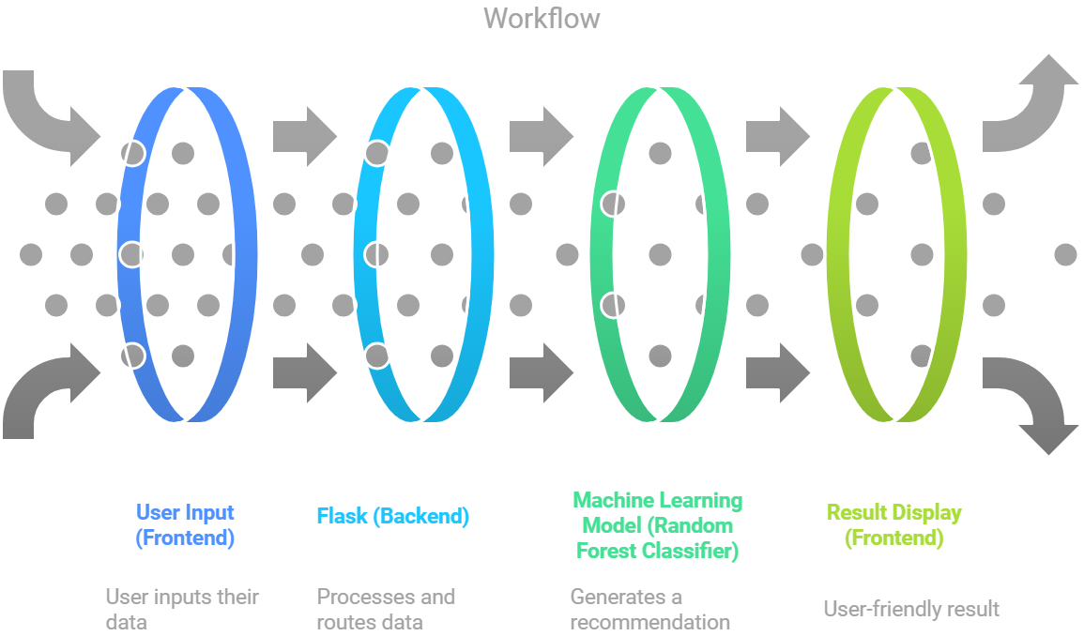
Workflow
The workflow will go in four main stages which are :

Slide 6
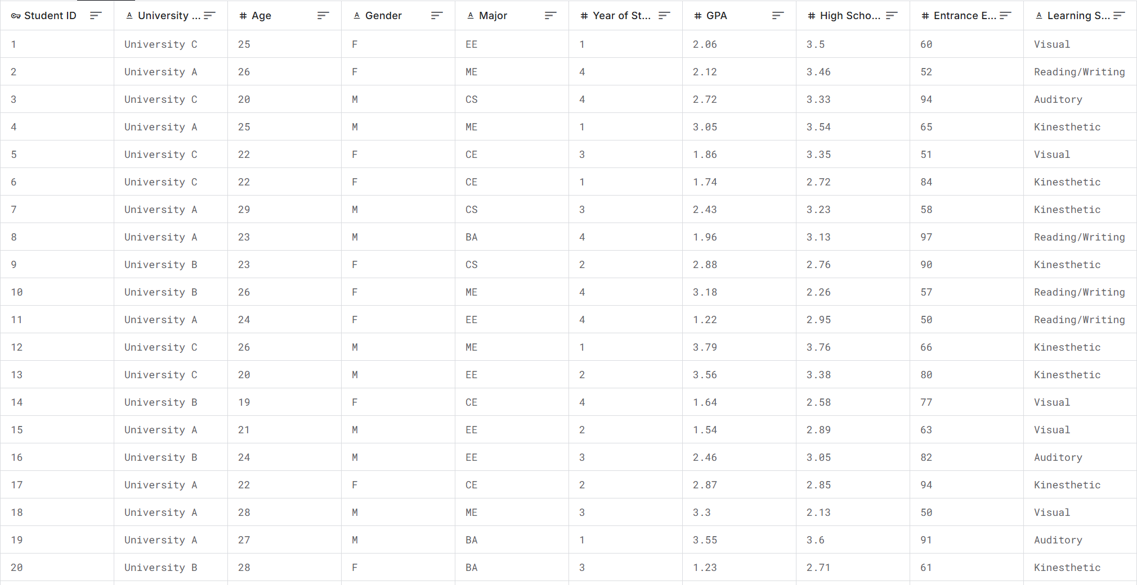
Dataset
Dataset used: Contains high school performance data and student preferences.
Features: High School GPA, Entrance Exam Scores, Gender, Learning Style, etc.

Slide 7
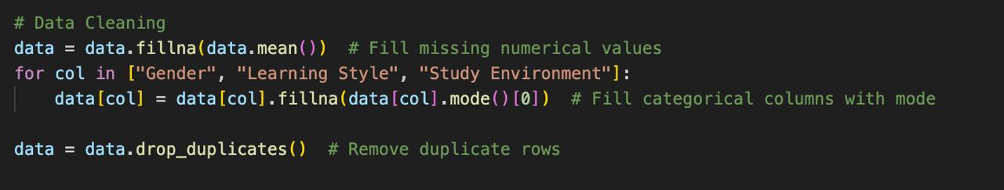
Dataset Cleaning
Handling Missing Values:
For numerical features, missing values were replaced with the column mean to retain the dataset's distribution.
For categorical features, missing values were filled with the most frequent value (mode) to maintain consistency.
Removing Duplicates:
Duplicate rows were identified and removed to ensure each record in the dataset was unique.

Slide 8
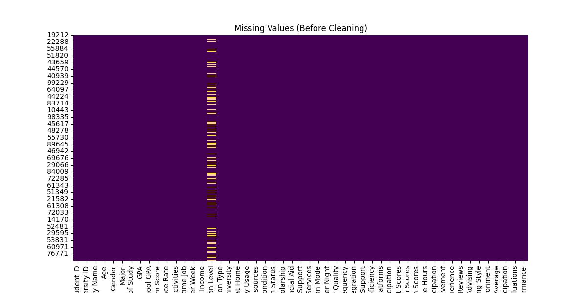
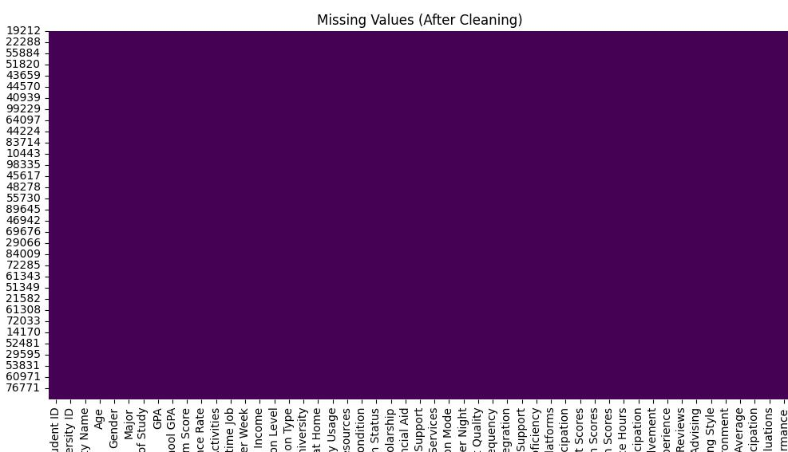
Dataset Cleaning

Slide 9
Algorithm (RandomForestClassifier)
Construction of Decision Trees: During the training phase, multiple decision trees are constructed, each trained on a different subset of the data.
Bootstrap Aggregation (Bagging): Random sampling is used to create these subsets, ensuring diversity among the trees.
Feature Randomization: At each split in a tree, a random subset of features is considered, improving the model’s robustness and reducing overfitting.
Prediction Aggregation: For classification tasks, the outputs of all trees are combined using majority voting to produce the final prediction.

Slide 10
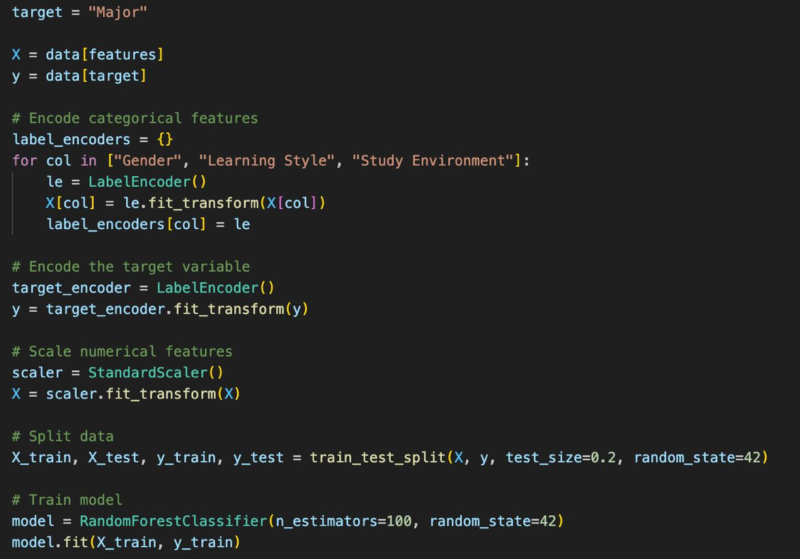
Training and testing
Training the model using RandomForestClassifier with feature scaling and label encoding.
Training and testing was split to
80% and 20% respectively.

Slide 11
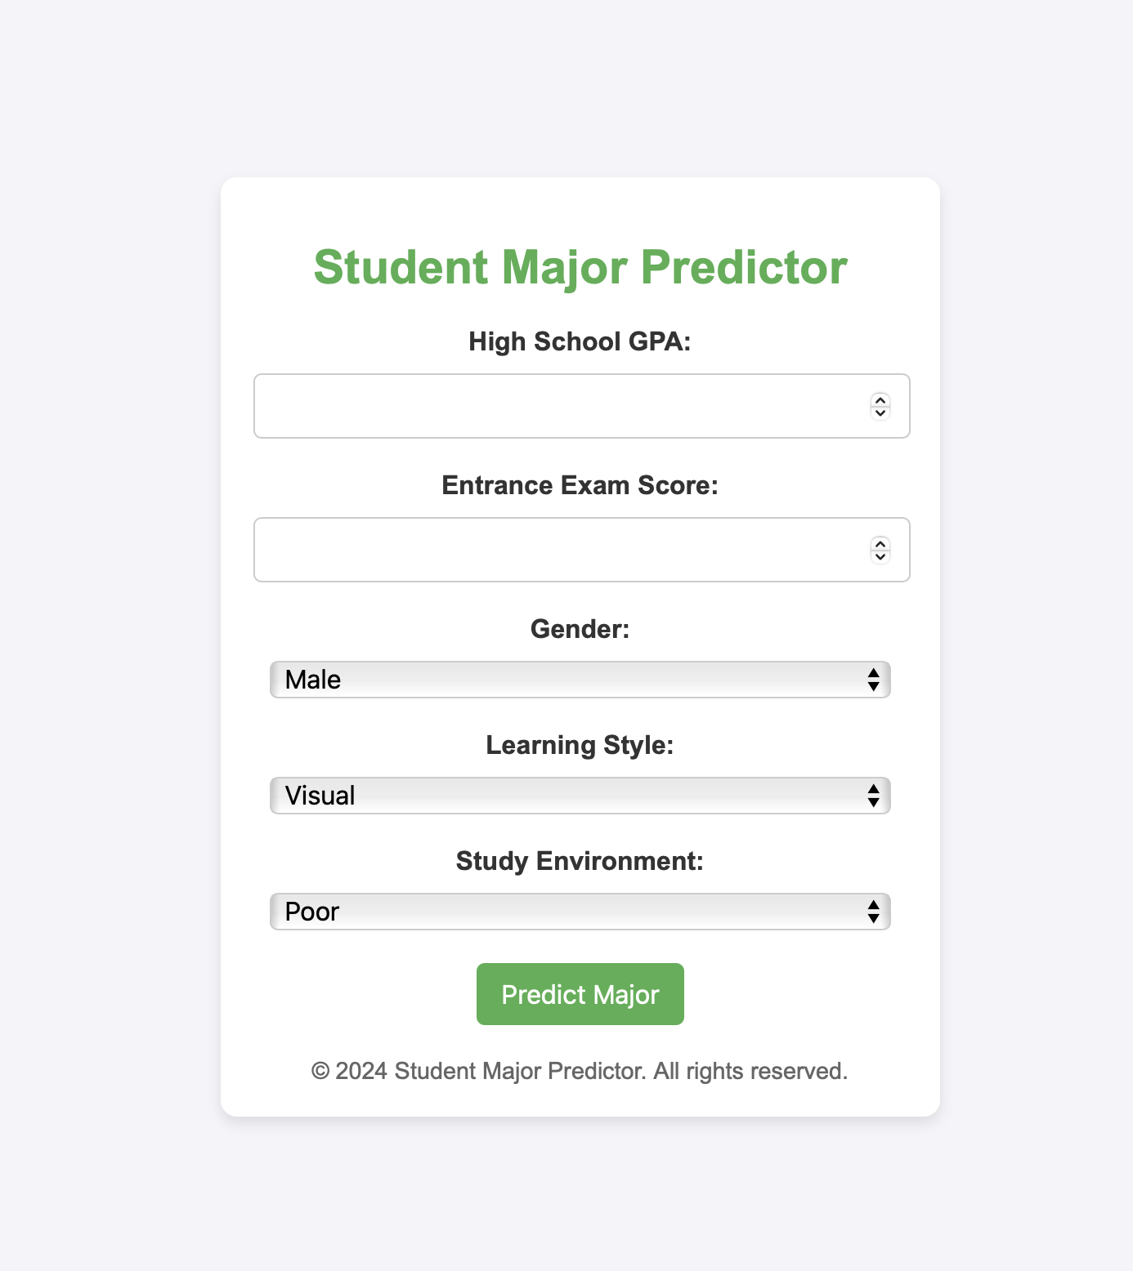
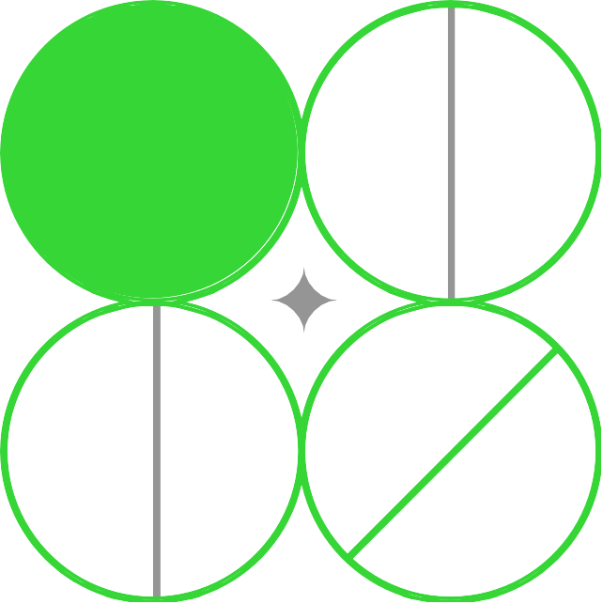
User Interface
The user interface (UI) is designed to provide a simple and comfortable experience for students, allowing them to input their relevant details to receive personalized major recommendations.

Slide 12
CONCLUSION
Our AI-Driven Major Decision Support, offers personalized recommendations through an intuitive interface and machine learning, complementing traditional academic advising to support informed decision-making.
We hope it can help much students as it can.

Slide 13


Thanks!

