Slide 1

MADANAPALLE INSTITUTE OF TECHNOLOGY & SCIENCE
Project Title
Real Time Face Recognition for Library Check in Check out System using opencv
Under the guidance of
Dr . M.SARAVANAMUTHU
PRESENTED BY
T. SULOCHANA
(22691F00G7)

Slide 2
CCONTENTS
TITLE
ABSTRACT
ARCHITECTURAL DESIGN FOR PROPOSED SYSTEM
UML DIAGRAMS
ALGORITHMS/TECHNIQUES USED
SAMPLE CODE
EXPECTED OUTCOMES
REFERENCES

Slide 3
Abstract
AWS Cloud-based data storage solutions have seen a spike in attention from academics and business in recent years because to their effective and low-cost administration.
Service providers must utilise secure data storage and sharing protocols to maintain data confidentiality and service user privacy since they deliver services via an open network.
In previous days all the library login and logout information is stored in records (books) manually.

Slide 4
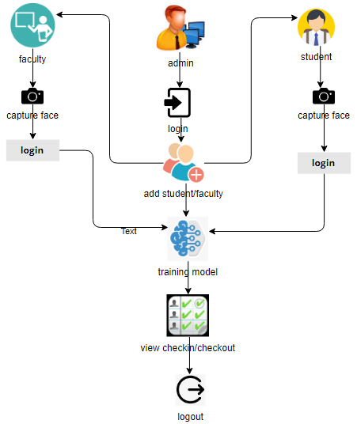
ARCHITECTURAL DESIGN FOR PROPOSED SYSTEM

Slide 5
UML DIAGRAMS
Uml stands for unified modeling language. Uml is a standardized general-purpose modeling language in the field of object-oriented software engineering.
The standard is managed, and was created by, the object management group.
The goal is for uml to become a common language for creating models of object oriented computer software.

Slide 6
USECASE DIAGRAM
A use case diagram in the unified modeling language (uml) is a type of behavioral diagram defined by and created from a use-case analysis.
Its purpose is to present a graphical overview of the functionality provided by a system in terms of actors, their goals and any dependencies between those use cases.
The main purpose of a use case diagram is to show what system functions are performed for which actor. Roles of the actors in the system can be depicted.

Slide 7
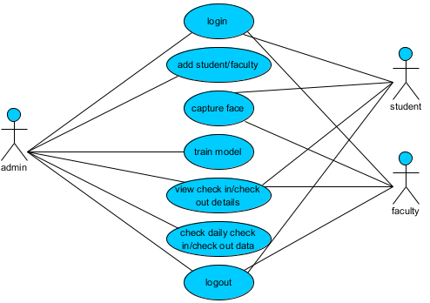
USECASE DIAGRAM

Slide 8
ENTITY RELATIONSHIP DIAGRAM
An Entity relationship model describes the structure of a database with the help of a diagram, which is known as Entity Relationship Diagram .
An ER model is a design or blueprint of a database that can later be implemented as a database.

Slide 9
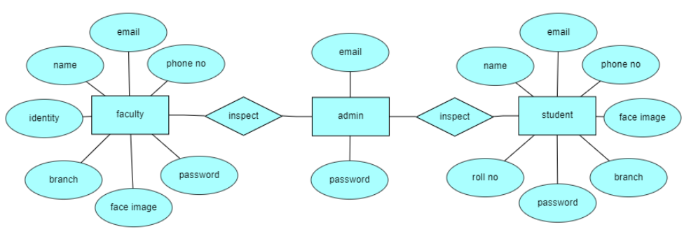

Slide 10
DATA FLOW DIAGRAM
A Data Flow Diagram (DFD) is a traditional way to visualize the information flows within a system.
A neat and clear DFD can depict a good amount of the system requirements graphically.
It can be manual, automated, or a combination of both.

Slide 11
It shows how information enters and leaves the system, what changes the information and where information is stored.
The purpose of a DFD is to show the scope and boundaries of a system as a whole.
It may be used as a communications tool between a systems analyst and any person who plays a part in the system that acts as the starting point for redesigning a system.

Slide 12
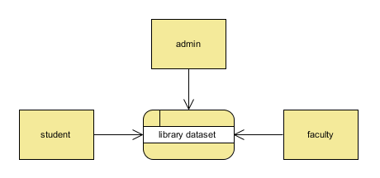
Context Level Diagram:

Slide 13
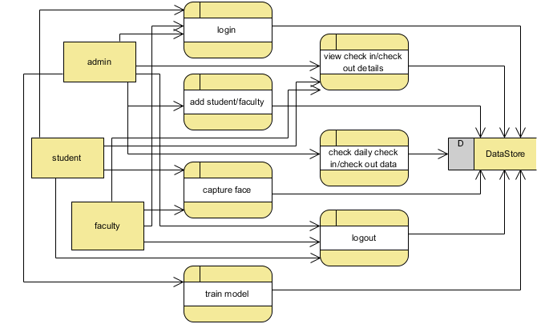
Level 1 Diagram:

Slide 14
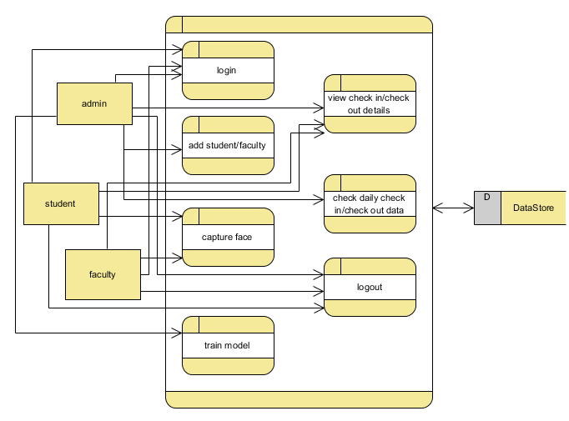
Level 2 Diagram:

Slide 15
TECHNIQUES USED
Face Detection: Use OpenCV's pre-trained face detection models to locate faces in the video stream.
Face Recognition: Train a face recognition model using techniques like Eigenfaces or LBPH (Local Binary Patterns Histograms). OpenCV provides implementations for these algorithms.

Slide 16
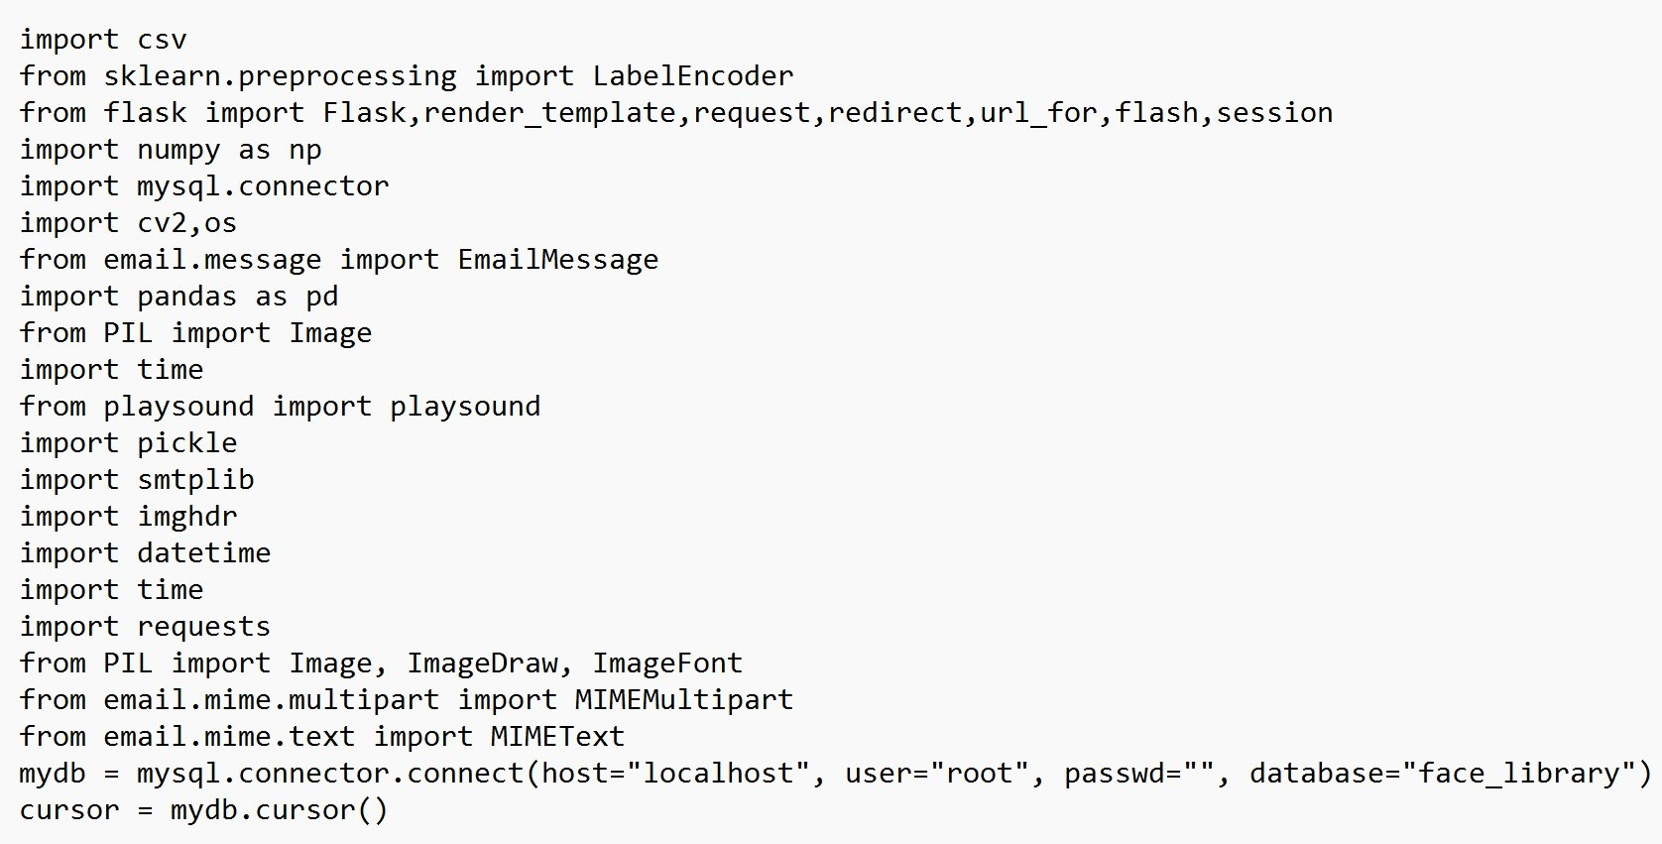
SAMPLE CODE

Slide 17
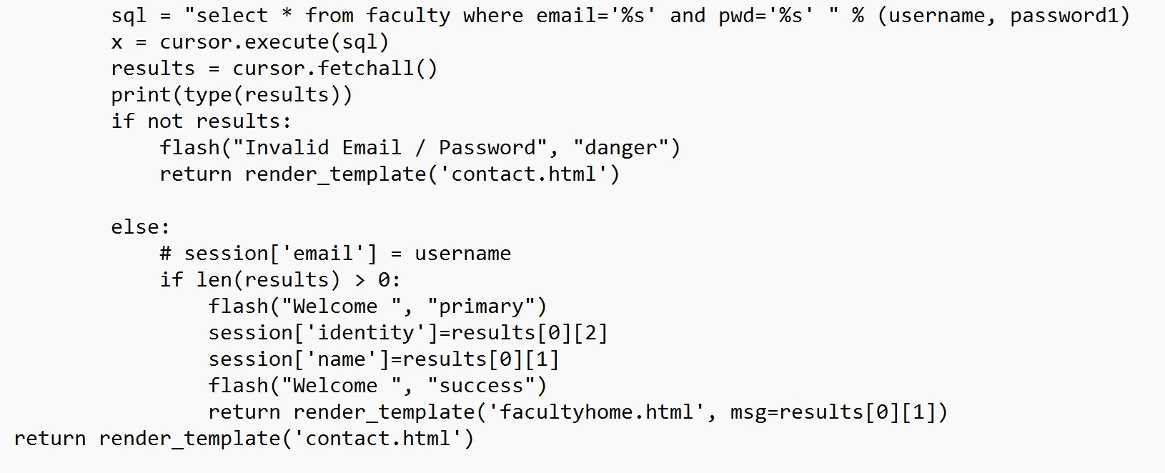

Slide 18
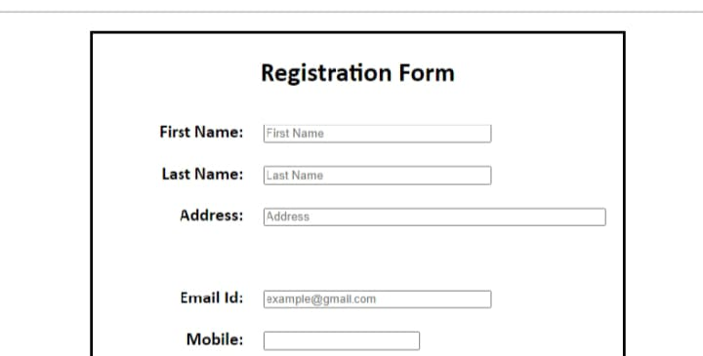
EXPECTED OUTCOMES(CONT...)

Slide 19
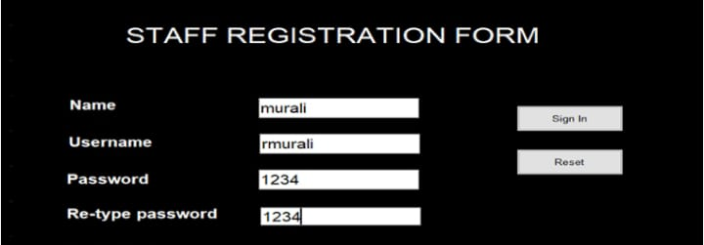

Slide 20
REFERENCES
1. H. S. G.Asep and Y. Bandung , “A design of continuous user verification for online exam proctoring on M-learning”, International Conference on Environmental and Energy Engineering (ICEEI), 2019
2. L.K.Musambo and J. Phiri ,” Student facial authentication model based on OpenCV’s object detection method and QR code for Zambian higher institutions of learning” , International Journal of Advanced Computer Science and Application (IJACSA), 2018

Slide 21


