Slide 1
Score
1. Customer satisfaction
Output score: 0.94
2. Offer Recommendation
Output score: 0.

Slide 2
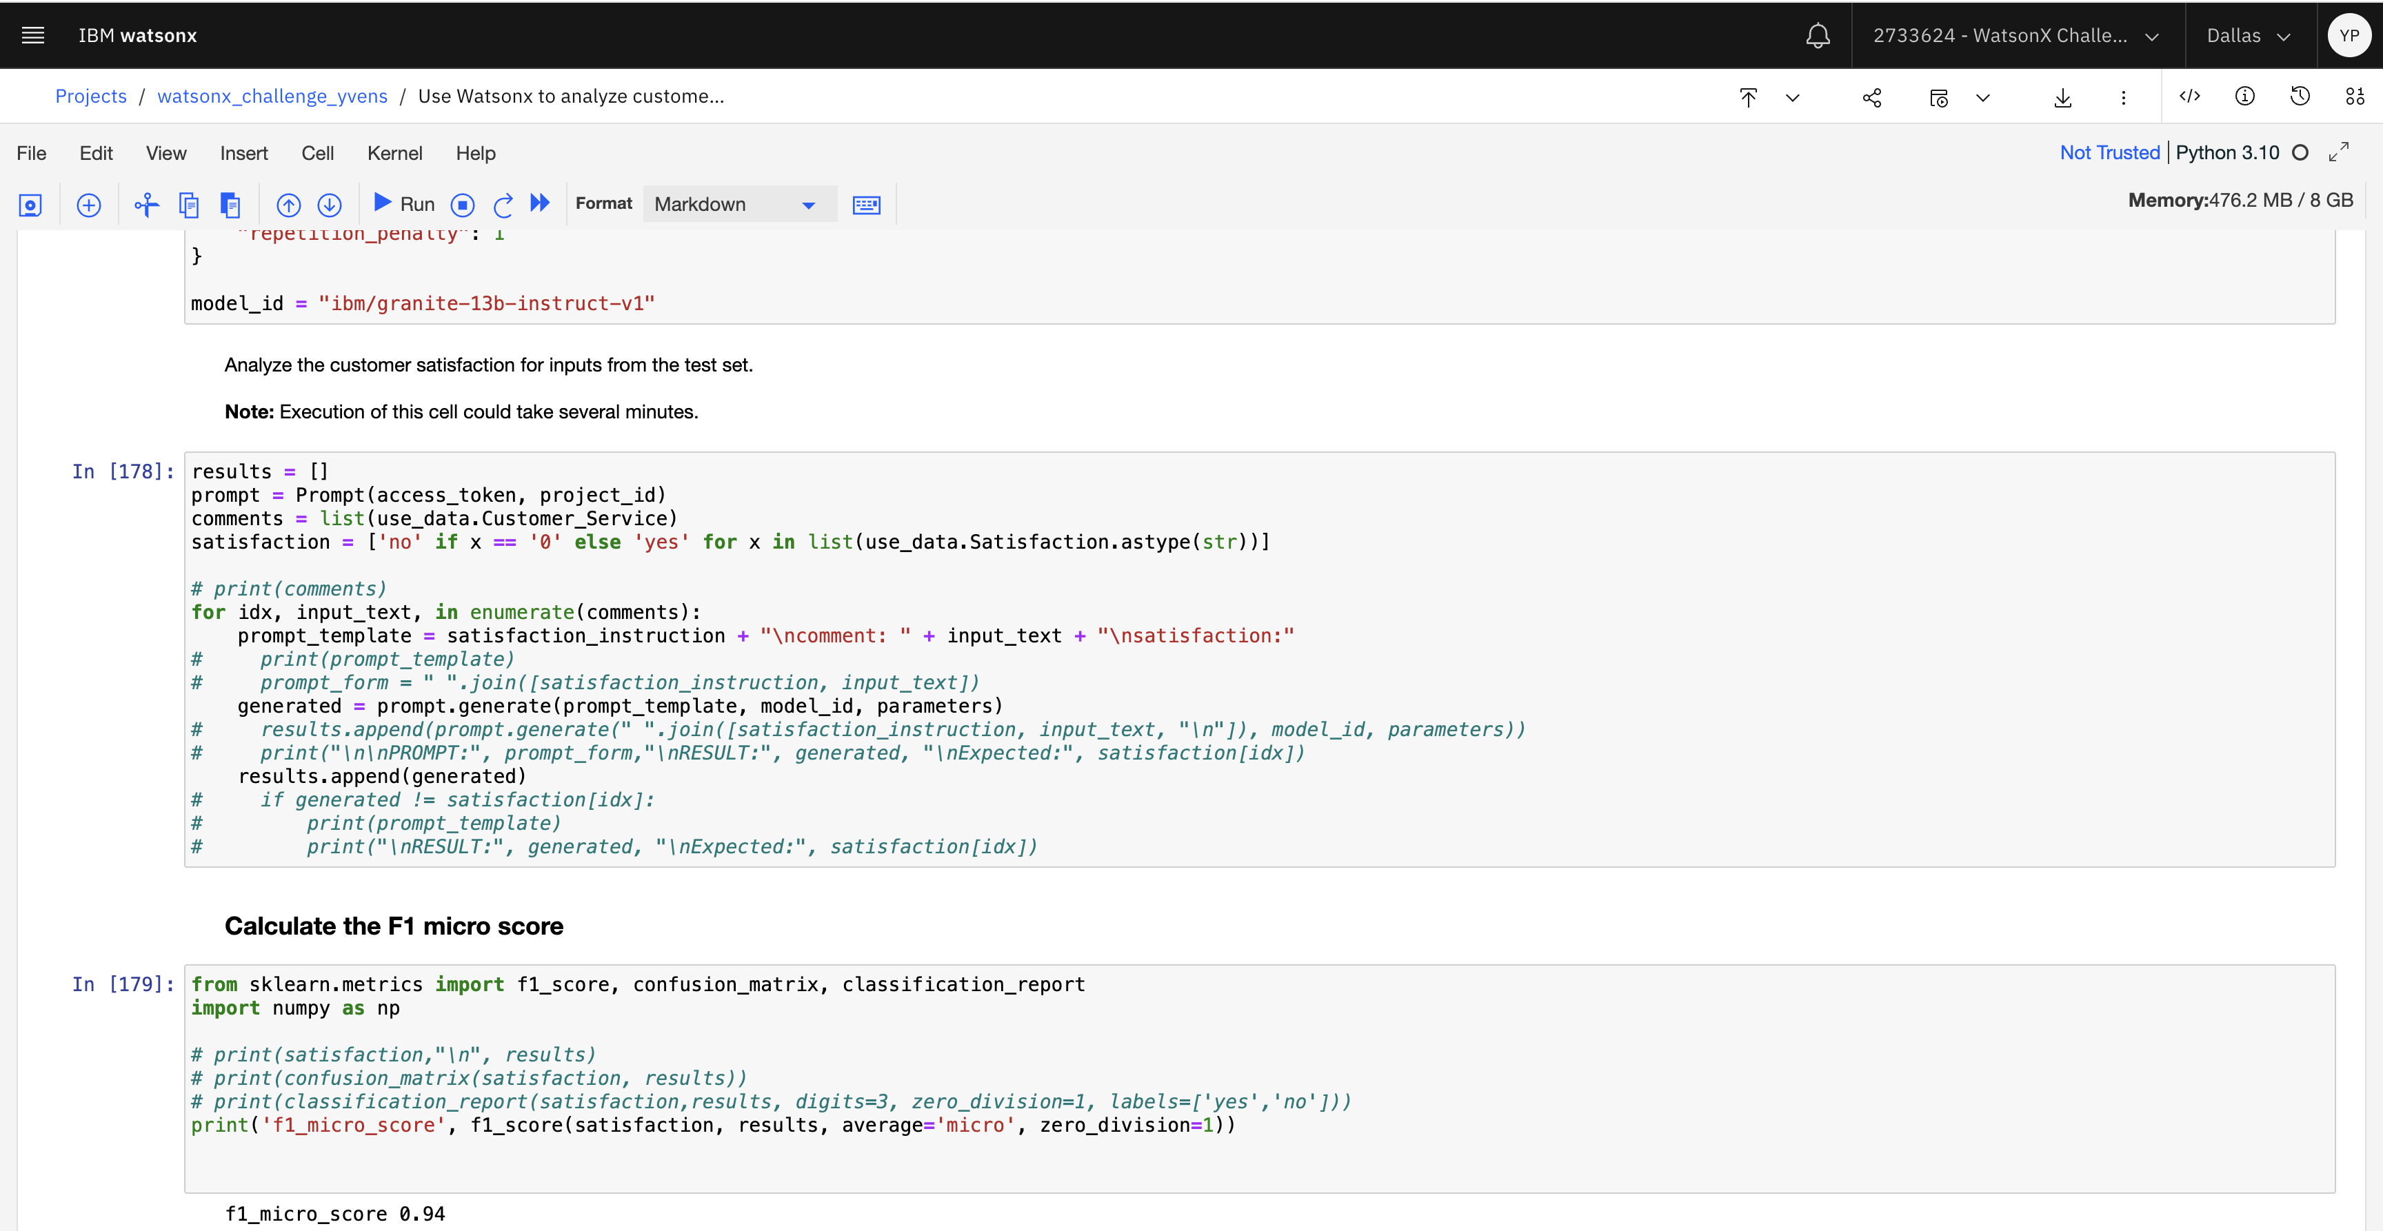
Customer satisfaction

Slide 3
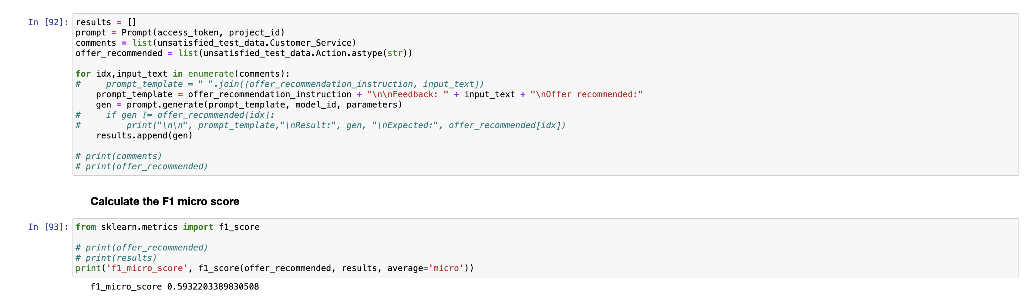
Offer Recommendation

Slide 4
Ideally, we would want to have client feedback along with the recommended offers an example set created and uploaded to a vector store.
Depending on the new customer feedback we dynamically fetch examples from the data store and add it to the prompt. We should also be deriving insights from business areas and trying to form a correlation with that
Prompt has been modified with more few shot examples that can generate better results.
The data generated has been striped of whitespaces to give a better score
Replaced 0 & 1 with yes or no, which the model was trained on yielding good score.
The notebook can be downloaded from github repo & run in the environment to test the score.
Project Pitch

Slide 5
Recommendation for an innovative use case using watsonx
WatsonX can be used in Sales/Marketing industry for doing analysis & prediction of the historical data & the current market data.
Using RAG, the web data in the public domain from the rival company can be scraped to construct new offers that can be competitive and aligned to the trends
Can be used to introduce dynamic discount/offer on the service offering to strike a balance between customer satisfaction & revenue generation.
How this can be used in education domain:
Currently we have udemy, IBM yourlearning etc. Getting sentiment, key areas from the feedback, and then providing results to the content creator to update the content as well as provide solutions to the feedback giving a corpus of knowledge can drive course purchases up

