Slide 1
AQI over the world
data mining and machine learning
Anastasia Potemkin
Tal Ben-Zur

Slide 2

Our research - intro
Research questions:
01
What is the main cause of air pollution? (Population, temperature, factories, quantity of cars…)
02
Is it possible to predict what the air pollution index is in a particular area?
03
What pattern can we observe and what conclusions can we learn from them? (according to the data)
04

Slide 3
Our research - intro
Data Acquisition
Data
Cleaning
Exploratory data
analysis
Machine Learning
Conclusions

Slide 4
Data sources
Crawling:
https://www.iqair.com/
https://en.wikipedia.org
https://www.indexmundi.com
https://worldpopulationreview.com/

Slide 5

IQAir- crawling
We used beautiful soup to crawl the relevant tables from IQAir web.
We did it step by step:
We found all the countries, and kept the link for each country.
In each link of a country, we found the regions, and the links to regions.
In each link of an area, we found the cities and city links.
Eventually, from the cities we could find the data:
AQI, temperature, humidity, wind and pressure.

Slide 6


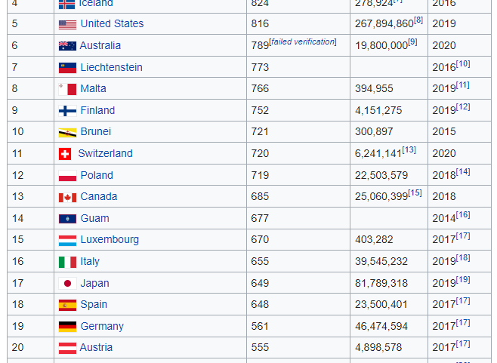
Wikipedia- crawling
We used beautiful soup to crawl the relevant tables from Wikipedia web

Slide 7

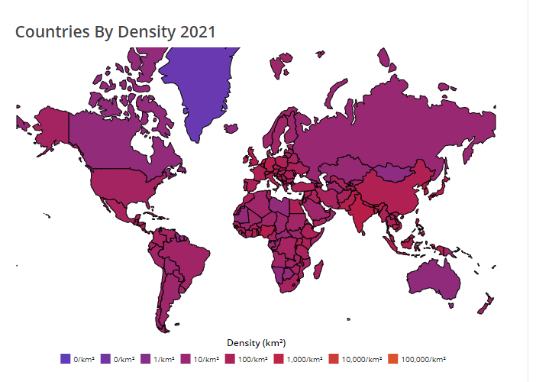
Indexmundi & worldpopulationreview- crawling
We used beautiful soup to crawl the relevant tables.

Slide 8
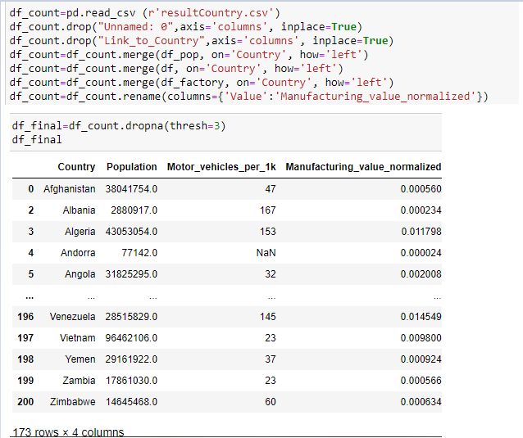
We combined all the data into one data frame: to "df_final",
by merge function.
More Scarping

Slide 9
Data cleaning
Concatenation of all the information into one table while adjusting the columns into a uniform format
Outliners handling
Filter duplicates and empty values
Delete unnecessary characters (“, %, °C, mb)

Slide 10
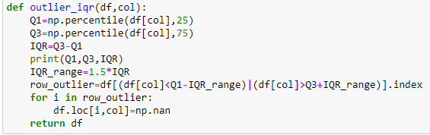
After we received the final DF, we handled the data.
We deleted all the outliers with IQR:
The information was filtered from about 58K records to 34K.
Outliers Handling

Slide 11
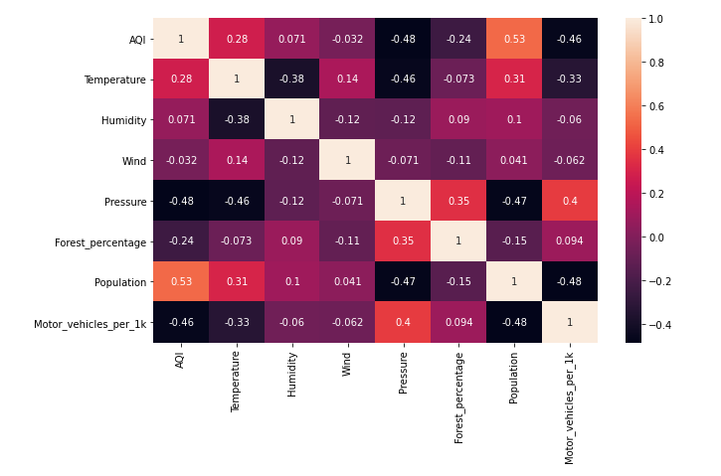
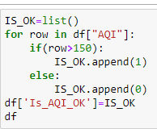
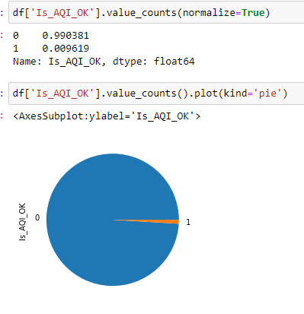
Exploratory data analysis
We added a column that show if the AQI is good(smaller than 150).
We found that the most record are “Good”.
We found high correlation between:
AQI and Population
AQI and Temperature

Slide 12

Machine Learning
Using `sklearn` library and logistic regression we were able to train a model that predicts if AQI in a particular city will be good or not
The model was able to find a match between the various variables,
and the AQI as we expected.
94% match

Slide 13
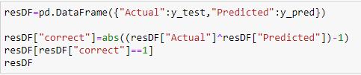

Machine Learning Prosses
Apply Machine Learning Algorithm - Train
01
Apply Machine Learning Algorithm - Predict
02
Res for Logistic Regression:
03
Evaluation
04

Slide 14
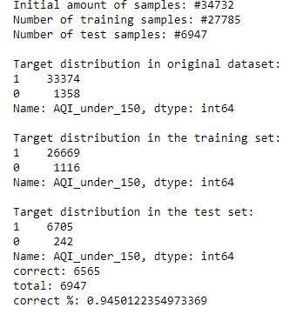
Evaluation
The total number of lists is: 34,732.
Of these, we trained 27,784 records,
And we did a check on 6,947 records.
From 6,947 records,
we were able to predict 6,565 records.
Which are over 94% success.

Slide 15
Thank you

