Slide 1
screenshots of mongoDB work
mongoDB, monngosh

Slide 2

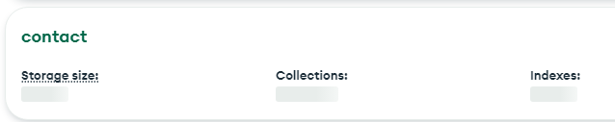
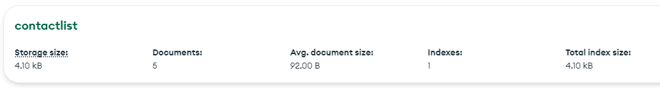
Create the data base named « contact » and collection named « contactlist »

Slide 3
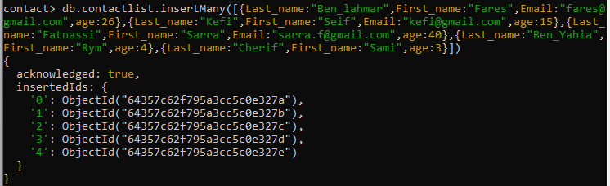
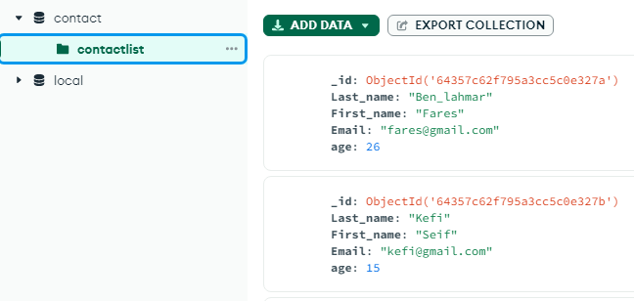
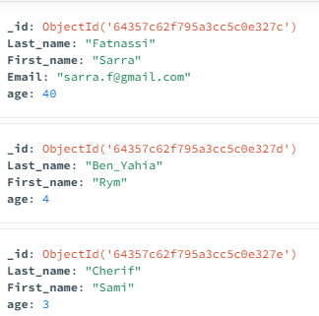
Insert documents in contactlist

Slide 4
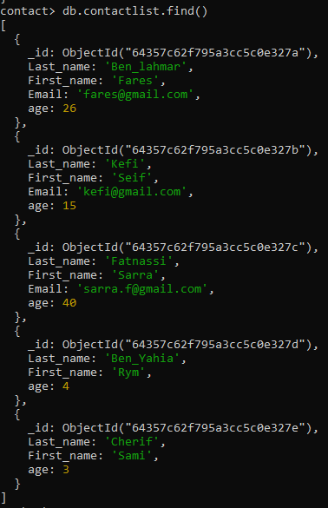
Display all of the contactlist with command: find()

Slide 5
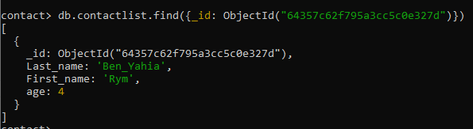
Display all the information about only one person using his ID

Slide 6
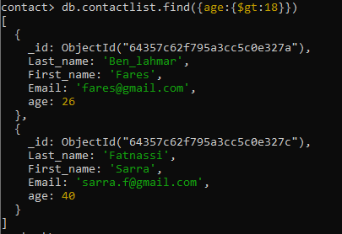
Display all the contacts with an age >18

Slide 7
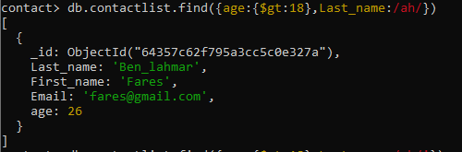
Display all the contacts with an age>18 and name containing "ah"

Slide 8
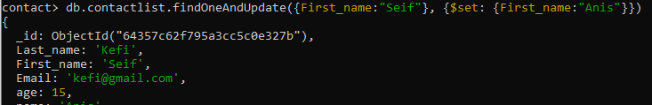
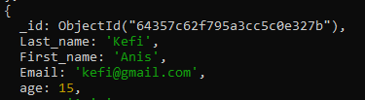
Change the contact's first name from"Kefi Seif" to "Kefi Anis".

Slide 9
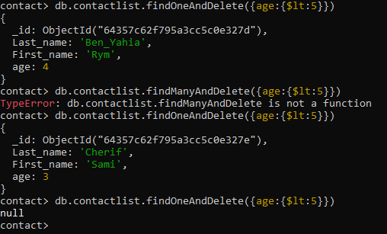
Delete the contacts that are aged under <5

Slide 10
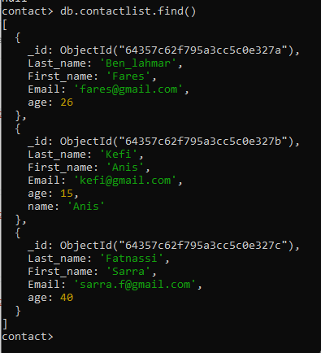
Display all of the contacts list

