Slide 1
Project Demonstration
A Software Plugin for Mass Spectrometry Analytics & A Java implementation of Normalized Cuts
MSc Computer Science
Andrew P Talbot
Supervised by Iain Styles

Slide 2
What Is the Project?
This project consists of the development of a software plugin for quick, easy access to the analytics of Mass Spectrometry datasets, in particular imzML.
There was also a focus on clustering algorithms, in particular this project consisted of a Java implementation of the Normalized Cuts Image Segmentation algorithm.
Given time, we would have explored and implemented the ToMaTo clustering algorithm, perhaps this is a good place for further research.

Slide 3
KNIME
KNIME is an open-source data analytics, reporting and integration platform. It is built in Java and on top of Eclipse.
The software is a GUI which allows you to chain together nodes (blocks of java code for processing data).
It features an extensive repository of nodes for :
- Reading, analyzing, and visualizing data.
Importantly, it is very easy to use!

Slide 4
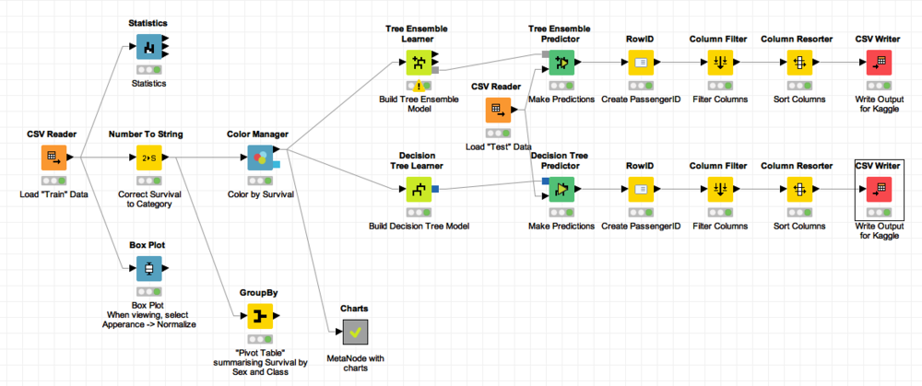
A Sample KNIME Workflow
https://www.byrnedata.com/blog/2017/3/6/using-knime-for-kaggle-titanic-survival-model

Slide 5
Mass Spectrometry
Analytical technique used to measure mass-to-charge ratios (m/z) of molecules in a sample.
Typically, mass spectrometers can be used to identify unknown compounds via molecular weight determination, to quantify known compounds, and to determine structure and chemical properties of molecules.
We store this data in imzML format, which aims to provide an open-source common data format for this data to be easily exchanged.
Inherently noisy data!

Slide 6
MS Data Format (imzML)
MSK includes reader nodes for MS datasets in the imzML format. To understand the nodes in MSK, we must understand this format.
Two parts to imzML files, .imzML and .ibd, .imzML stores the metadata, .ibd stores the raw binary data. Aimed for efficient sharing of MS data.
Two parts, m/z and Intensities, which is best explained in the image in the next slide.
We make use of imzMLConverter.jar, which has methods for parsing imzML

Slide 7
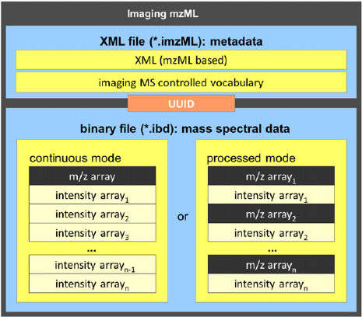
ImzML Data Format
(from www.imzML.org)

Slide 8
MSK Reader Nodes
Two nodes for reading imzML
- imzML Reader
- imzML Reader Loop Start (to process large amounts of data in chunks)
The former reads a whole dataset into KNIME, the latter loads the data into KNIME in chunks of a size specified by the user.

Slide 9
MSK Preprocessing Nodes
MSK has nodes supporting the following preprocessing methods, each of which has multiple algorithms supported:
- Baseline Subtraction
- Limit m/z Range
- Normalizer
- ROI (Rectangular Region of Interest)
- Rebinner
- Smoother

Slide 10
Multithreaded Preprocessing
The nodes are set up in a way such that if they must process over x rows in one chunk of data, then the nodes will create a thread pool so that each thread processes a row in the data concurrently.
Hence the preprocessor nodes extend RunnablePreprocessingTask, which is an abstract class that governs how the preprocessing methods implement concurrency.

Slide 11
Visualizer Nodes
MSK has support for the following methods of spectra and m/z visualizations :
- Spectrum Visualizer
- Spectrum Visualizer (Compare)
- Spectrum Visualizer JPEG
- m/z Channel Visualizer

Slide 12
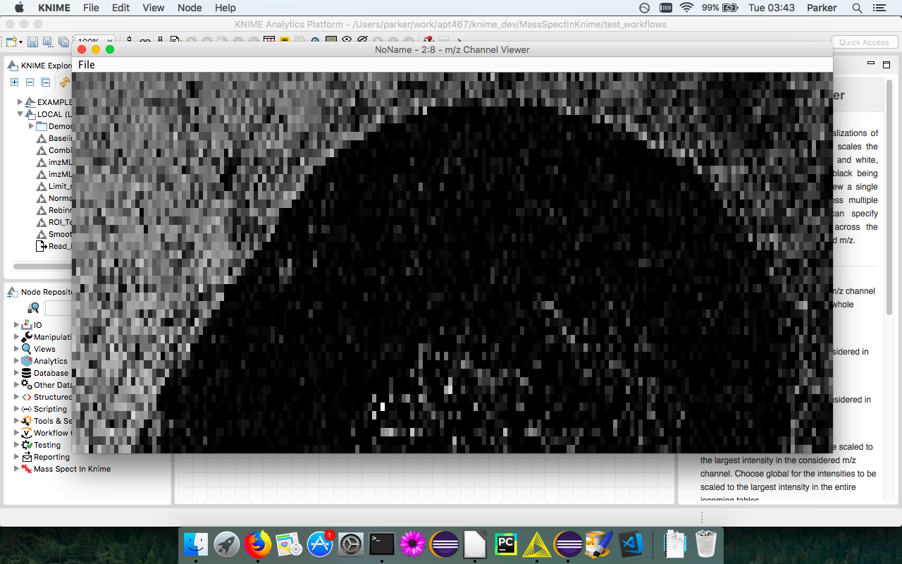

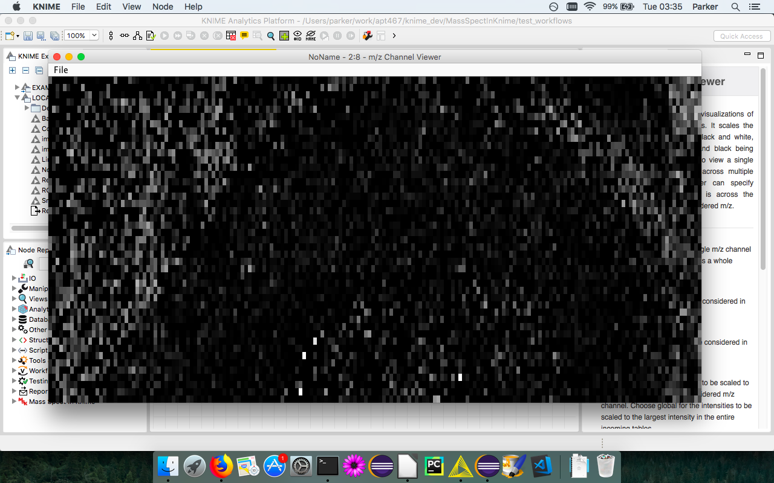
m/z Channel Viewer
m/z channel 247
Urinary bladder dataset (imzml.org)
- min m/z = 225 - width = 180 pixels
- max m/z = 249 - height = 90 pixels
- 300 m/z channels
Depiction of Original Data (imzml.org)
m/z channel 245

Slide 13
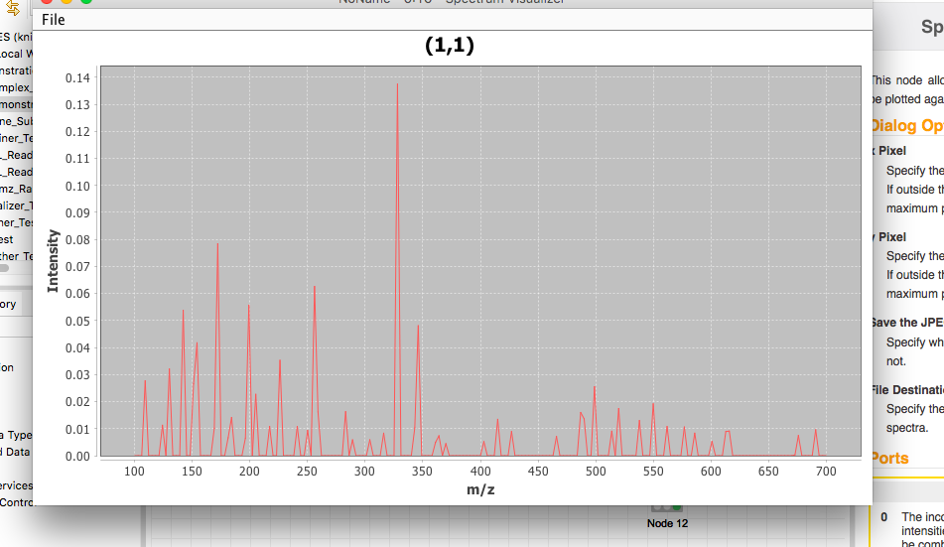
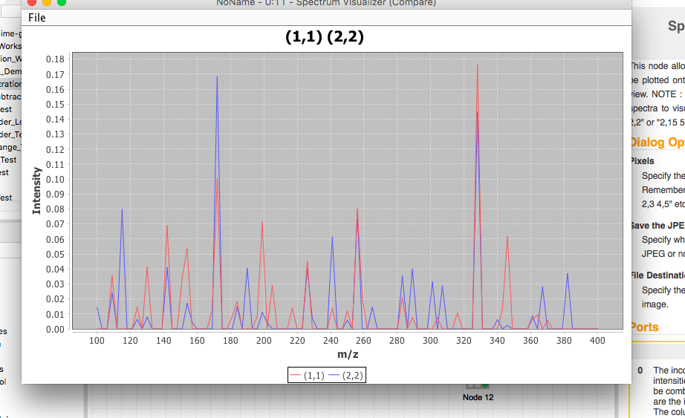
Spectrum Viewers
Example_Continuous.imzML synthetic data (imzml.org)
min m/z = 100, max m/z = 799, m/z channels = 8999
Pixel (1,1) range 100 - 700
Pixel (1,1) and (2,2) range 100 - 400

Slide 14
Cluster Nodes
KNIMES node repository has support for k-means, DBSCAN, among others. However it was lacking the following, which we have implemented nodes for :
- SOM* (Self Organizing Maps)
- Normalized Cuts
For future work in this project, we would aim to implement the ToMaTo clustering algorithm.
*SOM node was implemented using javaml library

Slide 15
Software Engineering Practice I
I began creating some supporting information (documentation including requirements, data interfaces, basic test plan – using JUnit and KNIME test workflows)). Initially, I was also following the strategy of rapid prototyping, in order to understand the KNIME node development process.
Once I was more comfortable in this regard I started to have week long sprints, in which I aimed to develop some nodes / java for some specific task.
Eg Sprint 1 : Reader nodes in KNIME, Sprint 2 : Smoother nodes in KNIME. etc

Slide 16
SE Practice II : Test Plan
KNIME’s library of data structures require a running instance of KNIME in order for it to run. Hence we have had to test things accordingly. There are two sections to testing:
- JUnit in which we test the logic which we have kept deliberately seperate from the KNIME code.
- KNIME test workflows to test individual nodes, using the KNIME testing framework, in particular the “Table Difference Checker” node to check for differences in expected and actual tables.

Slide 17
Normalized Cuts Java Implementation
This project includes a java implementation of the Normalized Cuts* image segmentation algorithm, this has been a challenging algorithm to implement.
It is currently the state of the art in terms of MSI clustering techniques.
Graph based clustering represented in massive symmetric sparse weight matrices.
Repartition the graph using the second smallest eigenvector.
*Normalized Cuts and Image Segmentation – Jianbo Shi & Jitendra Malik

Slide 18
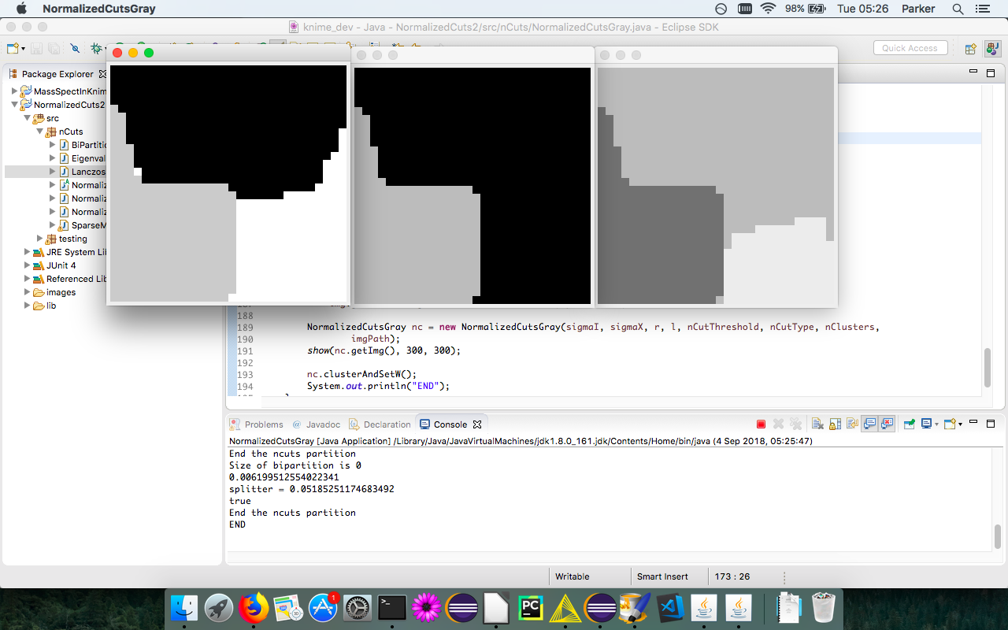
Normalized Cuts Images

Slide 19
Lanczos Algorithm Java Implementation
Normalized Cuts requires us to calculate the second smallest eigenvector of the weight matrix W.
- Suppose the image has width w, and height h, The weight matrix will be a (w*h)^2 by (w*h)^2 square matrix.
Hence, we cannot rely on the typical techniques to calculate the extreme eigenvector, so we use Lanczos, which approximates the extreme eigenvalues very well using iterative methods.

Slide 20
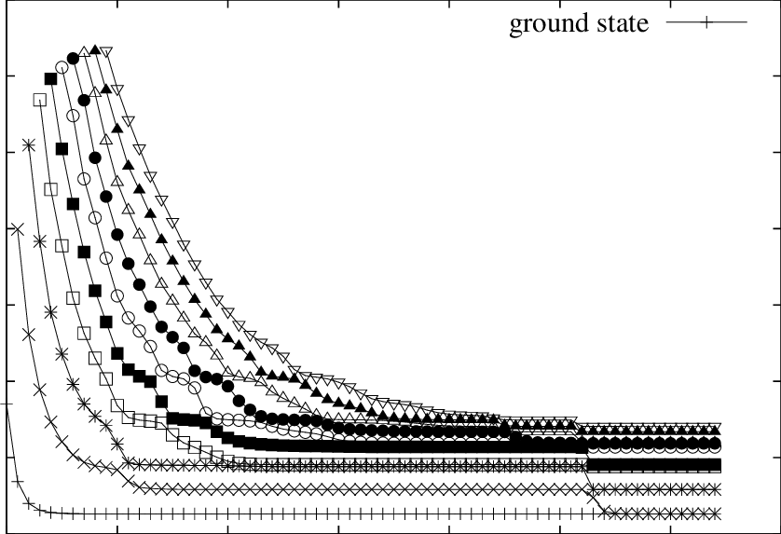
Lanczos Approximations
Iterations of Lanczos
Diagonalization- and Numerical Renormalization-Group-Based Methods for Interacting Quantum Systems
Eigenvalues

