Slide 1
PDO
1
Notes:
1

Slide 2
PDO
MYSQL
MYSQLI
PDO

Slide 3
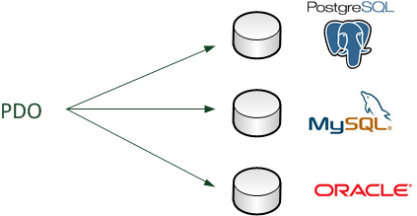
PDO

Slide 4
PDO
Extensions
PHP.INI
;extension=php_pdo_firebird.dll
;extension=php_pdo_mssql.dll
extension=php_pdo_mysql.dll
;extension=php_pdo_oci.dll
;extension=php_pdo_odbc.dll
Ajouter : display_errors = On

Slide 5
PDO
<?php
// Sous WAMP (Windows)
$bdd = new PDO('mysql:host=localhost;dbname=test;charset=utf8', 'root', '');
// Sous MAMP (Mac)
$bdd = new PDO('mysql:host=localhost;dbname=test;charset=utf8', 'root', 'root');
?>

Slide 6
PDO
EXCEPTIONS ERREURS
$pdo->setAttribute(PDO::ATTR_ERRMODE,
PDO::ERRMODE_EXCEPTION);
Try … catch(PDOException $e){ echo 'Mon erreur'.$e->getMessage().'<br>'; echo 'Mon n° ligne'.$e->getLine().'<br>'; echo 'Mon Fichier'.$e->getFile().'<br>'; echo 'Mon Code erreur'.$e->getCode().'<br>'; }

Slide 7
PDO
REQUETES PREPAREES
$stmt = $pdo->prepare($sql); $stmt->bindValue(':a', 1, PDO::PARAM_INT); $stmt->bindValue(':m', 'F50', PDO::PARAM_STR); $stmt->execute();
Constantes prédéfinies
$sql = "SELECT * FROM voiture WHERE id_voiture = :a AND modele=:m";

Slide 8
PDO
REQUETES PREPAREES
$sql = "SELECT * FROM voiture WHERE marque = ?
AND modele= ?"; $stmt = $pdo->prepare($sql); $marque='Porsche'; $modele='550'; $stmt->execute(array($marque,$modele));

Slide 9
PDO
LES TRANSACTIONS
$pdo->beginTransaction(); $sql = "INSERT INTO voiture (id_voiture,
marque, modele, couleur)
VALUES(Null,'renault', 'renault', 'red')"; $stmt=$pdo->exec($sql); // $pdo->rollback(); $pdo->commit();

