Slide 1
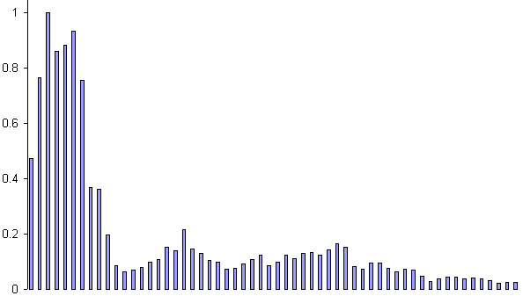
Example: Voice Recognition
Task: Learn to discriminate between two different voices saying “Hello”
Data
  Sources
    Gray Davis
    Arnold Schwarzenegger
  Format
    Frequency distribution (60 bins)
    Analogy: cochlea

Slide 2
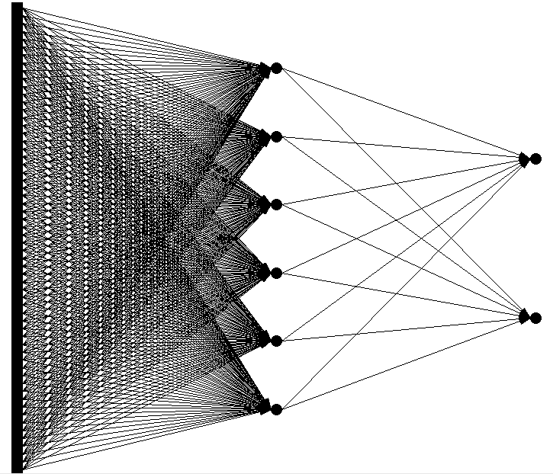
Network architecture
  Feed forward network
    60 input (one for each frequency bin)
    6 hidden
    2 output (0-1 for “Gray”, 1-0 for “Arnold”)

Slide 3
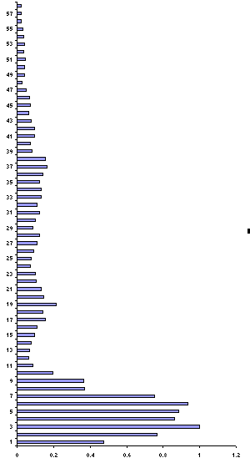
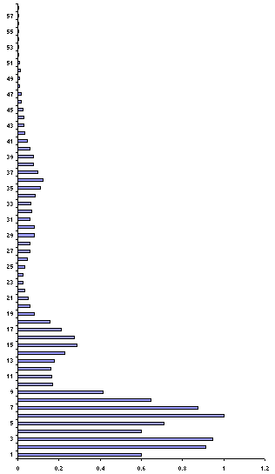
Presenting the data
Gray
Arnold

Slide 4
Presenting the data (untrained network)
Gray
0.43
0.26
Arnold
0.73
0.55

Slide 5
Calculate error
Gray
0.43 – 0 = 0.43
0.26 –1 = 0.74
Arnold
0.73 – 1 = 0.27
0.55 – 0 = 0.55

Slide 6
Back propagation error and adjust weights
Gray
0.43 – 0 = 0.43
0.26 – 1 = 0.74
1.17
Arnold
0.73 – 1 = 0.27
0.55 – 0 = 0.55
0.82

Slide 7
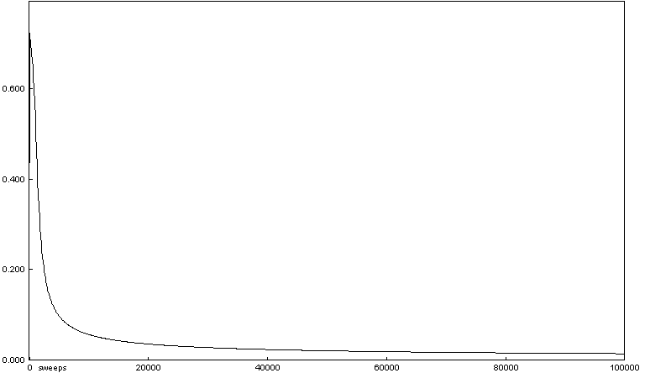
Repeat process (sweep) for all training pairs
  Present data
  Calculate error
  Back propagate error
  Adjust weights
Repeat process multiple times

Slide 8
Presenting the data (trained network)
Gray
0.01
0.99
Arnold
0.99
0.01

Slide 9
Results – Voice Recognition
  Performance of trained network
    Discrimination accuracy between known “Hello”s
      100%
    Discrimination accuracy between new “Hello”’s
      100%

