Slide 1
Chapter 11 Automatic Cluster Detection

Slide 2
Data Mining Techniques So Far…
Chapter 5 – Statistics
Chapter 6 – Decision Trees
Chapter 7 – Neural Networks
Chapter 8 – Nearest Neighbor Approaches: Memory-Based Reasoning and Collaborative Filtering
Chapter 9 – Market Basket Analysis & Association Rules
Chapter 10 – Link Analysis

Slide 3
Automatic Cluster Detection
DM techniques used to find patterns in data
Not always easy to identify
No observable pattern
Too many patterns
Decomposition (break down into smaller pieces)
Automatic Cluster Detection is useful to find “better behaved” clusters of data within a larger dataset; seeing the forest without getting lost in the trees

Slide 4
Automatic Cluster Detection
K-Means clustering algorithm – similar to nearest neighbor techniques (memory-based-reasoning and collaborative filtering) – depends on a geometric interpretation of the data
Other automatic cluster detection (ACD) algorithms include:
Gaussian mixture models
Agglomerative clustering
Divisive clustering
Self-organizing maps (SOM) – Ch. 7 – Neural Nets
ACD is a tool used primarily for undirected data mining
No preclassified training data set
No distinction between independent and dependent variables
When used for directed data mining
Marketing clusters referred to as “segments”
Customer segmentation is a popular application of clustering
ACD rarely used in isolation – other methods follow up

Slide 5
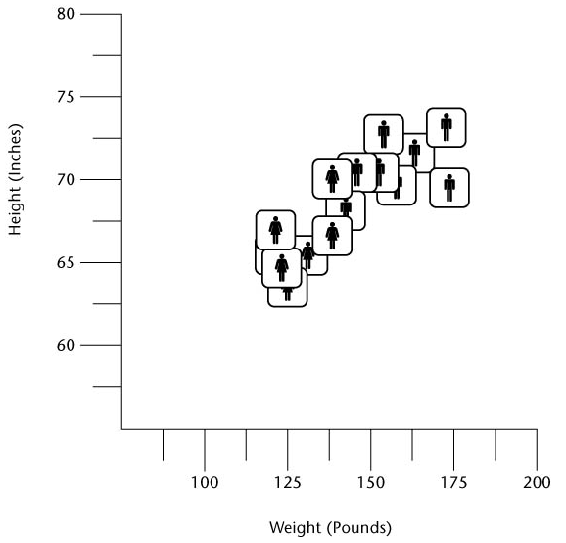
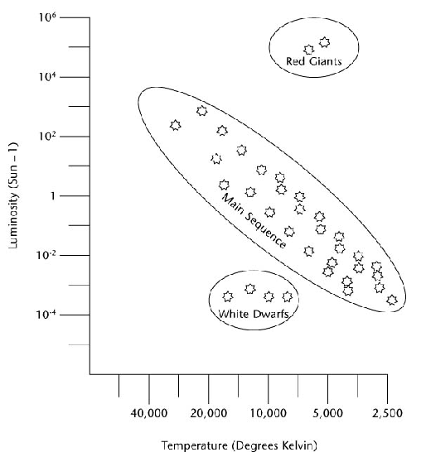
Clustering Examples
“Star Power” ~ 1910 Hertzsprung-Russell
Group of Teens
1990’s US Army – women’s uniforms:
100 measurements for each of 3,000 women
Using K-means algorithm reduced to a handful

Slide 6
K-means Clustering
“K” – circa 1967 – this algorithm looks for a fixed number of clusters which are defined in terms of proximity of data points to each other
How K-means works (see next slide figures):
Algorithm selects K (3 in figure 11.3) data points randomly
Assigns each of the remaining data points to one of K clusters (via perpendicular bisector)
Calculate the centroids of each cluster (uses averages in each cluster to do this)

Slide 7
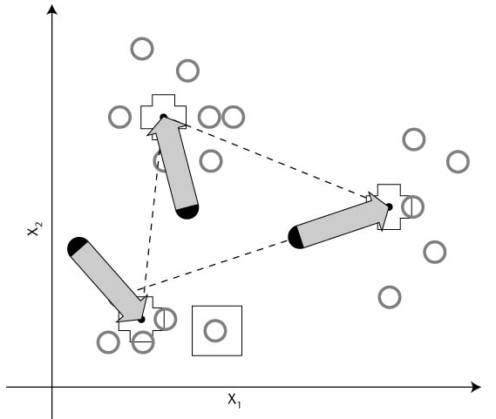
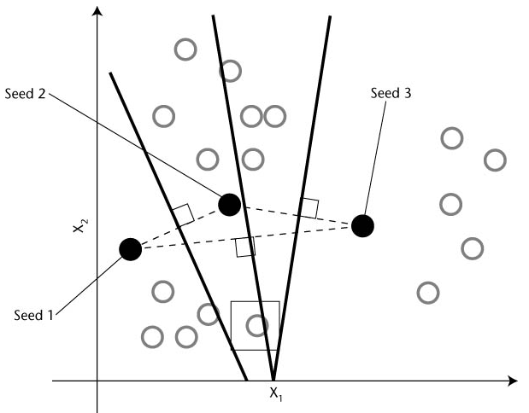
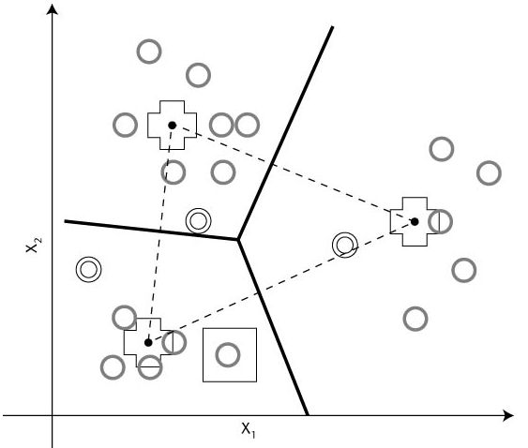
K-means Clustering

Slide 8

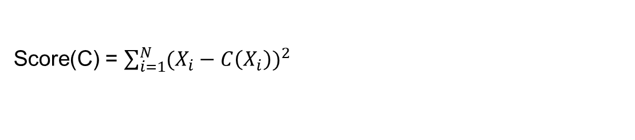
Function to be minimized

Slide 9
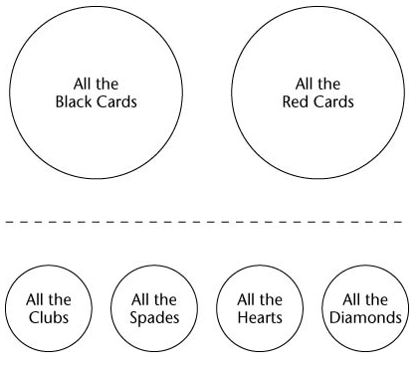
K-means Clustering
Resulting clusters describe underlying structure in the data, however, there is no one right description of that structure (Ex: Figure 11.6 – playing cards K=2, K=4)

Slide 10
K-means Clustering Demo
Clustering demo:
https://www.youtube.com/watch?v=BVFG7fd1H30

Slide 11
Similarity & Difference
Automatic Cluster Detection is quite simple for a software program to accomplish – data points, clusters mapped in space
However, business data points are not about points in space but about purchases, phone calls, airplane trips, car registrations, etc. which have no obvious connection to the dots in a cluster diagram

Slide 12
Similarity & Difference
Clustering business data requires some notion of natural association – records (data) in a given cluster are more similar to each other than to those in another cluster
For DM software, this concept of association must be translated into some sort of numeric measure of the degree of similarity
Most common translation is to translate data values (eg., gender, age, product, etc.) into numeric values so can be treated as points in space
If two points are close in geometric sense then they represent similar data in the database

Slide 13
Similarity & Difference
Business variable (fields) types:
Categorical (eg., mint, cherry, chocolate)
Ranks (eg., freshman, soph, etc. or valedictorian, salutatorian)
Intervals (eg., 56 degrees, 72 degrees, etc)
True measures – interval variables that measure from a meaningful zero point
Fahrenheit, Celsius not good examples
Age, weight, height, length, tenure are good
Geometric standpoint the above variable types go from least effective to most effective (top to bottom)
Finally, there are dozens/hundreds of published techniques for measuring the similarity of two data records

Slide 14
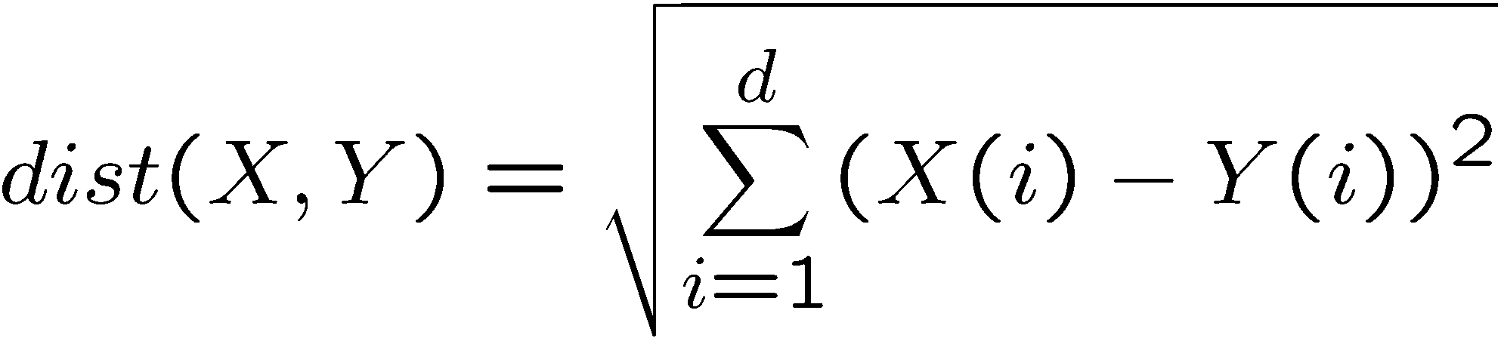
Distance Measure
Distance(X,Y) = 0 IFF X=Y
Distance(X,Y) >= 0 for all X & Y
Distance(X,Y) = Distance(Y,X)
Distance(X,Y) <= Distance(X,Z) + Distance(Z,Y)

Slide 15
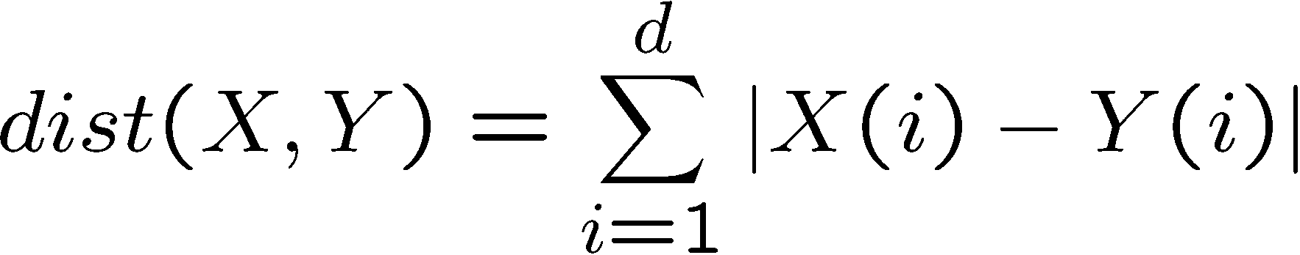
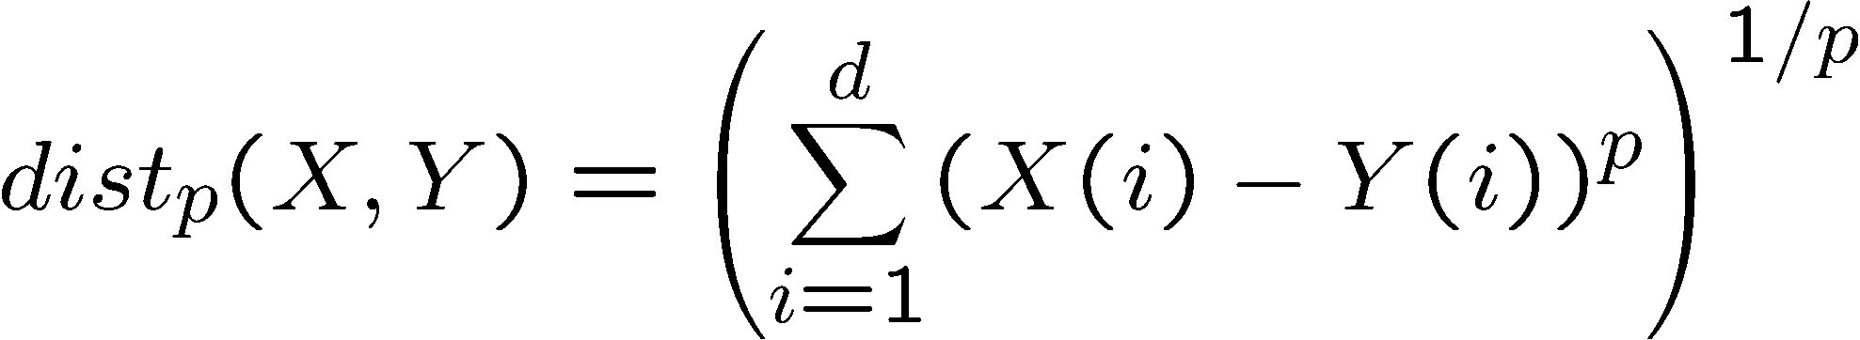
Other Distances
Manhattan distance
General Distance
Notes:
P = 1
P = 2
P = infinity
P = 0 how many are different.

Slide 16
X(100,2) Y(90,1)
L1 = 10+1 =11
L2 = 10**2 + 1**2 = 101 sqrt(101)=10.2
L3 = 10**3 + 1**3 =1001 1001^(1/3) = 10.001
L0 (X(i)-Y(i))**0 1 X(i)==Y(i) 0
L0(X,Y) ?
Number

Slide 17
Linf = Max(|X(i)-Y(i)|)
D(C) = sum(|Xj(i) – C|)
1 2 1 1 3 4 1 7
D(7) = 7 D(1) = 4 mode

Slide 18
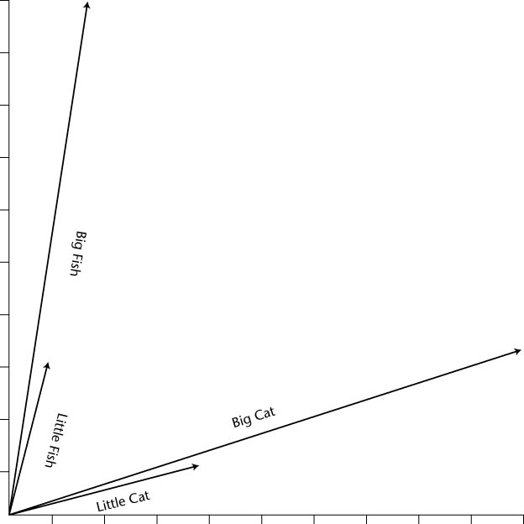
Other Distances
Angle between two Vectors
Compare cat to tiger
All values scaled.

Slide 19
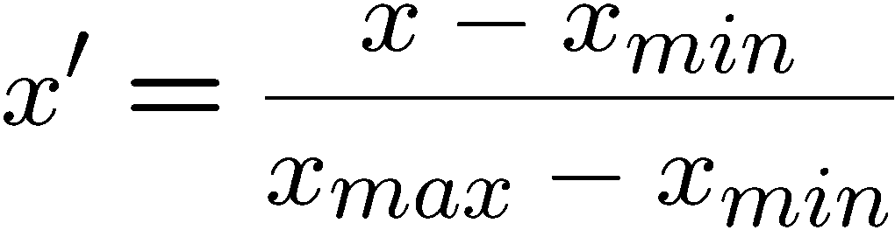
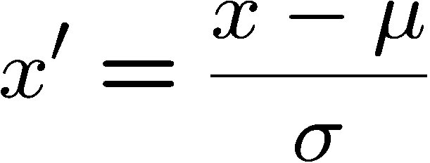
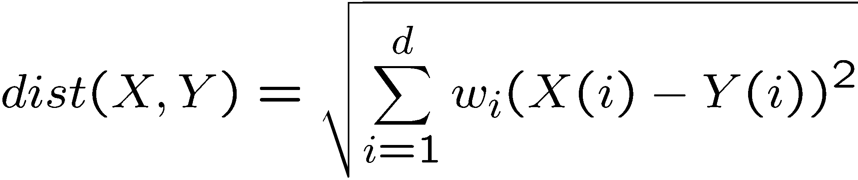
Scaling & Weighting
Scaling
weighting

Slide 20
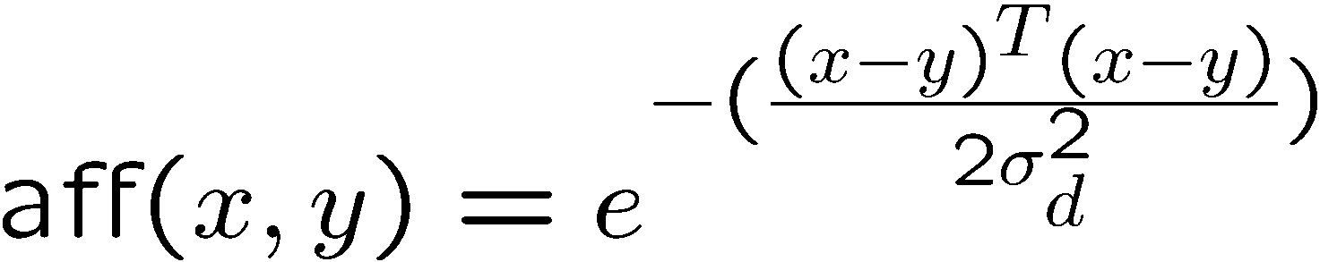
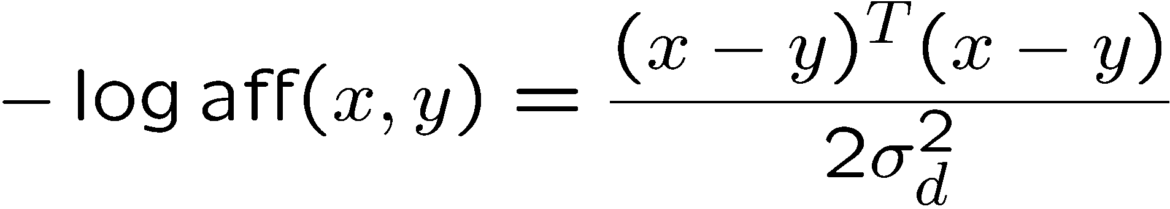
Why Least Squares?
The basis is from the Gaussian distribution
Notes:
T-מסמל וקטור אופקי(על מנת להכפיל 2 וקטורים ולא לקבל מטריצה, צריך שאחד יהיה אנכי ואחד אופקי)
X,Y הם וקטורים כל אחד, כל אחד של תכונה אחרת של התצפית

Slide 21
Other Approaches to Cluster Detection
Gaussian Mixture Models
Agglomerative Clustering
Divisive Clustering
Self-Organizing Maps (SOM)

Slide 22
Gaussian Mixture Models(GMM)
Soft clustering
Each point belongs to each cluster with a certain probability according to its distance from the cluster center.
This point therefore is used for computing all the cluster centers weighted by their weights
Ellipsoid shaped clusters
Besides computing the center of the cluster also estimate its shape.

Slide 23
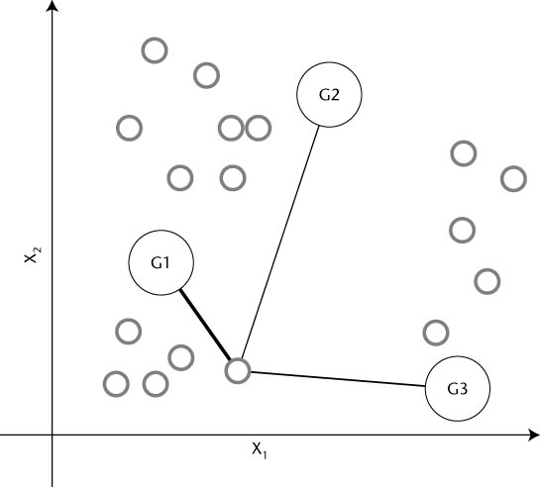
Gaussian Mixture Models (GMM)
Notes:
כל נקודה שייכת לקלאסטר בהסתברות שונה
ניתן לראות כי יש הסתברות גבוהה יותר להיות בG1 והרבה יותר נמוכה לאחרים

Slide 24
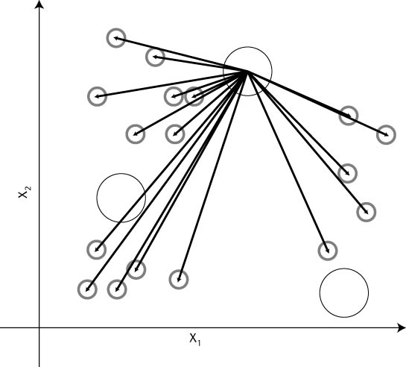
GMM

Slide 25

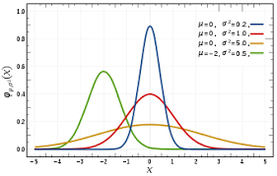
Derivation in 1D
Normal (Gaussian) Distribution
Notes:
אם נסתכל על הערך 4, ההסתברות להיות בקלאס הצהוב היא הכי גבוהה והשאר נמוכים
כך נקבל וקטור של הסתברויות עבור כל נקודה לאיזה קלאסטר היא שייכת.

Slide 26

Derivation in 1D
Estimate µ and $σ^{2}$ from $x_{1}…x_{N}$
$μ=\sum_{i=1}^{N}{x_{i}/N}$
$σ^{2}=(\sum_{i=1}^{N}{{\left(x_{i}− μ\right)}^{2})/(N−1)}$

Slide 27
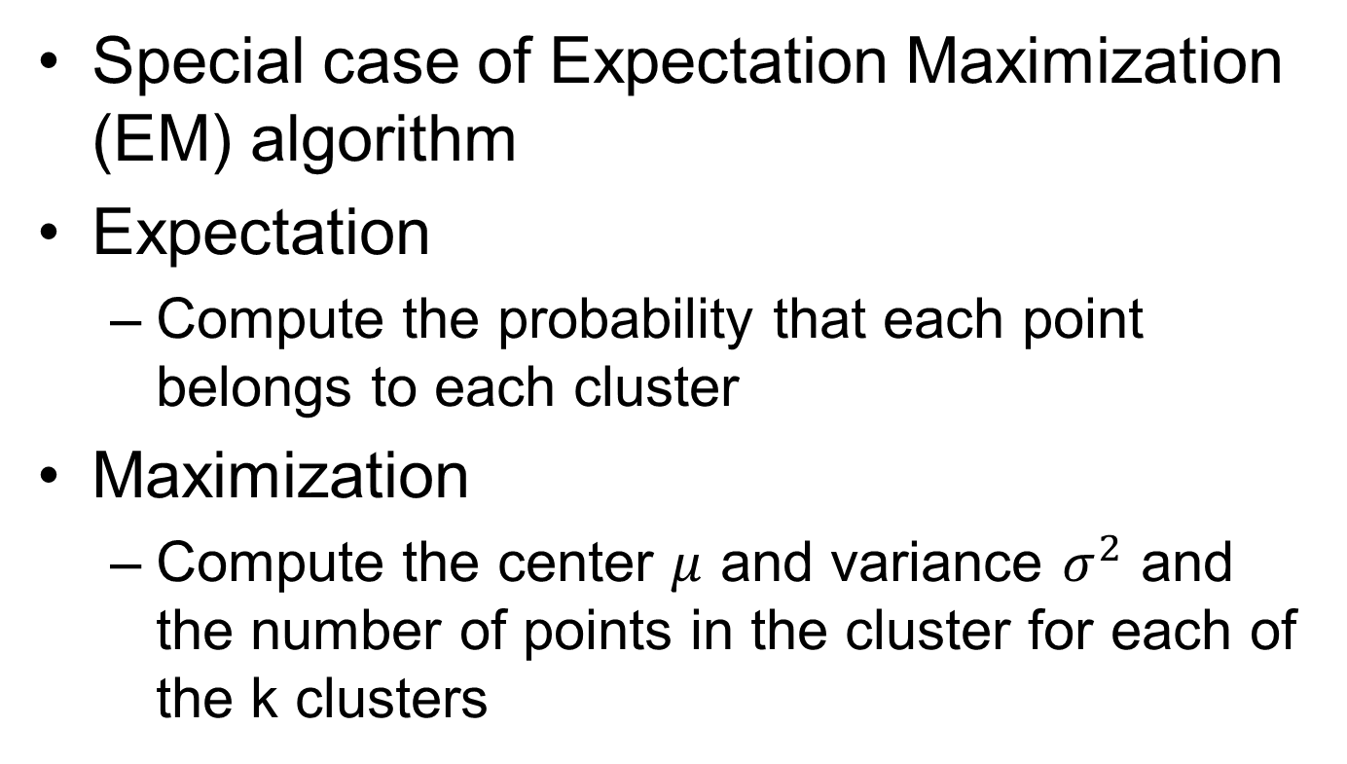
GMM
Special case of Expectation Maximization (EM) algorithm
Expectation
Compute the probability that each point belongs to each cluster
Maximization
Compute the center $μ$ and variance $σ^{2}$ and the number of points in the cluster for each of the k clusters
Notes:
maximization-לחשב את מרכזי הקלאסטרים מחדש, כך שיתאים יותר לנקודות
מרכז הקלאסטר- הממוצע של ערכי הנקודות שלו

Slide 28

K means
Variance is the same for all clusters
Expectation
Compute the probability that each point belongs to each cluster.
Choose the cluster with maximal probability which actually means the closest cluster.

Slide 29

K means
Maximization
Compute the center $μ$ for each of the k clusters
$μ_{k}=\frac{\sum_{i=1}^{N_{k}}{x_{i} }}{N_{k}}$

Slide 30
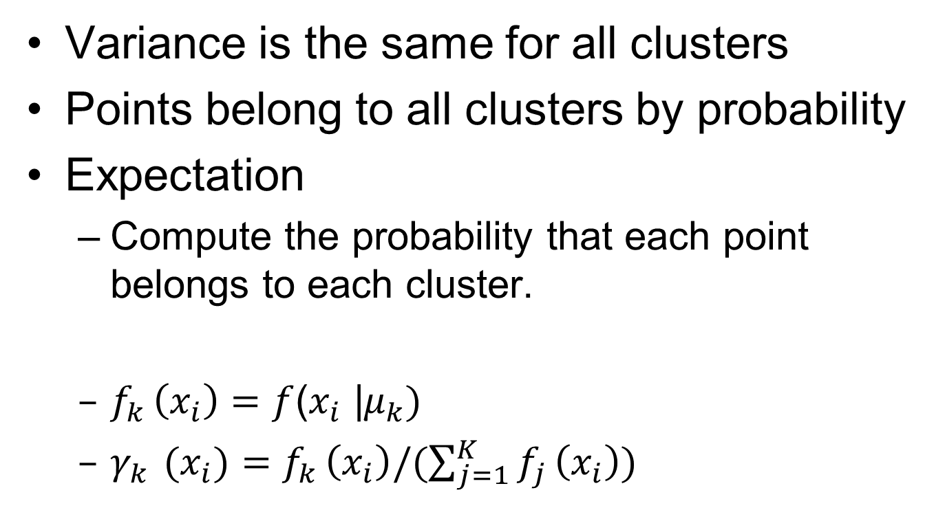
Soft K means
Variance is the same for all clusters
Points belong to all clusters by probability
Expectation
Compute the probability that each point belongs to each cluster.
$f_{k }\left(x_{i}\right)=f$($x_{i}$ |$μ_{k})$
$γ_{k }(x_{i})=f_{k }\left(x_{i}\right)/(\sum_{j=1}^{K}{f_{j }\left(x_{i}\right))}$

Slide 31
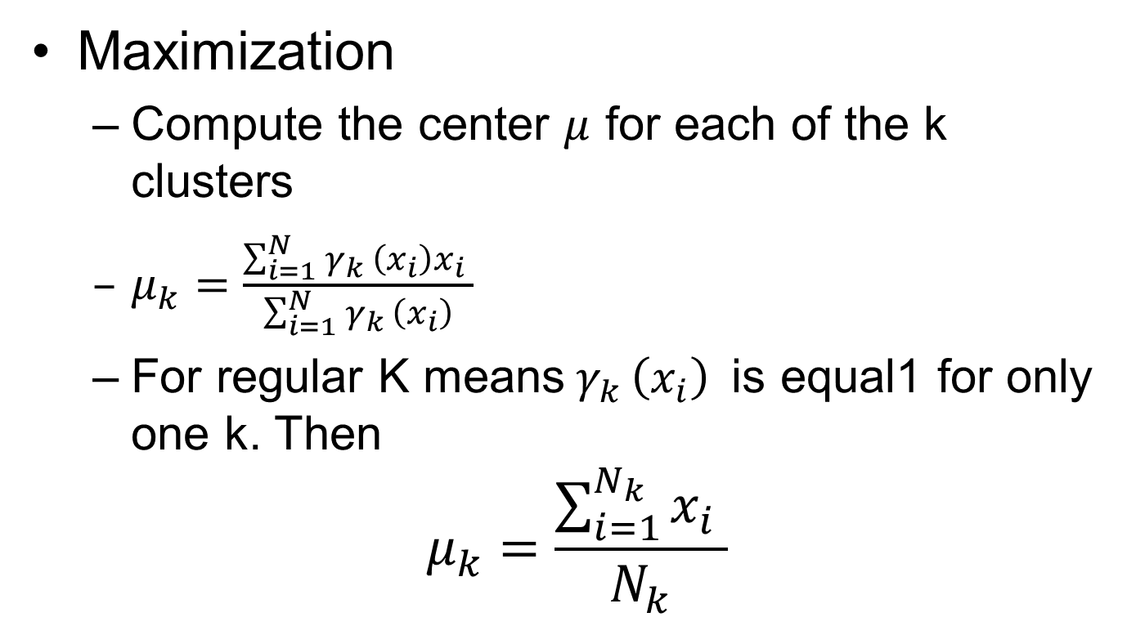
Soft K means
Maximization
Compute the center $μ$ for each of the k clusters
$μ_{k}=\frac{\sum_{i=1}^{N}{γ_{k }\left(x_{i}\right)x_{i} }}{\sum_{i=1}^{N}{γ_{k }\left(x_{i}\right)}}$
For regular K means${ γ}_{k }\left(x_{i}\right)$is equal1 for only one k. Then
$$μ_{k}=\frac{\sum_{i=1}^{N_{k}}{x_{i} }}{N_{k}}$$

Slide 32
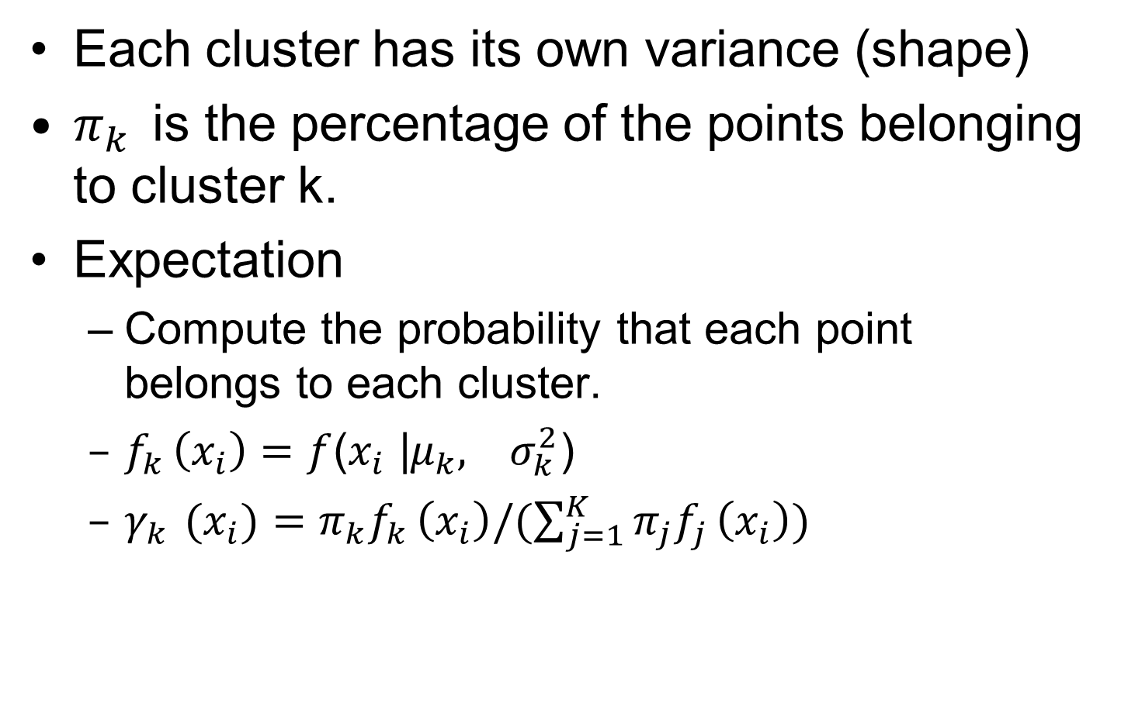
Full GMM
Each cluster has its own variance (shape)
$π_{k}$is the percentage of the points belonging to cluster k.
Expectation
Compute the probability that each point belongs to each cluster.
$f_{k }\left(x_{i}\right)=f$($x_{i}$ |$μ_{k}, σ_{k}^{2}$)
$γ_{k }(x_{i})={π_{k}f}_{k }\left(x_{i}\right)/(\sum_{j=1}^{K}{{π_{j}f}_{j }\left(x_{i}\right))}$

Slide 33
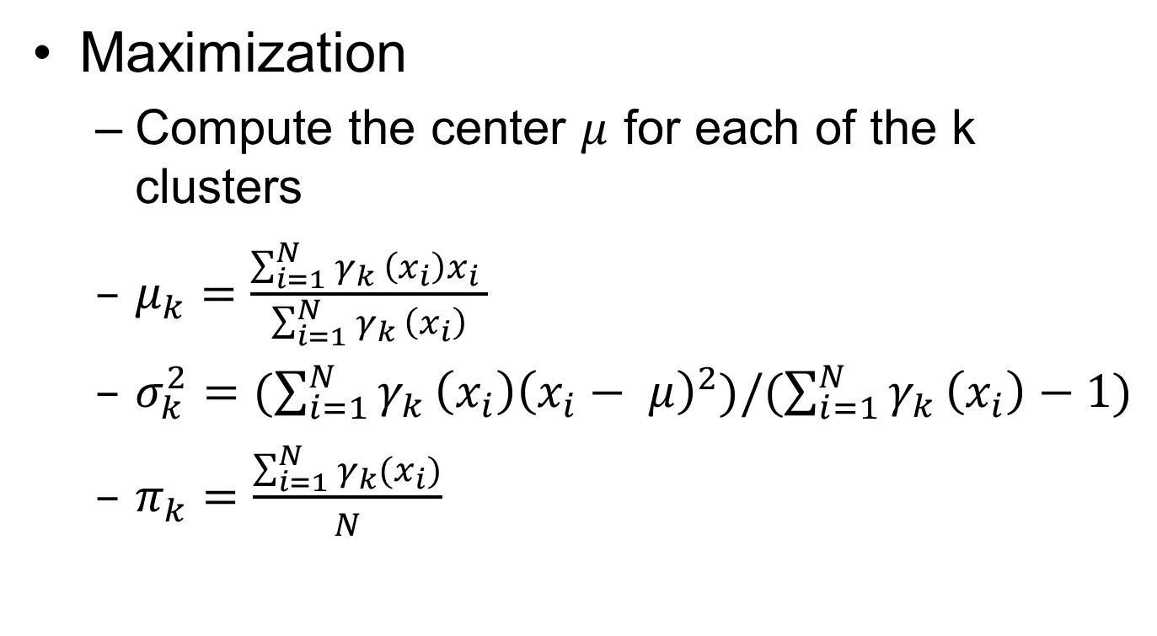
Full GMM
Maximization
Compute the center $μ$ for each of the k clusters
$μ_{k}=\frac{\sum_{i=1}^{N}{γ_{k }\left(x_{i}\right)x_{i} }}{\sum_{i=1}^{N}{γ_{k }\left(x_{i}\right)}}$
$σ_{k}^{2}=(\sum_{i=1}^{N}{{γ_{k }\left(x_{i}\right)\left(x_{i}− μ\right)}^{2})/(\sum_{i=1}^{N}{γ_{k }\left(x_{i}\right)}−1)}$
$π_{k}=\frac{\sum_{i=1}^{N}{γ_{k}(x_{i})}}{N}$

Slide 34
General Full GMM
Notes:
דוגמאות לצורות פיזור של קלאסטרים
K means עושה רק קלאסטרים בצורת עיגולים, GMM יכול ליצור גם צורות אחרות, ולכן יכול לאפשר רמת דיוק גבוהה יותר של חלוקה לקלאסטרים
התפלגות נורמלית רב ממדית היא מכפלה של התפלגויות נורמליות חד ממדיות, כל כיוון בערכי הסטייה שלו

Slide 35
Agglomerative Clustering
From small clusters to big clusters through merging “close” clusters
Stop when you are left with K clusters

Slide 36
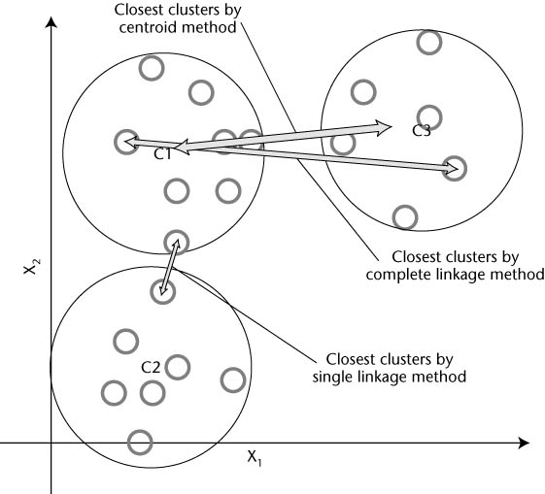
Agglomerative Clustering

Slide 37
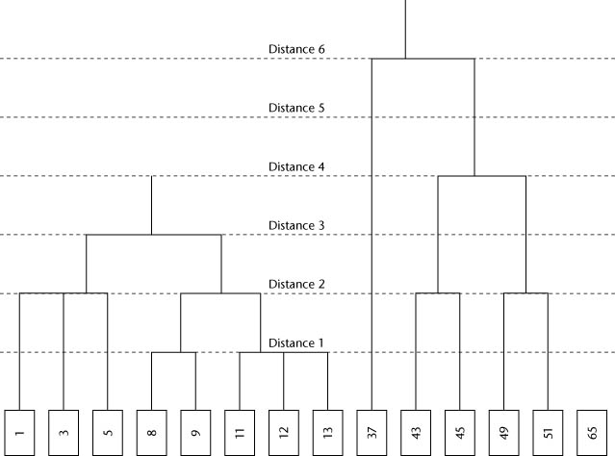
Agglomerative Clustering

Slide 38
Divisive Clustering
Based on Graph-theoretic ideas
Each point is a vertex
Each undirected edge gives the closeness of two points, the more similar the larger

Slide 39
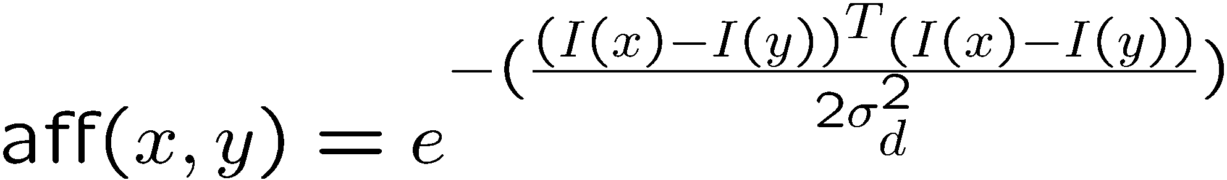
Affinity
Affinity by distance
Affinity by Intensity

Slide 40
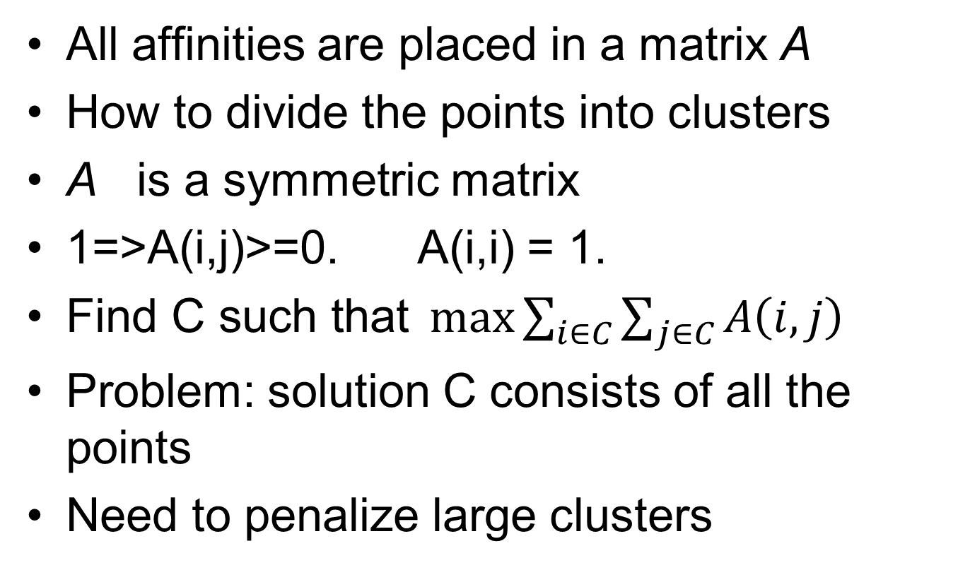
Affinity Matrix
Notes:
Max sum( A(I,j)) such that I,j in C
Solution all points belong to C.
To make smaller divide by 1/C^2.
Solution only one point belongs to the cluster.
Write as w A w / |w|^alpha. W(i) = {0,1}.
1/C^alpha. 0 < alpha < 2.
All values of alpha could be good. Choose alpha=1.
Problem discrete problem exponential.
Move to continuous.
W(i) = {0,1/sqrt(|c|)}

Slide 41
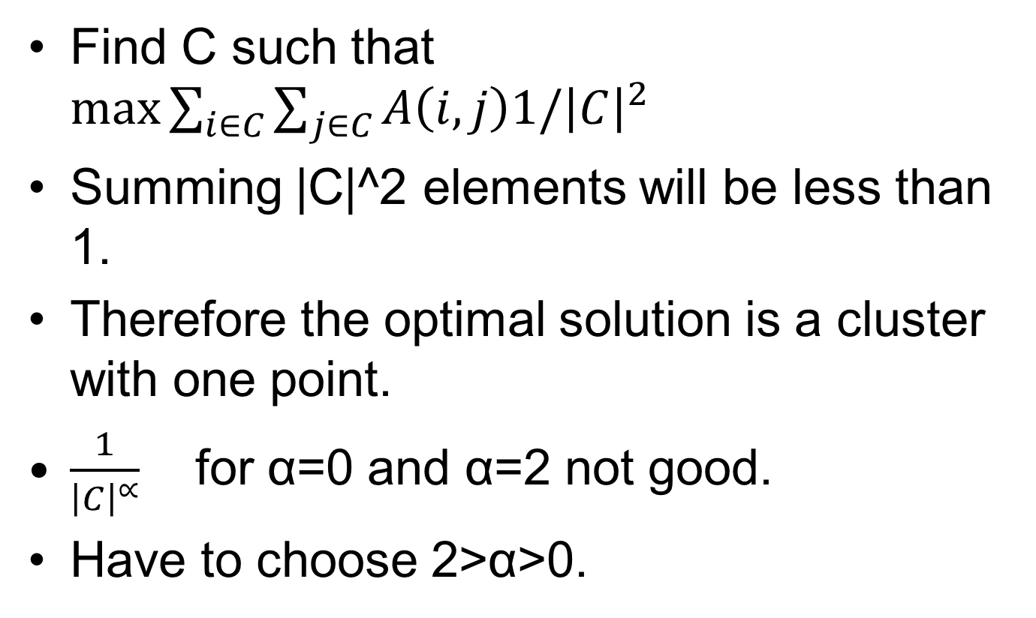
Affinity Matrix

Slide 42
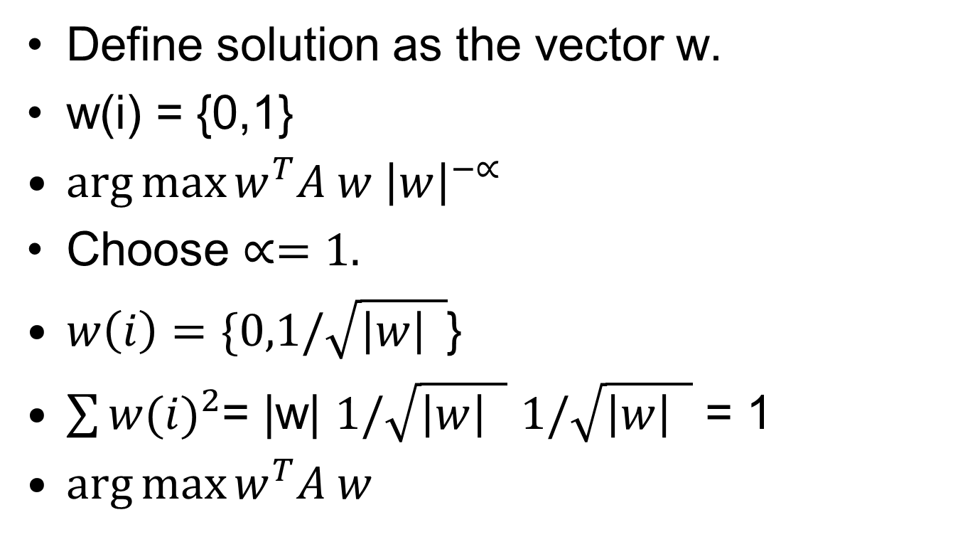
Affinity Matrix

Slide 43
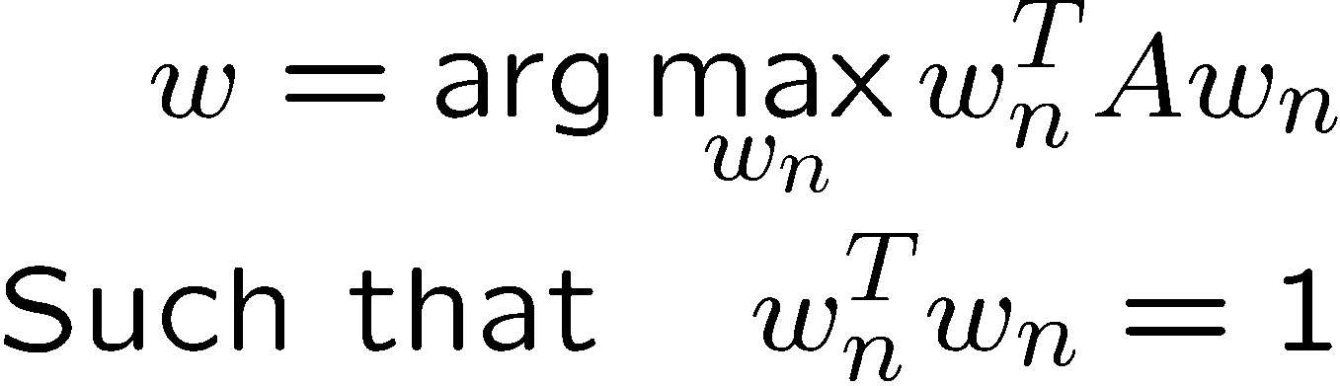
Affinity Matrix
Move to continuous
w(i) can be any number.
Solution:
W is the eigenvector which corresponds to the maximal
eigenvalue
Notes:
Max sum( A(I,j)) such that I,j in C
Solution all points belong to C.
To make smaller divide by 1/C^2.
Solution only one point belongs to the cluster.
Write as w A w / |w|^alpha. W(i) = {0,1}.
1/C^alpha. 0 < alpha < 2.
All values of alpha could be good. Choose alpha=1.
Problem discrete problem exponential.
Move to continuous.
W(i) = {0,1/sqrt(|c|)}

Slide 45
Multi-cluster problem
Find w.
Take all points with high values in w.
Remove them from the matrix (zero them)
Repeat.
What do you mean by high values in w?
Test all cutting values and see which one maximizes the discrete version of the problem.

Slide 46
How to cut?

Slide 47
How to cut?

Slide 48
Min Cut

Slide 49
Min Cut
W(b,b)=1
W(r,r) = 1
W(r,b)=0.25

Slide 50
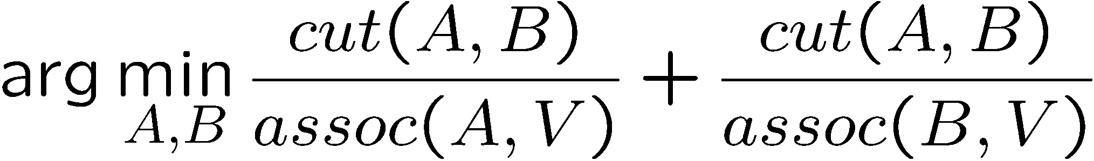
Normalized Cuts
Divide matrix into two clusters A and B
cut(A,B) = the sum of the edges between
A and B
Assoc(A,V) = the sum of the edges with one
vertex in A

Slide 51
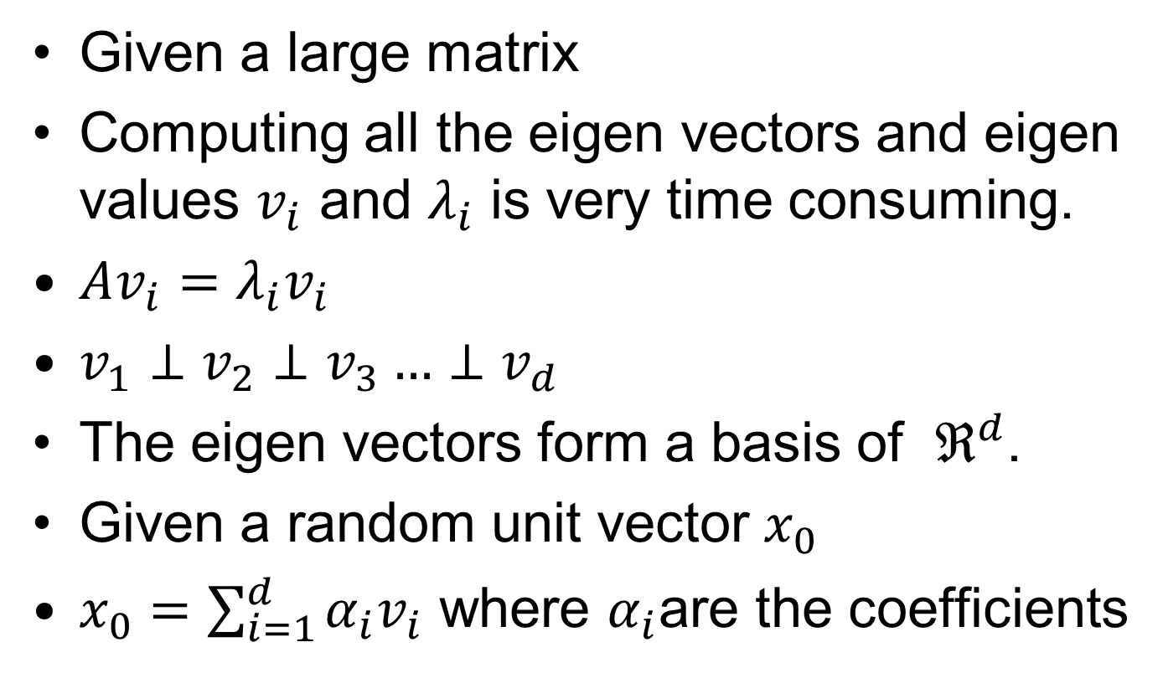
Finding the first Eigen Vector
Given a large matrix
Computing all the eigen vectors and eigen values $v_{i}$ and $λ_{i}$ is very time consuming.
$Av_{i}=λ_{i}v_{i}$
$v_{1}⊥v_{2}⊥v_{3}…⊥v_{d}$
The eigen vectors form a basis of $ℜ^{d}$.
Given a random unit vector $x_{0}$
$x_{0}=\sum_{i=1}^{d}{α_{i}v_{i}}$ where $α_{i}$are the coefficients

Slide 52
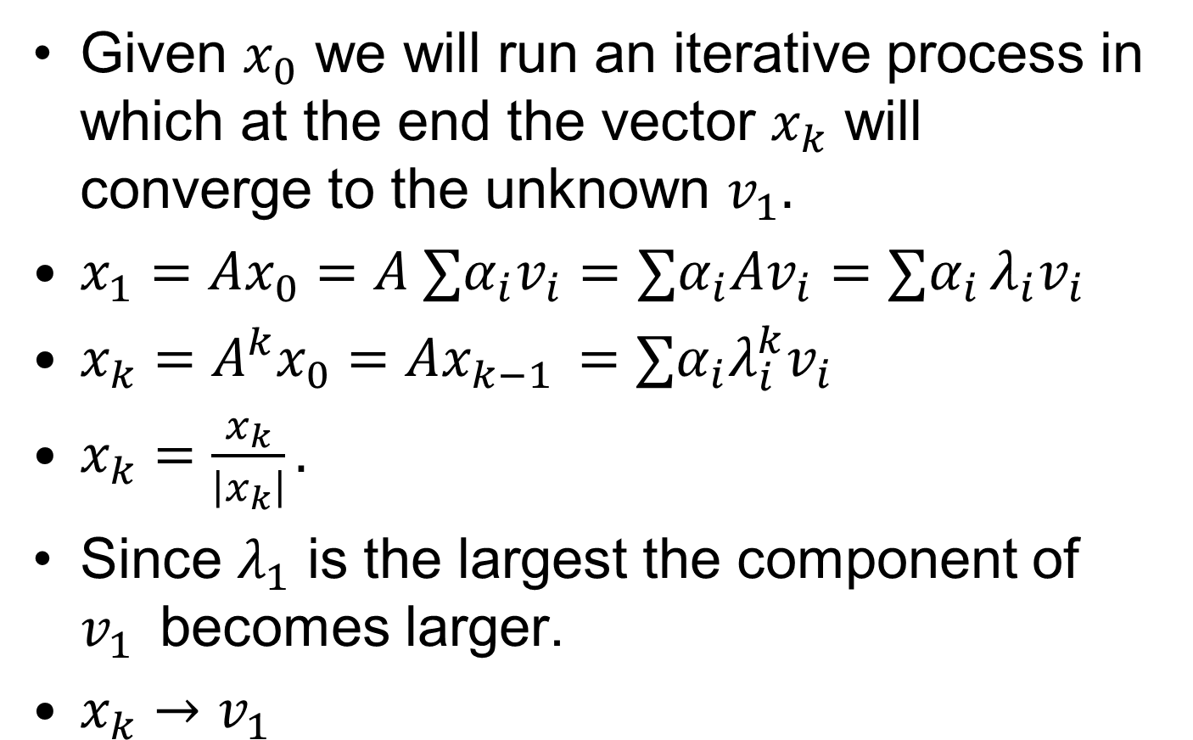
The Power Method
Given $x_{0}$ we will run an iterative process in which at the end the vector $x_{k}$ will converge to the unknown $v_{1}.$
$x_{1}=Ax_{0}=A ∑α_{i}v_{i}=∑α_{i}Av_{i}=∑α_{i }λ_{i}v_{i}$
$x_{k}=A^{k}x_{0}=Ax_{k−1 }={∑α}_{i}λ_{i}^{k}v_{i}$
$x_{k}=\frac{x_{k}}{\left|x_{k}\right|}.$
Since $λ_{1}$ is the largest the component of $v_{1}$becomes larger.
$x_{k}→v_{1}$

Slide 53
Evaluating Clusters
What does it mean to say that a cluster is “good”?
Clusters should have members that have a high degree of similarity
Standard way to measure within-cluster similarity is variance* – clusters with lowest variance is considered best
Cluster size is also important so alternate approach is to use average variance**
* The sum of the squared differences of each element from the mean
** The total variance divided by the size of the cluster
Notes:
Compare variance inside clusters vs outside clusters.

Slide 54
Evaluating Clusters
Finally, if detection identifies good clusters along with weak ones it could be useful to set the good ones aside (for further study) and run the analysis again to see if improved clusters are revealed from only the weaker ones

Slide 55
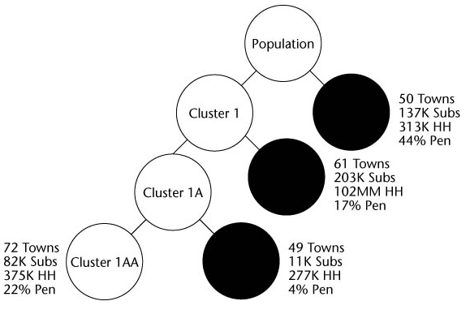
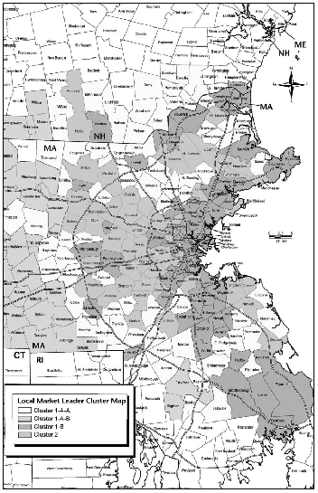
Case Study: Clustering Towns
Review using book, pp 374-379
“Best” based on delivery penetration
“2nd Best” based on delivery penetration
Cluster 2
Cluster 1B
Cluster 1AB

Slide 56
End of Chapter 11

