Slide 1
KNN & ANN

Slide 2
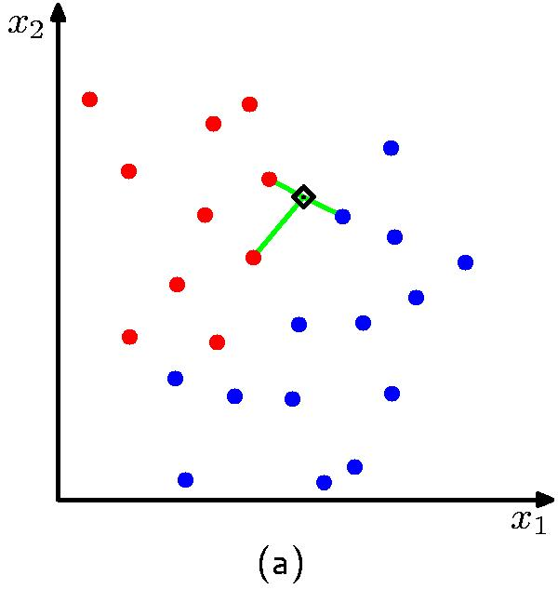
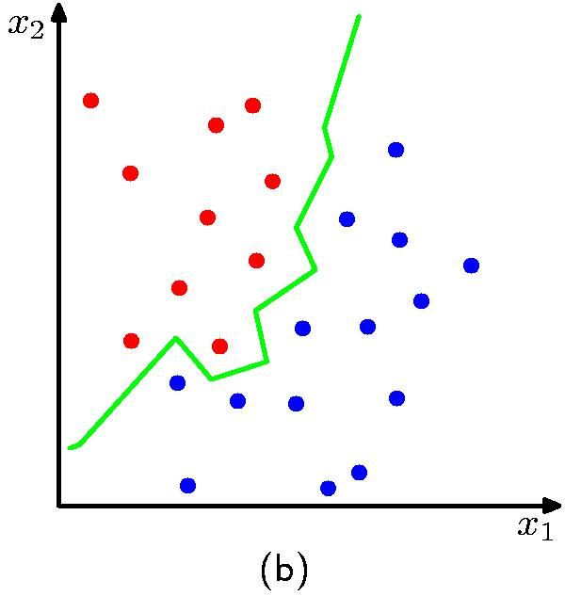
Nearest-Neighbours for Classification
K = 3
K = 1

Slide 3
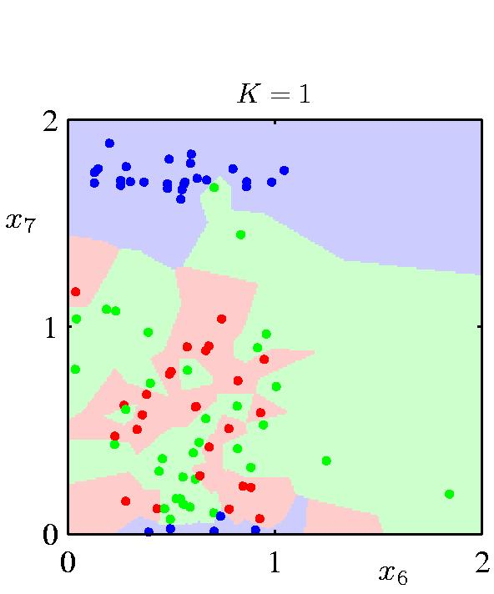
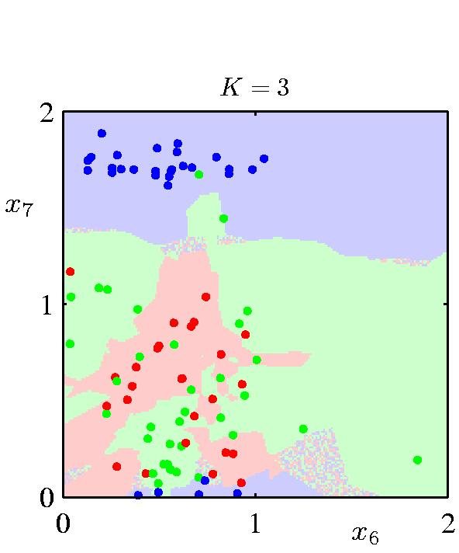
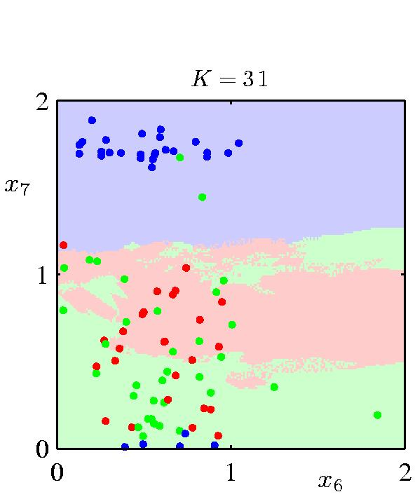

Nearest-Neighbours for Classification
K acts as a smother
For , the error rate of the 1-nearest-neighbour classifier is never more than twice the optimal error (obtained from the true conditional class distributions).

Slide 4
Leave One Out Verification
For all labelled points
Train model from the other N-1 points
Classify the point
Compare to ground truth
Want to verify a KNN algorithm
For all points in the dataset
Find K+1 NN
Compare class of point with classification performed on the other K points.
No need to train a model for each N-1 point sets

Slide 5
Approximate Nearest Neighbor
Given N points of dimension D
What is the time and space complexity for running a test query?
This is very high
NN queries are very useful in many applications not only ML.
Approximate Nearest Neighbor algorithms can not guarantee the correct answer but a close one.
Is that a problem?

Slide 6
KD Tree
function kdtree (list of points pointList, int depth) {
// Select axis based on depth so that axis cycles through all valid values
var int axis := depth mod k;
// Sort point list and choose median as pivot element
select median by axis from pointList;
// Create node and construct subtree
node.location := median;
node.leftChild := kdtree(points in pointList before median, depth+1);
node.rightChild := kdtree(points in pointList after median, depth+1);
return node;
}

Slide 8
Randomized KD Tree
Build several KD Trees randomly built.
Take the union of the results
Find the NN
Does this always work?

Slide 9
Locality Sensitive Hashing (LSH)
[Indyk, Motwani, 98], [Kushilevitz, Ostrovsky, Rabani 98], [Gionis, Indyk, Motwani, 99]
Build the data structure
Randomly choose K cuts (X(j) > cut)
Given a point X compute the K Boolean values of the cuts.
This is a key.
Save the point in a hash table in a list associated with the key.
Find the NN given a query q
Compute the key for q
Find the list associated with the key.
Find the nearest neighbor.
Does this work?

Slide 10
1
2
3
00011
4
11001
5

Slide 11
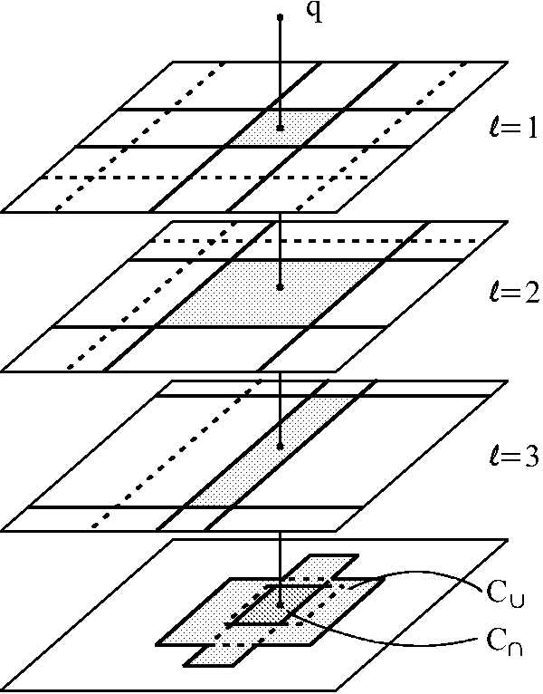
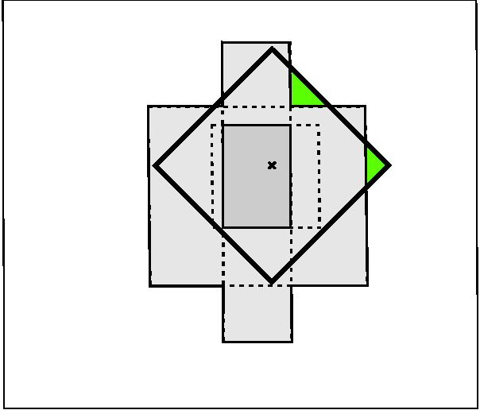
Locality Sensitive Hashing (LSH)
L random tessellations of the space by K random cuts each
a query returns the content of the L cells for a point q in sublinear time

Slide 12
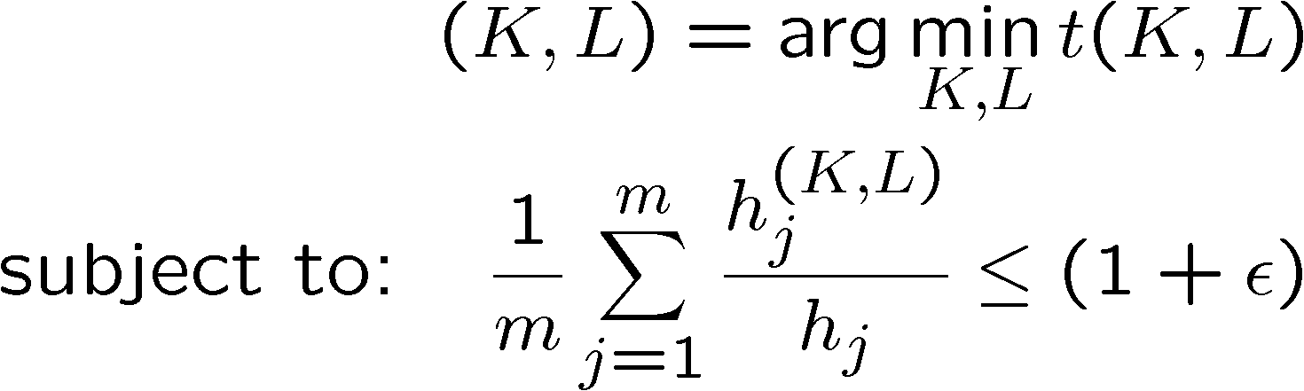
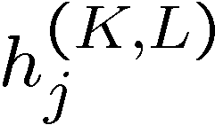

Complexity and Accuracy
RKDTREE $N_{0}$and L
LSH K L
$h_{j}$ is the real distance
the approximate distance

Slide 13


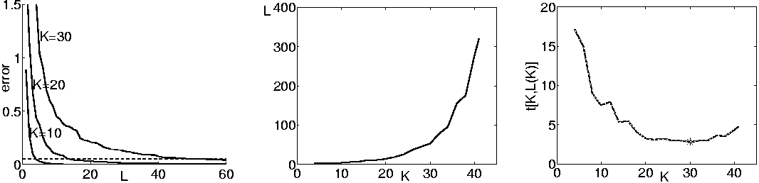
Choosing Optimal K and L
for each K estimate the error for
in one run for all L’s
find the minimal L satisfying the constraint L(K)
minimize the running time t(K,L(K)):
minimum
approximation
error for K,L
L(K) for ε=0.05
Running time
t[K,L(K)]

