Slide 1
Machine Learning
למידת מכונה
אילן שמשוני ודור דביר

Slide 2
Course topics
Data Warehouse
Data Mining

Slide 3
Data Warehouse
A large database used for analysis OLAP
Different from an OLTP application
Data transferred from regular DBs and an historic database is created
Aggregates are computed
The user can manipulate them using a GUI
Analysis results are fed back into the OLTP
Notes:
What is OLTP – data entry + triggers
What is OLAP – online analysis processing

Slide 4
Data Mining
Take data (e.g. from a data warehouse)
Apply data mining algorithm
  Classification Example
  Estimation
  Prediction
  Affinity grouping
  Clustering
  Description & profiling
Try to understand the result (optional)
Use it to solve a business problem
Notes:
Classification:
Ask for loan Determine faxes from regular phones. Fake insurance claims
Estimation:
Number of children in a family Household income Lifetime value of a customer Probability a customer will defect.
Prediction:
Which customers will leave in 6 months Will customer order a new phone feature.
Affinity grouping What people buy together. Symptoms of illnesses.
Clustering:
Divide customers into groups and do different things to different groups.
Profiling
What computer is working. E.g. google. & Ran.
More examples:
Nachum and his project software development DWH from version control.
The DM project of Iltam getting data from machines all over the globe. Producing reports.
Problem how to predict failures.

Slide 5
Why Now?
Data is being produced
Data is being warehoused
Computing is cheap
Interest in CRM
Everybody is service oriented
Information is a product
DM software available
Notes:
Example
013 Barak guy called me.
You card 15 items 50% off. How to choose them.

Slide 6
Requirements
עובדים בזוגות
תרגילים 50%
  תרגיל תכנות
  2 תרגילים ב python
בחינה 50%
Notes:
Algorithms easy and cool
Papers (e.g. how DW implemented)
Book on use of DM or DW in different fields
I will find but you can suggest
Tirgul is using BI tool of SQL Server
We will talk first about the CUBE

Slide 7
Related Courses
Basic
Business Intelligence (Tomer)
Artificial Intelligence (Einat)
Big Data (Tomer)
Machine Learning (Rita CS) very similar
Information Visualization (Joel)
Deep Learning seminar (me)

Slide 8
Related Courses
Specific
Information Retrieval (Tsvika)
Text Mining (Einat)
Process Mining (Pnina)
Medical Information Systems (Mor)
Analysis of social networks (Ossi)

Slide 9
Data Warehouse - Business
Convince the business that they need one
Find what questions need answered
Get sponsors
Estimate Return on Investment (ROI)
Design a small DWH first
Think about the long run
Notes:
Like building every IS.
You come to supersol and tell them they need a DW. What will they say?
Big project touches everything. Need help.
Ask the business people what they need.
Talk about it more later.

Slide 10
Why a Data Warehouse
Used for statistical analysis
Why not use the regular DB?
Notes:
Interferes
Lots of DB’s complicated
Not efficient

Slide 11
Data Warehouse – start
Choose a leader
Decide on hardware – scaleable
Decide on database, communication
Team
  A person from each OLTP project
  A DB person

Slide 12
DW - Design
Choose sources
Define DW DB
Define transformations from sources to DW
Data cleansing procedures
Data update procedures from sources
Data update procedures in DW
Aggregates computation

Slide 13
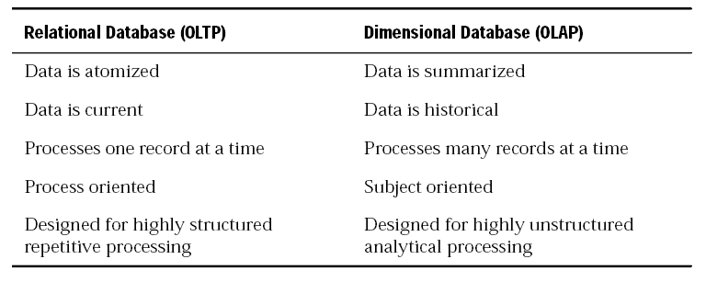
DW – DB structure

Slide 14
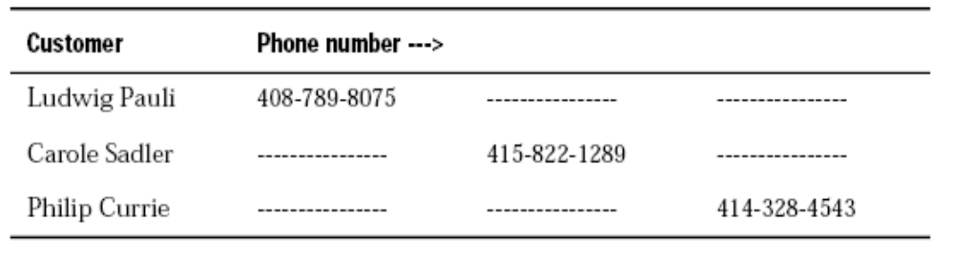
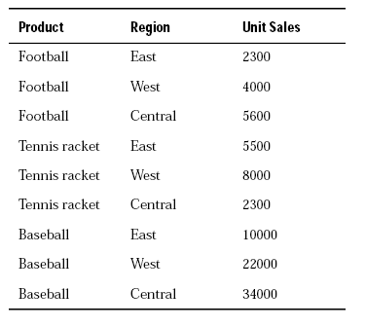
Notes:
1-1 דליל
צפוף
יש רצף

Slide 15
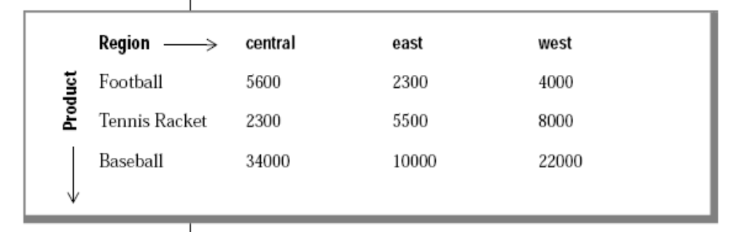
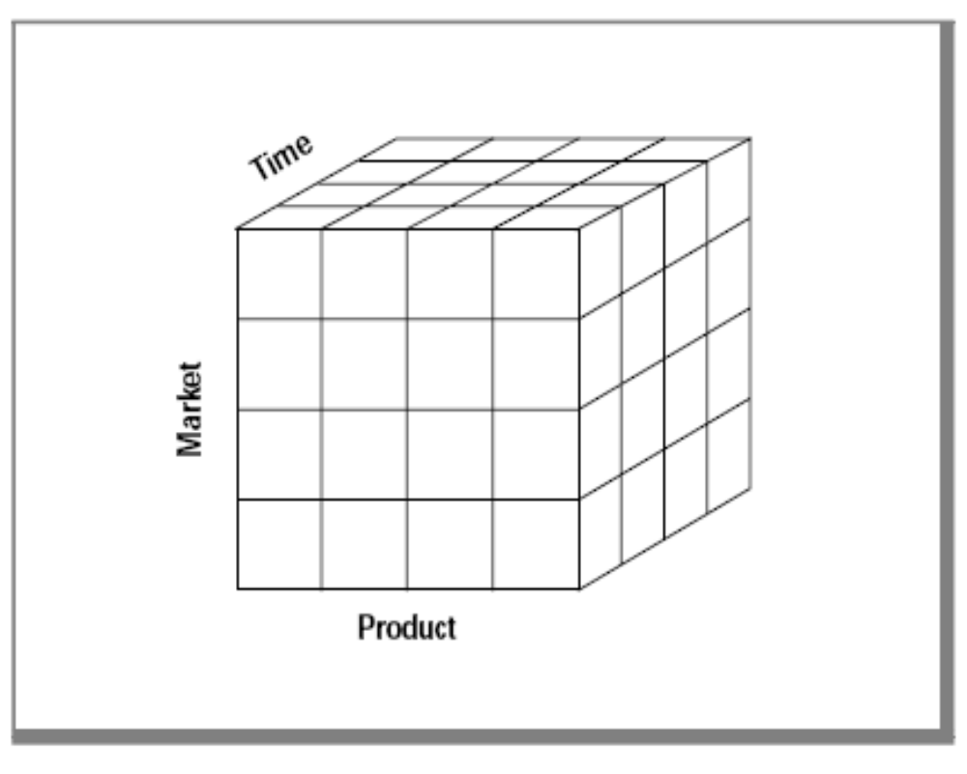
Notes:
Compute aggregates easily
What happens if matrix is דליל
ROLAP keep data in a regular table.
Market – where it is sold.

Slide 16
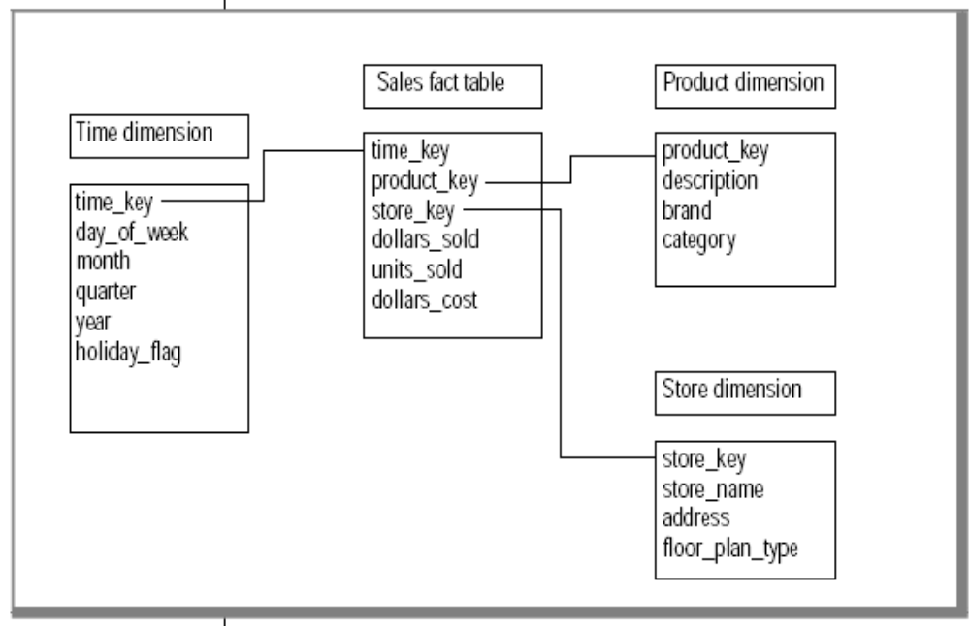
Star Schema
Notes:
Attributes have meanings. DWH is not for IS people its for regular people
Dimension tables, Fact table
Each dimension key is defined in the dimension table.
Keys are meaningless
Fact table has measurements.

Slide 17
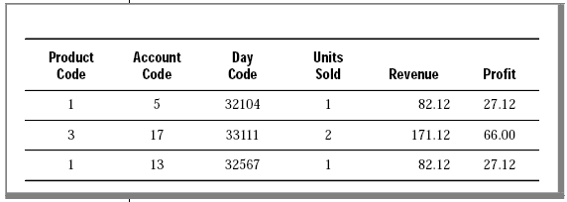
Fact Table

Slide 18
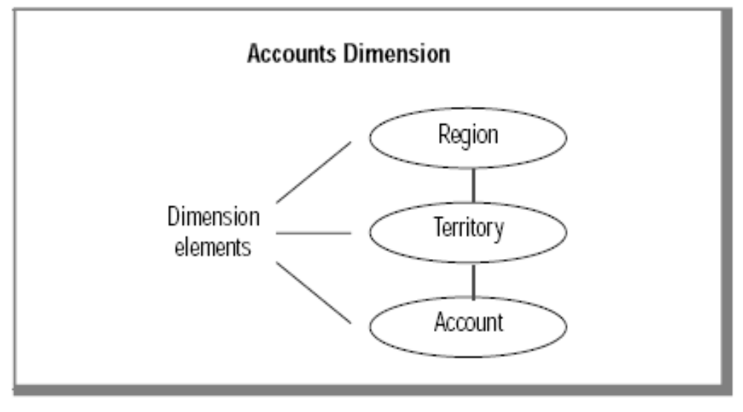
Dimension Elements

Slide 19
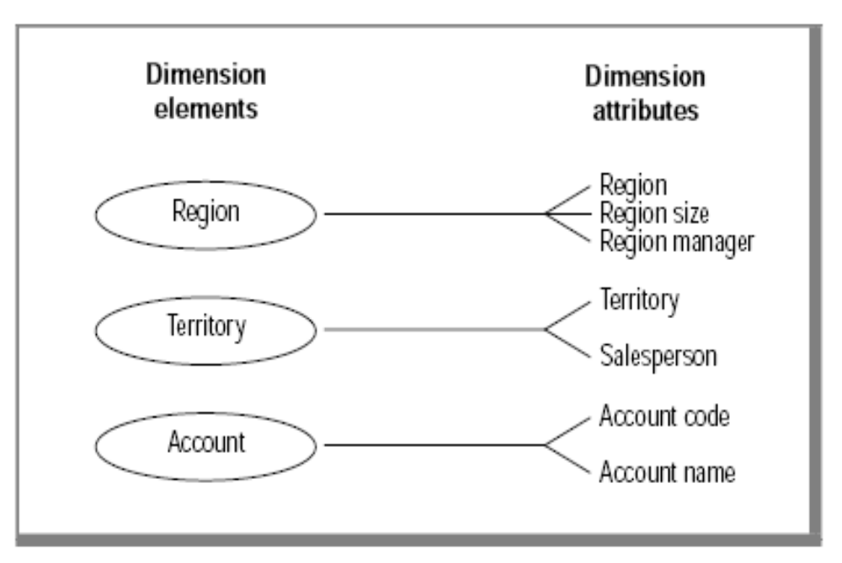
Dimension Attributes
Notes:
Hierarchy rollup drilldown

Slide 20
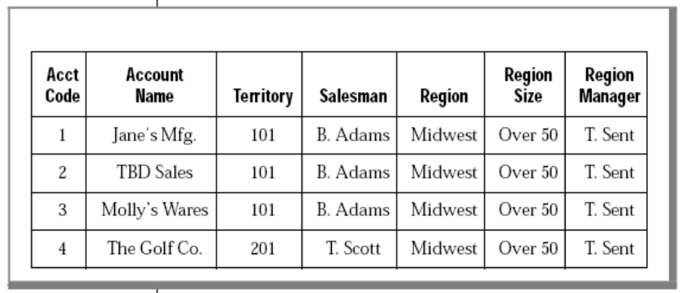
Dimension Tables
Notes:
What would Iris say?

Slide 21
Query
Notes:
Slice & Dice
Dollars_sold in a certain store
Dollars_sold in a certain store in February in 2006 for snacks by day in the week by product
Rotate.

Slide 22
Building a dimensional DB
Choose the business process(es) that you want to use to analyze the subject area to be modeled
Determine the granularity of the fact table(s)
Identify dimensions and hierarchies for each fact table
Identify measures for the fact table(s)
Determine the attributes for each dimension table
Get users to verify the data model

Slide 23
Choosing a Business Process
Sales
Shipments
Inventory
Orders
Invoices

Slide 24
Critical Reports for Marketing
Monthly revenue, cost, net profit by product line per vendor
Revenue and units sold by product, by region, by month
Monthly customer revenue
Quarterly revenue per vendor
Most sales analysis is based on monthly results but you may choose to analyze sales by week or accounting period (at a later date).

Slide 25
Summary of a Business Process
Customer-base information has changed.
Previously, sales districts were divided by city. Now the customer base corresponds to two regions:
Region 1: California
Region 2: all other states.

Slide 26
Where is the data
The stores database provides much of the revenue data that the marketing department uses.
The product code is stored in the catalog table as the catalog number.
The product line code is stored in the stock table as the stock number. The product line name is stored as description.
The product hierarchies are somewhat complicated. Each product line has many products and each manufacturer has many products.

Slide 27
Where is the Data 2
All the cost data for each product is stored in a flat file named costs.lst on a different purchasing system.
Customer data is stored in the stores database.
The region information has not yet been added to the database.

Slide 28
Determining the Granularity
Customer by Product by day by region
Customer by Product by month by region
Customer by Product by minute by city
Customer by Product by minute by street
Mixed Granularity
Customer by Product by District by Day
Notes:
High res vs. low res.
Why need MG?
How to do mixed granularity
Used for aggregates (ALL)

Slide 29
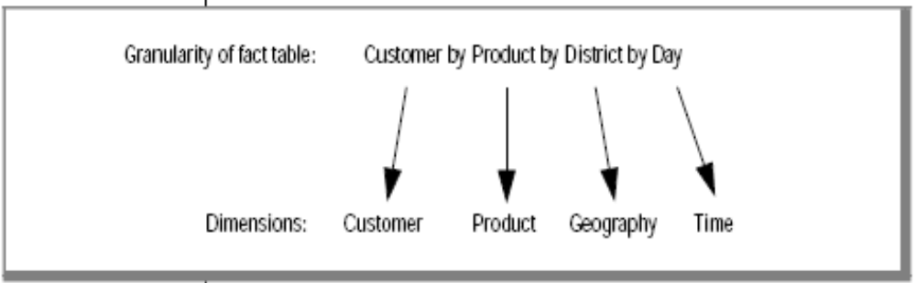
Granularity

Slide 30
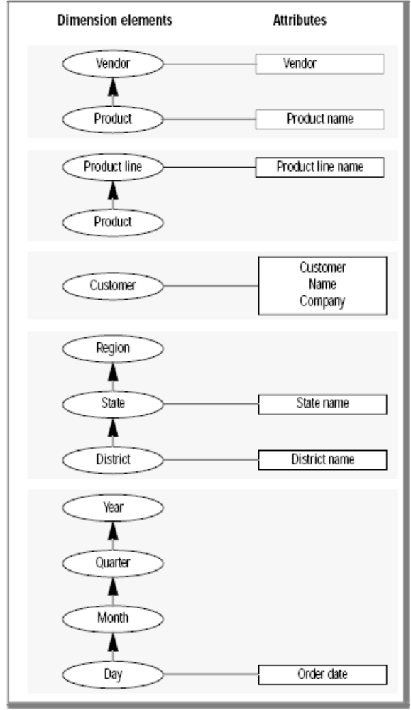

Slide 31
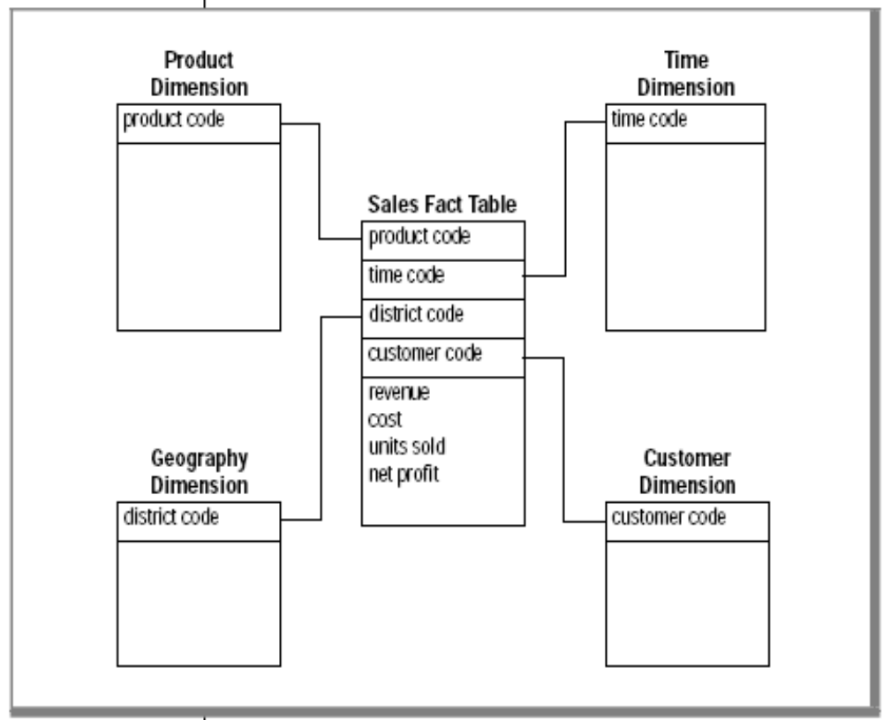
Star Schema

Slide 32
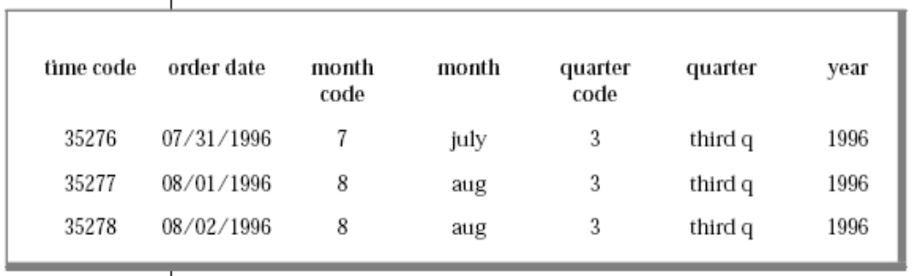
Choosing the Attributes for the Dimension Tables
Notes:
Every attribute can be used for a report.
Holiday
Names have to be meaningful.

Slide 33
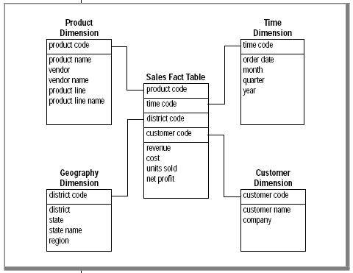
The final star schema
Notes:
Give me 8 product attributes and why we need it.

Slide 34
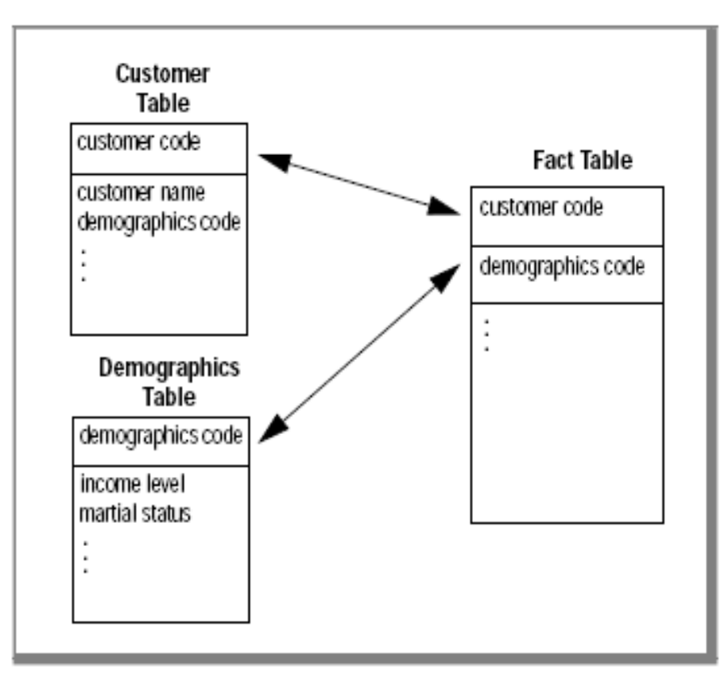
Minimizing no. of attributes

Slide 35
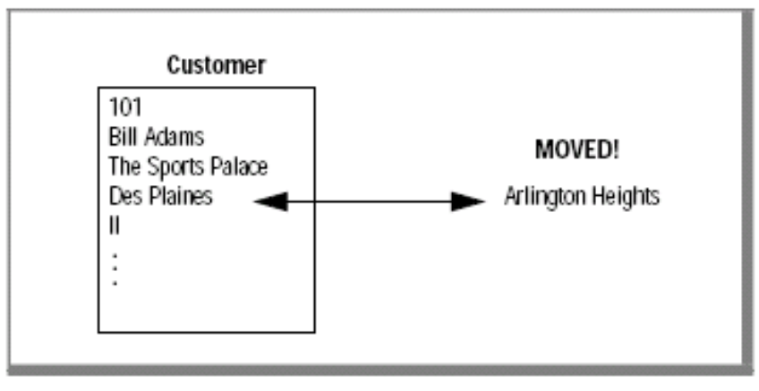
Handling Dimensions That Occasionally Change
Notes:
Just change.
Define key+version Usually forget about the version
Product add new entry in table. Know that they are the same by product code.
Add modification fields

Slide 36
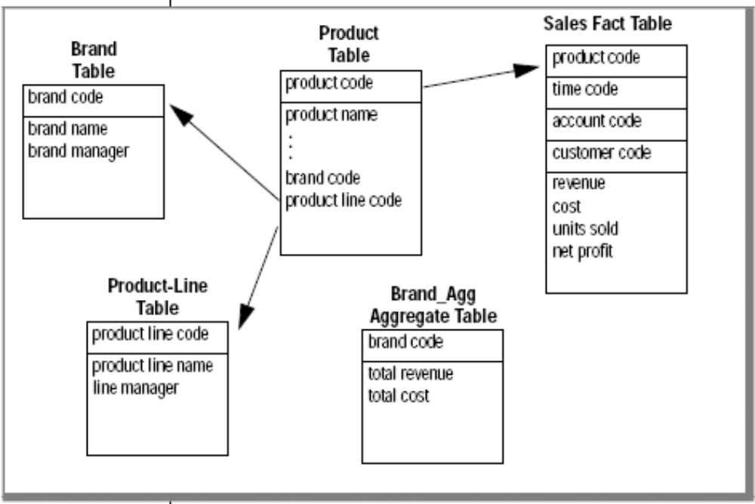
Using the Snowflake Schema
Notes:
Different than the demography case from before
Examples for product dimensions
Agg tables are good and fast but have to be computed

Slide 37
With brand_agg
SELECT brand.brand_name, brand_agg.total_revenue
FROM brand, brand_agg
WHERE brand.brand_code = brand_agg.brand_code
AND brand.brand_name = 'Anza'
Without brand_agg
SELECT brand.brand_name, SUM(sales.revenue)
FROM product, brand, sales
WHERE product.brand_code = brand.brand_code
AND product.product_code = sales.product_code
AND brand.brand_name = 'Alltemp'
GROUP BY brand_name
Notes:
With brand_agg very fast. Example for agg table.
Without 3 way join.
Mistake in example.
Maybe add brand_code to sales fact table.

Slide 38
Implementing a Dimensional
Data Model

Slide 39
DB star Schema

Slide 40
CREATE TABLE time
(
time_code INT,
order_date DATE,
month_code SMALLINT,
month_name CHAR(10),
quarter_code SMALLINT,
quarter_name CHAR(10),
year INTEGER
);

Slide 41
CREATE TABLE geography (
district_code SERIAL,
district_name CHAR(15),
state_code CHAR(2),
state_name CHAR(18),
region SMALLINT
);

Slide 42
CREATE TABLE product (
product_code INTEGER,
product_name CHAR(31),
vendor_code CHAR(3),
vendor_name CHAR(15),
product_line_code SMALLINT,
product_line_name CHAR(15)
);
CREATE TABLE customer (
customer_code INTEGER,
customer_name CHAR(31),
company_name CHAR(20));

Slide 43
CREATE TABLE sales
(
customer_code INTEGER,
district_code SMALLINT,
time_code INTEGER,
product_code INTEGER,
units_sold SMALLINT,
revenue MONEY(8,2),
cost MONEY(8,2),
net_profit MONEY(8,2)
);

Slide 44
Where is the data
The stores database provides much of the revenue data that the marketing department uses.
The product code is stored in the catalog table as the catalog number.
The product line code is stored in the stock table as the stock number. The product line name is stored as description.
The product hierarchies are somewhat complicated. Each product line has many products and each manufacturer has many products.

Slide 45
Where is the Data 2
All the cost data for each product is stored in a flat file named costs.lst on a different purchasing system.
Customer data is stored in the stores7 database.
The region information has not yet been added to the database.
Notes:
Fields have to be meaningful for the business people
Review DB structure

Slide 46
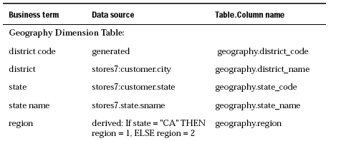
Mapping data from source to DW

Slide 47
INSERT INTO geography(district_name, state_code,
state_name)
SELECT DISTINCT c.city, s.code, s.sname
FROM stores7:customer c, stores7:state s
WHERE c.state = s.code;
UPDATE geography
SET region = 1
WHERE state_code = 'CA';
UPDATE geography
SET region = 2
WHERE state_code <> 'CA';

Slide 48
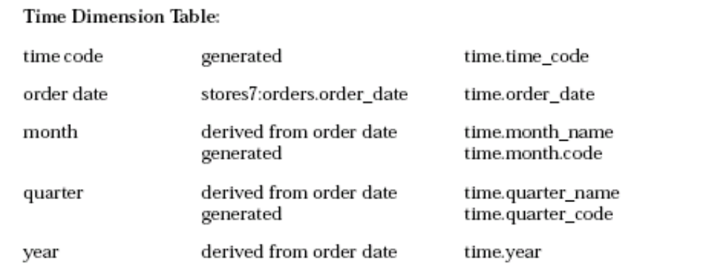
Notes:
Build it offline.
Why not use SQL date type.
8 bytes instead of 4.
Can’t do optimizations on it.

Slide 49
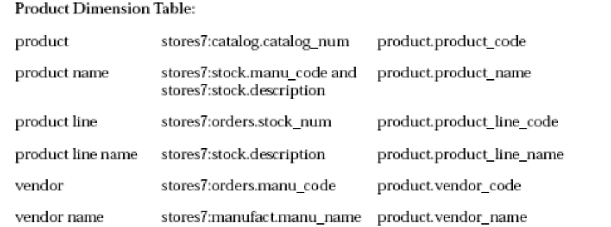
Notes:
Comes from catalog, stock, orders, manufact
A bit complicated
Should not use catalogue number.

Slide 50
INSERT INTO product
(product_code, product_name, vendor_code,
vendor_name,product_line_code, product_line_name)
SELECT a.catalog_num,
trim(m.manu_name)||' '||s.description,
m.manu_code, m.manu_name,
s.stock_num, s.description
FROM stores7:catalog a, stores7:manufact m,
stores7:stock s
WHERE a.stock_num = s.stock_num
AND a.manu_code = s.manu_code
AND s.manu_code = m.manu_code;

Slide 51
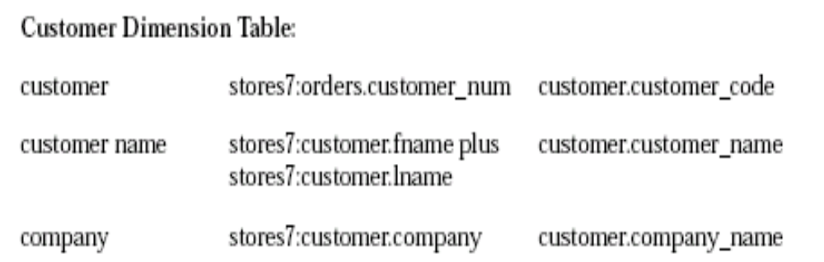
INSERT INTO customer
(customer_code, customer_name, company_name)
SELECT c.customer_num, trim(c.fname) ||' '|| c.lname,
c.company
FROM stores7:customer c;

Slide 52
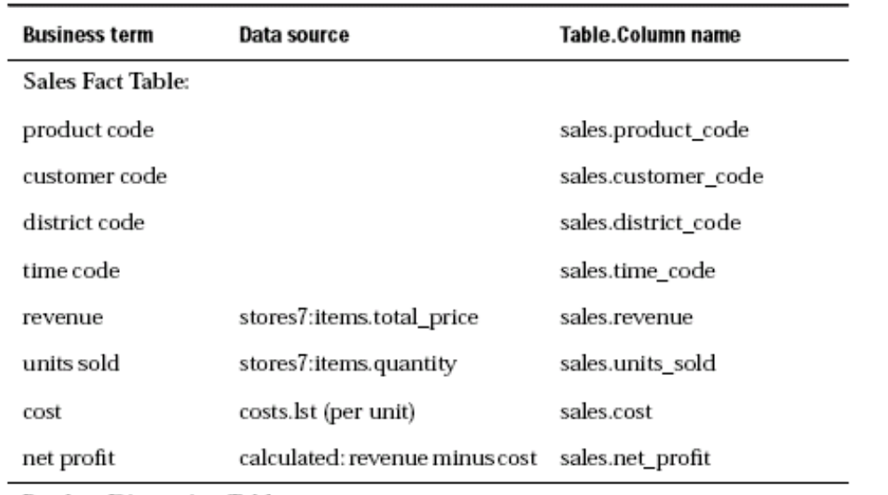
Notes:
Comes from items and costs.lst

Slide 53
INSERT INTO sales
(customer_code, district_code, time_code,
product_code, units_sold, cost, revenue,
net_profit)
SELECT
c.customer_num, g.district_code, t.time_code,
p.product_code, SUM(i.quantity),
SUM(i.quantity * x.cost), SUM(i.total_price),
SUM(i.total_price) - SUM(i.quantity * x.cost)
FROM stores7:customer c, geography g, time t,
product p,stores7:items i, stores7:orders o, cost x
WHERE c.customer_num = o.customer_num
AND o.order_num = i.order_num
AND p.product_line_code = i.stock_num
AND p.vendor_code = i.manu_code
AND t.order_date = o.order_date
AND p.product_code = x.product_code
AND c.city = g.district_name
GROUP BY 1,2,3,4;

Slide 54
The following statement returns the monthly customer revenue:
SELECT customer_name, company_name, month_name,
SUM(revenue)
FROM customer, time, sales
WHERE customer.customer_code = sales.customer_code
AND time.time_code = sales.time_code
GROUP BY customer_name, company_name, month_name
ORDER BY customer_name;
Notes:
The following statement returns the quarterly revenue per vendor:
SELECT vendor_name, year, quarter_name, SUM(revenue)
FROM product, time, sales
WHERE product.product_code = sales.product_code
AND time.time_code = sales.time_code
GROUP BY vendor_name, year, quarter_name
ORDER BY vendor_name, year;

Slide 55
The following statement returns the monthly revenue, cost, and net profit by product line for each vendor:
SELECT vendor_name, product_line_name, month_name,
SUM(revenue) total_revenue, SUM(cost) total_cost,
SUM(net_profit) total_profit
FROM product, time, sales
WHERE product.product_code = sales.product_code
AND time.time_code = sales.time_code
GROUP BY vendor_name, product_line_name, month_name
ORDER BY vendor_name, product_line_name;

Slide 56
The following statement returns the revenue and units sold by product, by region, and by month:
SELECT product_name, region, month_name,
SUM(revenue), SUM(units_sold)
FROM product, geography, time, sales
WHERE product.product_code = sales.product_code
AND geography.district_code = sales.district_code
AND time.time_code = sales.time_code
GROUP BY product_name, region, month_name
ORDER BY product_name, region;

Slide 57
Indexes
B+ indexes – when many values exist
Bitmap indexes – when many duplicates exist.
Skip – Scan
  Take index results and scan the table once looking for blocks which have required records
Generalized-key indexes
Notes:
One bit per record.
Very dense.
Easy and fast to do AND OR …
When delete record change exist bit to zero.
Result a bit map of all records satisfying cond.
How do we count
Select sum(Sales.price)
From sales
Where condition

Slide 58
Bit Sliced Indexes
a is defined by log(n) bits (a number).
Define log(n) indexes
Select sum(Sales.price)
From sales
Where condition
Bf index satisfies condition
Notes:
Retrieve records satisfying Bf
Get values from a B+ index
Sum(B_i) * 2^I

Slide 59
GK- Indexes
CREATE GK INDEX state_idx on geography
(SELECT district_code FROM geography
WHERE state_code = "CA")
SELECT product_name, region, month_name, SUM(revenue),
SUM(units_sold)
FROM product, geography, time, sales
WHERE product.product_code = sales.product_code AND
geography.district_code = sales.district_code AND
state_code = "CA" AND time.time_code = sales.time_code
GROUP BY product_name, region, month_name
ORDER BY product_name, region;
Notes:
the following type of
query that returns revenue and units sold by product, by region, and by
month where state = "CA". The database server uses the state_idx index to
retrieve rows from the geography table where state = "CA" to improve query
performance overall.

Slide 60
Defining a GK Index on an Expression
CREATE GK INDEX cost_idx on sales
(SELECT units_sold * cost FROM sales);
SELECT customer_name
FROM sales, customer
WHERE sales.customer_code = customer.customer_code
AND units_sold * cost > 10000.00;
Notes:
The database server can use the cost_idx index for the following type of
query that returns the names of customers who have spent more than
$10,000.00 on products.

Slide 61
Defining a GK Index on Joined Tables
CREATE GK INDEX time_idx on sales
(SELECT year FROM sales, time
WHERE sales.time_code = time.time_code )
Important: To create the preceding GK index, the time_code column of the sales table must be a foreign key that references the time_code column (a primary key) in the time table.

Slide 62
SELECT customer_name
FROM sales, customer, time
WHERE sales.time_code = time.time_code AND
year > 1996
AND sale.customer_code = customer.customer_code

