Slide 1

Chapter 2
The Virtuous Cycle of Data Mining

Slide 2
Introduction
Data are @ the heart of most companies’ core business processes
Data are generated by transactions regardless of industry (retail, insurance…)
In addition to this internal data, there are tons of external data sources (credit ratings, demographics, etc.)
Data Mining’s promise is to find patterns in the “gazillions” of bytes

Slide 3
But…
Finding patterns is not enough
Business (individuals) must:
  Respond to the pattern(s) by taking action
  Turning:
    Data into Information
    Information into Action
    Action into Value
Hence, the Virtuous Cycle of DM

Slide 4
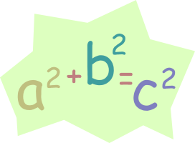
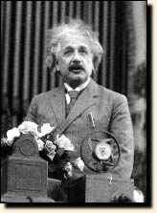
Data Mining…Easy?
Marketing literature makes it look easy!!!
  Just apply automated algorithms created by great minds, such as:
    Neural networks
    Decision trees
    Genetic algorithms
  “Poof”…magic happens!!!
Not So…Data Mining is an iterative, learning process
DM takes conscientious, long-term hard work and commitment
DM’s Reward: Success transforms a company from being reactive to being proactive

Slide 5
Case Study #1 – Business DM
Bank of America Case Study
Getting high quality home equity loans משכנתא שנייה על הבית
Known reasons for home equity loans
Pay for children college tuition
People with high variable income (smooth it)
Notes:
Lower rates – more people but ones who are not loyal.

Slide 6
BofA DM
Data even from 1914!
Each record has 250 fields
Decision tree on whether the client will or will not take a home equity loan
Using tree to add “good prospect” flag.
Use sequential pattern finding tool to check when will the customer apply for the loan

Slide 7
BofA DM
Cluster possible customers
Found 14 groups
One group 39% had personal & Business Accounts
More than 25% of those who were classified as possible responders for HEL.
People take loans to start businesses

Slide 8
Actions
Add question to market research
  Will the loan be used to open a business
Problems with market research
  Sample does not represent the clients
  Customers might not be honest
  An action (leave the bank) can be from a set of reasons:
    Bounced check
    Long wait at ATM
    Branch closed

Slide 9
Actions & Measurement
When doing market research use data mining to take into account knowledge
Target people opening businesses.
Results
  Response rate from 0.7% to 7.0%
Constantly doing marketing programs as a result of DM.

Slide 10




Data Mining’s Virtuous Cycle
Identify the business opportunity*
Mining data to transform it into actionable information
Acting on the information
Measuring the results
* Textbook interchanges “problem” with “opportunity”

Slide 11
1. Identify the Business Opportunity
Many business processes are good candidates:
  New product introduction
  Direct marketing campaign
  Understanding customer attrition/churn
  Evaluating the results of a test market
Measurements from past DM efforts:
  What types of customers responded to our last campaign?
  Where do the best customers live?
  Are long waits in check-out lines a cause of customer attrition?
  What products should be promoted with our XYZ product?
TIP: When talking with business users about data mining opportunities, make sure you focus on the business problems/opportunities and not on technology and algorithms.

Slide 12
2. Mining data to transform it into actionable information
Success is making business sense of the data
Numerous data “issues”:
  Bad data formats (alpha vs numeric, missing, null, bogus data)
  Confusing data fields (synonyms and differences)
  Lack of functionality (“I wish I could…”)
  Legal ramifications (privacy, etc.)
  Organizational factors (unwilling to change “our ways”)
  Lack of timeliness
Notes:
Lack of functionality: call center without per-customer comments
Legal reason: my neural net told me so not an answer.
Lack of timeliness: People leave a phone company because their plan does not fit and
Costs too much.

Slide 13
3. Acting on the Information
This is the purpose of Data Mining – with the hope of adding value
What type of action?
  Interactions with customers, prospects, suppliers
  Modifying service procedures
  Adjusting inventory levels
  Consolidating
  Expanding
  Etc…

Slide 14
4. Measuring the Results
Assesses the impact of the action taken
Often overlooked, ignored, skipped
Planning for the measurement should begin when analyzing the business opportunity, not after it is “all over”
Assessment questions (examples):
  Did this ____ campaign do what we hoped?
  Did some offers work better than others?
  Did these customers purchase additional products?
  Tons of others…

Slide 15
Wireless Communications Company
How to find a few customers for new application
Cost = fixed + customers*constant
Goal send to customers that will reply
2-3% respond
Order customers by score and send them
mail
Notes:
Wanted 500
16,000 – 25,000
Draw graph

Slide 16
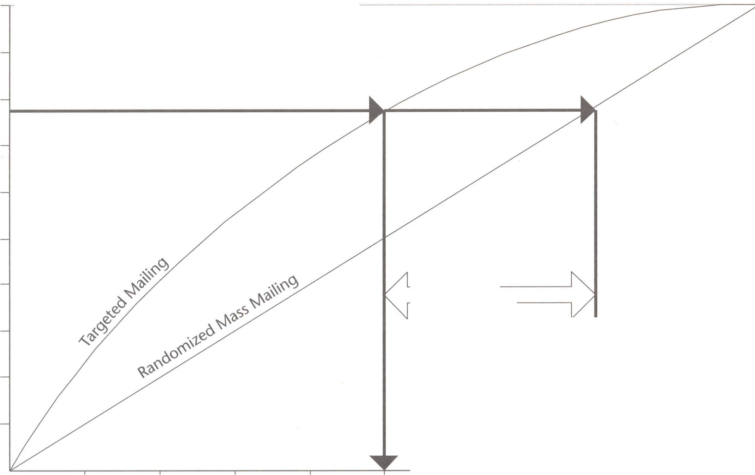
Gain from DM
....

Slide 17
Wireless Communications Company
Learn from examples create model.
Problem – no examples, the product is new.
Try non-response model
  Only reduces 10% not good enough
Try similar product
Take data on the customer + did he buy the product
Build a model to predict buying of product
Notes:
AARP – reduced 10% with no difference in response.

Slide 18
How to choose the data
Get all the experts together
Data sources
  Marketing customer information file
  Call detail database
  Demographic DB
Throw it all together and let the DM
sort it out.
Notes:
Demographic: Purchased
Marketing: plans
Show examples.

Slide 19
Derived inputs
Minutes of Use (MOU)
Number of incoming calls
Frequency of calls
Sphere of influence
Voice mail user flag
Notes:
SOI – to how many people does this person call
Frequency – many short calls small number of long calls.

Slide 20
Actions
Two mailing lists were made
  One according to DM
  One random
Results 15% vs. 3%
1/5 cost to receive the same results
Build a new model on the new product
Use it for the whole market

Slide 21
Neural Networks and Decision Trees Drive SUV Sales
First suggestion – Build expert system
  Interview experts, define rules
Second suggestion – Learn a model from data
Notes:
People sent mail.
Whoever came got sunglasses

Slide 22
Data
Mail file 1M
PRIZM zip-code demographic data
People who sent response card 32,904
People who called 16,453
Total 5%
Sales 270,172
Notes:
Called is problematic hard to match them with mail file
Try to automatically match sales with mail file 22,000 checked and got 4764. Half bought the model.

Slide 23
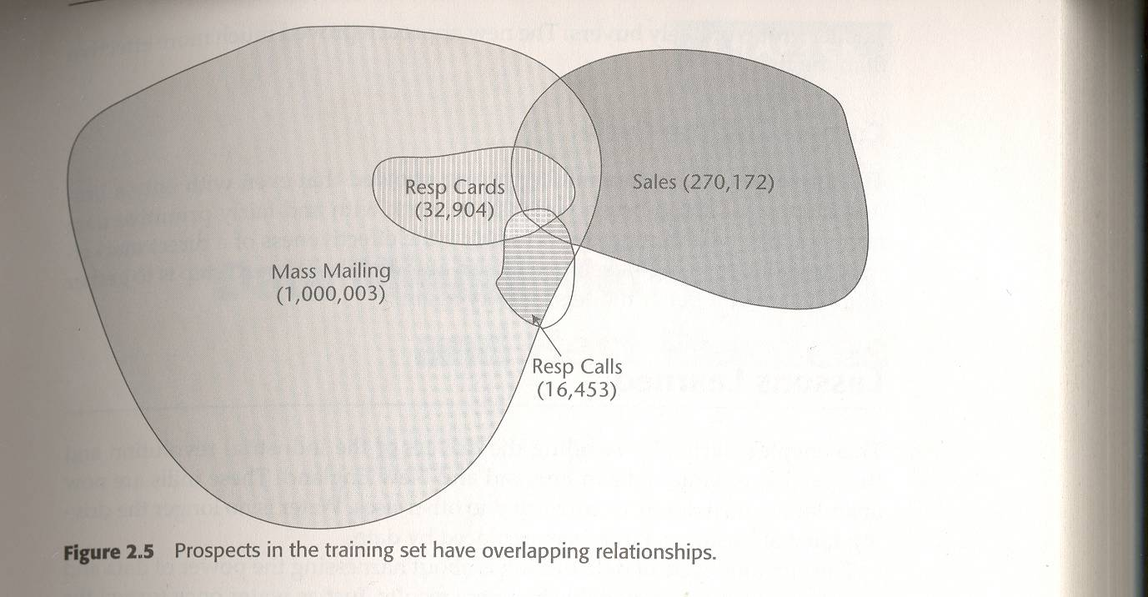
Customer segments

Slide 24
What to do
Ask question with yes no answer
Two stages
  Neural net (sparse): Buy car?
  Decision tree (dense): Buy this car?
Much better then each by itself
Upgrade sunglasses to boots.

Slide 25

End of Chapter 2

