Slide 1
Reducing Multiclass to Binary: A Unifying Approach for Margin Classifiers
Erin L. Allwein, Robert E. Schapire and
Yoram Singer
Journal of Machine Learning Research (2000)
Presented by: Maria Kushnir

Slide 2
Agenda
Motivation - Reducing Multiclass to Binary
Related work
Margin Classifiers
From Binary to Multiclass
Current paper
A Unifying Approach
Results
Summary

Slide 3



Motivation – Binary vs. Multi-Class
Input
Output
Spam
filtering
Binary
!!!!$$$!!!!
Multi-Class
Character
recognition
C

Slide 4
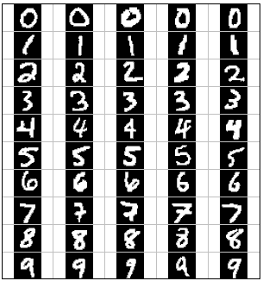
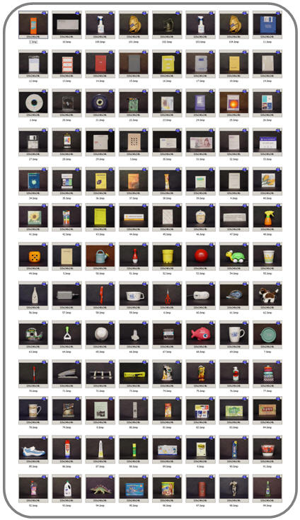
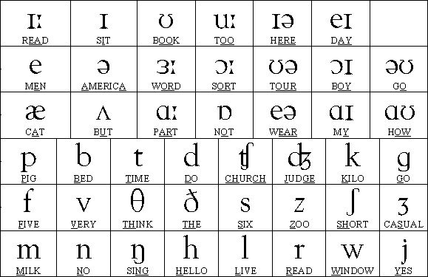
Motivation – Real world problems
Object recognition
Digit recognition
Many supervised machine learning tasks can be cast as the problem of assigning elements to a finite set of classes or categories.
10
Phoneme recognition
100
50

Slide 5
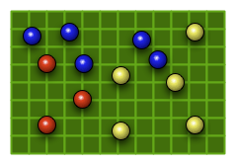
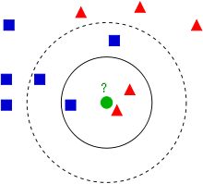
Motivation – from Binary to Multiclass
Some machine learning algorithms can then be naturally extended to handle the multiclass case.
Binary - KNN
Multi-Class - KNN
Notes:
KNN או עצי החלטה בנויים מראש לחלוקה לכמה קלאסים- multiclass

Slide 6
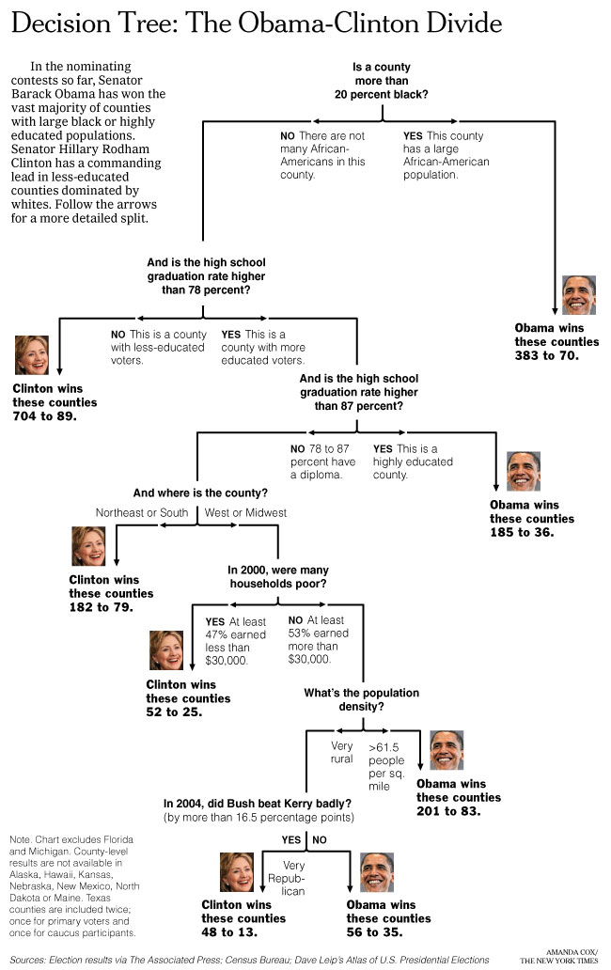
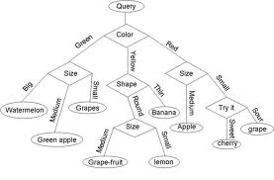
Motivation – from Binary to Multiclass
Some machine learning algorithms can then be naturally extended to handle the multiclass case.
Binary – Decision Tree
Multi-Class - Decision Tree

Slide 7

Motivation – from Binary to Multiclass
For other algorithms, such as AdaBoost and the Support-Vector Machines algorithm, a direct extension to the multiclass case may be problematic.
Typically, in such cases, the multiclass problem is reduced to multiple binary classification problems that can be solved separately.
Binary – SVM
Multi-Class - SVM
1
1
1
1
1
1
3
3
2
Class 2
2
2
2
3
2
m
3
3
3
2
Class 1
3
2
Notes:
אך יותר מסובך להשתמש בSVM לmulticlass, SVM קלאסי יודע לעבוד רק עם 2 קלאסים

Slide 8
Agenda
Motivation - Reducing Multiclass to Binary
Related work
Margin Classifiers
From Binary to Multiclass
Current paper
A Unifying Approach
Results
Summary

Slide 9


Margin-based Learning Algorithms
A binary margin-based learning algorithm takes as input binary labeled training examples (x₁y₁),…,(x_{m}y_{m}) where the labels y_{i} are {-1,1}.
Such a learning algorithm uses the data to generate a real-valued function or hypothesis:
The margin of an example (x,y) with respect to f is:
The margin of an training example is a number that is positive if and only if the example is correctly classified by a given classifier and whose magnitude is a measure of confidence in the prediction.
Notes:
נותנים לו דוגמה והוא מוציא מספר, המספר אומר כמה הוא בטוח שהדוגמה שייכת לקלאס A או קלאס B.
ככל שהמספר גדול יותר כך הוא יותר בטוח לאיזו קלאס שייכת הדוגמה.
אם הערך הוא שלילי אז הסיווג לא נכון

Slide 10
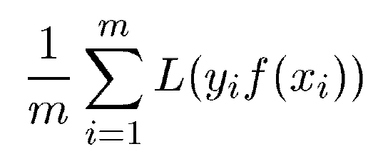
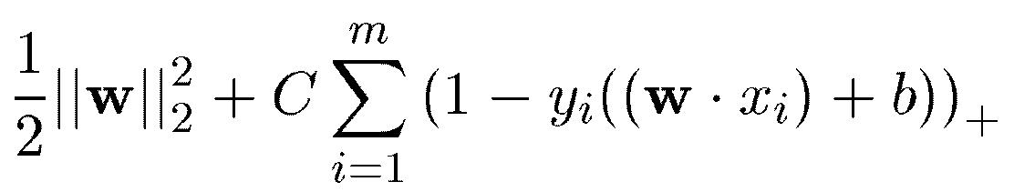

Margin-based Learning Algorithms
The nonnegative loss function of the margin
Different choices of the loss function L and different algorithms for minimizing over some hypothesis space lead to various well studied learning algorithms:
Support-Vector Machines
can be viewed here as a binary margin-based learning algorithm which seeks to achieve small empirical risk for the loss function
Notes:
loss functions- משוואות אשר מייצרות עונש על סיווגים לא נכונים, כך שככל שיש יותר בטיחות בסיווג אז הערך שהתקבל יהיה יותר גדול.

Slide 11
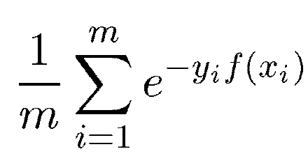
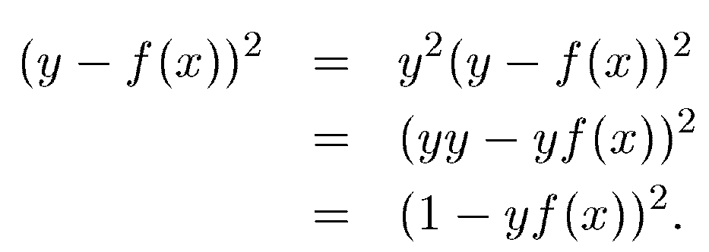

Margin-based Learning Algorithms
AdaBoost is a binary margin-based learning algorithm in which the loss function is
Least squares regression and neural networks attempt to minimize the squared error loss function
Thus, for binary problems, minimizing squared error

Slide 12
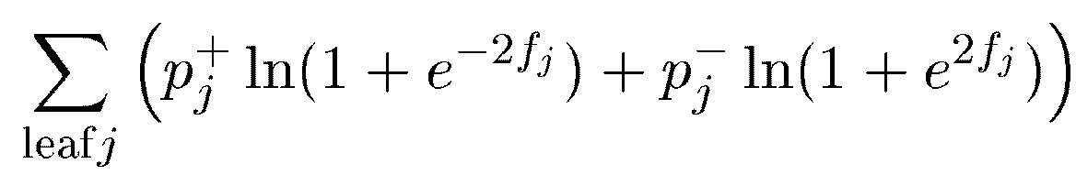

Margin-based Learning Algorithms
Decision trees splits decision nodes in a manner to greedily minimize
The empirical loss associated with decision trees and logistic regression is

Slide 13
Agenda
Motivation - Reducing Multiclass to Binary
Related work
Margin Classifiers
From Binary to Multiclass
Current paper
A Unifying Approach
Results
Summary

Slide 14
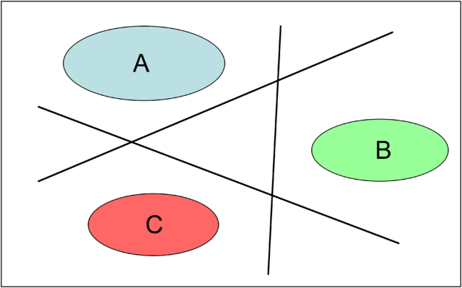
Related Work – from Binary to Multiclass
There are many ways to reduce a multiclass problem to multiple binary classification problems:
One-against-all – each class is compared to all others.
The approach is to create one binary problem for each of the K classes. That is, for each class y_{i} we solve a binary problem in which all examples labeled y_{i} are considered positive examples and all other examples are considered negative examples.
Notes:
נבנה מסווגים ל2 קלאסים- הקווים השחורים בציור.
שיטת 1 מול כולם: כל קלאס מושווה לשאר הקלאסים
כך נקבל קלאס שעבור מסווג אחד היא יוצאת חיובית ועבור כל השאר המסווגים היא יוצאת שלילית

Slide 15

Related Work – from Binary to Multiclass
There are many ways to reduce a multiclass problem to multiple binary classification problems:
All-pairs approach – all pairs of classes are compared to each other.
For each distinct pair of classes y_{i,} y_{j,} we solve a binary problem in which examples labeled y_{i} are considered positive, and those labeled y_{j} are negative. All other examples are simply ignored.
Notes:
גישת כל זוג: כל זוג קלאסים משווה לקלאסים האחרים.
עבור כל זוג קלאסים אנחנו מגדירים האם הדוגמה שייכת לאחד מהזוג
שאר הקלאסים לא ישתתפו
כך נקבל מטריצה של ערכים כאשר עבור כל קלאס (שורה) נקבל ערך 1 או -1 לכל זוג (כל זוג יהיה טור), הקלאסים שמהם נתעלם יקבלו ערך 0

Slide 16
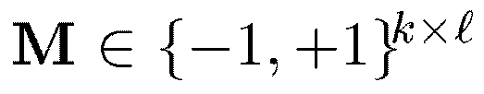
Related Work – from Binary to Multiclass
There are many ways to reduce a multiclass problem to multiple binary classification problems:
Error Correcting Output Codes - a general framework. The idea is to associate each class y with a row of a “coding matrix” M for some l.
The binary learning algorithm is then run once for each column of the matrix on the induced binary problem in which the label of each example labeled y is mapped to M(y,s). This yields l hypotheses f_{s}.
Given an example x, we then predict the label y for which row y of matrix M is “closest” to (f₁(x),…f_{l}(x)).
Notes:
יוצרים l מסווגים ובודקים עבור קלאס מסוים אם יוצא ערך 1 או -1, לכן עבור כל קלאס נקבל מערך של מספרים חיוביים ושליליים.
כאשר נבדוק דומה נחפש את הקלאס שקיבל את המערך הכי דומה מבחינת ערכים חיוביים ושליליים.

Slide 17
Agenda
Motivation - Reducing Multiclass to Binary
Related work
Margin Classifiers
From Binary to Multiclass
Current paper
A Unifying Approach
Results
Summary

Slide 18
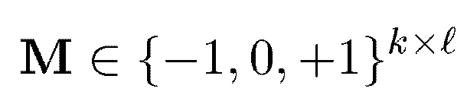
Current paper – A Unifying Approach
Learning multiclass problems using a binary margin-based learning algorithm A works as follows:
It begin with a given coding matrix

Slide 19
Current paper – A Unifying Approach
Examples of a coding matrix M:
One-against-all approach – coding matrix – M is a KxK matrix in which all diagonal elements are +1 and all other elements are -1.
All-pairs approach – coding matrix – M is a Kx(K!/(2!*(K-2)!)) matrix in which each column corresponds to a distinct pair (r₁,r₂). For this column, M has +1 in row r₁, -1 in row r₂ and zeros in all other rows.

Slide 20
Current paper – A Unifying Approach
Examples of a coding matrix M:
Additional examples – coding matrix – M is a mxn matrix, m classes, n classifiers
M | 1:2 | 1:3 | 1:4 | 2:3 | 2:4 | 3:4
1 | 1 | 1 | 1 | 0 | 0 | 0
2 | -1 | 0 | 0 | 1 | 1 | 0
3 | 0 | -1 | 0 | -1 | 0 | 1
4 | 0 | 0 | -1 | 0 | -1 | -1
M | 1,2 | 1,3 | 1,4 | 2,3 | 2,4 | 3,4
1 | 1 | 1 | 1 | -1 | -1 | -1
2 | 1 | -1 | -1 | 1 | 1 | -1
3 | -1 | 1 | -1 | 1 | -1 | 1
4 | -1 | -1 | 1 | -1 | 1 | 1
Notes:
מטריצה של ערכים כאשר עבור כל קלאס (שורה) נקבל ערך 1 או -1 לכל זוג (כל זוג יהיה טור), הקלאסים שמהם נתעלם יקבלו ערך 0
במטריצה השנייה השווה בין 1,2 ל3 ו4 היא אותו הדבר כמו השוואה בים 3,4 ל1 ו2, לכן אפשר להשתמש רק ב3 הטורים הראשונים

Slide 21
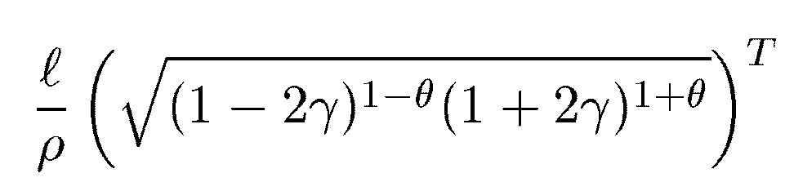
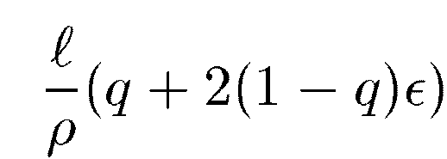
Current paper – A Unifying Approach
Considerations in design of a coding matrix M:
Rows to be far apart
Few non-zero entries
Binary problems that are easy to learn
Training error bound:
q - fraction of ignored pairs
ε - fraction of misclassification errors
ρ – distance between pairs of distinct rows
Notes:
משוואות אלו מחשבות מהי רמת השגיאה של הגדרת מה הקלאס מתוך כל הקלאסים (multiclass)

Slide 22


Current paper – A Unifying Approach
Learning multiclass problems using a binary margin-based learning algorithm A works as follows:
It begin with a given coding matrix
For s = 1,2,…,l the learning algorithm A is provided with labeled data of the form (x_{i},M(y_{i},s)) for all examples i in the training set but omitting all examples for which M(y_{i},s)=0.
The Algorithm A uses this data to generate a hypothesis f_{s}.
Another alternative is A that produces a single hypothesis f.

Slide 23

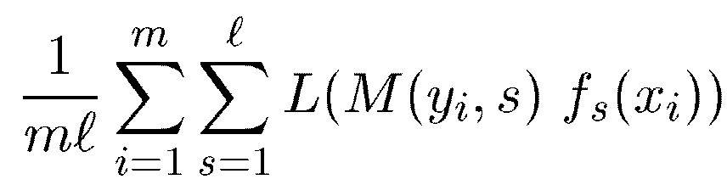
Current paper – A Unifying Approach
For either variant, the algorithm A attempts to minimize the loss L on the induced binary problem(s).
L is a function of the margin of an example so the loss of f_{s} on an example x_{i} with induced label M(y_{i},s) is
The average loss over all choices of s and all examples i is
This average loss is called the average binary loss of the hypotheses f_{s} on the given training set with respect to coding matrix M and loss L.

Slide 24
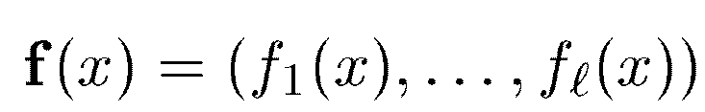

Current paper – Decoding Methods
After the binary classification problems have been solved, the resulting set of binary classifiers must then be combined in some way.
Let M(r) denote row r of M and let f(x) be the vector of predictions on an instance x:
Given the predictions of the f(x) on a test point x which of the k labels should be predicted?
The basic idea of decoding methods is to predict with the label r whose row M(r) is “closest” to the predictions f(x). In other words, predict the label r that minimizes:

Slide 25
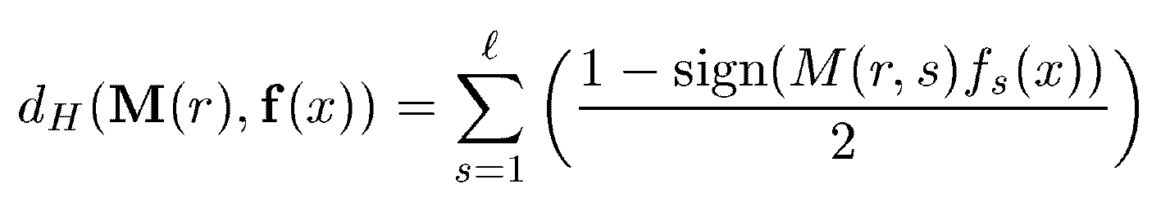
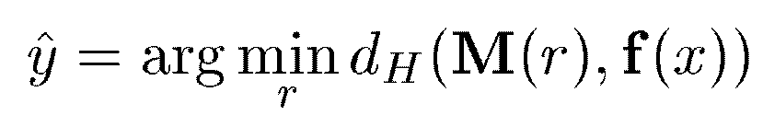
Current paper – Hamming Decoding
Hamming Decoding - count up the number of positions s in which the sign of the prediction f_{s}(x) differs from the matrix entry M(r,s). Formally, this means that the distance measure is:
where sign(z) is +1 if z>0, -1 if z<0 and 0 if z=0. If either f_{s}(x) or M(r,s) is zero then that component contributes ½ to the sum.
For an instance x and a Matrix M, the predicted label y is therefore:

Slide 26
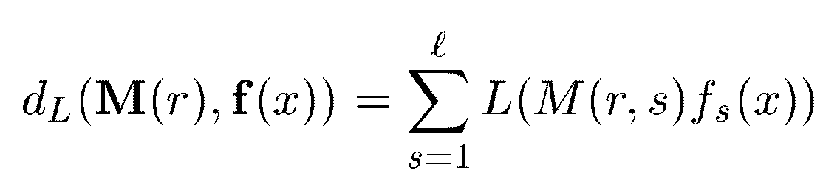
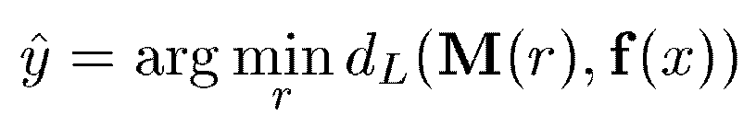
Current paper – Loss-based decoding
Loss-based decoding - choose the label r that is most consistent with the predictions f_{s}(x).
If example x were labeled r, the total loss on example (x,r) would be minimized over choices of r. Formally, this means that the distance measure is the total loss on a proposed example:
For an instance x and a Matrix M, the predicted label y is therefore:

Slide 27
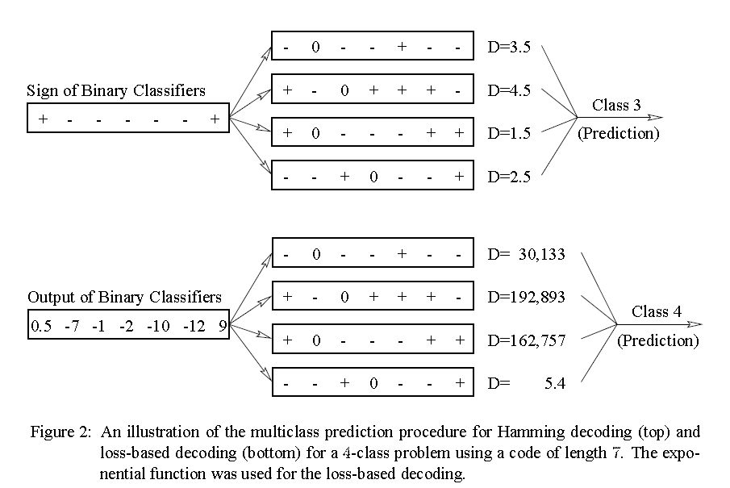
Current paper – Decoding Methods
An illustration of the two decoding methods

Slide 28
Agenda
Motivation - Reducing Multiclass to Binary
Related work
Margin Classifiers
From Binary to Multiclass
Current paper
A Unifying Approach
Results
Summary

Slide 29
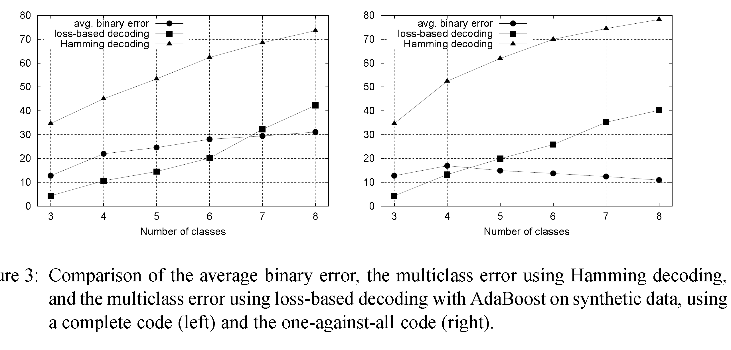
Results – Synthetic data
Synthetic data instances were generated according to the normal distribution with zero mean and a unit variance. To create a multiclass problem with k classes, k+1 thresholds denoted θ₀,θ₁… θ_{k} were set.
Instance x is associated with class j if and only if θ_{j-1}x<θ_{j}.

Slide 30
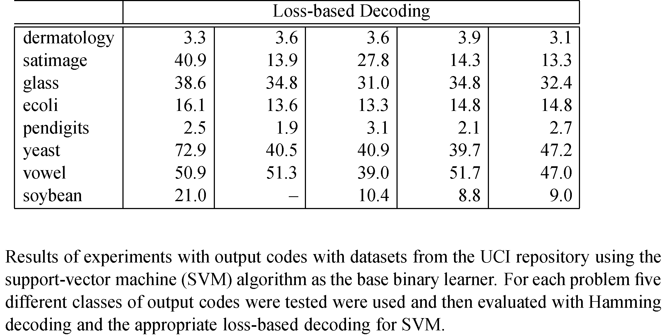
Results – UCI ML Repository

Slide 31
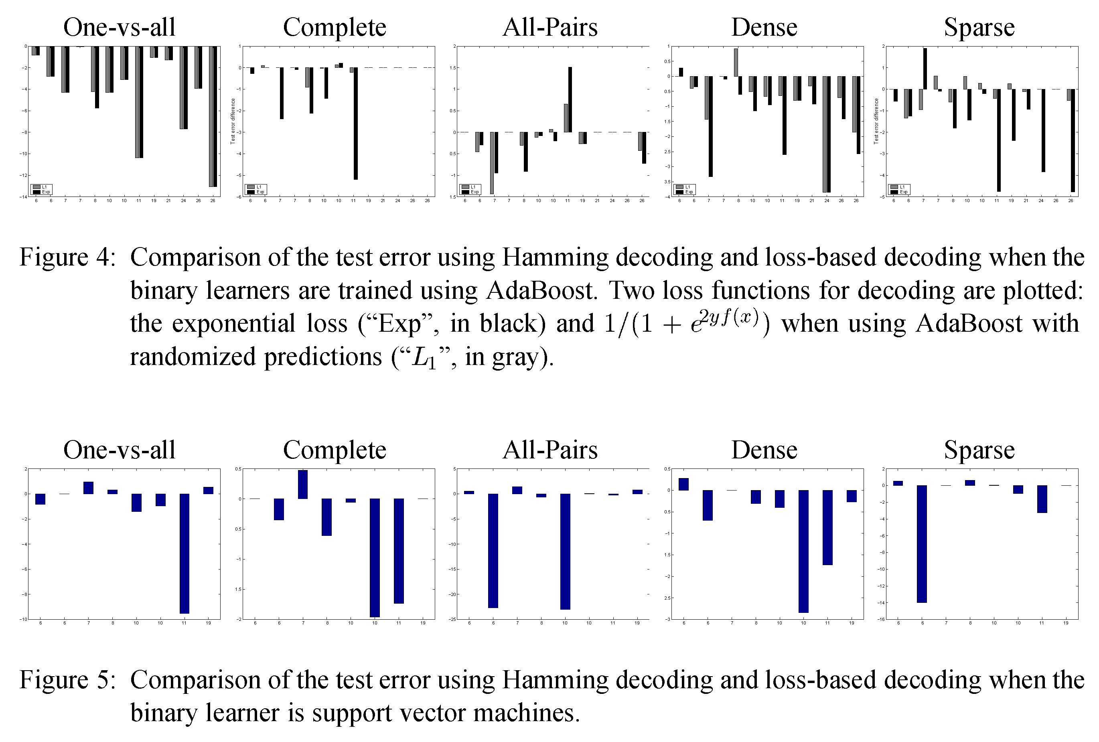
Results – UCI ML Repository

Slide 32
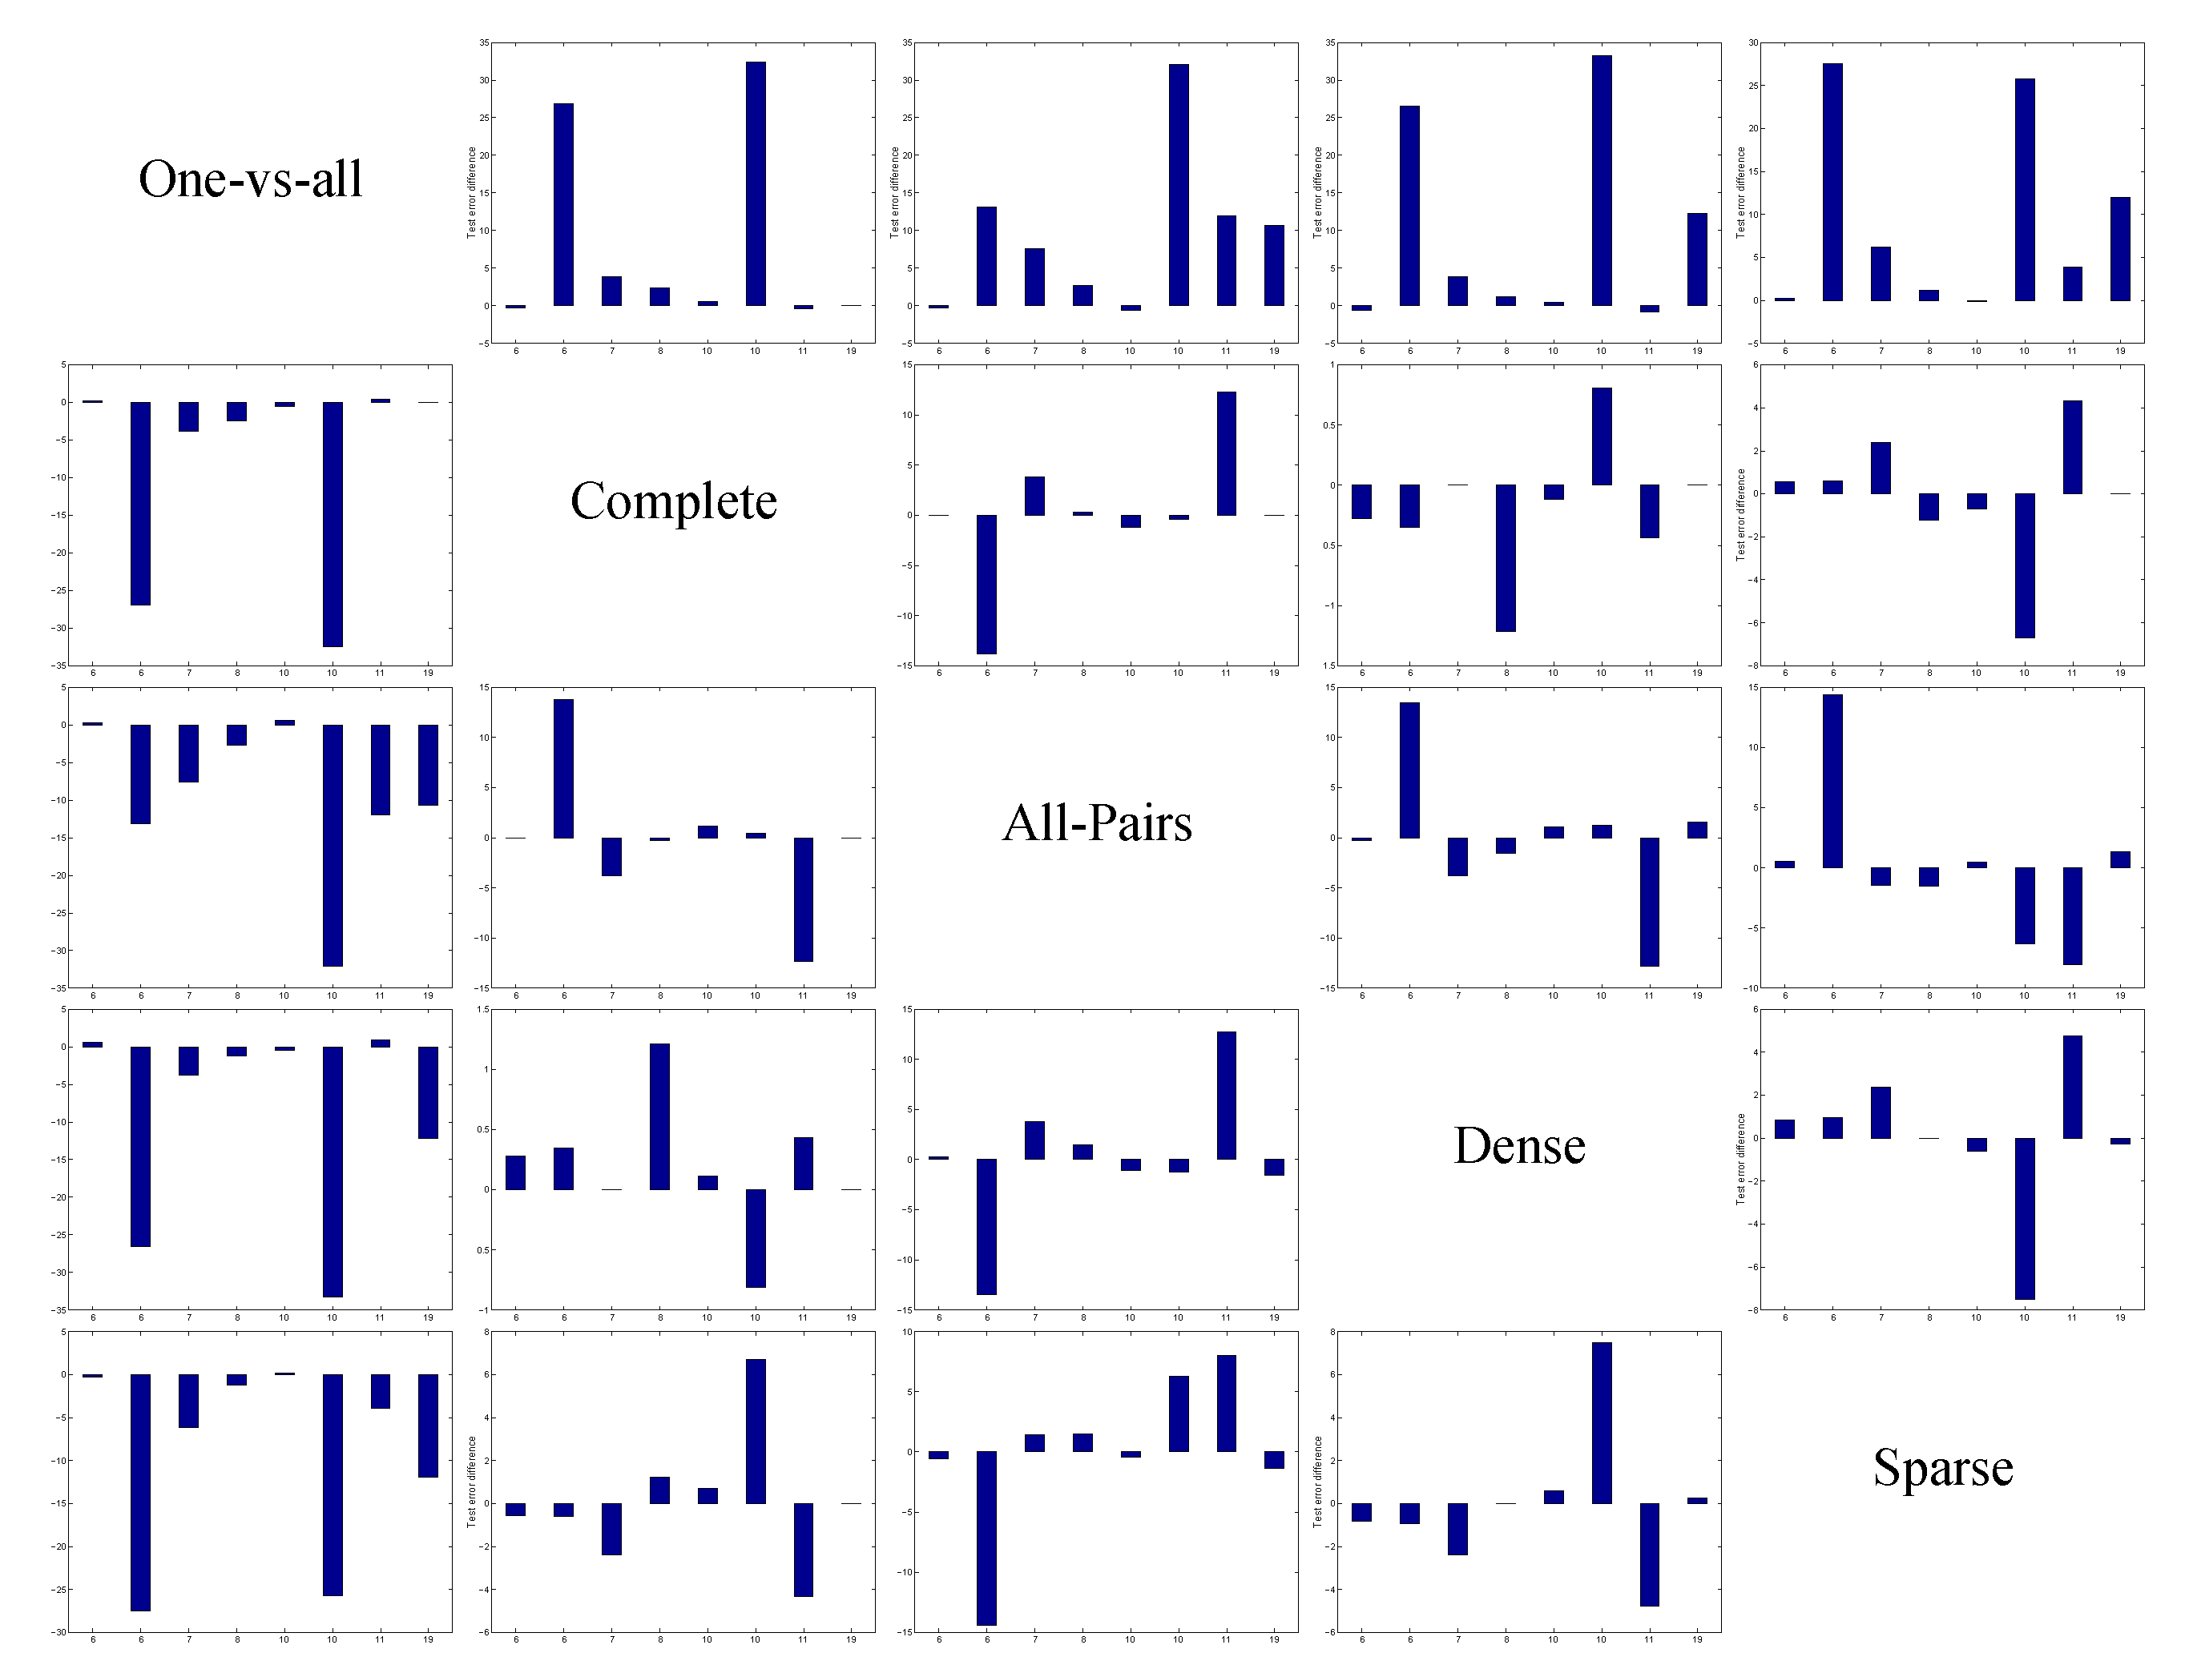
Results – UCI ML Repository

Slide 33
Agenda
Motivation - Reducing Multiclass to Binary
Related work
Margin Classifiers
From Binary to Multiclass
Current paper
A Unifying Approach
Results
Summary

Slide 34
Summary
A general method for combining the classifiers generated on the binary problems is presented.
The scheme and the corresponding bounds apply to many popular classification learning algorithms including support-vector machines, AdaBoost, regression, logistic regression and decision-tree algorithms.
A new technique for combining predictions of binary classifiers is proposed.
Experimental results with SVM and AdaBoost show that current scheme provides a viable alternative to the most commonly used multiclass algorithms.

Slide 35

References
Reducing multiclass to Binary: A Unifying Approach for Margin Classifiers. E.L.Allwein, R.E.Schapire, Y.Singer.
Solving multiclass learning problems via error-correcting
output codes. T. G.Dietterich,.,G.Bakiri.
http://courses.media.mit.edu/2006fall/mas622j/Projects/aisen-project/index.html
Waibel, Hanzawa, Hinton,Shikano, Lang 1989
http://www.glue.umd.edu/~zhelin/recog.html

