Slide 1
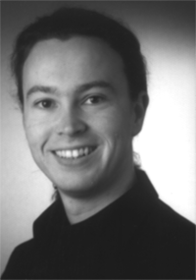
Support Vector Machines
Thorsten Joachims
Presented by: Avi Edri

Slide 2
Overview
Inductive SVM
Text Classification
Bag of Words
TF/IDF
Shuttering and VC-Dimension
Transductive SVM

Slide 3
Generative vs. Discriminative
Generative model is a model for randomly generating observable data, typically given some hidden parameters.
Discriminative models used to modeling the dependence of an unobserved variable y on an observed variable x. Within a statistical framework, this is done by modeling the conditional probability distribution P(y | x), which can be used for predicting y from x.

Slide 4
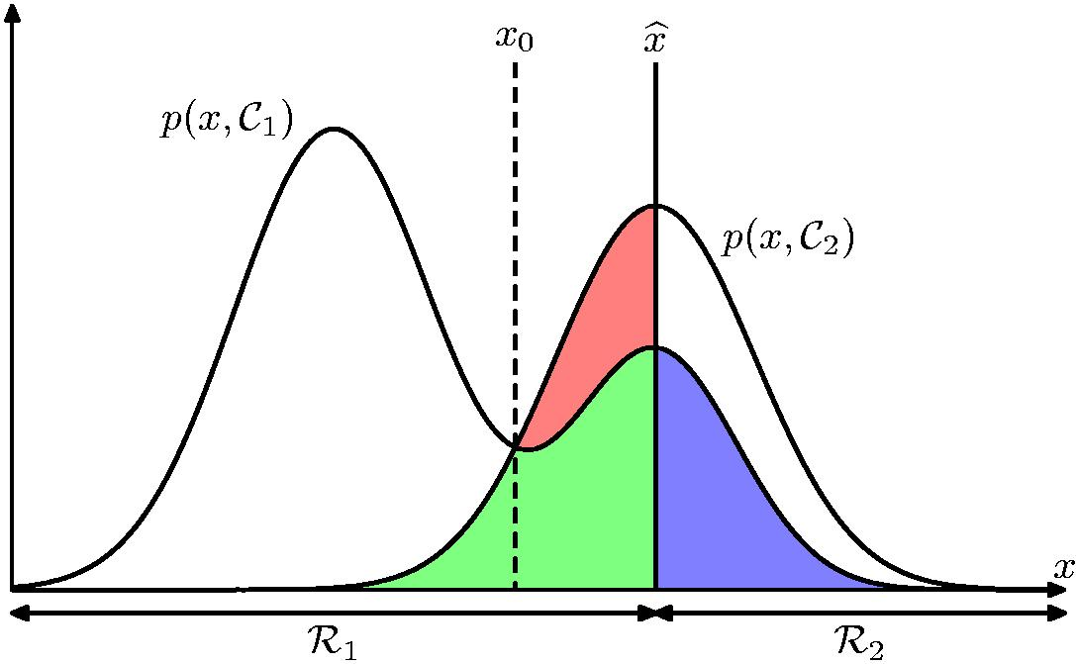
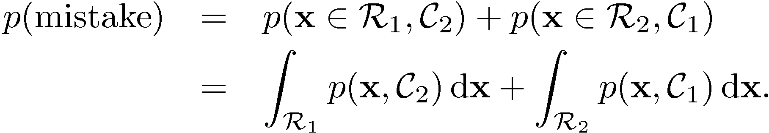
Minimum Misclassification Rate
Notes:
ההסתברות שx שייך לc1 ועוד ההסתברות שx שייך לc2 זו ההתסברות לטעות- סיווג לקבוצה הלא נכונה
זה מה שבמצעים כאשר יש ממד אחד. לכן כאשר יש בעיה עם כמה ממדים אז עוברים לממד אחד ומצבעים את תהליך זה.

Slide 5
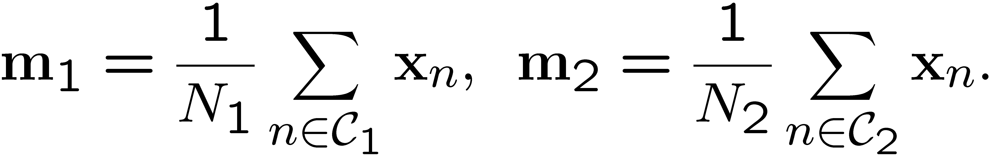
Simple linear classifier
Given two classes
Project points with respect to vector w
How to choose w
Compute means:
Notes:
בהינתן 2 קלאסים מחפשים את הוקטור שמחבר בין 2 המרכזים של הקלאסים
המרכזים הם הממוצע של כל קלאס.
כאשר מכפילים וקטור אחד באחר נקבל מספר אחד- נרד ממד
רוצים שהקלאסים יהיו כמה שפחות מעורבבים כאשר מכפילים בוקטור ועוברים למימד אחד.
כאשר נכפיל בוקטור w שהוא עובר במרכז בין 2 הקלאסים אז נקבל מעבר למימד אחד שבו יש את ההפרדה הכי גבוהה בין 2 הקלאסים.

Slide 6
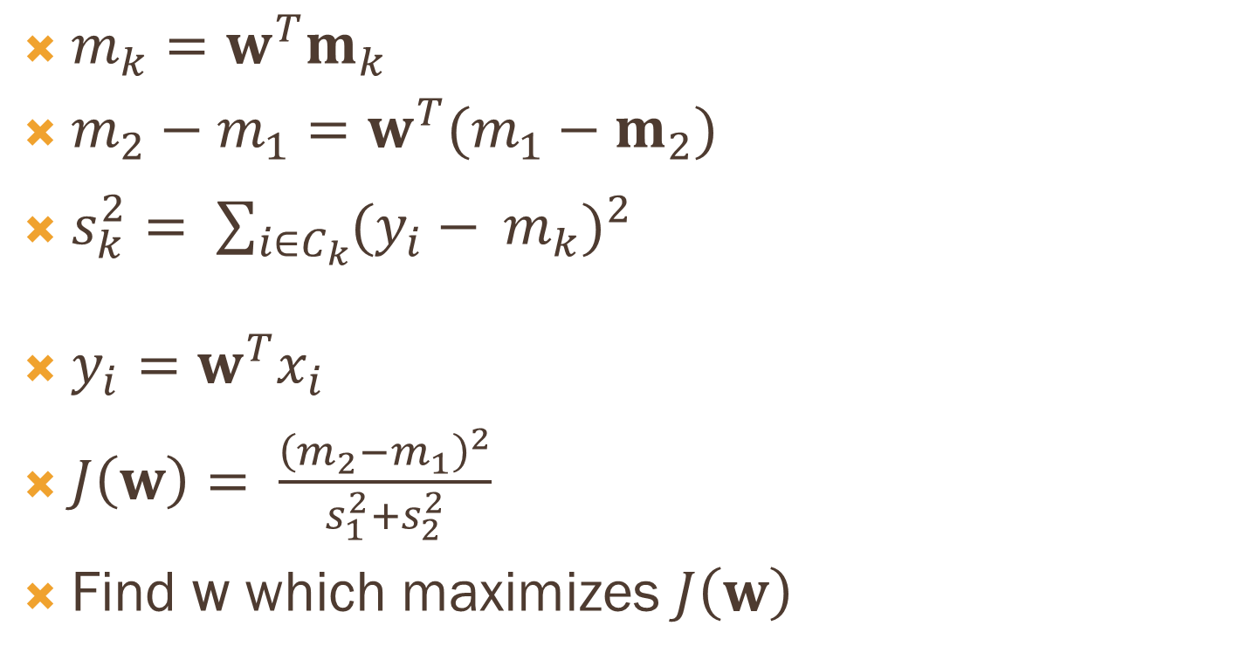
Maximize Fisher Criterion
$m_{k}=w^{T}m_{k}$
$m_{2}−m_{1}=w^{T}(m_{1}−m_{2})$
$s_{k}^{2}= {\sum_{\begin{aligned}i∈C_{k} \\ \end{aligned}}{(y_{i}−} m_{k})}^{2}$
$y_{i}=w^{T}x_{i}$
$J\left(w\right)= \frac{{\left(m_{2}−m_{1}\right)}^{2}}{s_{1}^{2}+s_{2}^{2}}$
Find w which maximizes $J\left(w\right)$

Slide 7
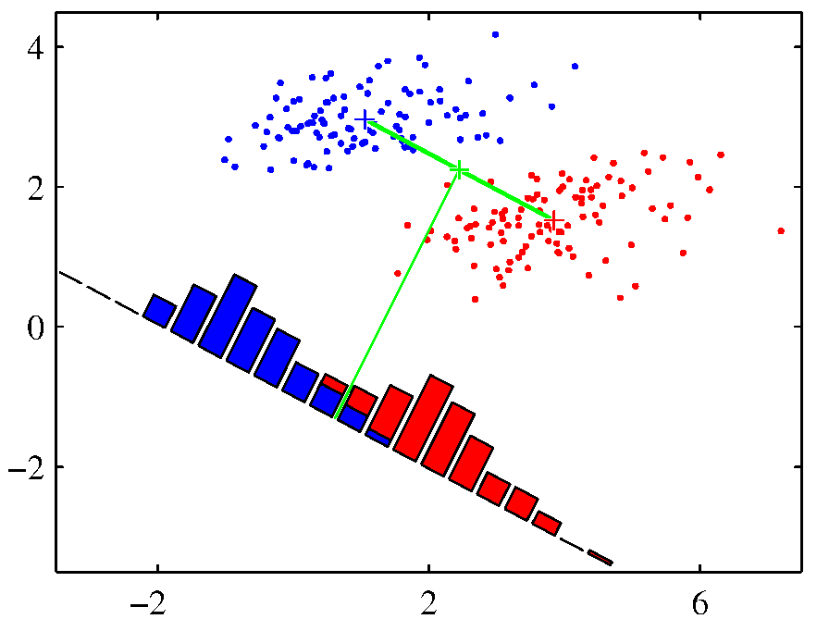
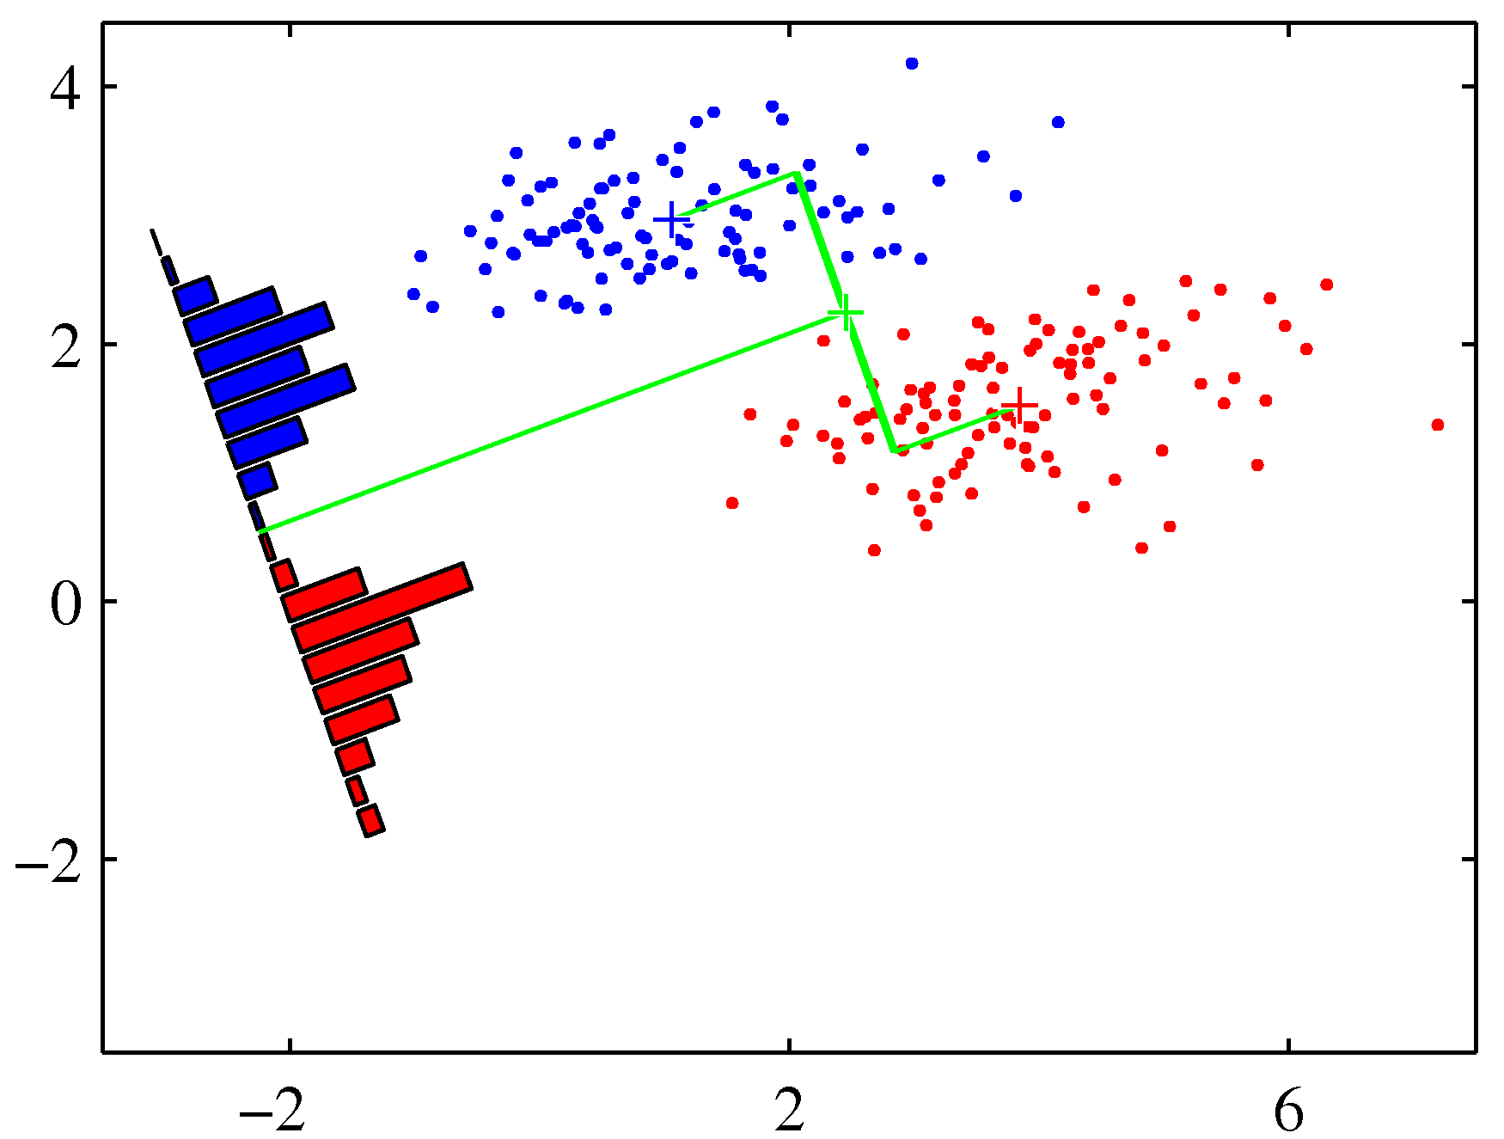
Notes:
ניתן לראות בגרף העליון כי כאשר אנחנו מכפילים בוקטור w אנחנו מקבלים מספר נקודות שהן לא מסווגות טוב
כיוון שהקלאסטרים לא כדוריים, אלא אליפסות. לכן צריך לקחת בחשבון את צורת הקלאסטר כאשר אנחנו רוצים לעשות הפרדה. בגרף השני אנחנו רואים הפרדה טובה בין הקלאסים כי יש התחשבות בכך שהקלאסטרים הם אליפסה. זה מתקבל באמצעות חלוקה של התוצאות בהכפלה של וקטור w בסכום סטיות התקן של המרכזים של הקלאסטרים. אנחנו מחפשים את הw עם המרחק הכי גדול בין המרכזים והשונות הכי קטנה של כל מרכז.
למקסם את הנוסחה:$\frac{{\left(m_{1}−m_{2}\right)}^{2}}{S_{1}^{2}+S_{2}^{2}}$

Slide 8
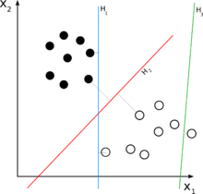
Inductive svm
SVM stands for Support Vector Machines.
Searching for a linear discriminator (hyper plane) with maximal margin.
Notes:
SVM מאפשר לנו למצוא את הוקטור שמפריד את הנתונים בצורה הכי טובה גם כאשר הנתונים הם לא בהתפלגות נורמלית (כמו שהדגמנו מקודם).
מגדירים מפריד במימד הכי גבוה ובודקים האם זה מפריד בין הקלאסים בtraining data.
צריך למצוא מפריד שהאזור הריק (margin) בין הקו המפריד לבין כל קלאס הוא הגדול ביותר, על מנת שבהמשך לא יהיו נקודות באוספי נתונים אחרים שבו יהיו טעויות בסיווג.
SVM- אלגוריתם מסווג

Slide 9
α
Linear Classifiers
x
f
y^{est}
f(x,w,b) = sign(w x + b)
denotes +1
denotes -1
w x + b>0
w x + b=0
How would you classify this data?
w x + b<0
Mingyue Tan The University of British Columbia Nov 26, 2004
Notes:
הערך של wx+b אומר אם התצפית שייכת לקלאס +1 או קלאס -1 .
אם גדול מ0 אז קלאס +1 אם קטן מ0 אז קלאס -1.
אז מעניין רק אם הערך גדול, קטן או שווה ל0-חיובי או שלילי, נקרא ערך הsign.

Slide 10
α
Linear Classifiers
x
f
y^{est}
f(x,w,b) = sign(w x + b)
denotes +1
denotes -1
How would you classify this data?
Mingyue Tan The University of British Columbia Nov 26, 2004

Slide 11
α
Linear Classifiers
x
f
y^{est}
f(x,w,b) = sign(w x + b)
denotes +1
denotes -1
How would you classify this data?
Mingyue Tan The University of British Columbia Nov 26, 2004

Slide 12
α
Linear Classifiers
x
f
y^{est}
f(x,w,b) = sign(w x + b)
denotes +1
denotes -1
Any of these would be fine..
..but which is best?
Mingyue Tan The University of British Columbia Nov 26, 2004
Notes:
כל הקוים תופסים כדי לסווג נכון, אך אנחנו מחפשים את הכי טוב, עם הmargin הכי גדול

Slide 13
α
Linear Classifiers
x
f
y^{est}
f(x,w,b) = sign(w x + b)
denotes +1
denotes -1
How would you classify this data?
Misclassified
to +1 class
Mingyue Tan The University of British Columbia Nov 26, 2004
Notes:
הנקודה המסומנת יסווג את הנקודה כשחורה(+1) למרות שהיא כנראה לבנה(-1)

Slide 14
α
α
Classifier Margin
Classifier Margin
x
x
f
f
y^{est}
y^{est}
f(x,w,b) = sign(w x + b)
f(x,w,b) = sign(w x + b)
denotes +1
denotes -1
denotes +1
denotes -1
Define the margin of a linear classifier as the width that the boundary could be increased by before hitting a datapoint.
Define the margin of a linear classifier as the width that the boundary could be increased by before hitting a datapoint.
Notes:
מתרחקים מהקו המסווג לשני הכיוונים עד שנתקלים בנקודה בשני הכיוונים, זה יקבע כערך הmarign של המסווג

Slide 15
α
Maximum Margin
x
f
y^{est}
Maximizing the margin is good according to intuition and PAC theory
Implies that only support vectors are important; other training examples are ignorable.
Empirically it works very very well.
f(x,w,b) = sign(w x + b)
denotes +1
denotes -1
The maximum margin linear classifier is the linear classifier with the, um, maximum margin.
This is the simplest kind of SVM (Called an LSVM)
Support Vectors are those datapoints that the margin pushes up against
Linear SVM
Mingyue Tan The University of British Columbia Nov 26, 2004
Notes:
Support vectors אלו הוקטורים שמגדירים לנו את הmargin.
SVM-Support Vector Machine מחפש את המסווג עם הsupport vectors שנותנים את הmargin ההכי גדול.

Slide 16
Linear SVM Mathematically
x⁺
M=Margin Width
“Predict Class = +1” zone
X⁻
wx+b=1
“Predict Class = -1” zone
wx+b=0
wx+b=-1
What we know:
<w , x^{+>} + b = +1
<w , x^{->} + b = -1
<w , (x⁺-x^{-)>} = 2
Mingyue Tan The University of British Columbia Nov 26, 2004

Slide 17
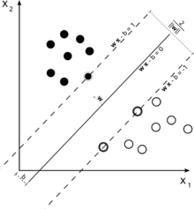



Inductive svm

Slide 18

Inductive svm – The primal problem
This is a quadratic programming problem and can be solved using efficient numeric algorithms, finding the global minimum.

Slide 19







Inductive svm – The Dual problem
Notes:
לגרנזיאן

Slide 20
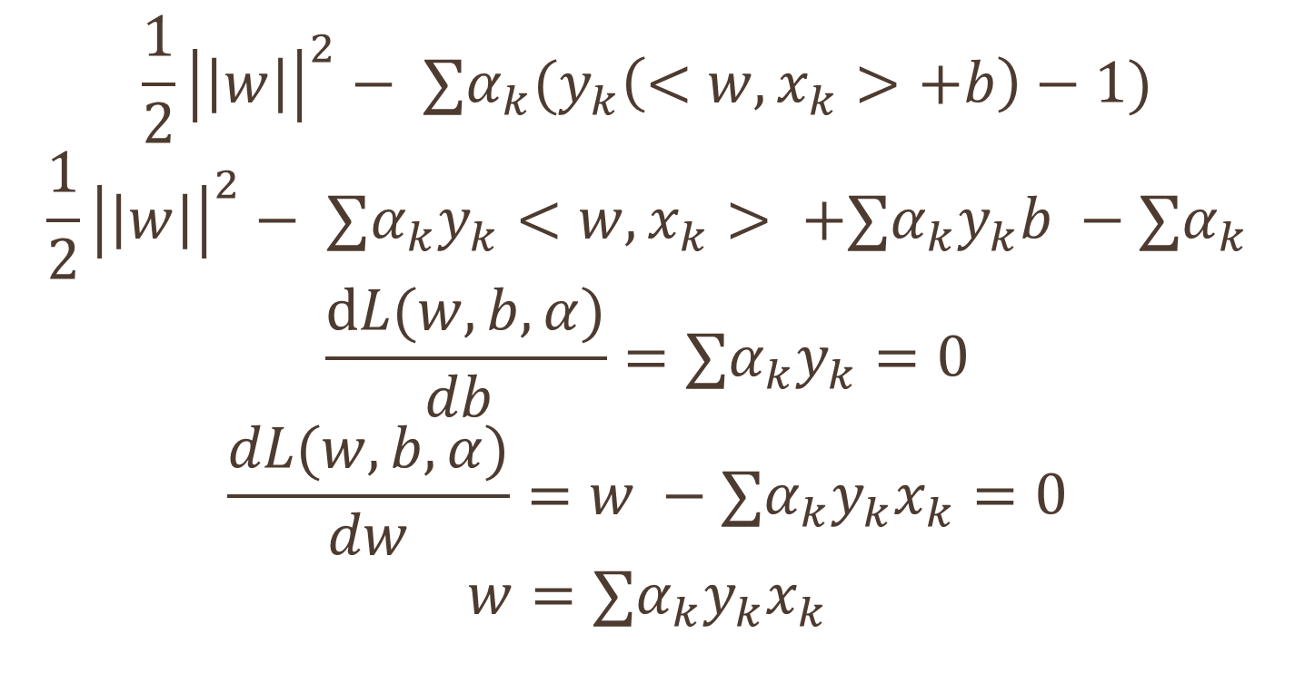
Derivation
$$\frac{1}{2}{\left|\left|w\right|\right|}^{2}− ∑α_{k}{(y}_{k}\left(<w,x_{k}>+b\right)−1)$$
$$\frac{1}{2}{\left|\left|w\right|\right|}^{2}− ∑α_{k}y_{k}<w,x_{k}> +∑α_{k}y_{k}b −∑α_{k}$$
$$\frac{dL(w,b,α)}{db }=∑α_{k}y_{k}=0$$
$$\frac{dL(w,b,α)}{dw}=w −∑α_{k}y_{k}x_{k}=0$$
$$w=∑α_{k}y_{k}x_{k}$$

Slide 21
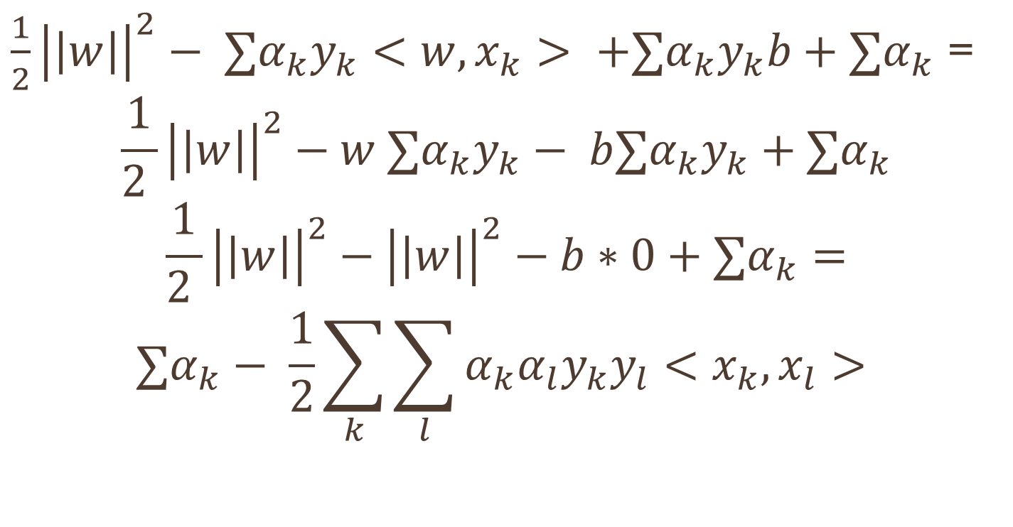
Derivation
$\frac{1}{2}{\left|\left|w\right|\right|}^{2}− ∑α_{k}y_{k}<w,x_{k}> +∑α_{k}y_{k}b+∑α_{k}$ =
$$\frac{1}{2 }{\left|\left|w\right|\right|}^{2}−w ∑α_{k}y_{k}− b∑α_{k}y_{k}+∑α_{k}$$
$$\frac{1}{2 }{\left|\left|w\right|\right|}^{2}−{\left|\left|w\right|\right|}^{2}−b∗0+∑α_{k}=$$
$$∑α_{k}− \frac{1}{2}\sum_{k}{\sum_{l}{α_{k}α_{l}y_{k}y_{l}<x_{k},x_{l}> }}$$

Slide 22
Dataset with noise
denotes +1
denotes -1
Hard Margin: So far we require all data points be classified correctly
- No training error
What if the training set is noisy?
- Solution 1: use very powerful kernels
OVERFITTING!
Mingyue Tan The University of British Columbia Nov 26, 2004

Slide 23
Soft Margin Classification
Slack variables ξi can be added to allow misclassification of difficult or noisy examples.
What should our quadratic optimization criterion be?
Minimize
ε₁₁
ε₂
wx+b=1
ε₇
wx+b=0
wx+b=-1
Mingyue Tan The University of British Columbia Nov 26, 2004

Slide 24
Hard Margin v.s. Soft Margin
The old formulation:
The new formulation incorporating slack variables:
Parameter C can be viewed as a way to control overfitting.
Find w and b such that
Φ(w) =½ <w^{T,}w> is minimized and for all {(x_{i} ,y_{i})}
y_{i} (<w^{T,}x_{i} >+ b) ≥ 1
Find w and b such that
Φ(w) =½ <w^{T,}w> + CΣξ_{i} is minimized and for all {(x_{i} , y_{i})}
y_{i} (<w^{T,} x_{i} >+ b) ≥ 1- ξ_{i} and ξ_{i} ≥ 0 for all i
Mingyue Tan The University of British Columbia Nov 26, 2004

Slide 25
Non-linear SVMs
Datasets that are linearly separable with some noise work out great:
But what are we going to do if the dataset is just too hard?
How about… mapping data to a higher-dimensional space:
0
x
0
x
x²
0
x
Mingyue Tan The University of British Columbia Nov 26, 2004

Slide 26
Non-linear SVMs: Feature spaces
General idea: the original input space can always be mapped to some higher-dimensional feature space where the training set is separable:
Φ: x → φ(x)
Mingyue Tan The University of British Columbia Nov 26, 2004

Slide 27
The “Kernel Trick”
The linear classifier relies on dot product between vectors K(x_{i},x_{j})=x_{i}^{T}x_{j}
If every data point is mapped into high-dimensional space via some transformation Φ: x → φ(x), the dot product becomes:
K(x_{i},x_{j})= φ(x_{i}) ^{T}φ(x_{j})
A kernel function is some function that corresponds to an inner product in some expanded feature space.
Example:
2-dimensional vectors x=[x₁ x₂]; let K(x_{i},x_{j})=(1 + x_{i}^{T}x_{j})²,
Need to show that K(x_{i},x_{j})= φ(x_{i}) ^{T}φ(x_{j}):
K(x_{i},x_{j})=(1 + x_{i}^{T}x_{j})²,
= 1+ x_{i1}²x_{j1}² + 2 x_{i1}x_{j1} x_{i2}x_{j2}+ x_{i2}²x_{j2}² + 2x_{i1}x_{j1} + 2x_{i2}x_{j2}
= [1 x_{i1}² √2 x_{i1}x_{i2} x_{i2}² √2x_{i1} √2x_{i2}]^{T} [1 x_{j1}² √2 x_{j1}x_{j2} x_{j2}² √2x_{j1} √2x_{j2}]
= φ(x_{i}) ^{T}φ(x_{j}), where φ(x) = [1 x₁² √2 x₁x₂ x₂² √2x₁ √2x₂]

Slide 28
Other Kernels
Polynomial homogeneous
k(x,z)=(x • z)^{d}
Polynomial inhomogeneous
k(x,z) = (x • z+1)^{d}
Radial Basis Functions
k(x,z) = exp(γ ||x – z ||²), γ > 0
Hyperbolic tangent
k(x,z) = tanh(κ x • z + c), for some κ>0 and c<0

Slide 29
Properties of SVM
Sparseness of solution when dealing with large data sets
only support vectors are used to specify the separating hyperplane.
Ability to handle large feature spaces
complexity does not depend on the dimensionality of the feature space.
Overfitting can be controlled by soft margin approach.
Nice math property: a simple convex optimization problem which is guaranteed to converge to a single global solution.
Mingyue Tan The University of British Columbia Nov 26, 2004

Slide 30
Weakness of SVM
It is sensitive to noise
A relatively small number of mislabeled examples can dramatically decrease the performance
It only considers two classes
how to do multi-class classification with SVM?
Mingyue Tan The University of British Columbia Nov 26, 2004

Slide 31
Text classification
The task of text classification is to assign a document to one or more predefined categories.
A problem in the area of Text Mining.
A lot of useful application – categorization, spam detection, net-news filtering etc…

Slide 32
Bag of words
The text is represented as an unordered collection of words (unigrams).
Disregarding grammar and word order.
Two major event model approaches:
Multinomial (Term frequency)
Multivariate (Bernoulli model)

Slide 33
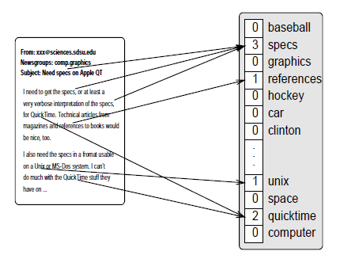

TF/IDF
TF – The number of time a word occurs in a document.
IDF – Inverse document frequency.
Notes:
n is the number off all documents
DF is the number of document word wi occur in them

Slide 34
svm is good for Text classification
High dimensional input space.
Few irrelevant features.
Document vectors are sparse.
Most text categorization problems are linearly separable.
Notes:
הצורך בהפחתת תכוניות קטן בגלל שבטקסט רוב המילים חשובות.

Slide 35
shuttering
A classification model f with some parameter vector θ is said to shatter a set of data points (x1, x2 .. xr ) if and only if for every possible training set of the form (x1,y1) , (x2,y2) ,… (xr ,yr) there exists some value of θ that gets zero training error.
There are 2^r such training sets to consider, each with a different combination of +1’s and –1’s for the y’s.

Slide 36
shuttering

Slide 37
VC - Dimension
The maximum number of points that can be arranged so that f shatter them.
In case of a line VC-Dim = 3
In case of linear classifier in m dimension the VC-Dim = m+1

Slide 38
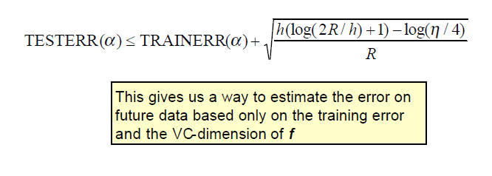
Why does VC – Dimension helps us
Another way to do it is by cross-validation.
Notes:
Empirical Risk Minimization

Slide 39
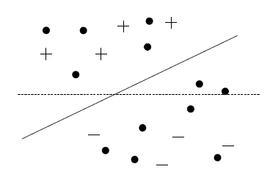
Transductive svm
Inductive SVM try to induce a general decision function which has a low error rate on the whole distribution of examples for the particular learning task.
Transductive SVM take into account a particular test set.

Slide 40





Transductive svm theory

Slide 41
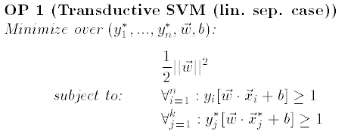
TSVM oP - linear

Slide 42
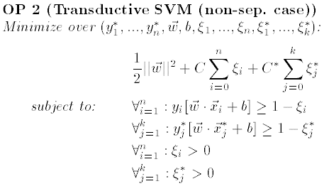
TSVM oP - linear

Slide 43
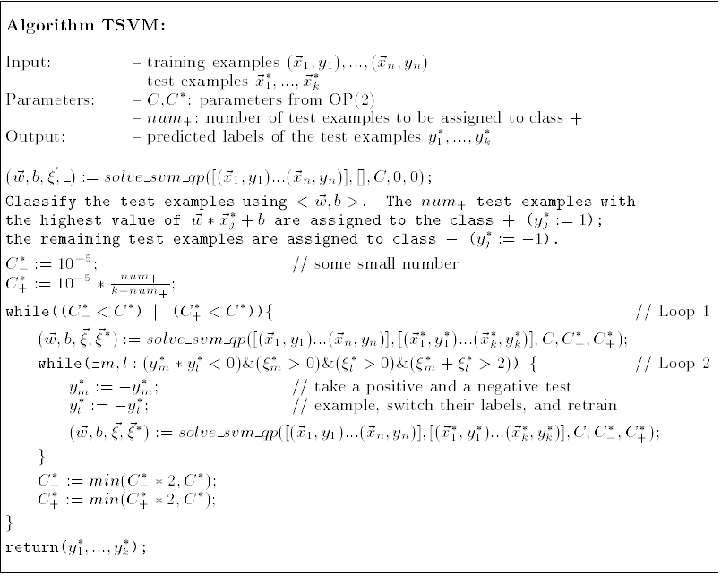

Slide 44
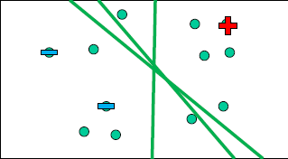
Transductive svm algorithm
Assign labels to test example
(s.t class balance constraint)
Train supervised SVM
Do
Find pair of test labels to flip
Retrain supervised SVM
While objective decreased
Smoothed objective to avoid local optima
Smoothing reduced as optimization progress
Criterion for selecting pair that guarantees descent
Criterion is efficiently computable

Slide 45
Text classification using Tsvm
Bag of Words, using the multinomial event model approach.
Preprocessing using stemming.
A better representation using the IDF where a word is low if it occurs in many documents.
Precision/Recall breakeven point measure used for evaluation.

Slide 46
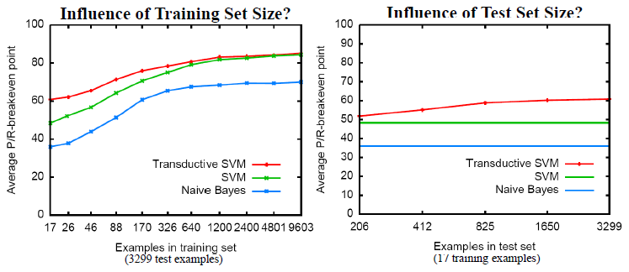
Experiment: Reuters-21587
Top 10 categories of Reuters-21587 dataset
~12000 features after stemming and stopword removal

Slide 47
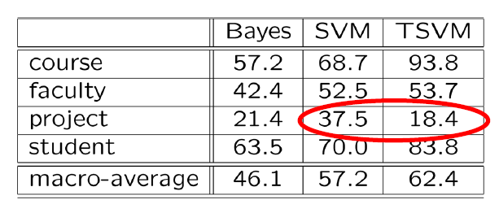
Experiment: web-kb
9 training examples, 3957 test examples

Slide 48
Questions?

