Slide 1
Rapid Object Detection using a Boosted Cascade of Simple Features
Paul Viola
Michael Jones
Notes:
זיהוי "מזורז" של אובייקטים באמצעות שימוש בפיצ'רים
In the Viola-Jones object detection framework, the Haar-like features are therefore organized in something called a classifier cascade to form a strong learner or classifier.
מטרת האלגוריתם הוא זיהוי פרצופים
כאשר יש לנו מצלמה דבר ראשון צריך להכניס אותה לפוקוס, תחילה ביצעו זו ידנית, לאחר מכן הייתה גירסה שמשנה את הצמצמם עד שהיא נכנסת לפוקוס, לאחר מכן אוטומטית המצלמה מבצעת פוקוס על האובייקט המרכזי בתמונה, היום המצלמות מזהות מה האובייקט בתמונה ולפכי כך מחליטות על מה לעשות פוקוס.
אלגוריתם זה מזהה באופן מהיר אובייקטים.

Slide 2
Contents
Abstract
Introduction
Suggested approach
Results
Conclusions

Slide 3
Abstract
This paper describes a machine learning approach for visual object detection which is capable of processing images extremely rapidly and achieving high detection rates.
3 key contributions:
The introduction of a new image representation called the “Integral Image” which allows the features used by our detector to be computed very quickly.
A learning algorithm, based on AdaBoost, which selects a small number of critical visual features from a larger set and yields extremely efficient classifiers.
A method for combining increasingly more complex classifiers in a “cascade” which allows background regions of the image to be quickly discarded while spending more computation on promising object-like regions.
Notes:
AdaBoost is an algorithm for constructing a ”strong” classifier as linear combination of “simple” “weak” classifiers
Cascade – סדרה של פעולות שבה פעולה אחת גוררת את זו שבאה אחריה
באלגוריתם יש כמה חלקים חשובים:
דבר ראשון הוא למצוא את הfeatures- נדרש כי תהליך זה יתבצע כמה שיותר מהר כדי לא לעכב את שאר העבודה. הם משתמשים במשהו שנקרא "integral image"
האלגוריתם מבוסס על adaboost, זאת אומרת על מסווגים פשוטים
החלק השלישי הוא cascade (מפל מים)- הוא מקבל תמונה ומגדיר מה בוודאות לא פרצוף וכך חוסך הרבה זמן ביזהוי הפרצוף (זורק 98 אחוז מהפיקסלים בתמונה כי מזהה אותם כרקע
השלבים מתבצעים כל פעם על מה שנשאר עד להגעה לתוצאה רצויה

Slide 4
Abstract (2)
The cascade can be viewed as an object specific focus-of-attention mechanism which unlike previous approaches provides statistical guarantees that discarded regions are unlikely to contain the object of interest.
Used in real-time applications, the detector runs at 15 frames per second without resorting to image differencing or skin color detection.
Notes:
ניתן להסתכל על סדרת הפעולות כעל מכניזם המתמקד באזורים מסויימים בתמונה אשר בניגוד לגישות קודמות מספק התחייבות סטטיסטית שסביר להניח שאזורים שאינם מרכזיים בתמונה לא יכילו את האובייקט אותו מחפשים
ה-detector סורק 15 תמונות לשנייה מבלי להזדקק לשיטות להבחנה/הבדלה בין תמונות או לזיהוי ספציפי של צבע עור
A cascaded classifier to combine many features efficiently

Slide 5
Introduction
This face detection system is most clearly distinguished from previous approaches in its ability to detect faces extremely rapidly.
Operating on 384 by 288 pixel images, faces are detected at 15 frames per second on a conventional 700 MHz Intel Pentium III.
Achieves high frame rates working only with the information present in a single grey scale image.

Slide 6
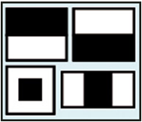
1st Contribution: Integral Image
A new image representation that allows for very fast feature evaluation.
The detection system does not work directly with image intensities.
Instead, it uses a set of features which are reminiscent of Haar Basis functions.
The integral image can be computed
from an image using a few operations per pixel.
Once computed, any one of these Harr-like features can be computed at any scale or location in constant time.
Notes:
מעבירים הכל לשחור לבן, כל מה שכתוב בשחור מכפילים את ערך האפרוריות שלו ב1, כל מה שכתוב בלבן מכפילים ב-1, סוכמים את הפיקסלים באזור מסוים, אם הערך יוצא קרוב ל0 אז מעיפים את אזור זה
Reminiscent – מזכיר
Simple rectangular features, called Haar features
לאחר שה-detector עיבד את ה-harr like features, הוא יהיה מסוגל לזהות אותם בכל מימד או מיקום בזמן קבוע

Slide 7
2nd Contribution: Classifier Construction Method
Selecting a small number of important features using AdaBoost.
Within any image sub-window the total number of Harr-like features is very large, far larger than the number of pixels.
In order to ensure fast classification, the learning process must exclude a large majority of the available features, and focus on a small set of critical features.
Feature selection is achieved through a simple modification of the AdaBoost procedure: the weak learner is constrained so that each weak classifier returned can depend on only a single feature.
As a result each stage of the boosting process (which selects a new weak classifier) can be viewed as a feature selection process.
Notes:
שיטה לבניית מסווגים

Slide 8
3rd Contribution: The Attentional Cascade
a method for combining successively more complex classifiers in a cascade structure which dramatically increases the speed of the detector by focusing attention on promising regions of the image.
The notion behind focus of attention approaches is that it is often possible to rapidly determine where in an image an object might occur.
More complex processing is reserved only for these promising regions.
Notes:
Attentional - ששייך או קשור ליכולת לשים לב, ששייך או קשור לתשומת לב
שיטה לשילוב בין מסווגים במבנה מדורג אשר מגדיל את מהירות הזיהוי ע"י התמקדות באזורים רלוונטיים בתמונה
היתרון בשיטות כאלו אשר מנסות להתמקד באזורים מסויימים בעיקר בתמונה היא שלעיתים ניתן לזהות מהר מאוד היכן בתמונה נמצא האובייקט
עיבוד מורכב יותר מתבצע על האזורים האלו שזוהו
המדד העיקרי בשיטה זו היא שכל האינסטנסים של האובייקט צריכים להיות מזוהים ע"י הפילטר

Slide 9
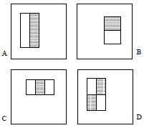
Features
Images are classified based on the value of simple features, rather than using pixels directly.
3 kinds of features:
The value of a two-rectangle feature is the difference
between the sum of the pixels within two rectangular regions.
The regions have the same size and shape
and are horizontally or vertically adjacent.
A three-rectangle feature computes the
sum within two outside rectangles
subtracted from the sum in a center
rectangle.
A four-rectangle feature computes the
difference between diagonal pairs of
Rectangles.
Notes:
בשלב הראשון מגדירים עשרות אלפי פיצ'רים, לאחר שנפעיל את הadaboost לא נשתמש בכל הפיצ'רים, אלא נבחר רק את פיצ'רים המשמעותיים
Why features?
Features can act to encode ad-hoc domain knowledge that is difficult to learn using a finite quantity of training data.
The feature based system operates much faster than a pixel-based system.
Figure 1: Example rectangle features shown relative to the enclosing detection window. The sum of the pixels which lie within the white rectangles are subtracted from the sum of pixels in the grey rectangles. Two-rectangle features are shown in (A) and (B). Figure (C) shows a three-rectangle feature, and (D) a four-rectangle feature.
Note that unlike the Haar basis, the set of rectangle features is over complete.

Slide 10

Integral Image
Rectangle features can be computed very rapidly using an intermediate representation for the image which we call the integral image.
The integral image at location x,y contains the sum of the pixels above and to the left of x,y, inclusive:
Notes:
מחשבים את האינטגרל של הפיקסל בפינה העליונה בצד שמאל, לאחר מכן מחשבים כל פעם מה יהיה הערך של האינטגרל אם מוסיפים את הפיקסל הבא, באמצעות חישוב הערך של הפיקסל החדש וחיבור עם הערך שכבר חושב בפעם הקודמת, כך מחשבים עבור על התמונה.
האינטגרל אימג' של x,y הוא סכום כל האינטגרלים שהגיעו לפני

Slide 11
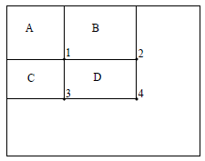
Integral Image (2)
Using the integral image any rectangular sum can be computed in four array references:
The sum of the pixels within Rectangle D:
The value of the integral image at location 1 is sum
of the pixels in rectangle A.
The value at location 2 is A + B, at location 3 is
A + C.
The value at location 4 is A + B + C + D.
The sum within D can be computed as
4 + 1 – (2 + 3) = ((A + B + C +D + A) –
(A + B + (A + C)) = D
Notes:
נניח ורוצים לחשב את מלבן D , אז הולכים לערכים בintegral image של כל פינות המלבן.
השטח של 1 זה A
השטח של 2 זה A+B
השטח של 3 זה C+A
השטח של 4 זה A+B+C+D
אז ניתן לחשב $4+1−\left(2+3\right)=(\left(A+B+C+D+A\right)−\left(A+B+\left(A+C\right)\right)=D$

Slide 12
Learning Classification Functions
Given a feature set and a training set of positive and negative images, any number of machine learning approaches could be used to learn a classification function.
In our system a variant of AdaBoost is used both to select a small set of features and train the classifier.
In its original form, the AdaBoost learning algorithm is used to boost the classification performance of a simple (sometimes called weak) learning algorithm.
Notes:
על מנת ללמוד צריך דוגמאות של תמונות חיוביות ושליליות להתאמן עליהן. לכן מכינים training set באופן ידני.

Slide 13
Learning Classification Functions (2)
There are over 180,000 rectangle features associated with each image sub-window, a number far larger than the number of pixels.
Even though each feature can be computed very efficiently, computing the complete set is expensive.
The hypothesis here is that a very small number of these features can be combined to form an effective classifier.
The main challenge is to find these features.
Notes:
קיימים 180,000 פיצ'רים אפשריים עבור כל תת חלון, אך לא מחשבים את כולם.

Slide 14
Learning Classification Functions (3)
In support of this goal, the weak learning algorithm is designed to select the single rectangle feature which best separates the positive and negative examples.
For each feature, the weak learner determines the optimal threshold classification function, such that the minimum number of examples are misclassified.
In practice no single feature can perform the classification task with low error.
Features which are selected in early rounds of the boosting process had error rates between 0.1 and 0.3.
Features selected in later rounds, as the task becomes more difficult, yield error rates between 0.4 and 0.5.
Notes:
כל feature הוא weak learner
עבור כל feature שנבחר המסווג קובע את ערך הסף האופטימלי בו מתקבל מספר מינימלי של דוגמאות שאינן מסווגות נכון
בפועל אין feature יחיד אשר יכול לבצע את תהליך הסיווג ללא טעויות
ל-Features בניסויים ראשוניים היו טעויות בין הערכים 0.1 ל-0.3 ובהמשך כאשר המשימה נהייתה קשה יותר בין 0.4 ל-0.5

Slide 15
Learning Classification Results
Initial experiments demonstrated that a frontal face classifier constructed from 200 features yields a detection rate of 95% with a false positive rate of 1 in 14084. These results are compelling, but not sufficient for many real-world tasks.
In terms of computation, this classifier is probably faster than any other published system, requiring 0.7 seconds to scan an 384 by 288 pixel image.
Unfortunately, the most straightforward technique for improving detection performance, adding features to the classifier, directly increases computation time.
Notes:
באמצעות שימשו בadaboost עם 200 features אז יצא רמת דיוק של זיהוי פרצופים ב95%, אם false positive של 1 מתוך 14048.
תוצאות אלו לא מספיקות למשימות בעולם האמיתי.
צריך משהו לשפר את הביצועים בלי להעלות את זמן היבצוע.

Slide 16
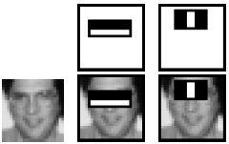
Learning Classification Results (2)
For the task of face detection, the initial rectangle features selected by AdaBoost are meaningful and easily interpreted.
The first and second features selected by Ad-aBoost are shown in the top row and then overlayed on a typical training face in the bottom row.
Notes:
The first feature measures the difference in intensity between the region of the eyes and a region across the upper cheeks.
The feature capitalizes on the observation that the eye region is often darker than the cheeks.
The second feature compares the intensities in the eye regions to the intensity across the bridge of the nose.

Slide 17
The Attentional Cascade
An algorithm for constructing a cascade of classifiers which achieves increased detection performance while radically reducing computation time
boosted classifiers can be constructed which reject many of the negative sub-windows while detecting almost all positive instances
Simpler classifiers are used to reject the majority of sub-windows before more complex classifiers are called upon to achieve low false positive rates
Notes:
מפעילים classifier אם הוא אומר שזה בטוח לא פרצוף אז מוותרים עליו, אם לא בטוח אז הוא עובר לשלב הסיווג הבא. לכן נדרש שכמעט ולא יהיה מקרים בהם שהוא אומר שפרצוף הוא לא פרצוף, כי אז המלבן בתמונה נזרק הצידה ואבד ולא נזהה אותו כפרצוף.
בכל מעבר לסיווג הבא אנחנו מצמצים את כמות המלבנים שאנחנו עוברים עליהם.

Slide 18
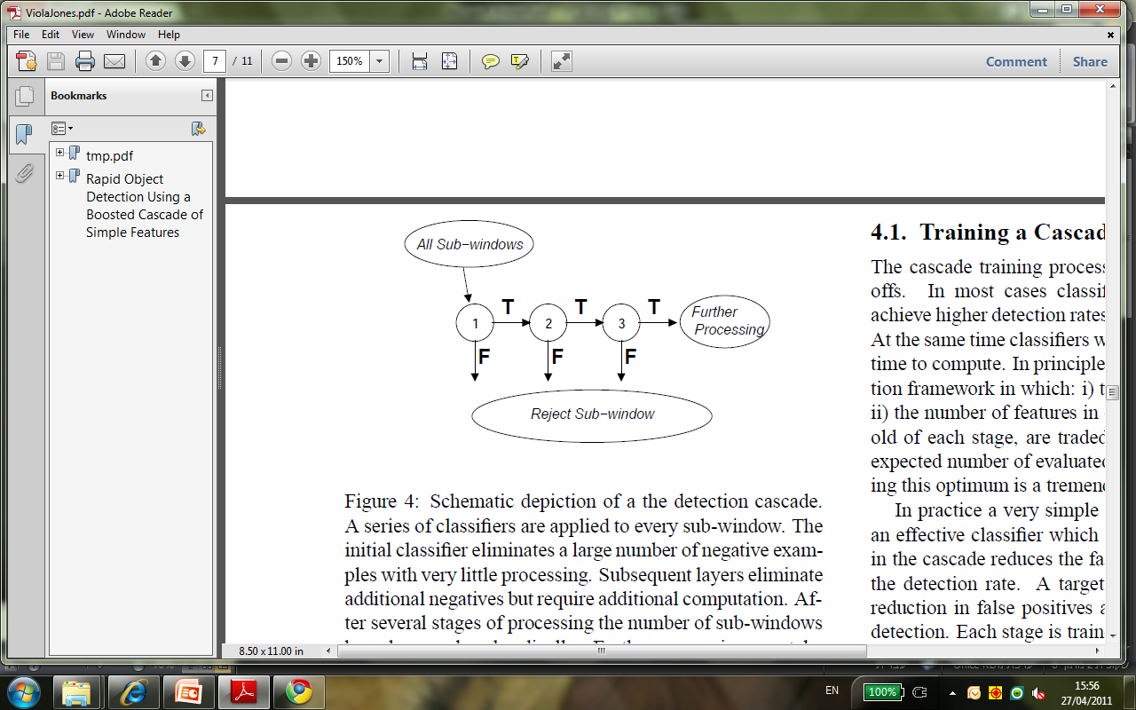
The Attentional Cascade
The overall form of the detection process is that of a degenerate decision tree
Notes:
A positive result from the first classifier triggers the evaluation of a second classifier which has also been adjusted to
achieve very high detection rates. A positive result from the second classifier triggers a third classifier, and so
on. A negative outcome at any point leads to the immediate rejection of the sub-window

Slide 19
The Attentional Cascade
Stages in the cascade are constructed by training classifiers using AdaBoost and then adjusting the threshold to minimize false negatives
A lower threshold yields higher detection rates and higher false positive rates
For example an excellent first stage classifier can be constructed from a two-feature strong classifier by reducing the threshold to minimize false negatives
The cascade attempts to reject as many negatives as possible at the earliest stage possible
Notes:
Note: the second classifier faces a more difficult task than the first

Slide 20
Training a Cascade
In most cases classifiers with more features will achieve higher detection rates and lower false positive rates
Classifiers with more features require more time to compute
Each stage in the cascade reduces the false positive rate and decreases the detection rate. A target is selected for the minimum reduction in false positives and the maximum decrease in detection
Each stage is trained by adding features until the target detection and false positives rates are met
Stages are added until the overall target for false positive and detection rate is met

Slide 21
Detector Cascade
The complete face detection cascade has 38 stages with over 6000 features
On a difficult dataset, containing 507 faces and 75 million sub-windows, faces are detected using an average of 10 feature evaluations per sub-window
The detector is purely density discriminative
Notes:
In comparison, this system is about 15 times faster than an implementation of the detection system constructed
by Rowley et al.

Slide 22
Results
A 38 layer cascaded classifier was trained to detect frontal upright faces
To train the detector, a set of face and nonface training images were used. The face training set consisted of 4916 hand labeled faces scaled and aligned to a base resolution of 24 by 24 pixels
The number of features in the first five layers of the detector is 1, 10, 25, 25 and 50 features respectively
The remaining layers have increasingly more features
The total number of features in all layers is 6061
Each classifier in the cascade was trained with the 4916 training faces and 10,000 non-face sub-windows using the Adaboost training procedure

Slide 23
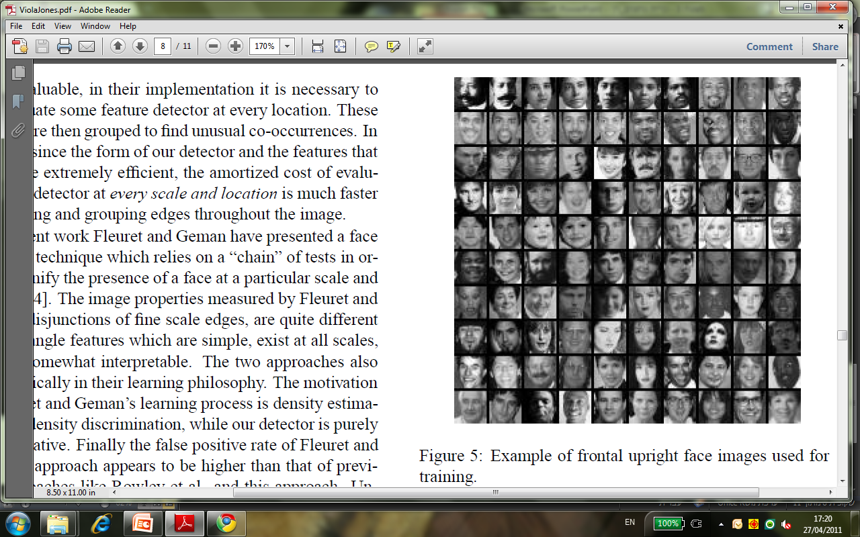
Results
Notes:
אלו התמונות שהשתמשו בהם בtraining- תמונות כשהם מסתכלים פרונטלית למצלמה

Slide 24
Results
Speed of Detector:
The speed of the cascaded detector is directly related to the number of features evaluated per scanned sub-window
an average of 10 features out of a total of 6061 are evaluated per sub-window
This is possible because a large majority of sub-windows are rejected by the first or second layer in the cascade
On a 700 Mhz Pentium III processor, the face detector can process a 384 by 288 pixel image in about 0.067 seconds

Slide 25
Results
Image Processing:
All example sub-windows used for training were variance normalized to minimize the effect of different lighting conditions
During scanning the effect of image normalization can be achieved by post-multiplying the feature values rather than pre-multiplying the pixels
Scanning the Detector:
The final detector is scanned across the image at multiple scales and locations
Scaling is achieved by scaling the detector itself, rather than scaling the image

Slide 26
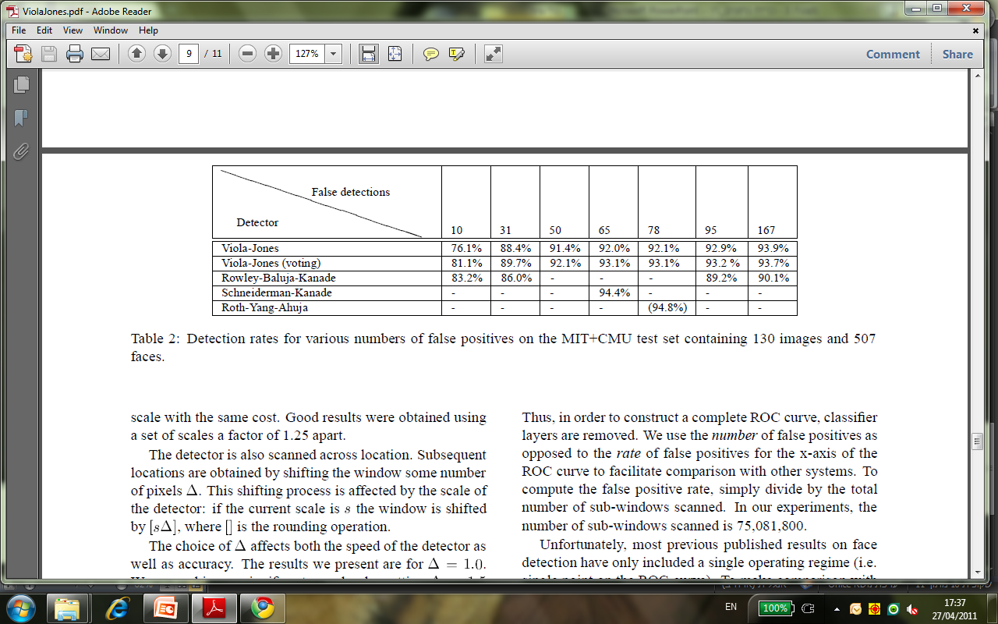
Results
Experiments on a Real-World Test Set:
The system tested on the MIT+CMU frontal face test set
This set consists of 130 images with 507 labeled frontal faces
Notes:
A simple voting scheme to further improve results
In table 2 we also show results from running three detectors
(the 38 layer one described above plus two similarly
trained detectors) and outputting the majority vote of the
three detectors

Slide 27
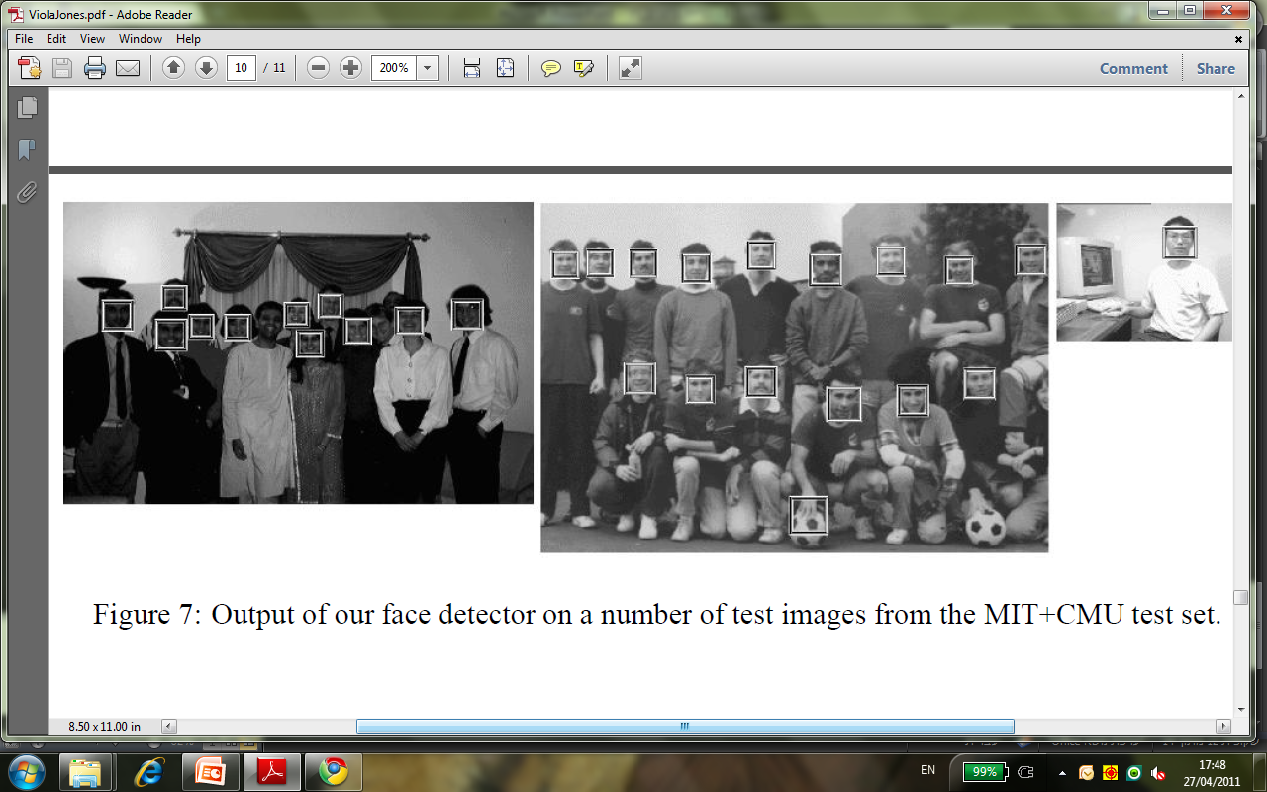
Results

Slide 28
Conclusions
The article presented an approach for object detection which minimizes computation time while achieving high detection accuracy
The approach was used to construct a face detection system which is approximately 15 faster than any previous approach
This paper brings together new algorithms, representations, and insights which are quite generic and may well have broader application in computer vision and image processing
This dataset includes faces under a very wide range of conditions including: illumination, scale, pose, and camera variation. Systems which work under these conditions are unlikely to be limited to a single set of conditions

Slide 29

Questions?

