Slide 1
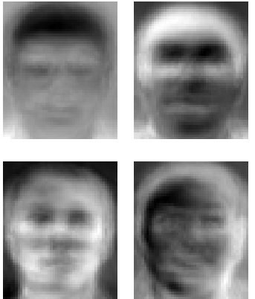
Eigen Faces For Recognition

Slide 2
Introduction
Eigen Faces – face recognition algorithm
Based on physiology & information theory.
Near realtime operation time
Big learning capacity
Insensitivity to small or gradual changes in face image.

Slide 3
Introduction
Human face recognition power
Average human can store thousands of faces thorough out lifetime period.
Very robust, can detect face after years with little affect by
Viewing condition
Expression
Aging
Hairstyle/facial hair, glasses

Slide 4
Benefits of Face Recognition
Suspect tracking
Security systems
Film development (apply auto color)
Smart house

Slide 5
Introduction cont.
Usage of Eigen faces
Face Recognition
Face detection
Photo reconstruction

Slide 6
Face Image Processing
Difficult problem
High level data 20x20 pixel face image (400 dim)
No high level feature’s that can be automated extracted
Other works
Detecting individual features
(eyes, mouth, nose, head outline)
Later build a face model based on size on position relations between those.

Slide 7
Face Image Processing
First semi automate approach
Bledsoe (66’) - manual inputs, eye and mouth corners, nose tip, chin point. Normalized distance recognitions.
Harmon lesk (71’) – 21 features input (hair shade, length of ears, lip thickness
Kehonan (89’) auto associative face reconstruct network.
Fleming and Cottrell (90’) – backpropagation

Slide 8
Eigen Face approach
Intuitive notion of face feature’s for us are
Eyes, nose, mouth, lips hair..
Information theory coding is different and might find other feature as global and local to describe content of face.

Slide 9
High Level
Break face into small set of characteristic called Eigen faces as main component.
Eigen faces are ordered for most significant to least and span a “face space” we define.
(those who fit the largest covariance in the training set).
Define the face as combination of the Eigen faces
Learn/recognize image

Slide 10
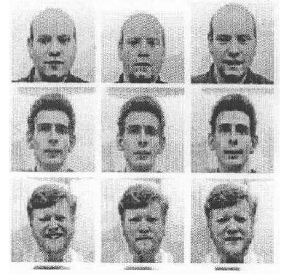
High level steps
Acquire initial set of face images (training set)
note (centered and of the same size)

Slide 11
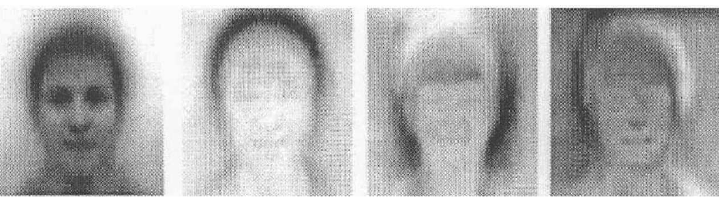
High level steps
2. Calculate the Eigen faces from training set, keep only the M most significant Eigen faces
Notes:
כל תמונה היא וקטור u (כל תמונה היא 20X 20 והיא הופכת לוקטור באורך 400)

Slide 12
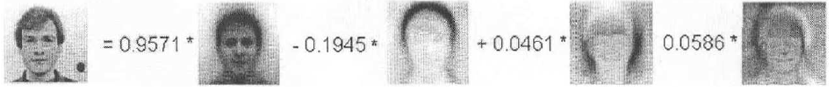
High level steps
3. Calculate the corresponding distribution in m dimensional of each known individual into the “face space”
Notes:
באמצעות סכימה שלהם והכפלה במקדמים ניתן לשחזר את התמונה המקורית בחזרה

Slide 13
High level steps
Given new image
Calculate set’s of weights by projecting into each of the M Eigen faces from training.
Determine if picture is face at all
Determine known or unknown person
(optional) update eigen faces
(optional) update new person
Notes:
על מנת להבין אם זה אותו בן אדם אז בודקים האם הערכים של המקדמים דומים, אם הם כן אז זה אותו בן אדם.

Slide 14

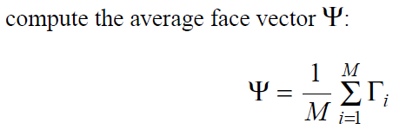
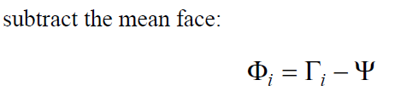
Low Level look – calculate Eigen faces

Slide 15
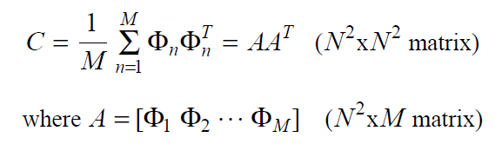

Low Level look – calculate Eigen faces

Slide 16
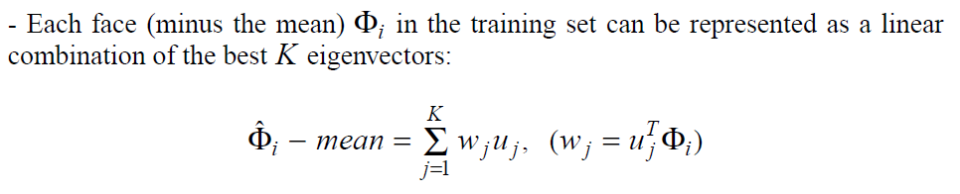
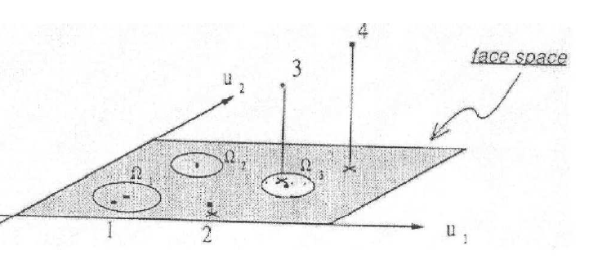
Project a face into face space
תמונה מקורית
ממוצע פרצופים
Notes:
אם הערכים של תמונה לא נמצאת בטווח של פרצופים אז ניתן להבין שמה שנמצא בתמונה הוא לא פרצוף
אם זה כן בטווח אבל לא דומה לערכים של פרצוף שכבר קיים במסד נתונים אז זה פרצוף חדש
אם זה נמצא קרוב לערכים של אחד מהפרצופים שקיימים במסד הנתונים (העיגולים בתרשים) אז ניתן לזהות איזה אדם נמצא בתמונה

Slide 17
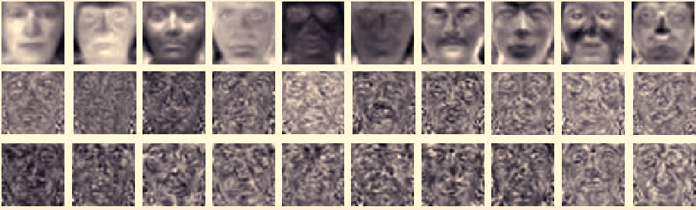
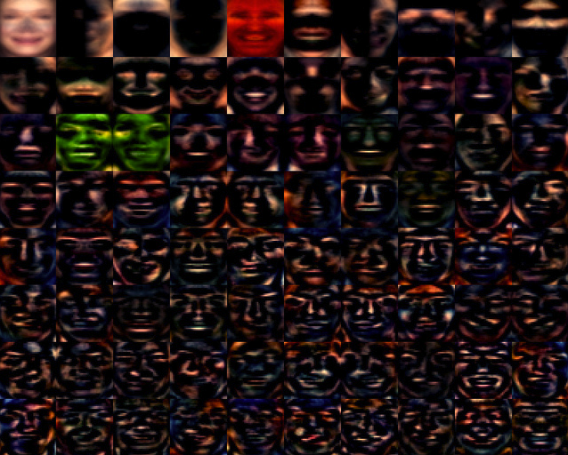
Eigen Faces Example’s

Slide 18
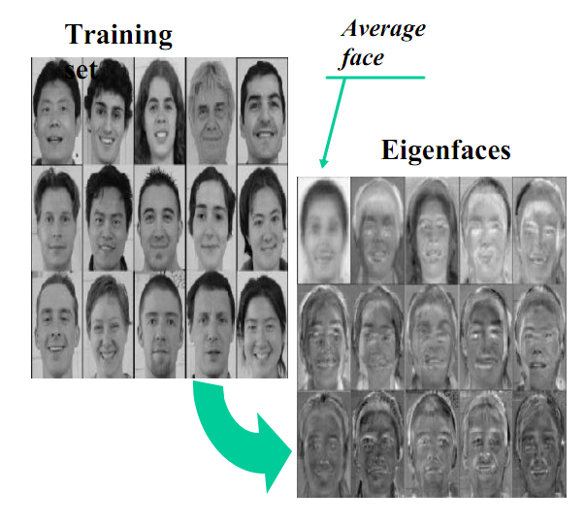
Eigen Faces Example’s

Slide 19
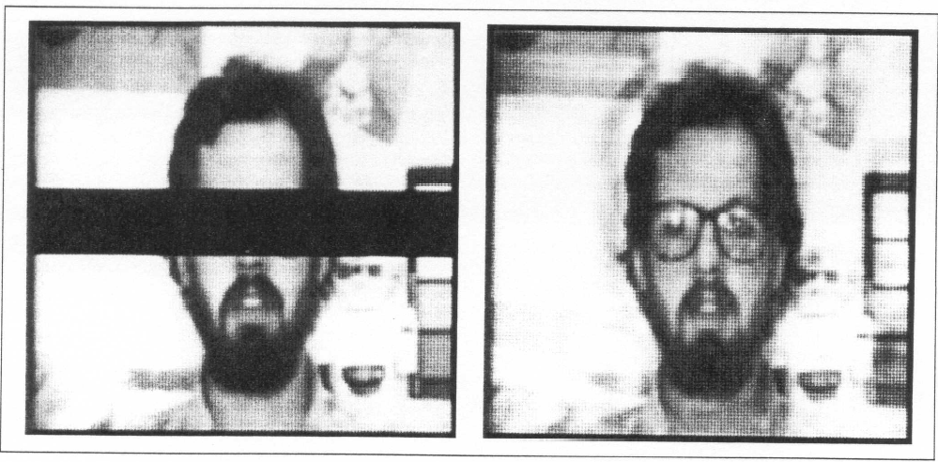
Image reconstruction
First use was to reconstruct image.
Experiment took M=115 white males images
Found 40 Eigen faces
Was able to reconstruct cropped images with 2% error rate.

Slide 20

Face recognision
Can use less Eigen faces (no need to reconstruct, just recognize)
Outcome:
1.Near face space and near face class
2.Near face space but not near face class
3.Distant from face space and near face class
4. Distant from face space and not near face class

Slide 21
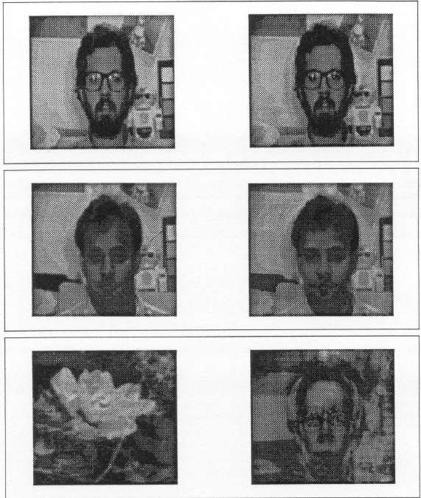
Face Mapping

Slide 22
Locating and Detecting Faces
Up until now, we assume we have training set, and same size centered images to work with.
Two method were developed to track and/or locate faces, using motion detection and manipulation of images in “face space”

Slide 23
Motion detection and head tracking
People are constantly moving, even while sitting, we adjust position etc.
Over a set of images from constant view point we can filter moving object
Apply a basic set of rules to locate head area
(small blob – head, above large blob – torso) and return the head box to the algorithm.

Slide 24
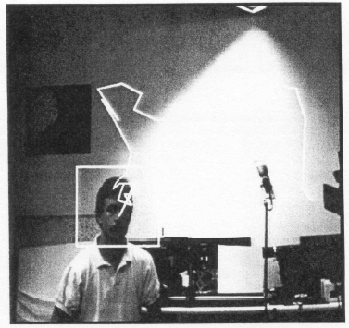
Motion detection and head tracking

Slide 25
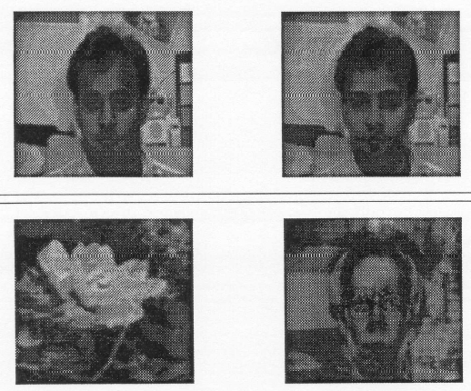
Using Face Space to locate Face
In Case – little movement, many moving objects.
We use the face space to estimate a face in image.
We create a “faceness” measure

Slide 26
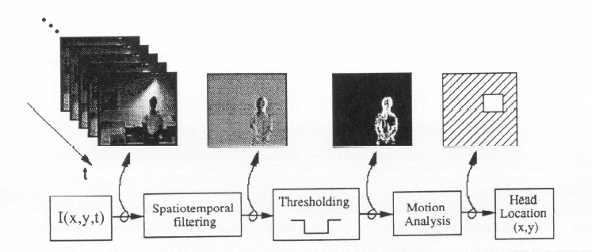
Motion Detection logic

Slide 27
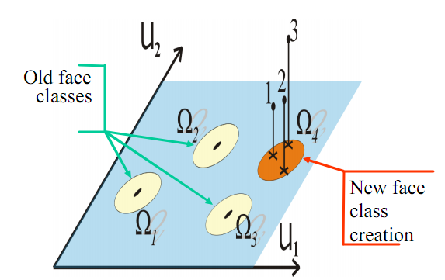
Learning new faces
Keep location of unknown faces, and when define unknown stand in threshold, make new face class.

Slide 28
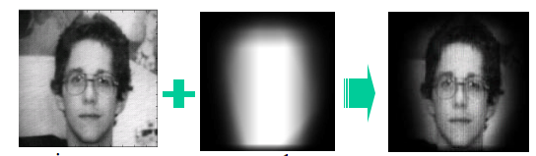
Issues and Improvement
Eliminate to background
(robust segmentation of the head)
Gaussian mask
-Multiple views

Slide 29
Issues and Improvement
Scale
On the output box of the motion analysis perform scale to Eigen faces head scale.
Or
MultiScale Eigen Faces.

Slide 30
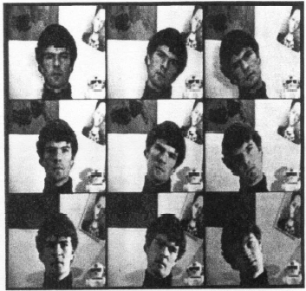
Issues and Improvement
Multiple views
-side +/- 45 degrees

Slide 31
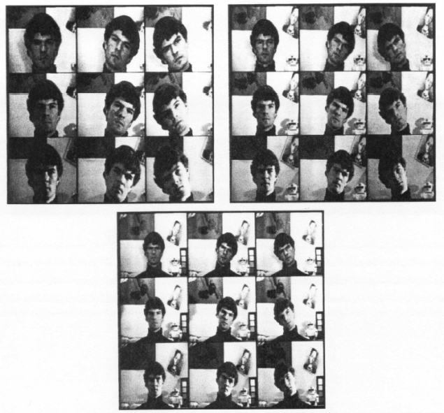
Experiments with Eigen Faces
Database – 2500 images of faces In control enviroment
16 subjects in all combination
3 head orientation, 3 head sizes, 3 lightning condition

Slide 32
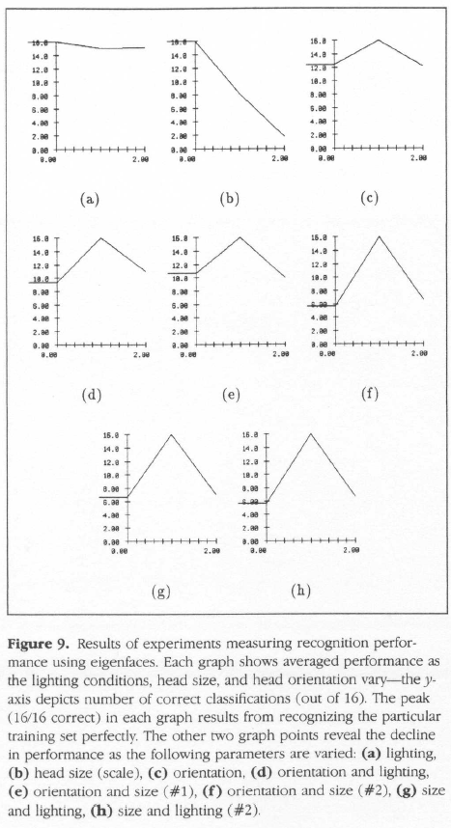
Experiments with Eigen Faces
96% avg lighting
85% correct orientation
64% size variation.

Slide 33
Conclusion
- One time operation to calculate the Eigen Faces make it cheap
- No significant pre processing
- Eigenfaces are accurate but have a hard
time dealing with discrepancies between
the training and testing sets in light,
camera angle, and variable facial features.
(i.e. smiling, mustaches, glasses, etc.

