Slide 1

Statistics Background
Created and Edited by Amanda Magzal
01

Slide 2
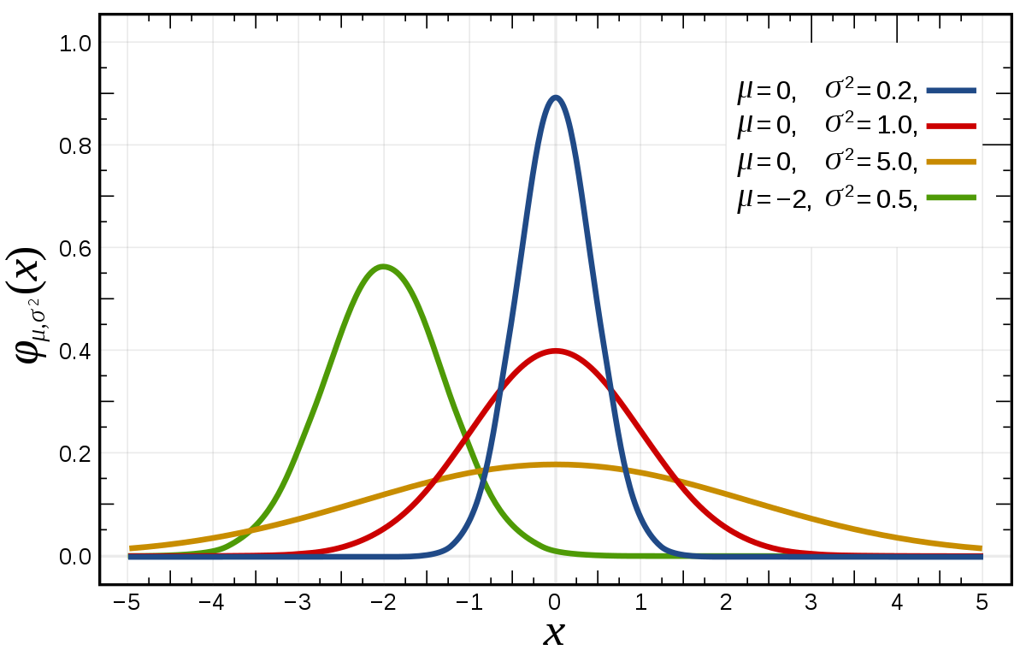

The Normal Distribution
A symmetric bell-shaped curve.
Defined by the parameters: Mean $μ$ and Variance $σ^{2}$.

Slide 3
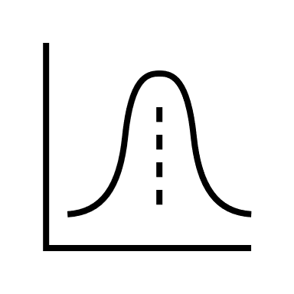


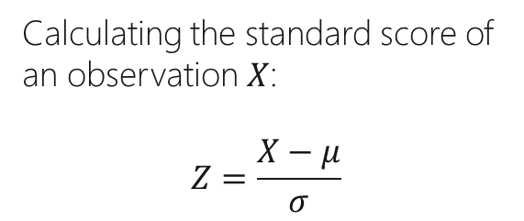
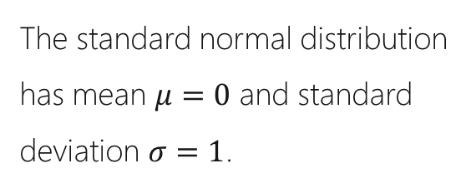
Standardization
The standard normal distribution has mean $μ=0$ and standard deviation $σ=1$.
Standardization allows us to compare between different populations.
Calculating the standard score of an observation $X$:
$$Z=\frac{X−μ}{σ}$$

Slide 4



The Normal Distribution
Resources
Normal Distribution
Normal Distribution

Slide 5

Linear Regression
Y
Regression Line
Linear regression attempts to model the relationship between two variables by fitting a linear equation to observed data.
A linear regression line has an equation of the form $Y=β_{0}X+β_{1}$, where $X$ is the explanatory variable and $Y$ is the dependent variable.
X

Slide 6



Least Squares
Y
residual
$$y_{i}$$
We want to minimize the square of the distance between the observed value ($y_{i}$) and the line (the SSR).
$$\overline{y}$$
The SSR (Sum of squared residuals) is a measure of how well the line fits the data.
X

Slide 7


Y
Y
Regression Line
residual
$$y_{i}$$
$$\overline{y}$$
X
X

Slide 8
Fitting a Line to Data
Resources
Least Squares
Simple Linear Regression

