Slide 1

Data Visualization
03

Slide 2
Steps of Machine Learning
Model Evaluation
Model Building
Data Preprocessing
Data Exploration & Visualization
Data Collection
& Assembly

Slide 3
Why do we need visualizations?
“Data is a story told in numbers, visualizing it is how you’re telling the story.”

Slide 4
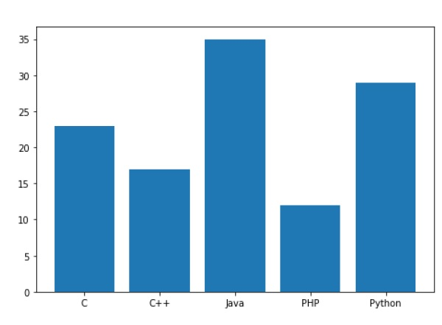
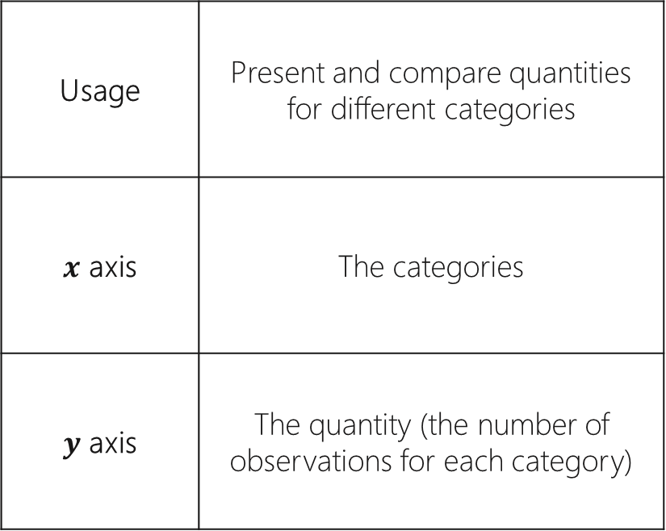
Bar Plot
Usage | Present and compare quantities for different categories
$x$ axis | The categories
$y$ axis | The quantity (the number of observations for each category)

Slide 5
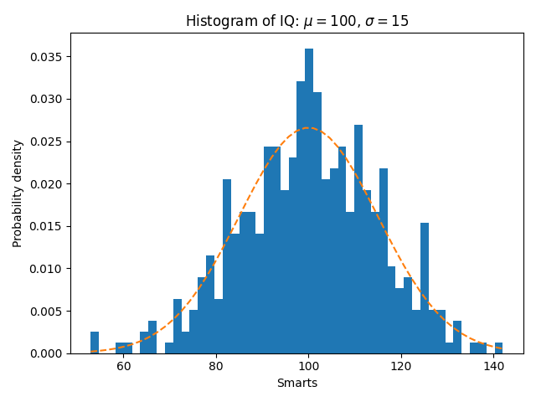
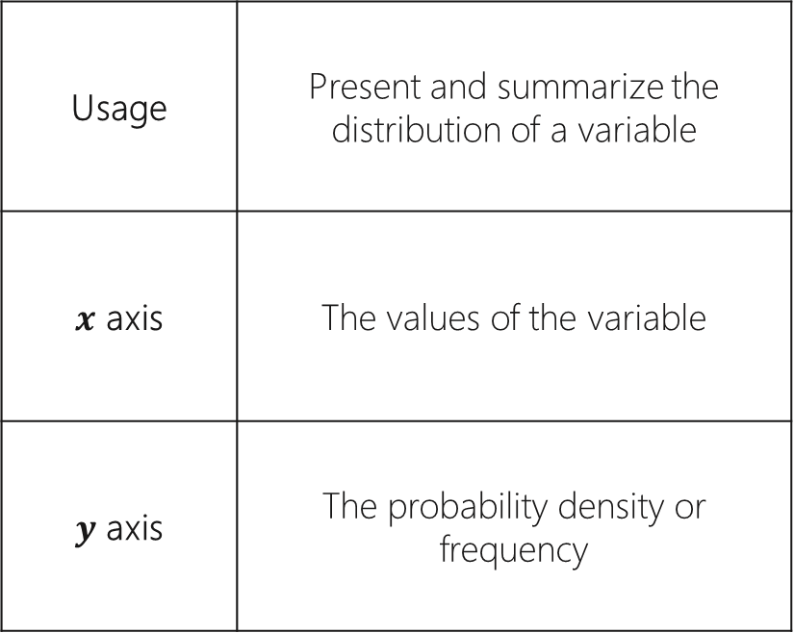
Histogram
Usage | Present and summarize the distribution of a variable
$x$ axis | The values of the variable
$y$ axis | The probability density or frequency

Slide 6
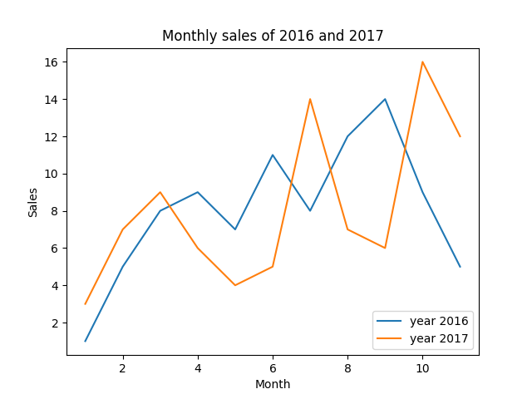
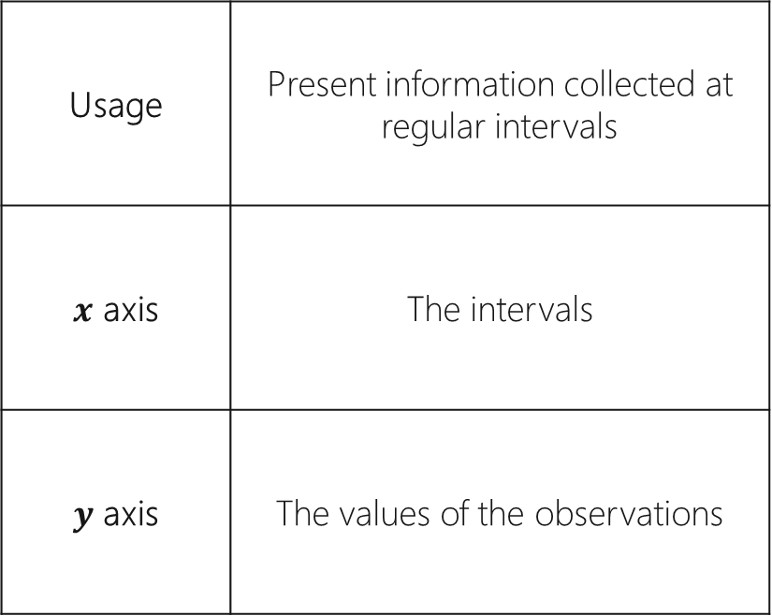
Line Plot
Usage | Present information collected at regular intervals
$x$ axis | The intervals
$y$ axis | The values of the observations

Slide 7
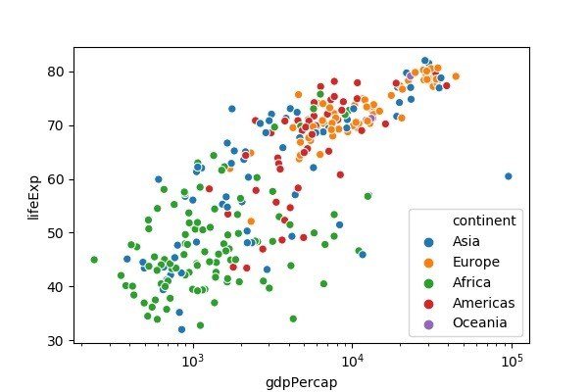
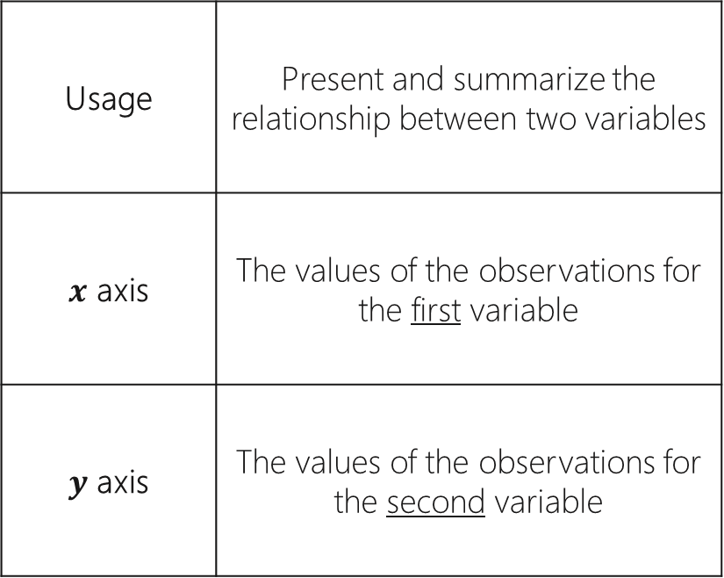
Scatter Plot
Usage | Present and summarize the relationship between two variables
$x$ axis | The values of the observations for the first variable
$y$ axis | The values of the observations for the second variable

Slide 8
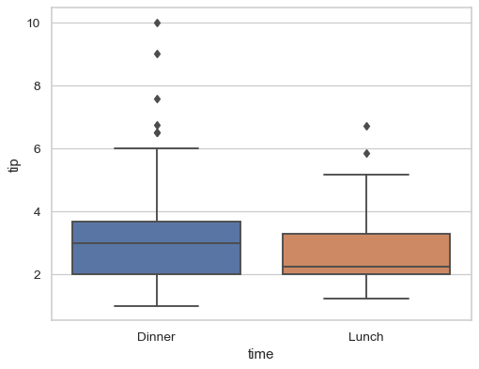
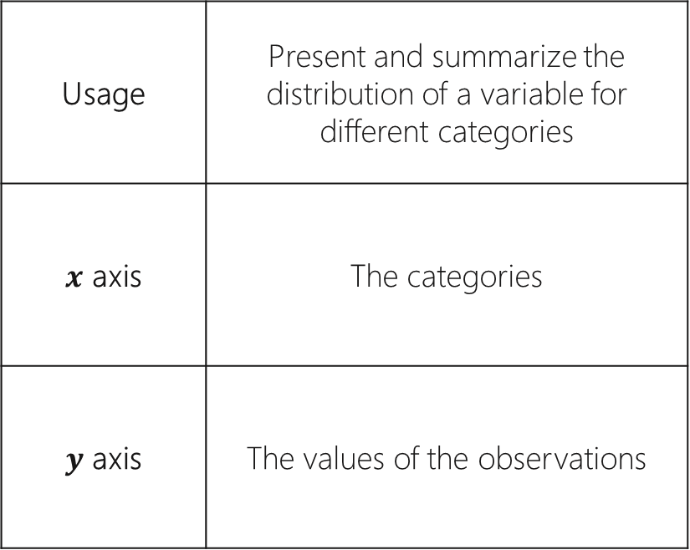
Box Plot
Usage | Present and summarize the distribution of a variable for different categories
$x$ axis | The categories
$y$ axis | The values of the observations

Slide 9
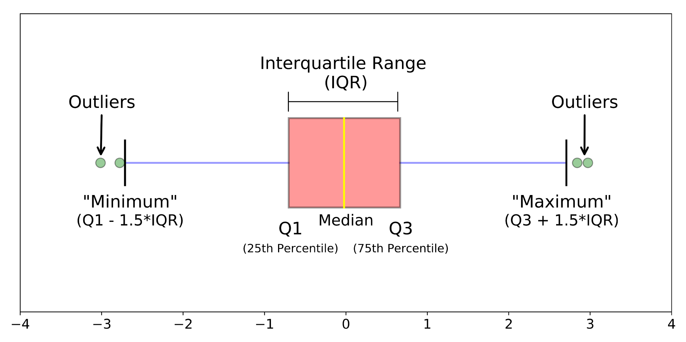
Understanding the Box Plot

Slide 10


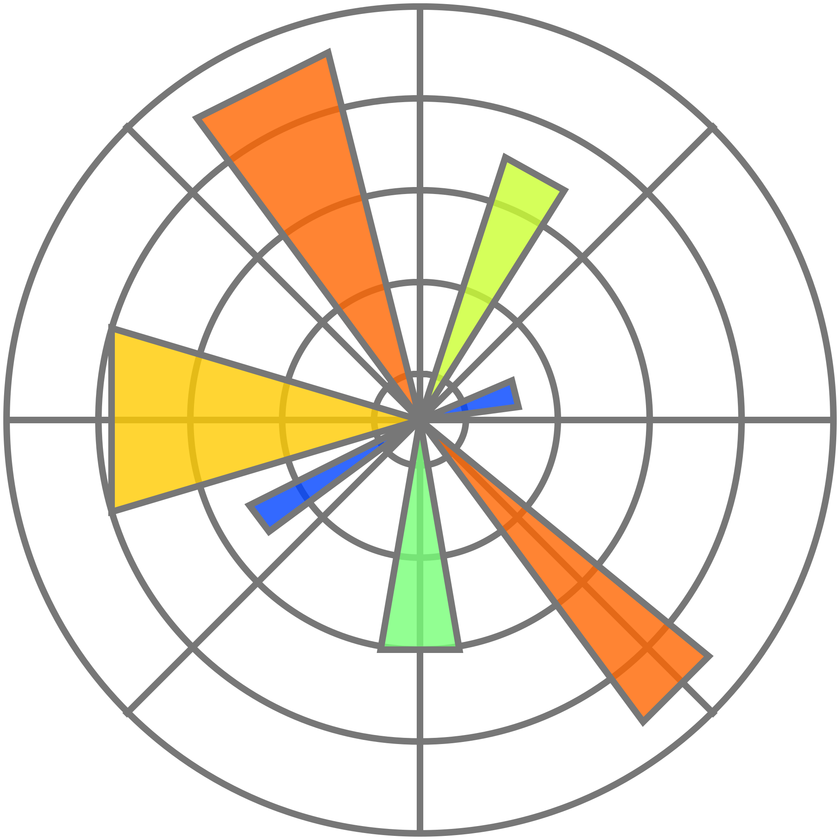

Effective Visualizations
How to Choose a Chart Type
Resources
Data Visualization in Python
Data Visualization Using Python
The Matplotlib Library
The Seaborn Library

