Slide 1

Data Pre-processing
04

Slide 2
Steps of Machine Learning
Model Evaluation
Model Building
Data Preprocessing
Data Exploration & Visualization
Data Collection
& Assembly

Slide 3
Why do we need pre-processing?
Raw data can have missing or inconsistent values as well as present a lot of redundant information.

Slide 4
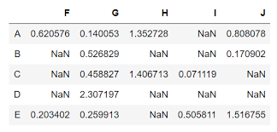
Imputation
01
Drop features or observations
02
Arbitrary value imputation
The process of substituting the missing values of the dataset.
03
Statistical estimates (mean, median, mode)
04
KNN
05
MICE

Slide 5
01 Drop features or observations
Drop features (or observations) that have many missing values.
If a feature has many missing values, we can consider dropping it all together as the imputation could be very inaccurate (same for an observation with many missing data).
Pros | Cons
Easy and quick to implement | Can create bias in the dataset
No data manipulation required | Deleted data could be informative
Notes:
Some algorithms can handle missing data either by ignoring or by learning the best imputation values during training, but most algorithms will panic so it’s not recommended to do nothing :)

Slide 6
02 Arbitrary value imputation
Assign all missing values to a new value.
Examples:
Using the mode.
Creating a new category for “other”.
Using a conventional number such as 0, 1 or -1.
Pros | Cons
Easy and quick to implement | Can distort original variable distribution
Works for both numerical and categorical variables | Can create outliers
Retains the importance of missing values if it exists

Slide 7
03 Statistical estimates
Filling in the missing values using a statistical estimate.
The process is done for each feature separately and is based on the existing observations.
Examples:
Mean
Median
Mode
Pros | Cons
Easy and quick to implement | Can distort original variable distribution
Works well with small datasets with numerical variables | May lead to over-representation of a particular category.
 | Does not account for correlation between variables

Slide 8
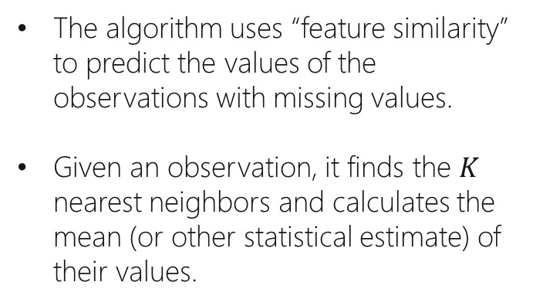
04 KNN
Filling in the missing values using the KNN algorithm.
The algorithm uses “feature similarity” to predict the values of the observations with missing values.
Given an observation, it finds the $K$ nearest neighbors and calculates the mean (or other statistical estimate) of their values.
Pros | Cons
More accurate than previous methods as it is based on an approximate subset of the data | Computationally expensive (stores the data in memory)
 | Sensitive to outliers

Slide 9

How does KNN work?
Y
For example, for $K=3$, the algorithm calculates the mean of the 3 nearest observations and fills in the missing value.
X

Slide 10
05 MICE
Filling in the missing values using the MICE algorithm.
MICE – Multivariate Imputation by Chained Equation.
The process includes several steps where in each step we use a different method to fill in the missing values, using the values from previous steps.
Pros | Cons
More accurate than previous methods as it is adaptive | High time complexity
Works with different types of data

Slide 11
Age | Experience | Salary
25 | NA | 50
27 | 3 | NA
29 | 5 | 110
31 | 7 | 140
33 | 9 | 170
NA | 11 | 200
Age | Experience | Salary
25 | 7 | 50
27 | 3 | 134
29 | 5 | 110
31 | 7 | 140
33 | 9 | 170
29 | 11 | 200
How does MICE work?
mean()
Step 1: Impute all the missing values with the mean.
Step 2: Remove the imputed value(s) of age.
Step 3: Use the rest of the features to impute the missing values of age.
Age | Experience | Salary
25 | 7 | 50
27 | 3 | 134
29 | 5 | 110
31 | 7 | 140
33 | 9 | 170
 | 11 | 200
Age | Experience | Salary
25 | 7 | 50
27 | 3 | 134
29 | 5 | 110
31 | 7 | 140
33 | 9 | 170
36.2532 | 11 | 200
linearRegression()
Step 4: Do the same for the rest of the features.

Slide 12
Age | Experience | Salary
25 | 1.8538 | 50
27 | 3 | 72.7748
29 | 5 | 110
31 | 7 | 140
33 | 9 | 170
36.2532 | 11 | 200
Age | Experience | Salary
25 | 7 | 50
27 | 3 | 134
29 | 5 | 110
31 | 7 | 140
33 | 9 | 170
29 | 11 | 200
How does MICE work?
-
Step 5: Subtract the latest datasets.
=
Step 6: Repeat steps 2-5 until the difference becomes very small or after a pre-defined number of iterations.
Age | Experience | Salary
25 | -5.1462 | 50
27 | 3 | -61.2252
29 | 5 | 110
31 | 7 | 140
33 | 9 | 170
7.2532 | 11 | 200

Slide 13





Imputation Techniques
Advanced Imputation Methods
Resources
Imputation Implementation
Imputation Functions
MICE

Slide 14
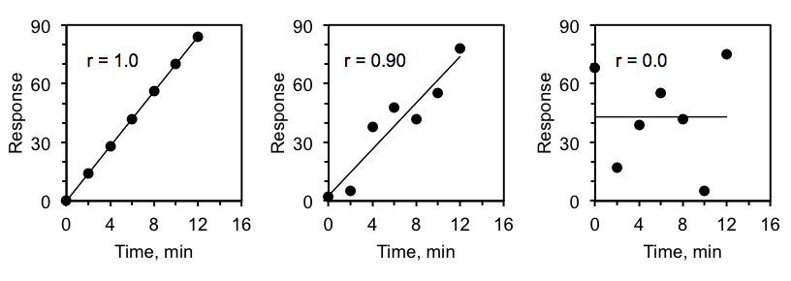
Correlation
01
Pearson Correlation
The process of identifying relationships between variables.
02
Spearman Correlation
03
Correlation Matrix

Slide 15
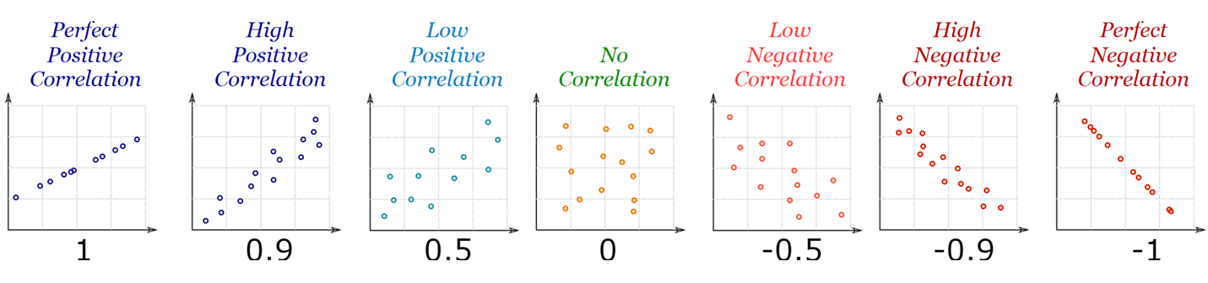
01 Pearson correlation
The Pearson correlation evaluates the linear relationship between two continuous variables.

Slide 16
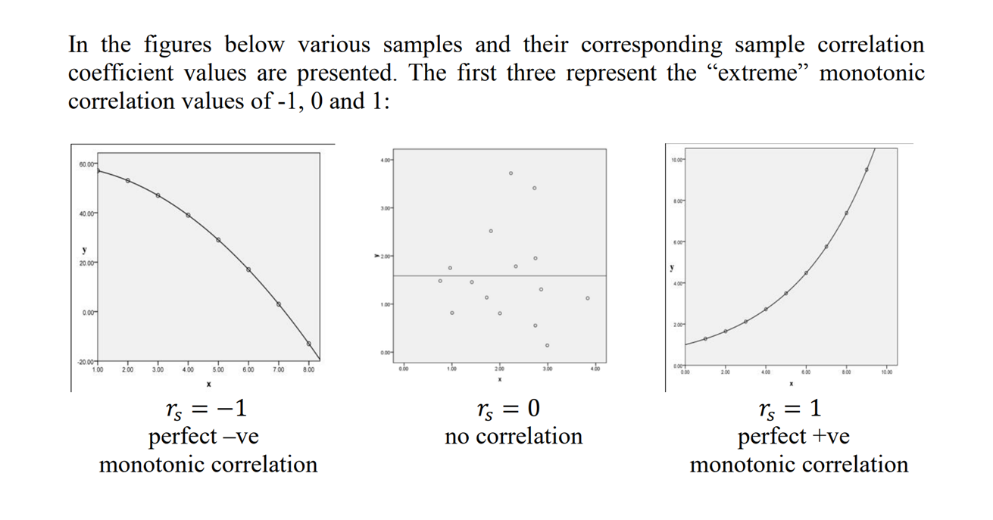
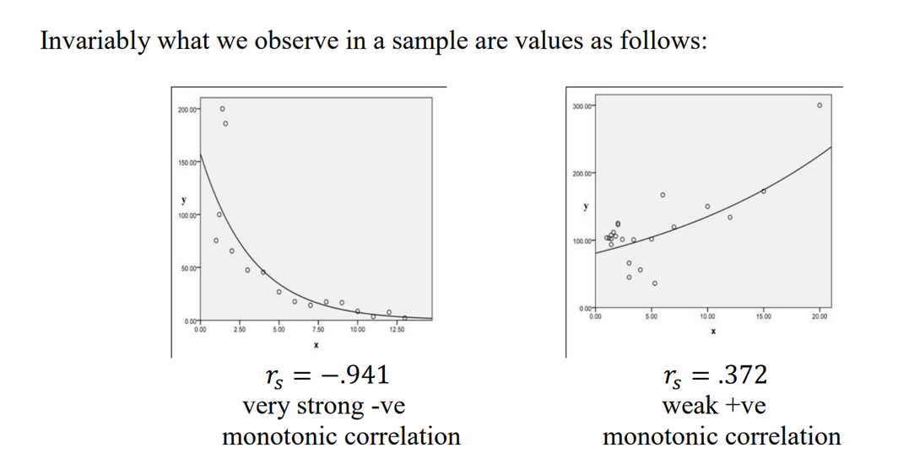
02 Spearman correlation
The Spearman correlation evaluates the monotonic relationship between two continuous or ordinal variables.

Slide 17
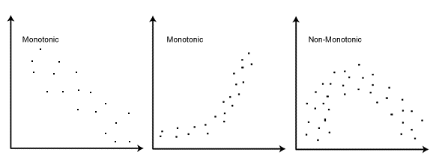
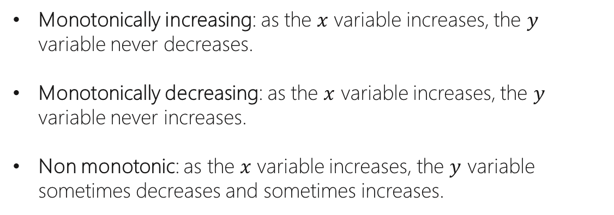
Monotonically increasing: as the $x$ variable increases, the $y$ variable never decreases.
Monotonically decreasing: as the $x$ variable increases, the $y$ variable never increases.
Non monotonic: as the $x$ variable increases, the $y$ variable sometimes decreases and sometimes increases.
What is a Monotonic Relationship?

Slide 18
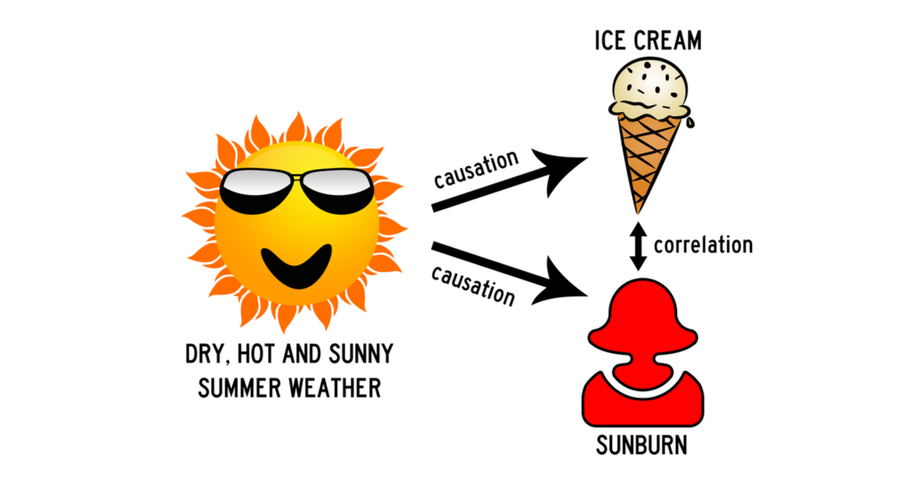
Correlation is NOT Causation

Slide 19
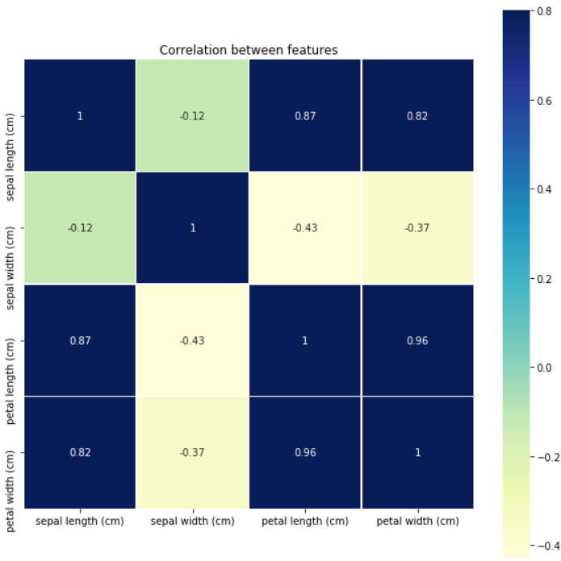
03 Correlation Matrix
The correlation matrix presents the correlation coefficients between every pair of features in the dataset.
It is common to present it in a heatmap with a color gradient, where the higher the correlation, the darker that color.

Slide 20
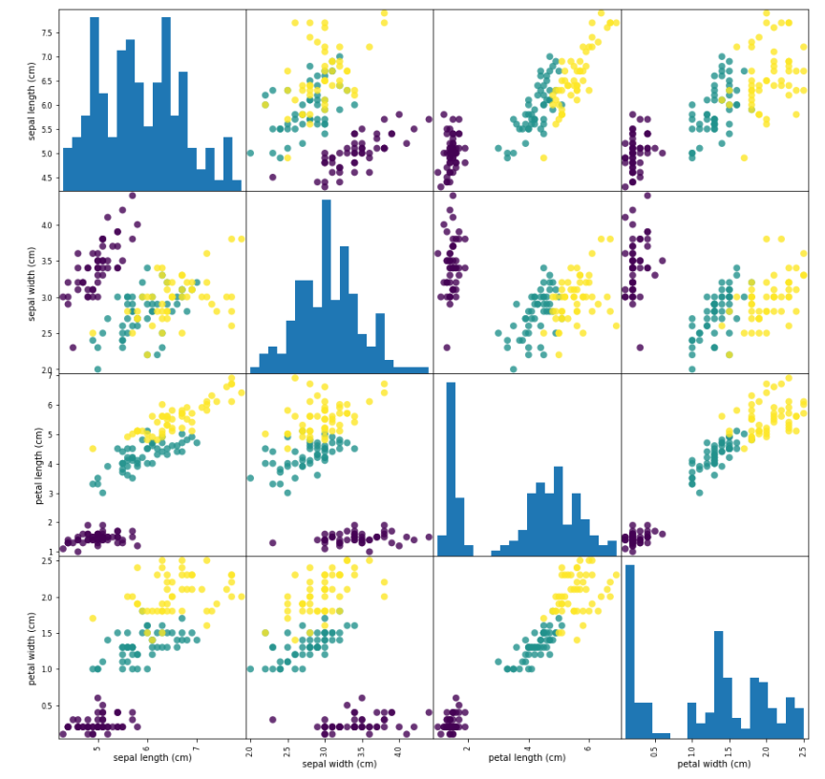
A Different Representation
Notes:
We can see the relationships between the features using scatter plots (in this case, each color represents a species).
The histogram represents the distribution of each variable.

Slide 21


Correlation Types
Pearson Correlation
Resources
Spearman Correlation
Comparison (Pearson & Spearman)
Correlation in Python

Slide 22

Transformation
01
Standardization
The process of transforming raw data to a different representation.
02
Normalization
03
One-hot Encoding

Slide 23
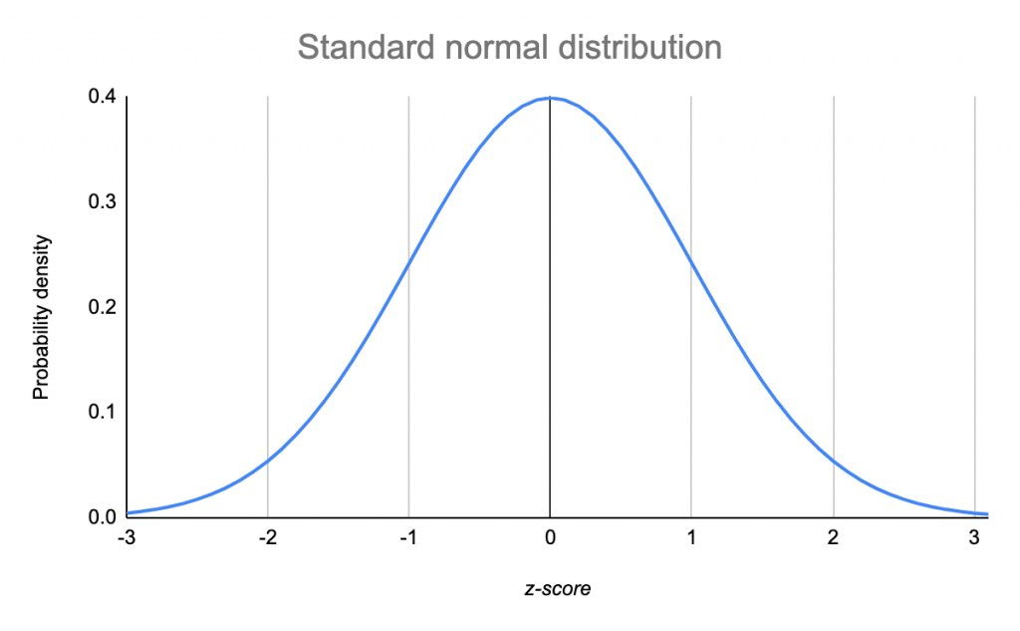
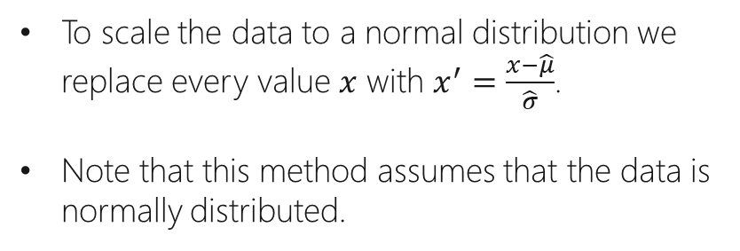
01 Standardization
Transforming the feature’s distribution to a standard normal distribution.
To scale the data to a normal distribution we replace every value $x$ with $x^{′}=\frac{x−\hat{μ}}{\hat{σ}}$.
Note that this method assumes that the data is normally distributed.

Slide 24
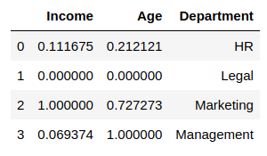
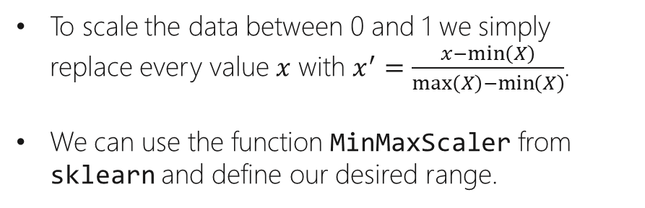
02 Normalization
Transform and restrict the feature’s values to a specific range.
To scale the data between 0 and 1 we simply replace every value $x$ with $x^{′}=\frac{x−\min\left(X\right)}{\max\left(X\right)−\min\left(X\right)}$.
We can use the function MinMaxScaler from sklearn and define our desired range.

Slide 25
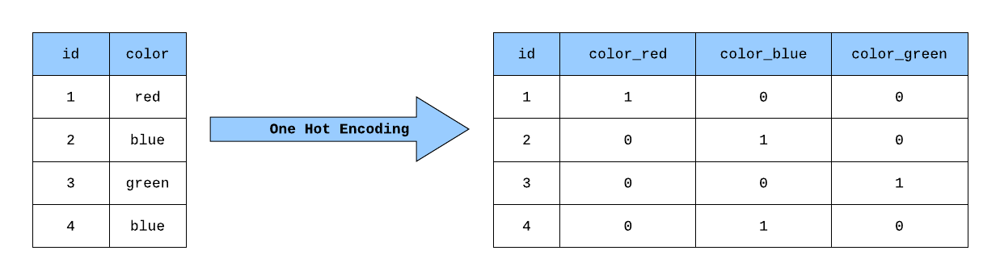
03 One hot encoding
Transforms a categorical feature with $n$ possible values into $n$ binary features, with one of them 1, and all others 0.

Slide 26

Transformation Techniques
Resources
Normalization vs. Standardization
One-hot Encoding
Pre-processing Package

