Slide 1

Decision Trees,
Random Forest
Created and Edited by Amanda Magzal
06

Slide 2
Easy to work with.
Decision Trees
Work with all types of data.
Prone to overfit.

Slide 3
Terminology
Root node: the first decision node of the tree that includes the entire dataset.
Leaf node: a terminal node that includes the final output of the tree.
Splitting: the process of dividing a decision node into sub-nodes according to a given condition.
Sub-tree/Branch: a tree formed by splitting a node.
Root Node
Decision Node
Decision Node
Sub-tree
Splitting
Leaf Node
Decision Node
Leaf Node
Leaf Node
Leaf Node
Leaf Node
Notes:
The same feature can appear more than once (different thresholds).
Final predictions can be repeated in different leaves.

Slide 4
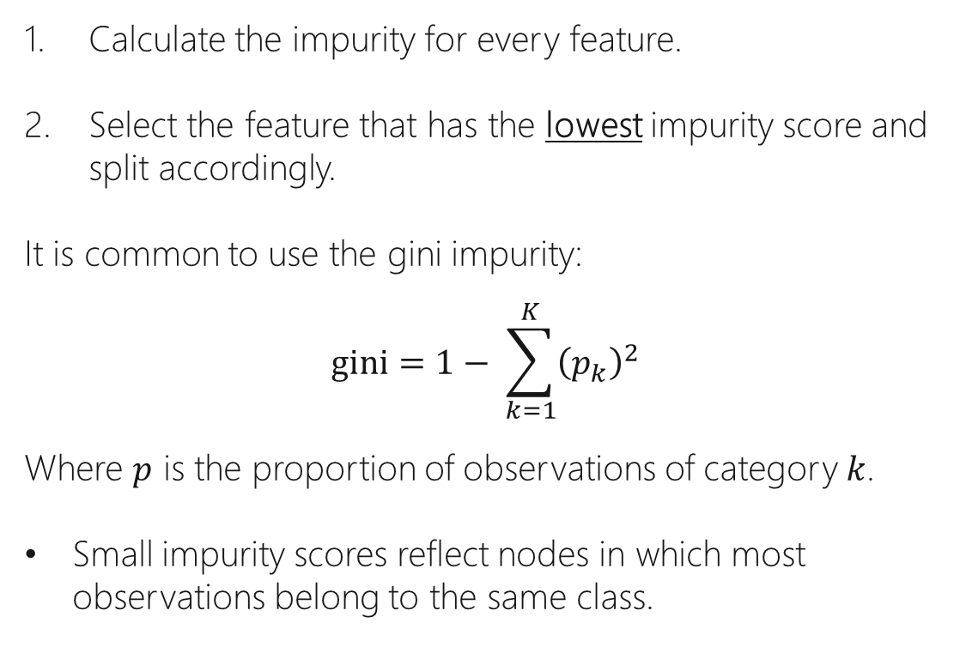
Calculate the impurity for every feature.
Select the feature that has the lowest impurity score and split accordingly.
It is common to use the gini impurity:
$$gini=1− \sum_{k=1}^{K}{{\left(p_{k}\right)}^{2}}$$
Where $p$ is the proportion of observations of category $k$.
Small impurity scores reflect nodes in which most observations belong to the same class.
Classification
Tree
Notes:
-$p_{k}$כמות הפרטים אשר שייכים למחלקה מסוימת בקבוצה שהתקבלה, לאחר שחילקנו על פי תנאי מסוים לפי ערך של תכונה חלקי סך הכל הפרטים בקבוצה זו מכל המחלקות

Slide 5
Building a Classification Tree
Loves Popcorn | Loves Soda | Age | Loves Movies
Yes | Yes | 7 | No
Yes | No | 12 | No
No | Yes | 18 | Yes
No | Yes | 35 | Yes
Yes | Yes | 38 | Yes
Yes | No | 50 | No
No | No | 83 | No
Given a simple dataset with 3 features (loves popcorn, loves soda and age), we want to build a classification tree to predict whether a person loves movies.

Slide 6
Select the root node
Loves Popcorn | Loves Soda | Age | Loves Movies
Yes | Yes | 7 | No
Yes | No | 12 | No
No | Yes | 18 | Yes
No | Yes | 35 | Yes
Yes | Yes | 38 | Yes
Yes | No | 50 | No
No | No | 83 | No
Loves Popcorn
True
False
Yes | No
Yes | No

Slide 7
Check how well each feature predicts
Loves Popcorn | Loves Soda | Age | Loves Movies
Yes | Yes | 7 | No
Yes | No | 12 | No
No | Yes | 18 | Yes
No | Yes | 35 | Yes
Yes | Yes | 38 | Yes
Yes | No | 50 | No
No | No | 83 | No
Loves Popcorn
True
False
Yes | No
1 | 3
Yes | No
2 | 1
Loves Soda
True
False
Yes | No
3 | 1
Yes | No
0 | 3

Slide 8



Calculate the gini impurity
Loves Popcorn | Loves Soda | Age | Loves Movies
Yes | Yes | 7 | No
Yes | No | 12 | No
No | Yes | 18 | Yes
No | Yes | 35 | Yes
Yes | Yes | 38 | Yes
Yes | No | 50 | No
No | No | 83 | No
Loves Popcorn
True
False
Yes | No
1 | 3
Yes | No
2 | 1
gini = $1−{\left(\frac{1}{1+3}\right)}^{2}−{\left(\frac{3}{1+3}\right)}^{2}=0.375$
gini = $1−{\left(\frac{2}{2+1}\right)}^{2}−{\left(\frac{1}{2+1}\right)}^{2}=0.444$
Total gini = $\left(\frac{4}{4+3}\right)⋅0.375+\left(\frac{3}{4+3}\right)⋅0.444=0.405$
Notes:
Gini impurity of a leaf = $1−P{\left(Yes\right)}^{2}−P{\left(No\right)}^{2}$

Slide 9


Calculate the gini impurity
Loves Popcorn | Loves Soda | Age | Loves Movies
Yes | Yes | 7 | No
Yes | No | 12 | No
No | Yes | 18 | Yes
No | Yes | 35 | Yes
Yes | Yes | 38 | Yes
Yes | No | 50 | No
No | No | 83 | No
Loves Popcorn
True
False
gini = $0.405$
Yes | No
1 | 3
Yes | No
2 | 1
Loves Soda
True
False
gini = $0.214$
Yes | No
3 | 1
Yes | No
0 | 3

Slide 10
Dealing with a numeric feature
Age | Loves Movies
7 | No
12 | No
18 | Yes
35 | Yes
38 | Yes
50 | No
83 | No
1. Sort the observations by age.
2. Calculate the average age for all adjacent people.
9.5
15
26.5
36.5
44
66.5
gini = 0.429
gini = 0.343
gini = 0.476
gini = 0.476
gini = 0.343
gini = 0.429
3. Calculate the gini impurity value for each average age.
Age < 9.5
True
False
Yes | No
0 | 1
Yes | No
3 | 3
Notes:
The gini scores for 15 and 44 are the same so we can choose either one.

Slide 11



Select the root node
gini = $0.405$
Loves Popcorn | Loves Soda | Age | Loves Movies
Yes | Yes | 7 | No
Yes | No | 12 | No
No | Yes | 18 | Yes
No | Yes | 35 | Yes
Yes | Yes | 38 | Yes
Yes | No | 50 | No
No | No | 83 | No
Loves Popcorn
True
False
Yes | No
1 | 3
Yes | No
2 | 1
gini = $0.214$
Loves Soda
True
False
gini = $0.343$
Age < 15
Yes | No
3 | 1
Yes | No
0 | 3
True
False
Yes | No
3 | 1
Yes | No
0 | 3

Slide 12
Split the dataset
Loves Popcorn | Loves Soda | Age | Loves Movies
Yes | Yes | 7 | No
Yes | No | 12 | No
No | Yes | 18 | Yes
No | Yes | 35 | Yes
Yes | Yes | 38 | Yes
Yes | No | 50 | No
No | No | 83 | No
Loves Soda
True
False
Yes | No
3 | 1
Yes | No
0 | 3

Slide 13
Split the dataset
Loves Popcorn | Loves Soda | Age | Loves Movies
Yes | Yes | 7 | No
Yes | No | 12 | No
No | Yes | 18 | Yes
No | Yes | 35 | Yes
Yes | Yes | 38 | Yes
Yes | No | 50 | No
No | No | 83 | No
Loves Soda
True
False
Yes | No
3 | 1
Yes | No
0 | 3

Slide 14
Continue building the tree
Loves Popcorn | Loves Soda | Age | Loves Movies
Yes | Yes | 7 | No
Yes | No | 12 | No
No | Yes | 18 | Yes
No | Yes | 35 | Yes
Yes | Yes | 38 | Yes
Yes | No | 50 | No
No | No | 83 | No
Loves Soda
Age < 12.5
Loves Movies
Yes | No
0 | 3
Loves Movies
Yes | No
0 | 1
Loves Movies
Yes | No
3 | 0

Slide 15
The final decision tree
Loves Popcorn | Loves Soda | Age | Loves Movies
Yes | Yes | 7 | No
Yes | No | 12 | No
No | Yes | 18 | Yes
No | Yes | 35 | Yes
Yes | Yes | 38 | Yes
Yes | No | 50 | No
No | No | 83 | No
Loves Soda
Age < 12.5
Doesn’t Love Movies
Doesn’t Love Movies
Loves Movies

Slide 16
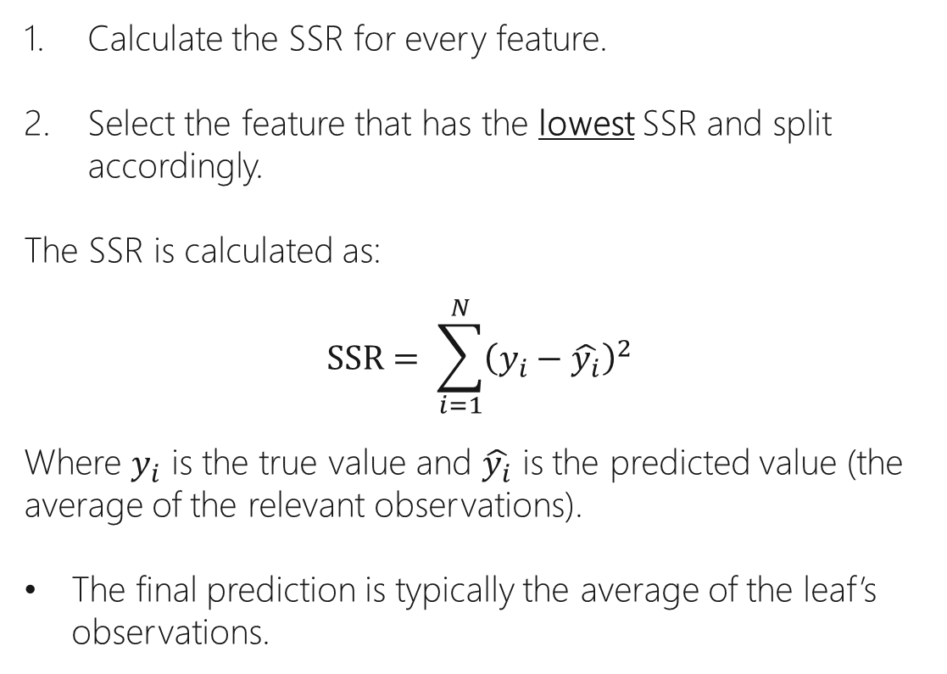
Calculate the SSR for every feature.
Select the feature that has the lowest SSR and split accordingly.
The SSR is calculated as:
$$SSR= \sum_{i=1}^{N}{{\left(y_{i}−\hat{y_{i}}\right)}^{2}}$$
Where $y_{i}$ is the true value and $\hat{y_{i}}$ is the predicted value (the average of the relevant observations).
The final prediction is typically the average of the leaf’s observations.
Regression
Tree
Notes:
סכום השאריות של המרחק מy האמית לy שחזינו( הממוצע של התצפיות לפי החלוקה)

Slide 17
Building a Regression Tree
Y
1. Sort the observations by feature X.
2. Calculate the average for all adjacent values of X.
3. Calculate the SSR value for each split.
4. Select the split that yields the lowest SSR.
X

Slide 18
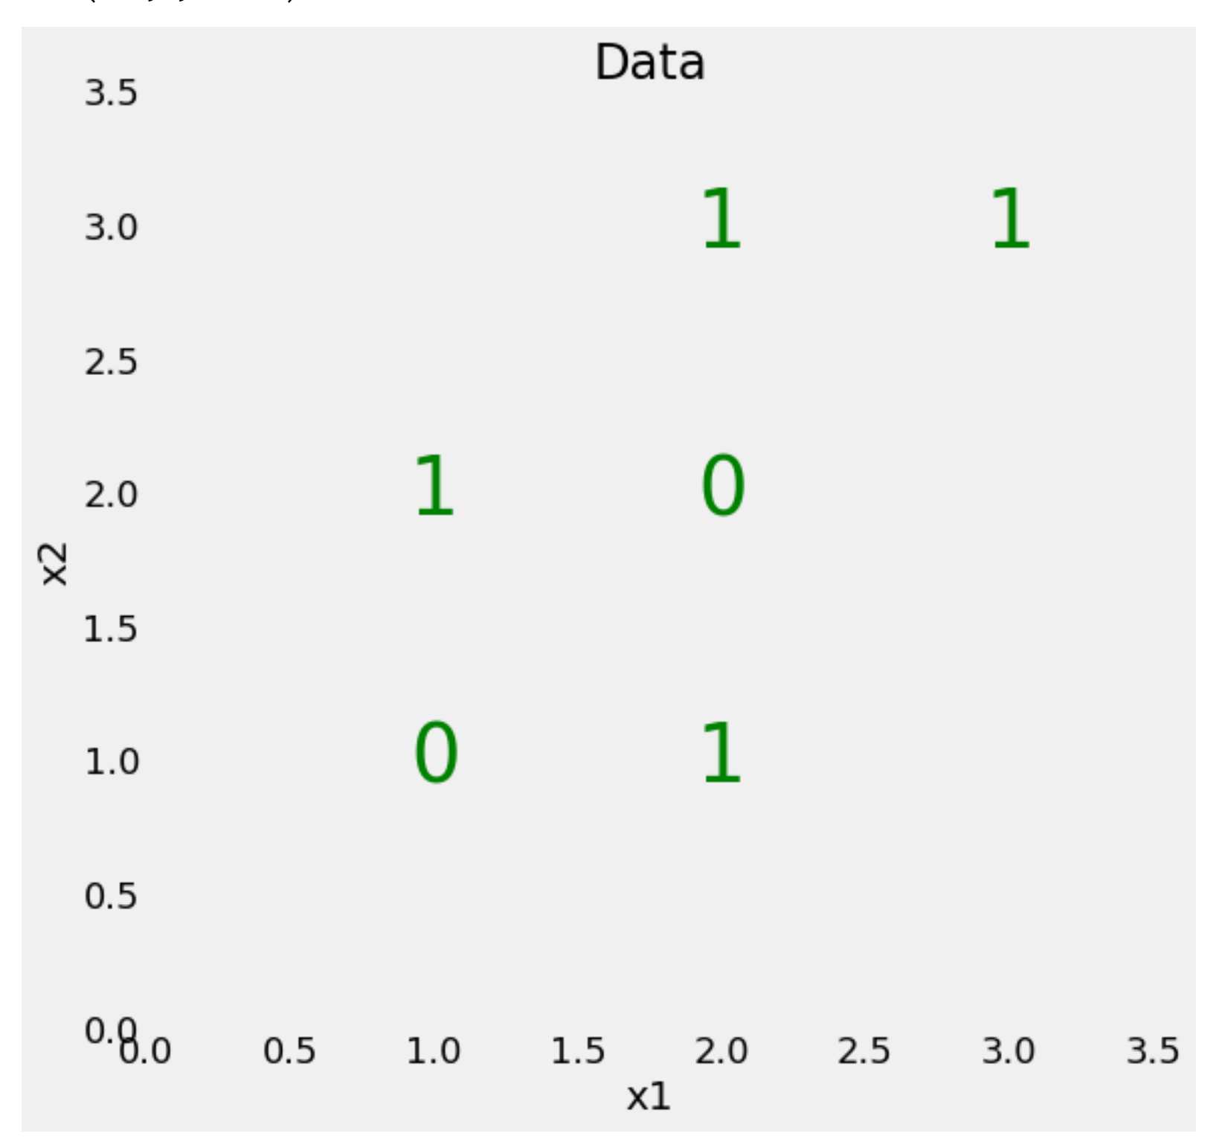
Example
Our dataset includes two features (x1, x2) and 6 observations. Every observation belongs to a class (0 or 1).
Our goal is to build a decision tree to be able to predict to which class an observation belongs, given its features.
We’ll do so by drawing straight lines to divide the observations into boxes which we’ll call nodes.
Notes:
החלוקה הראשונה שתמיד הכי עדיפה היא חלוקה שמאפשרת לקבל קבוצה אחת טהורה- שכל הנתונים בקבוצה זו שייכים לאותה מחלקה.

Slide 19
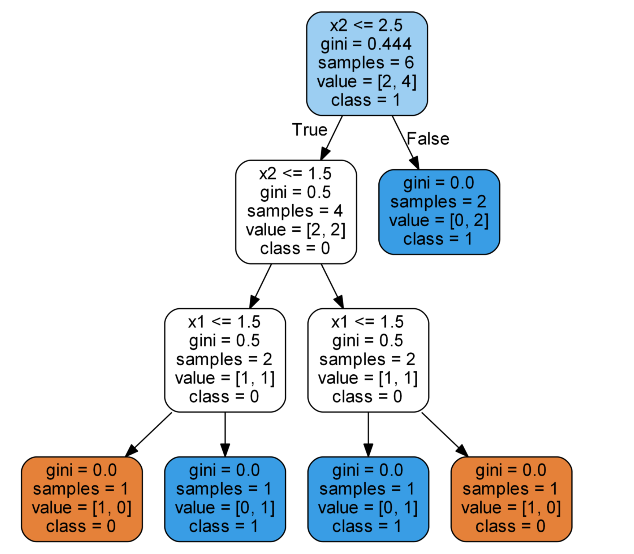
Nodes Information
Statement: a condition that splits the node’s data into two or more separate sub-trees.
gini: the gini impurity of the node.
samples: the number of observations in the node.
value: the number of observations for each class.
class: the majority class. In case of a leaf node, that would be the model’s prediction.

Slide 20
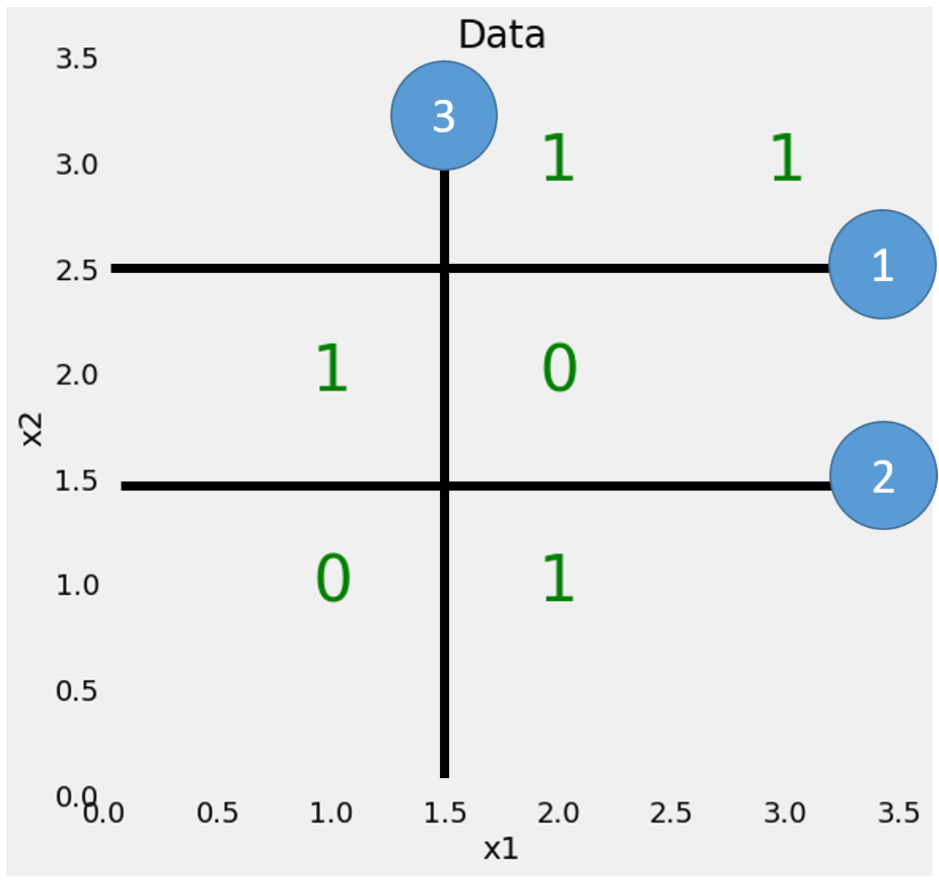

Slide 21
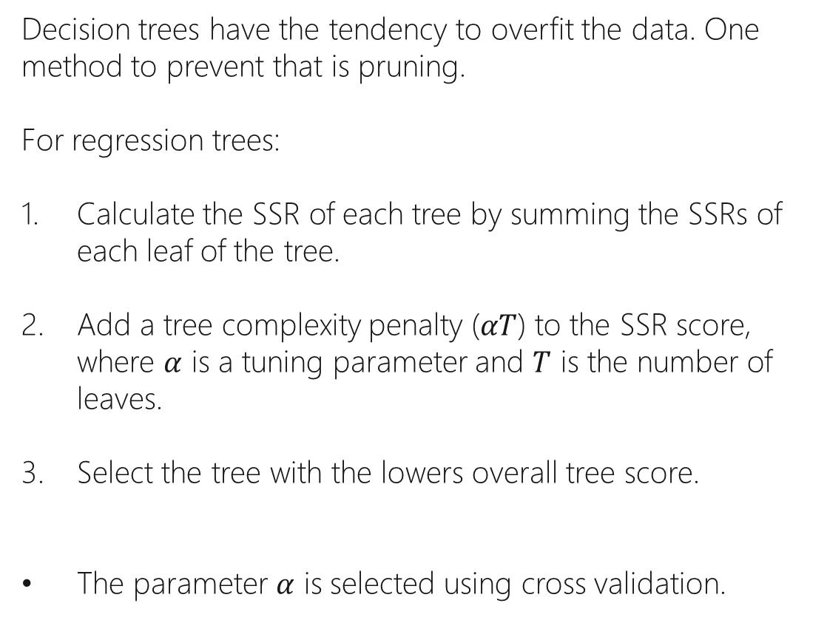
Decision trees have the tendency to overfit the data. One method to prevent that is pruning.
For regression trees:
Calculate the SSR of each tree by summing the SSRs of each leaf of the tree.
Add a tree complexity penalty ($αT$) to the SSR score, where $α$ is a tuning parameter and $T$ is the number of leaves.
Select the tree with the lowers overall tree score.
The parameter $α$ is selected using cross validation.
Pruning
Removing some of the leaves and replacing the split with a leaf that includes more observations.
Notes:
Weakest link pruning.
For classification trees, a similar method is used – instead of SSR, we use the gini index.

Slide 22
Decision Tree Hyper-Parameters
criterion (classification): {“gini”, “entropy”}, default=”gini”
The function to measure the quality of a split.
criterion (regression): {“squared_error”, “friedman_mse”, “absolute_error”, “poisson”}, default=”squared_error”
The function to measure the quality of a split.
max_depth: int, default=None
The maximum depth of the tree. If None, then nodes are expanded until all leaves are pure or until all leaves contain less than min_samples_split samples.
min_samples_split: int or float, default=2
The minimum number of samples required to split an internal node.
min_samples_leaf: int or float, default=1
The minimum number of samples required to be at a leaf node.

Slide 23



Classification Trees
Regression Trees
Resources
Decision Trees
Pruning Regression Trees
Decision Trees

Slide 24
What is Bootstrap?
Bootstrapping is a statistical procedure that resamples a single dataset to create many simulated samples.
Notes:
לכל תצפית יש הסתברות שווה להיכלל בתוך הdataset החדש
הגודל של הdataset החדש יהיה בגודל של המקורי
תצפית יכולה להיבחר כמה פעמים לdataset החדש

Slide 25
How Bootstrapping Works
Each original data point has an equal probability of being randomly drawn and included in the resampled datasets.
The data points are drawn with replacement. i.e. each data point can be selected more than once for the same resampled dataset.
The resampled datasets are of the same size as the original dataset.
The central assumption for bootstrapping is that the original sample accurately represents the actual population.

Slide 26
Creating a Bootstrapped Dataset
Loves Popcorn | Loves Soda | Age | Loves Movies
Yes | Yes | 7 | No
Yes | No | 12 | No
No | Yes | 18 | Yes
No | Yes | 35 | Yes
Yes | Yes | 38 | Yes
Yes | No | 50 | No
No | No | 83 | No
Loves Popcorn | Loves Soda | Age | Loves Movies
Yes | Yes | 7 | No
Yes | No | 12 | No
No | Yes | 18 | Yes
No | Yes | 18 | Yes
Yes | Yes | 38 | Yes
Yes | No | 50 | No
Yes | No | 50 | No

Slide 27
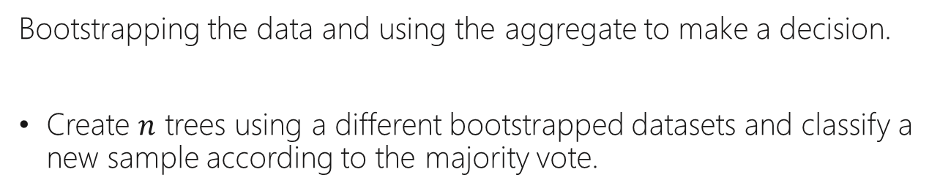
What is Bagging?
Bootstrapping the data and using the aggregate to make a decision.
Create $n$ trees using a different bootstrapped datasets and classify a new sample according to the majority vote.
Notes:
באגינג-יוצרים nעצים מתוך datasets שונים של אותו data. לאחר מכן משתמשים בעצים שהתקבלו ביחד על מנת לחזות את הסיווג של הנתונים, על פי הבחירה של רוב העצים או הממוצע (אם זה משתנה מספרי).

Slide 28
Easy to work with.
Random Forest
Work with all types of data.
More accurate than a single tree.
Notes:
יוצר n עצים במקום עץ אחד, אך לא לוקח datasets מתוך הdata, אלא גם לוקח רק חלק מהfeatures בכל שלב חלוקה- על מנת לבחור באיזה feature להתשמש בכל חלוקה בעץ, הוא בוחר כל פעם feature אחד מתוך רק חלק מהfeatures.

Slide 29
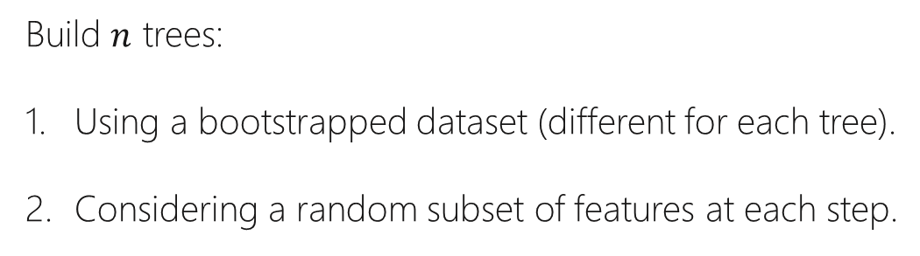
Creating a Random Forest
Build $n$ trees:
Using a bootstrapped dataset (different for each tree).
Considering a random subset of features at each step.

Slide 30
Classification:
Run the sample down each tree and keep track of the predictions.
The final output is the one that received most of the votes.
Regression:
Run the sample down each tree and keep track of the predictions.
The final output is the average of all predictions.
Making Predictions using a RF

Slide 31
Estimating the Accuracy of a RF
Loves Popcorn | Loves Soda | Age | Loves Movies
Yes | Yes | 7 | No
Yes | No | 12 | No
No | Yes | 18 | Yes
No | Yes | 35 | Yes
Yes | Yes | 38 | Yes
Yes | No | 50 | No
No | No | 83 | No
Loves Popcorn | Loves Soda | Age | Loves Movies
Yes | Yes | 7 | No
Yes | No | 12 | No
No | Yes | 18 | Yes
No | Yes | 18 | Yes
Yes | Yes | 38 | Yes
Yes | No | 50 | No
Yes | No | 50 | No
Out-of-bag dataset
Notes:
Out-of-bag dataset – samples that were not included in the bootstrapped data that was used to build a tree in the random forest.
ניתן להשתמש בתצפיות שלא נכללו בdataset לבניית עץ ספציפי זה, על מנת לבדוק את רמת הדיוק של העץ-out of bag error

Slide 32
Out-of-bag Error
We can measure how accurate our random forest is by the proportion of out-of-bag samples that were correctly classified.
Out-of-bag Error: the proportion of out-of-bag samples that were incorrectly classified.
Notes:
כאשר בונים עץ בsklearnהוא מבצע זאת אוטומוטית אם מגדירים לו לעשות

Slide 33
Random Forest Hyper-Parameters
n_estimators: int, default=100
The number of trees in the forest.
bootstrap: bool, default=True
Whether bootstrap samples are used when building trees. If False, the whole dataset is used to build each tree.
The same parameters used for decision trees can be used for random forests.

Slide 34



Random Forest
Random Forest
Resources
Random Forest
Random Forest in Pyhton
Random Forest Classifier
Random Forest Regressor

