Slide 1

K-Means, GMM
Created and Edited by Amanda Magzal
09

Slide 2
A centroids-based algorithm.
K-Means
Pre-defined number of clusters.
Clusters are assumed to be spherical and evenly sized.

Slide 3



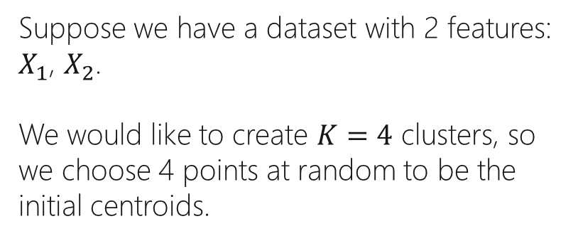
Step 1: Select $K$ Centroids
$$X_{2}$$
Suppose we have a dataset with 2 features: $X_{1}$, $X_{2}$.
We would like to create $K=4$ clusters, so we choose 4 points at random to be the initial centroids.
$$X_{1}$$

Slide 4

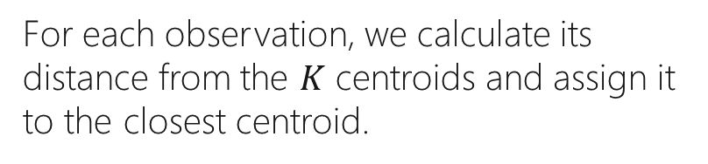




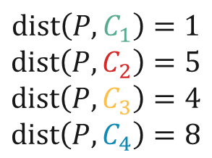

Step 2: Assign Observations to Clusters
$$X_{2}$$
For each observation, we calculate its distance from the $K$ centroids and assign it to the closest centroid.
$$P$$
$$C_{1}$$
$$C_{3}$$
$$dist\left(P, C_{1}\right)=1$$
$$dist\left(P, C_{2}\right)=5$$
$$dist\left(P, C_{3}\right)=4$$
$$dist\left(P, C_{4}\right)=8$$
$$C_{2}$$
The observation $P$ will be assigned to the first cluster (green).
$$C_{4}$$
$$X_{1}$$

Slide 5






The Clusters after One Iteration
$$X_{2}$$
$$C_{1}$$
$$C_{3}$$
$$C_{2}$$
$$C_{4}$$
$$X_{1}$$

Slide 6


Step 3: Recompute the Centroids
$$X_{2}$$
For each cluster, we recompute the centroid.
The location of the new centroid is the point in which the average distance from each observation of the cluster is minimal.
$$X_{1}$$

Slide 7
Step 4: Reassign the Observations
$$X_{2}$$
Using the same method as before, we calculate the distance of each observation from the centroids and reassign them to the clusters.
One observation moved from the yellow to the blue cluster.
$$X_{1}$$

Slide 8
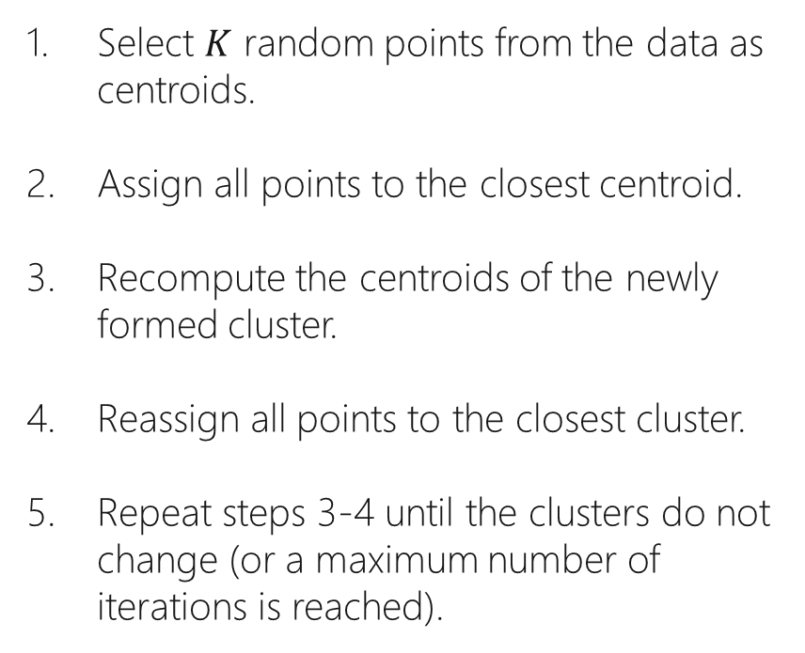
Select $K$ random points from the data as centroids.
Assign all points to the closest centroid.
Recompute the centroids of the newly formed cluster.
Reassign all points to the closest cluster.
Repeat steps 3-4 until the clusters do not change (or a maximum number of iterations is reached).
K-Means Steps

Slide 9
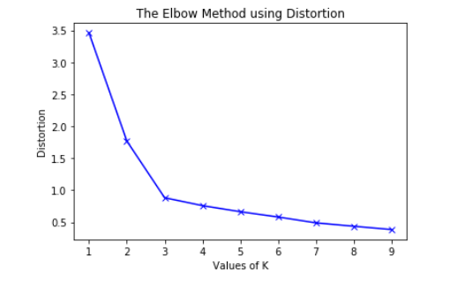


The Elbow Method
The elbow method is used for finding the best value of $K$ in K-Means.
We calculate a metric (typically distortion (sum of Squared Error) for each value of $K$.
The best value of $K$ is where there is no significant reduction in distortion (aka the elbow point).
In this example, we would choose $K=3$.

Slide 10
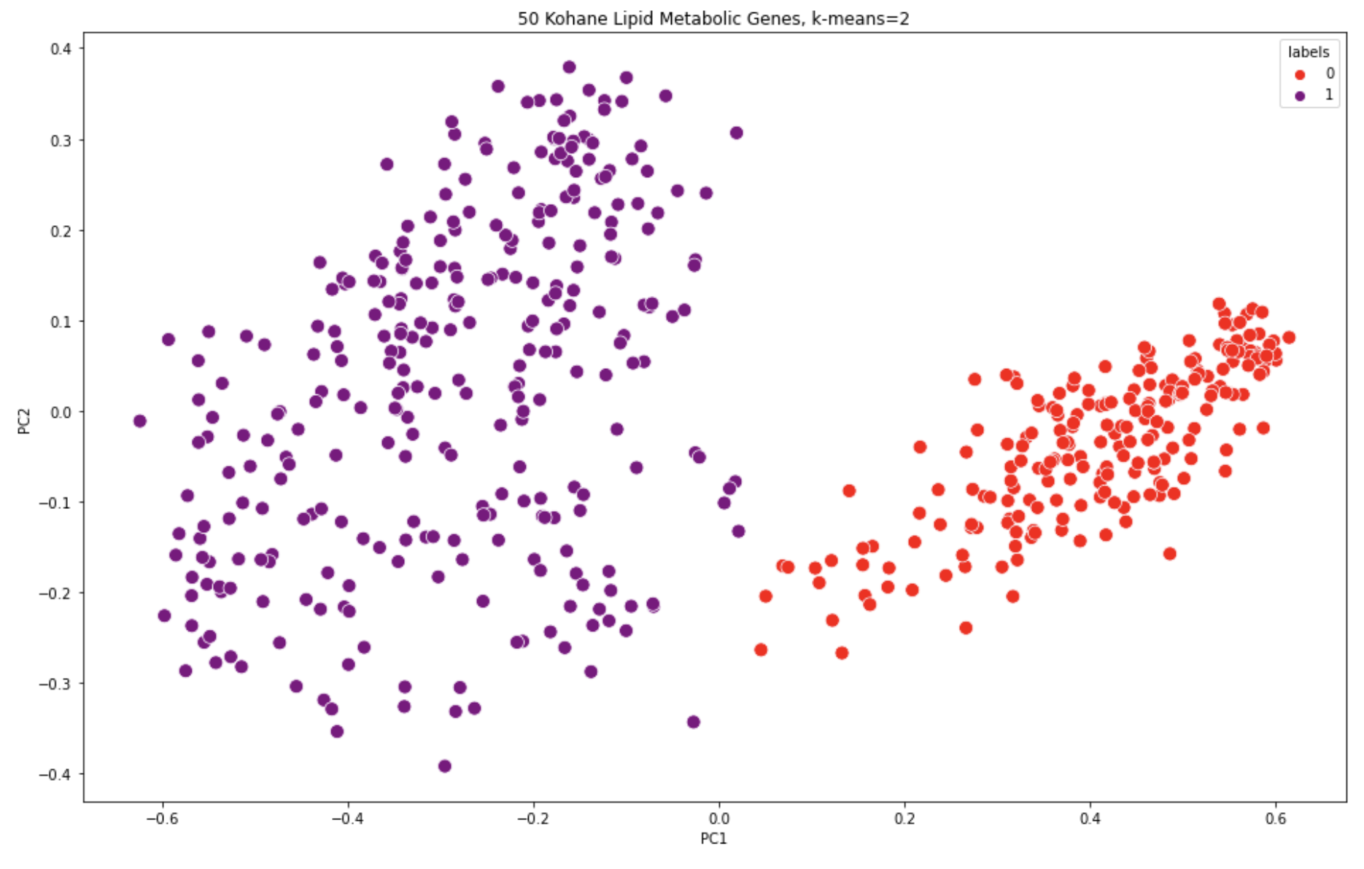
Real Life Example

Slide 11
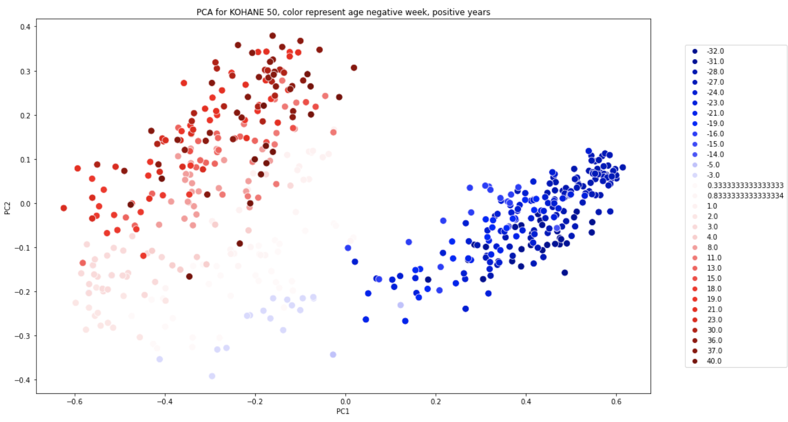
Real Life Example

Slide 12
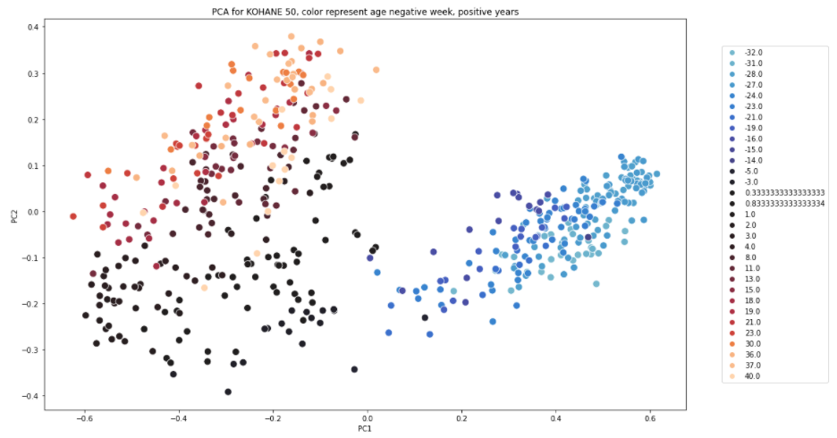
Real Life Example

Slide 13
K-Means Hyper-Parameters
n_clusters: int, default=8
The number of clusters to form as well as the number of centroids to generate.
n_init: int, default=10
Number of time the k-means algorithm will be run with different centroid seeds. The final results will be the best output of n_init consecutive runs in terms of inertia.
max_iter: int, default=300
Maximum number of iterations of the k-means algorithm for a single run.
tol: float, default=1e-4
Relative tolerance with regards to Frobenius norm of the difference in the cluster centers of two consecutive iterations to declare convergence.

Slide 14




K-Means Clustering
Resources
K-Means
K-Means Comprehensive Guide
K-Means

Slide 15
A distribution-based algorithm.
GMM Gaussian Mixture Models
Pre-defined number of clusters.
Can account for clusters of different shapes.

Slide 16
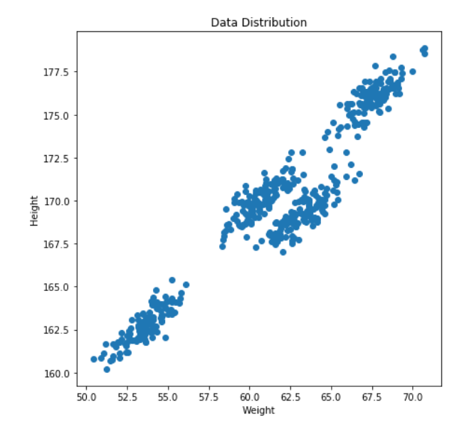
K-Means vs. GMM
Suppose we have a dataset with 2 features: Height and Weight.
We would like to create 𝐾=4 clusters.

Slide 17
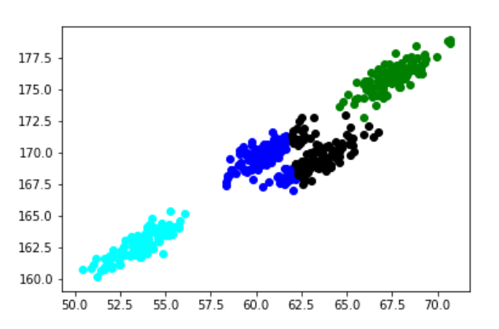
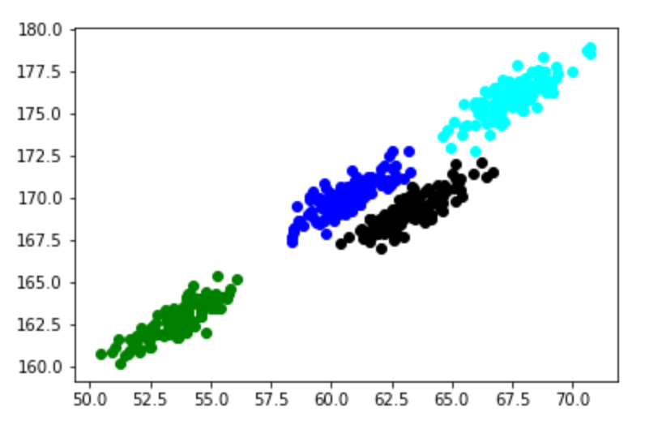
K-Means vs. GMM
K-Means
GMM

Slide 18
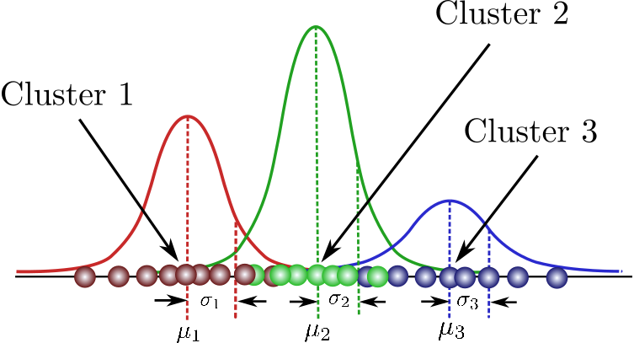

Gaussian Parameters
$μ$ – the centroid of the cluster.
$Σ$ – the covariance of the cluster (in 1D it’s equivalent to the variance $σ^{2}$).
$π$ – the percentage of points in the cluster, where $\sum_{i=1}^{k}{π_{i}}=1$.

Slide 19
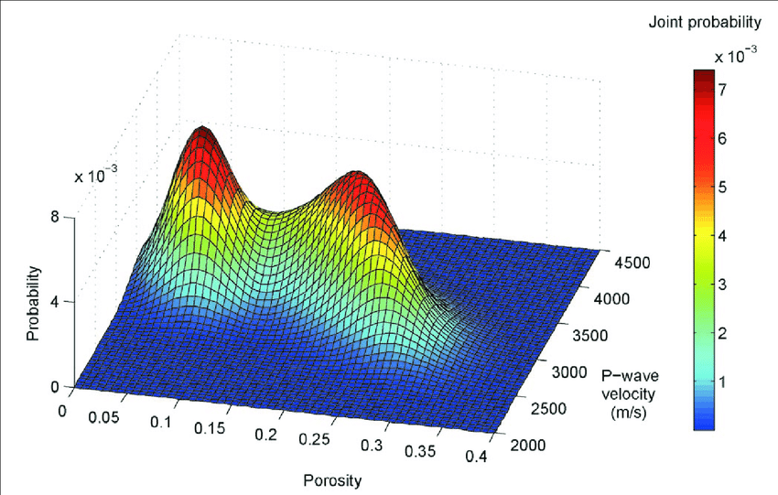
GMM for Two Features

Slide 20
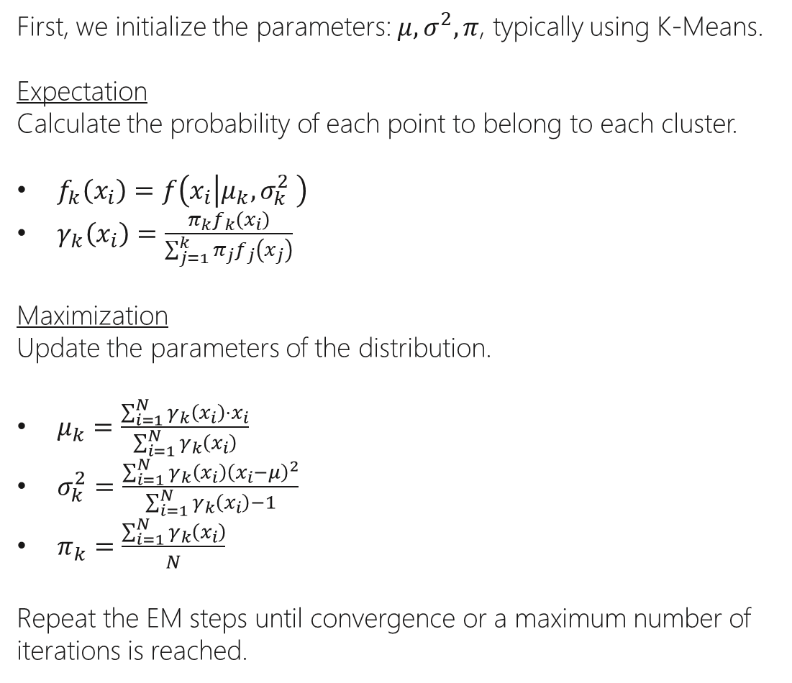
First, we initialize the parameters: $μ, σ^{2}, π$, typically using K-Means.
Expectation
Calculate the probability of each point to belong to each cluster.
$f_{k}\left(x_{i}\right)=f\left(x_{i} | μ_{k},σ_{k}^{2} \right)$
$γ_{k}\left(x_{i}\right)=\frac{π_{k}f_{k}\left(x_{i}\right)}{\sum_{j=1}^{k}{π_{j}f_{j}\left(x_{j}\right)}}$
Maximization
Update the parameters of the distribution.
$μ_{k}=\frac{\sum_{i=1}^{N}{γ_{k}\left(x_{i}\right)⋅x_{i}}}{\sum_{i=1}^{N}{γ_{k}\left(x_{i}\right)}}$
$σ_{k}^{2}=\frac{\sum_{i=1}^{N}{γ_{k}\left(x_{i}\right){\left(x_{i}−μ\right)}^{2}}}{\sum_{i=1}^{N}{γ_{k}\left(x_{i}\right)−1}}$
$π_{k}=\frac{\sum_{i=1}^{N}{γ_{k}\left(x_{i}\right)}}{N}$
Repeat the EM steps until convergence or a maximum number of iterations is reached.
Expectation - Maximization Algorithm

Slide 21
GMM Hyper-Parameters
n_components: int, default=1
The number of mixture components.
covariance_type: {‘full’, ‘tied’, ‘diag’, ‘spherical’}, default=’full’
String describing the type of covariance parameters to use.
tol: float, default=1e-3
The convergence threshold. EM iterations will stop when the lower bound average gain is below this threshold.
max_iter: int, default=100
The number of EM iterations to perform.
n_init: int, default=1
The number of initializations to perform. The best results are kept.
init_params: {‘kmeans’, ‘random’}, default=’kmeans’
The method used to initialize the weights, the means and the precisions.

Slide 22
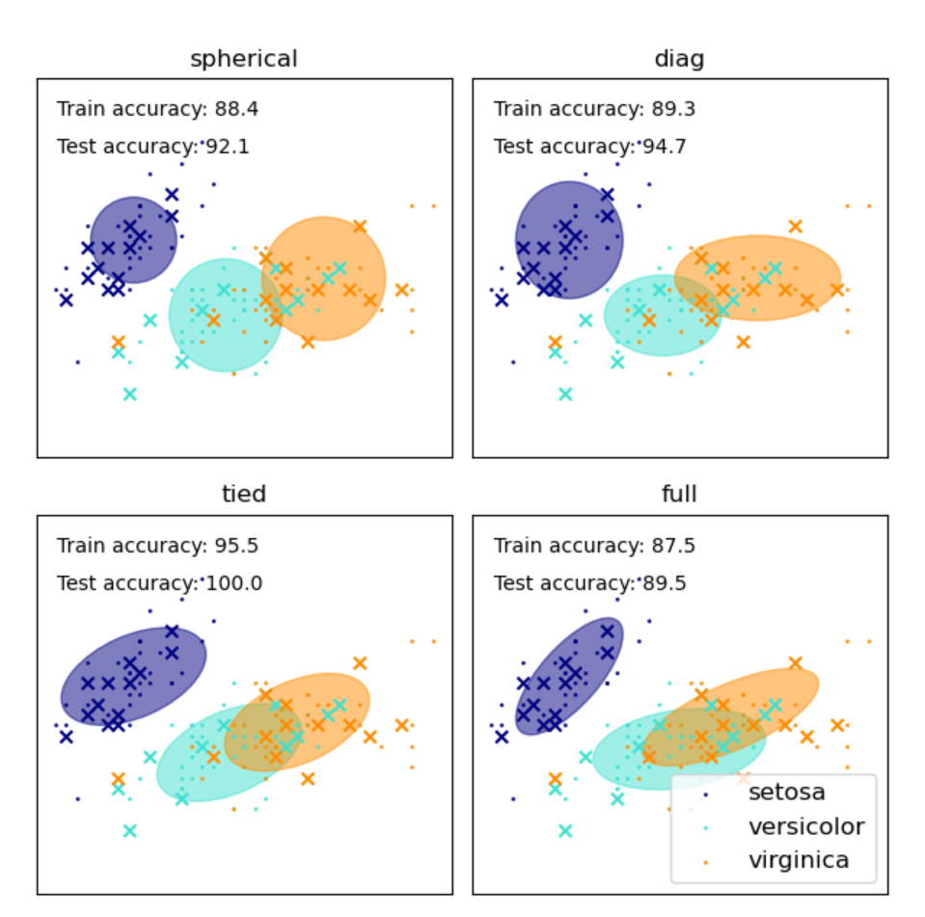
Covariance Type
‘full’: each component has its own general covariance matrix.
‘tied’: all components share the same general covariance matrix.
‘diag’: each component has its own diagonal covariance matrix.
‘spherical’: each component has its own single variance.

Slide 23
GMM Clustering
Resources
GMM
GMM
Gaussian Mixture

