Slide 1

Basic Python

Slide 2
Python is an interpreted, high-level, general-purpose programming language. Created by Guido van Rossum and first released in 1991, Python's design philosophy emphasizes code readability with its notable use of significant whitespace. Its language constructs and object-oriented approach aims to help programmers write clear, logical code for small and large-scale projects. https://en.wikipedia.org/wiki/Python_(programming_language)

Slide 3
What do I need to get started?
Somewhere for Python to run
Interpreter
Installation
https://www.anaconda.com/distribution/
More info
https://www.anaconda.com/why-anaconda/
Something for writing Python (not a must)
Editor
Installation
https://www.jetbrains.com/pycharm/download/#section=windows

Slide 4
Enclose strings in single or double quotes
print('Hello world single quotes')
print("Hello world double quotes")
Hello world single quotes
Hello world double quotes

Slide 5
Functions
def area_of_square(a):
return a * a
print(area_of_square(6))

Slide 6
Getting information from the user
str_number = input('Please enter a number')
print(str_number)
int_number = int(input('Please enter a number’))
print(int_number)

Slide 7

Comments

Slide 8
We add comments to our code using #
# This is a comment in my code it does nothing
‘’’
Block of comment
Block of comment
Block of comment
Block of comment
‘’’

Slide 9
You can combine strings with +
first_name = 'Susan'
last_name = 'Ibach'
print(first_name + last_name)
print('Hello ' + first_name + ' ' + last_name)
SusanIbach
Hello Susan Ibach

Slide 10
You can use functions to modify strings
sentence = 'The dog is named Sammy'
print(sentence.upper())
print(sentence.lower())
print(sentence.capitalize())
print(sentence.count('a'))
THE DOG IS NAMED SAMMY
the dog is named sammy
The dog is named sammy
2

Slide 11
The functions help us format strings we save to files and databases, or display to users
first_name = input('What is your first name? ')
last_name = input('What is your last name? ')
print ('Hello ' + first_name.capitalize() + ' ' \
+ last_name.capitalize())
What is your first name? SUSAN
What is your last name? IBACH
Hello Susan Ibach

Slide 12

Working with numbers

Slide 13
You can do math with numbers
first_num = 6
second_num = 2
print(first_num + second_num)
print(first_num ** second_num)
Symbol | Operation
+ | Addition
- | Subtraction
* | Multiplication
/ | Division
** | Exponent
8
36

Slide 14
When displaying a string that contains numbers you must convert the numbers into strings
days_in_feb = 28
print(str(days_in_feb) + ' days in February')
28 days in February

Slide 15
Numbers can be stored as strings Numbers stored as strings are treated as strings
first_num = '5'
second_num = '6'
print(first_num + second_num)
56

Slide 16
The input function always returns strings
first_num = input('Enter first number ')
second_num = input('Enter second number ')
print(first_num + second_num)
Enter first number 5
Enter second number 6
56

Slide 17
Numbers stored as strings must be converted to numeric values before doing math
first_num = input('Enter first number ')
second_num = input('Enter second number ')
print(int(first_num) + int(second_num))
print(float(first_num) + float(second_num))
Enter first number 5
Enter second number 6
11
11.0

Slide 18

Dates

Slide 19
We often need current date and time when logging errors and saving data
# To get current date and time
# we need to use the datetime library
from datetime import datetime
current_date = datetime.now()
# the now function returns a datetime object
print('Today is: ' + str(current_date))
Today is: 2019-06-06 16:17:18.694511

Slide 20
There are functions you can use with datetime objects to manipulate dates
from datetime import datetime, timedelta
today = datetime.now()
print('Today is: ' + str(today))
# timedelta is used to define a period of time
one_day = timedelta(days=1)
yesterday = today - one_day
print('Yesterday was: ' + str(yesterday))
Today is: 2019-06-06 16:14:24.615495
Yesterday was: 2019-06-05 16:14:24.615495

Slide 21
Use date functions to control date formatting
from datetime import datetime
current_date = datetime.now()
print('Day: ' + str(current_date.day))
print('Month: ' + str(current_date.month))
print('Year: ' + str(current_date.year))
Day: 6
Month: 6
Year: 2019

Slide 22

Loops

Slide 23
Loop through a list or a range
for name in ['Christopher', 'Susan']:
print(name)
Christopher
Susan
for index in range(0, 2):
print(index)
0
1

Slide 24
Loop through a list or a range
for name in ['Christopher', 'Susan']:
print(name)
Christopher
Susan
for index in range(2):
print(index)
0
1

Slide 25
Catching runtime errors
try:
print(x / y)
except ZeroDivisionError as e:
# Optionally, log e somewhere
print('Sorry, something went wrong')
except:
print('Something really went wrong')
finally:
print('This always runs on success or failure')
Sorry, something went wrong
This always runs on success or failure

Slide 26
You can add a default action using else
if price >= 1.00:
tax = .07
print(tax)
else:
tax = 0
print(tax)

Slide 27

Handling multiple conditions

Slide 28

Collections

Slide 29
Lists are collections of items
names = ['Christopher', 'Susan']
scores = []
scores.append(98) # Add new item to the end
scores.append(99)
print(names)
print(scores)
print(scores[1]) # Collections are zero-indexed
['Christopher', 'Susan']
[98, 99]
99

Slide 30
Common operations
names = ['Susan', 'Christopher']
print(len(names)) # Get the number of items
names.insert(0, 'Bill') # Insert before index
print(names)
names.sort()
print(names)
2
['Bill', 'Susan', 'Christopher']
['Bill', 'Christopher', 'Susan']

Slide 31
Retrieving ranges
names = ['Susan', 'Christopher', 'Bill']
presenters = names[0:2] # Get the first two items
# Starting index and number of items to retrieve
print(names)
print(presenters)
['Susan', 'Christopher', 'Bill']
['Susan', 'Christopher']

Slide 32
Dictionaries
person = {'first': 'Christopher'}
person['last'] = 'Harrison'
print(person)
print(person['first'])
{'first': 'Christopher', 'last': 'Harrison'}
Christopher

Slide 33
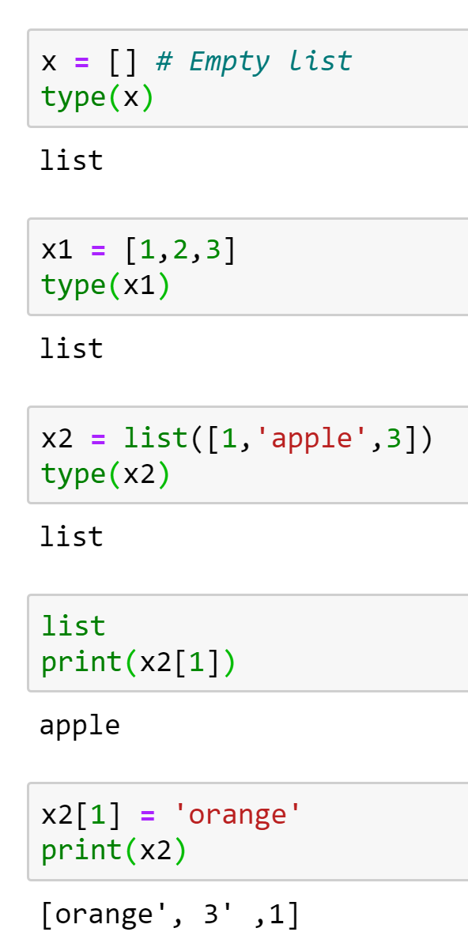
Non-Primitive Data Structures
Lists
Lists in Python are used to store collection of heterogeneous items. These are mutable, which means that you can change their content without changing their identity. You can recognize lists by their square brackets [ and ] that hold elements , separated by a comma , .
[1,’orange’,3]

Slide 34
Non-Primitive Data Structures
Array
First off, arrays in Python are a compact way of collecting basic data types, all the entries in an array must be of the same data type. However, arrays are not all that popular in Python, unlike the other programming languages such as C++ or Java.
In general, when people talk of arrays in Python, they are actually referring to lists. However, there is a fundamental difference between them
Arrays can be seen as a more efficient way of storing a certain kind of list. This type of list has elements of the same data typeץ
In our case, we will use NumPy library.

Slide 35
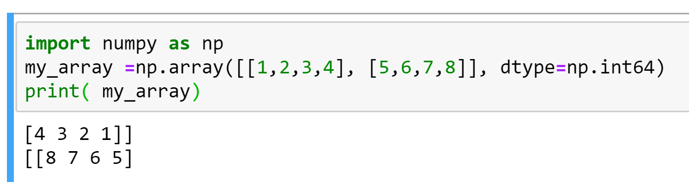
NumPy
However, you should know that, on a structural level, an array is basically nothing but pointers. It’s a combination of a memory address, a data type, a shape, and strides:
The data pointer indicates the memory address of the first byte in the array,
The data type or dtype pointer describes the kind of elements that are contained within the array,
The shape indicates the shape of the array, and
The strides are the number of bytes that should be skipped in memory to go to the next element. If your strides are (10,1), you need to proceed one byte to get to the next column and 10 bytes to locate the next row.
In other words, an array contains information about the raw data, how to locate an element and how to interpret an element.
NumPy is a Python library that is the core library for scientific computing in Python. It contains a collection of tools and techniques that can be used to solve on a computer mathematical models of problems in Science and Engineering. One of these tools is a high-performance multidimensional array object that is a powerful data structure for efficient computation of arrays and matrices.

Slide 36
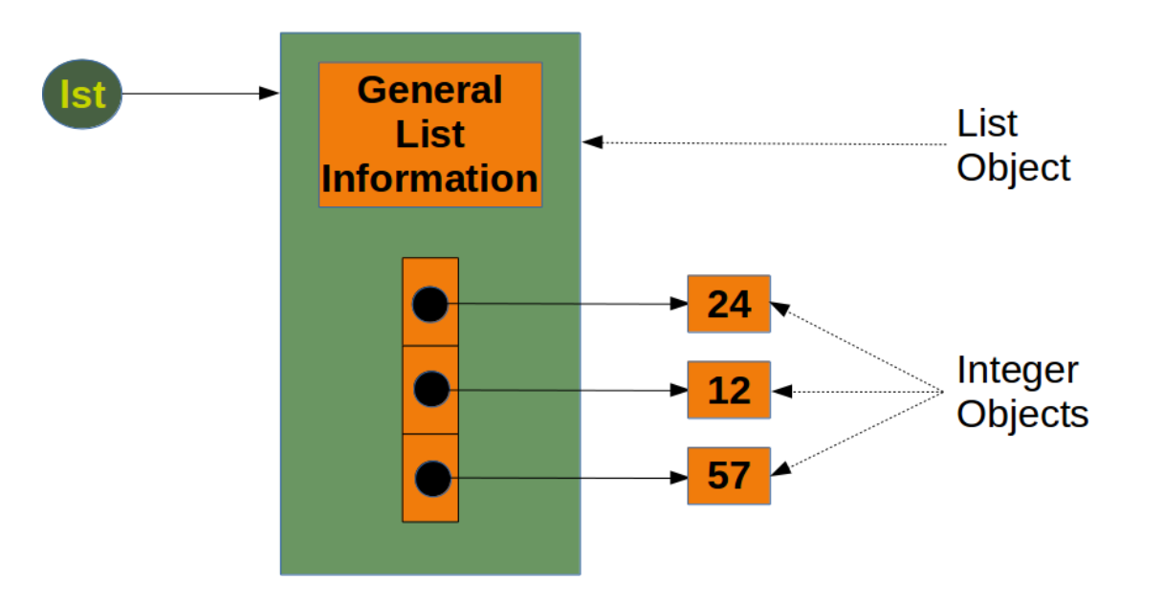
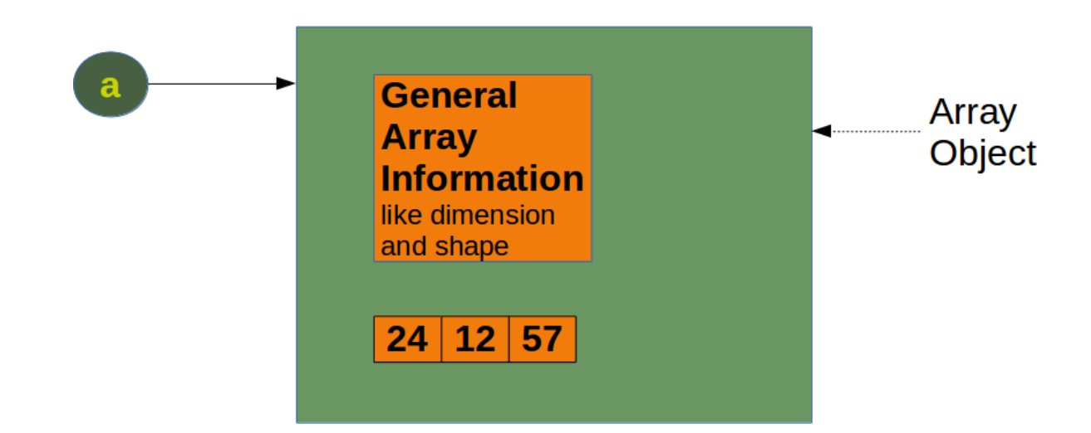
Python Lists vs. NumPy Arrays
Size - NumPy data structures take up less space.
Performance - they have a need for speed and are faster than lists
Functionality - SciPy and NumPy have optimized functions such as linear algebra operations built in.
With arrays, you can perform an operations on all its item individually easily, which may not be the case with lists.

Slide 37
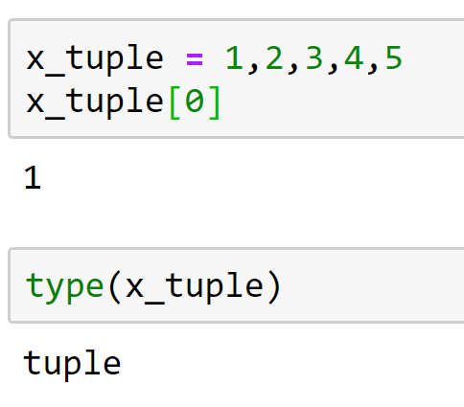
Tuples
Tuples are another standard sequence data type. The difference between tuples and list is that tuples are immutable, which means once defined you cannot delete, add or edit any values inside it. This might be useful in situations where you might to pass the control to someone else but you do not want them to manipulate data in your collection, but rather maybe just see them or perform operations separately in a copy of the data.

Slide 38
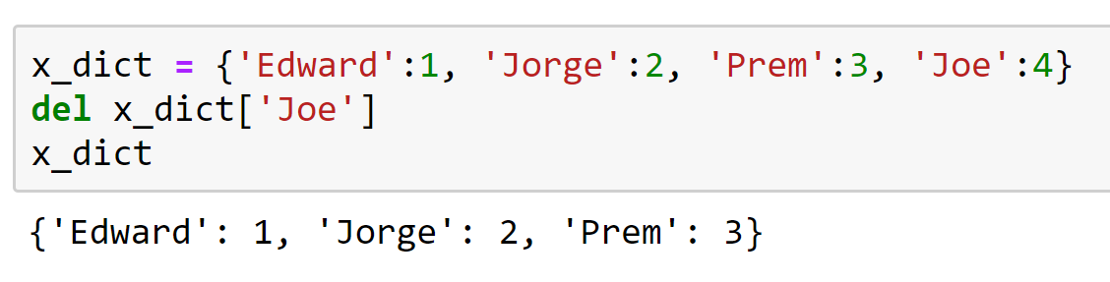
Dictionary
Dictionaries are exactly what you need if you want to implement something like a telephone book. None of the data structures that you have seen before are suitable for a telephone book. This is when a dictionary can come in handy.
Dictionaries are made up of key-value pairs. key is used to identify the item and the value holds as the name suggests, the value of the item.

Slide 39
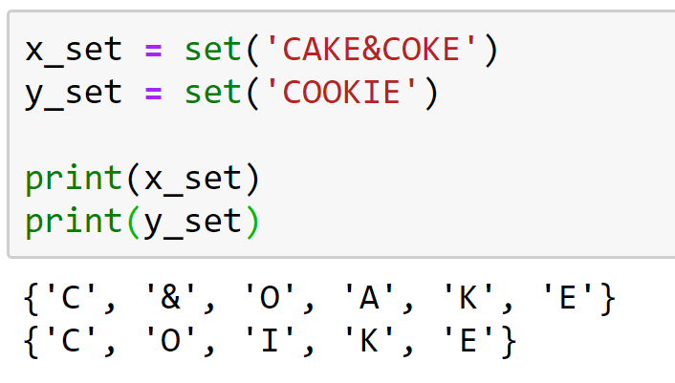
Sets
Sets are a collection of distinct (unique) objects. These are useful to create lists that only hold unique values in the dataset.
It is an unordered collection but a mutable one, this is very helpful when going through a huge dataset.

Slide 40
Files
Files are traditionally a part of data structures. And although big data is commonplace in the data science industry, a programming language without the capability to store and retrieve previously stored information would hardly be useful.

Slide 41
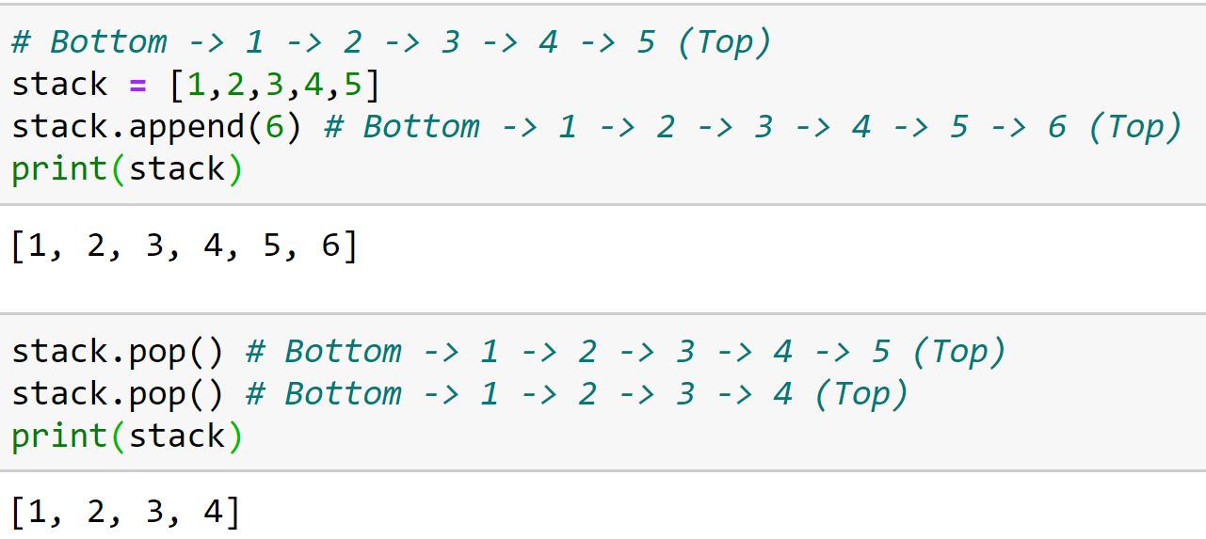
Stacks
A stack is a container of objects that are inserted and removed according to the Last-In-First-Out (LIFO) concept. Think of a scenario where at a dinner party where there is a stack of plates, plates are always added or removed from the top of the pile.
Stacks can be implemented using lists in Python. When you add elements to a stack, it is known as a push operation, whereas when you remove or delete an element it is called a pop operation.

Slide 42
Queue
A queue is a container of objects that are inserted and removed according to the First-In-First-Out (FIFO) principle. An excellent example of a queue in the real world is the line at a ticket counter where people are catered according to their arrival sequence and hence the person who arrives first is also the first to leave
Lists are not efficient to implement a queue, because append() and pop() from the end of a list is not fast and incur a memory movement cost. Also, insertion at the end and deletion from the beginning of a list is not so fast since it requires a shift in the element positions.
https://www.geeksforgeeks.org/queue-in-python/

Slide 43
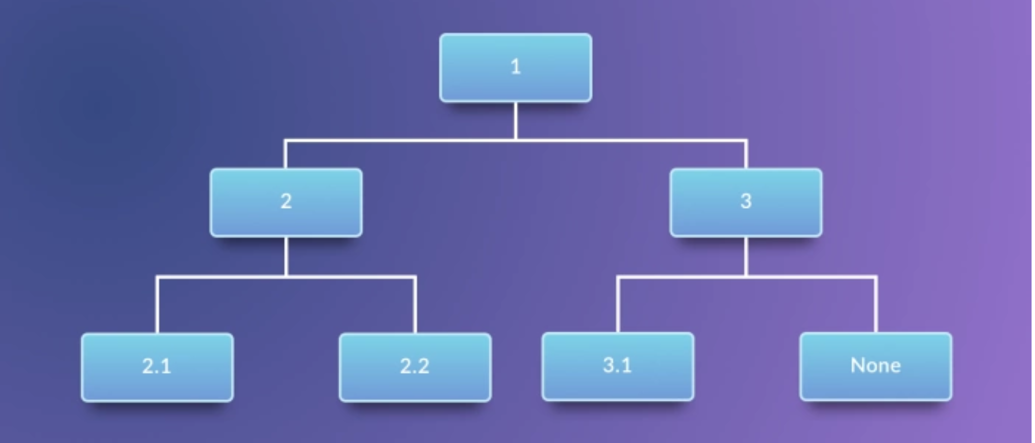
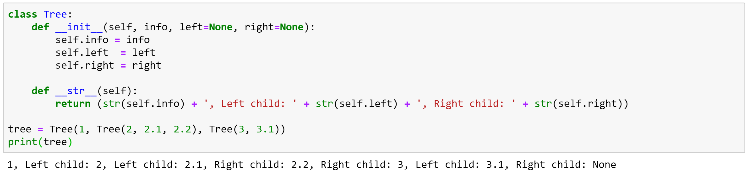
Trees
A tree in the real world is a living being with its roots in the ground and the branches that hold the leaves, fruit out in the open. The branches of the tree spread out in a somewhat organized way. In computer science, trees are used to describe how data is sometimes organized, except that the root is on the top and the branches, leaves follow, spreading towards the bottom and the tree is drawn inverted compared to the real tree. However, graphs are an important concept specially in Data Science and are often used to model real life problems.

Slide 44
תרגול נוסף - מומלץ
https://www.machinelearningplus.com/python/101-numpy-exercises-python/
https://www.machinelearningplus.com/python/list-comprehensions-in-python/

