Slide 1









WeapDet‏
Prevent the next disaster

Slide 2
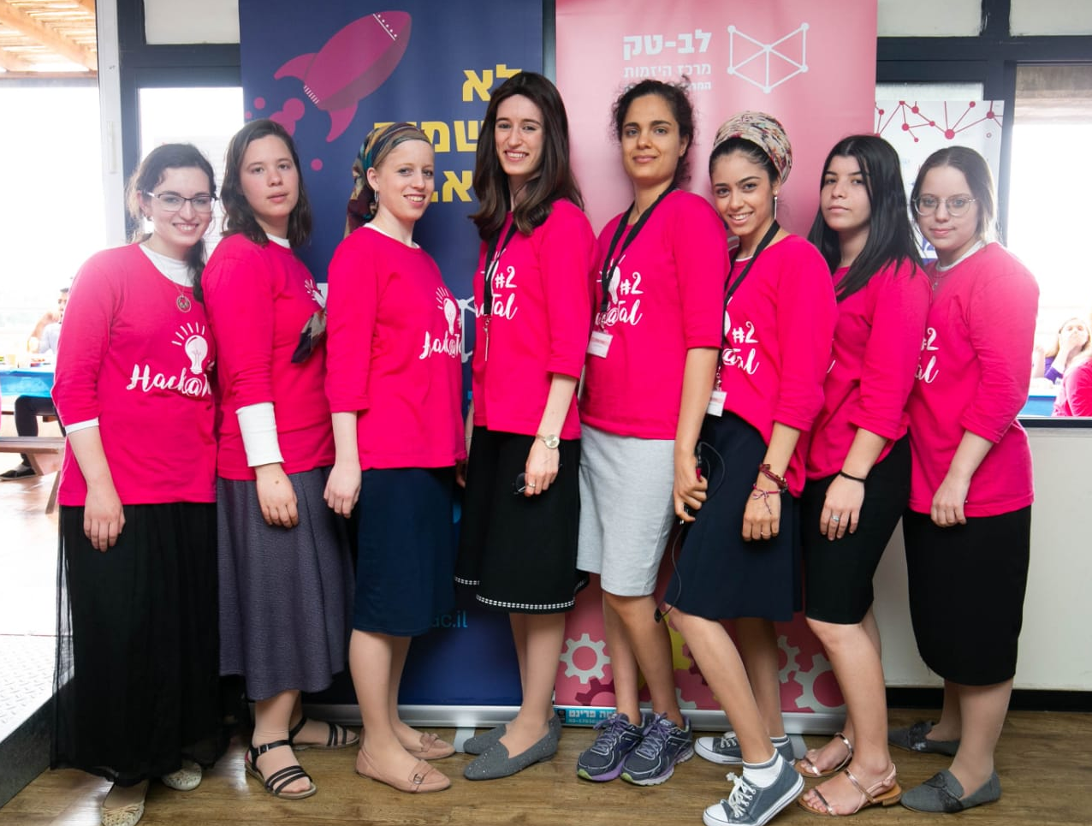

Participants
Sarah Knapp
Bioinformatics
Bat Sheva Aharonov
Computer Science
Bat Sheva Tkach
Computer Science
Bat Tzion Metzger
Computer Science
Talel Halevi
Computer Science
Chaya Alfa
Computer Science
Neora Asulin Bioinformatics
Rivki shafer
Business Administration

Slide 3
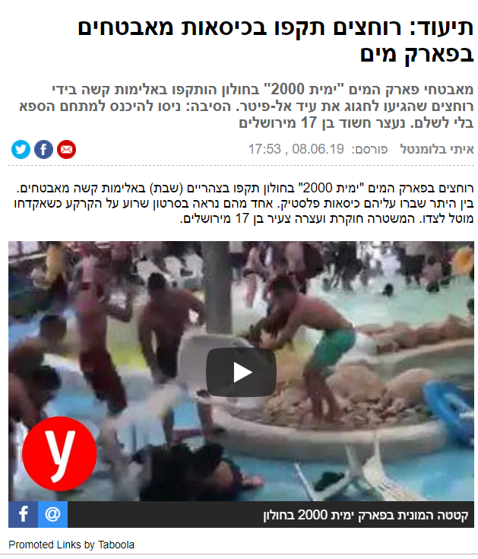
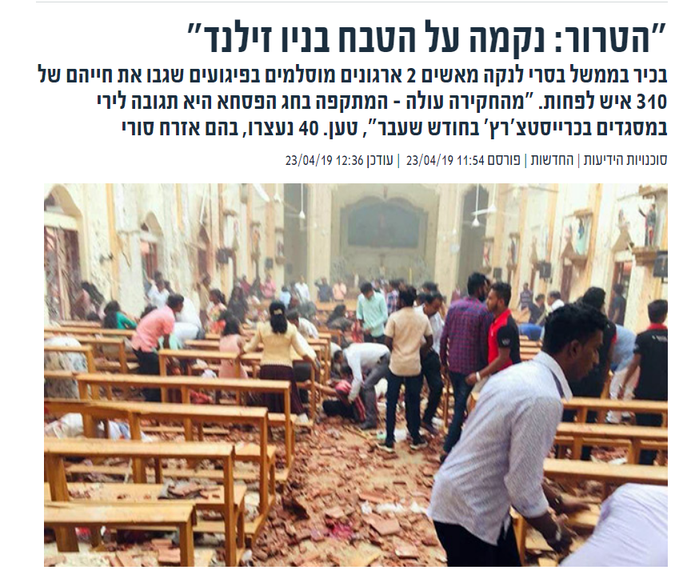
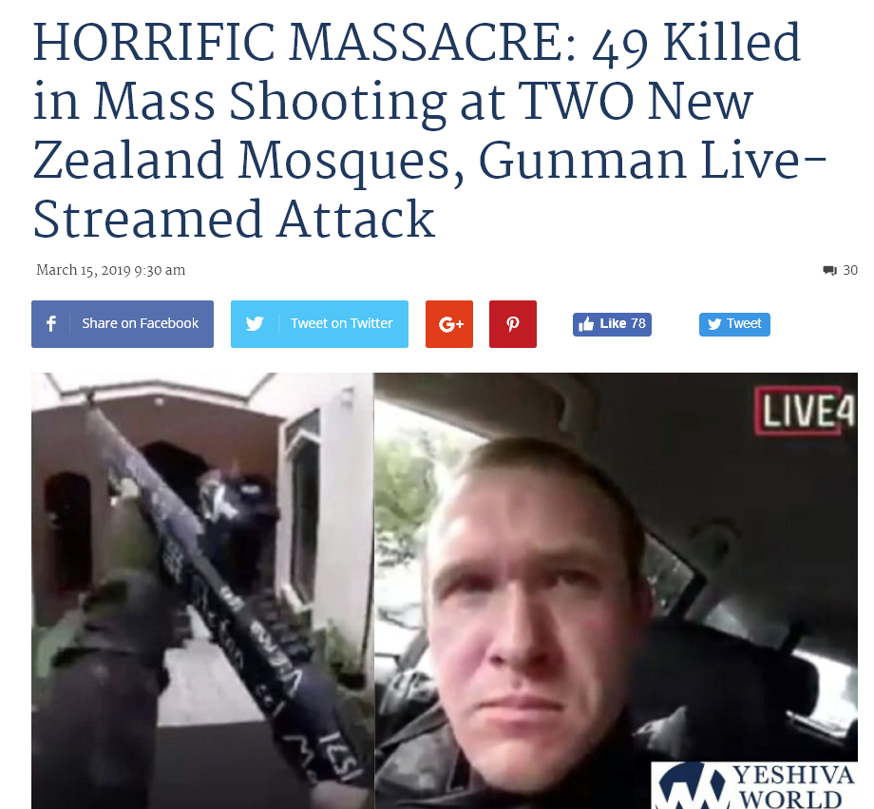
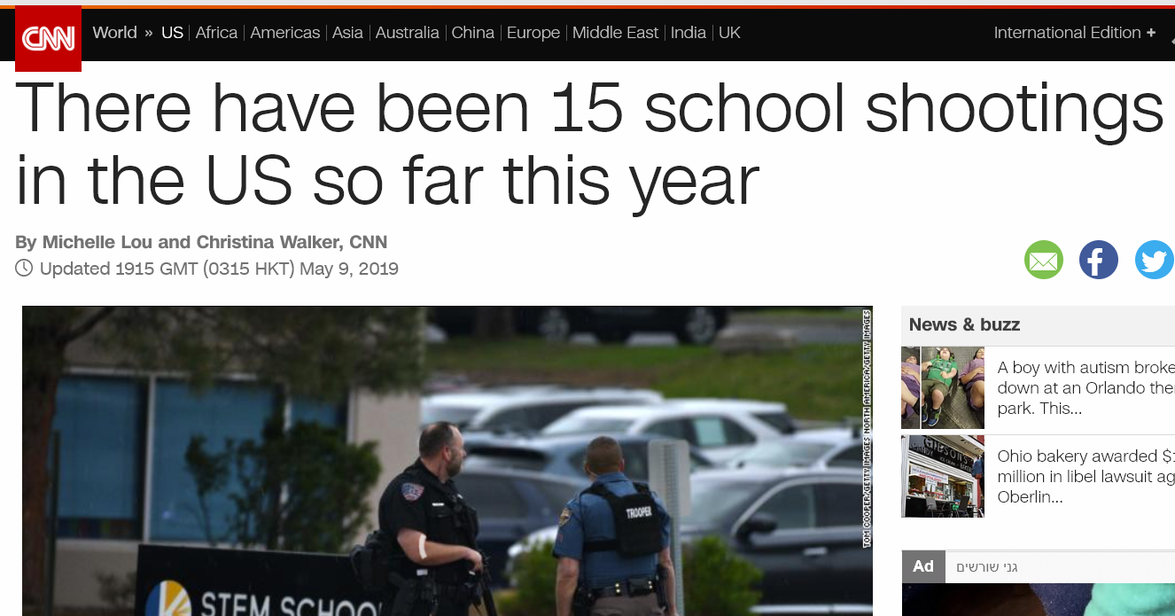
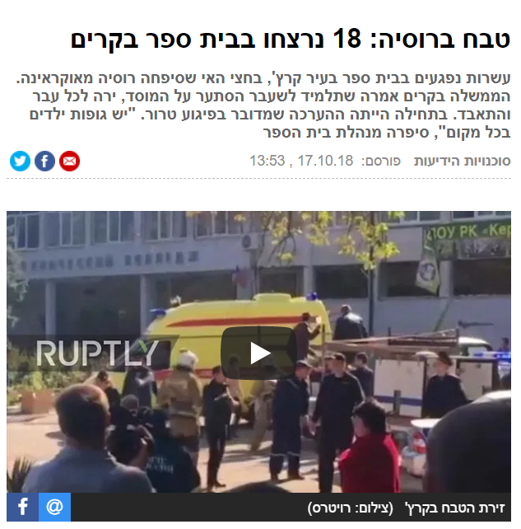
problem The

Slide 4



≈3-5 min
≈4-11min
wikipedia
FBI
Time = life

Slide 5

Our solution

Slide 6
Our customers
Public institutions
Government institutions
Private organizations

Slide 7









Cost & potential
before
after

Slide 8

Sales and Marketing
Trial Period & Simulations

Slide 9





Value Added
Stabbing attacks
Data Analysis
Security and privacy
Service and support
cost
Notes:
כספית.
-אבטחת מידע.
-אין פרוט וניתוח.
-ליווי אישי.

Slide 10




Future development
face recognition
Suspicious object
application

Slide 11







Technological tools
Camera detector
Machine Learning
Real time
Recognize attack
recognize attack
SMS-Whatsup-picture

Slide 12
Demo

Slide 13

Thank you :)

