Slide 1
MailingList
Talen Fisher

Slide 2
problem
I have a list of people who want to subscribe to emails I send out and I don’t want to send each email out individually
A Mailing List is the solution and that is my project

Slide 3
Structure
I used a Map and a Queue
Technically the map is a LinkedMap since there is no fixed size and is structured internally like a linkedlist
Queue is for sending out emails
There is a Person object that is used to store the person's first and last name as well as how many "clicks" they have

Slide 4
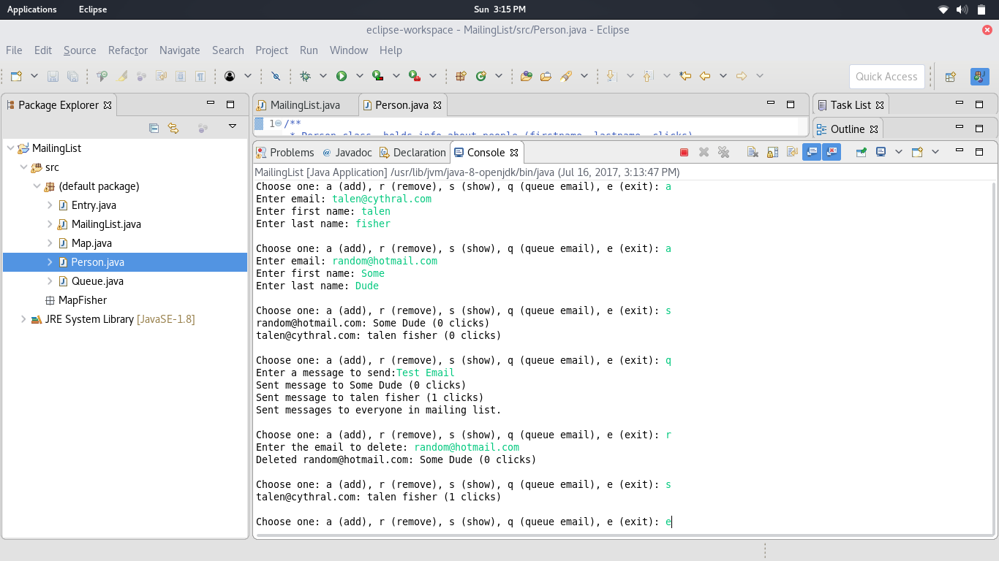
Sample run

Slide 5
github
View the code on github: https://github.com/TalenFisher/MailingList

