Slide 1
A clear picture of our digital estate
Vision, agents and next steps
Notes:
Open with the outcome: one accessible, trustworthy picture of the digital estate.
[Sources]
- User-provided service catalogue objective
[/Sources]

Slide 2

Service knowledge is scattered
Finding the answer takes too long
People search repositories, documents and conversations. Information can be incomplete, inconsistent or out of date.
Notes:
Describe the everyday problem without technical detail: people spend time piecing together a service from several sources.
[Sources]
- User-provided service catalogue objective
- Generated editorial picture: scattered.png
[/Sources]

Slide 3
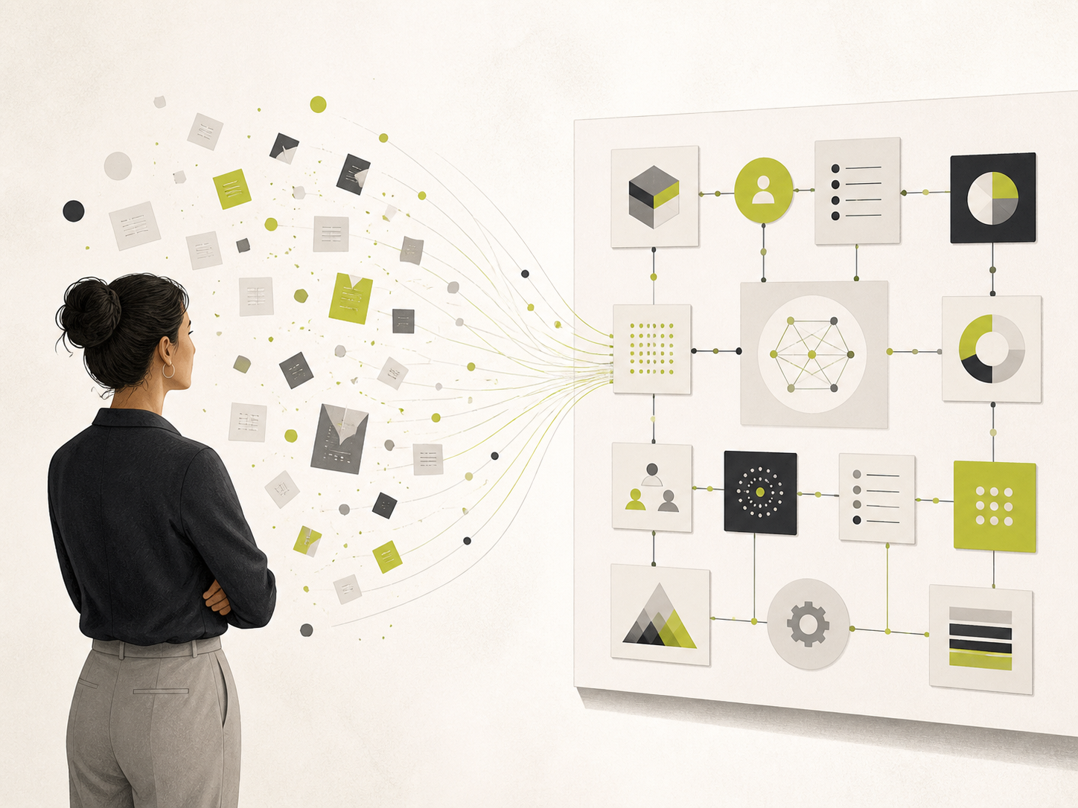
The catalogue creates one trusted view
A shared map for everyone
People can understand services, interfaces, data and ownership without reading source code. Teams gain a dependable starting point for discovery and change.
Notes:
The catalogue translates engineering evidence into an accessible view for delivery, product, operations and architecture colleagues.
[Sources]
- User-provided service catalogue objective
- Generated editorial picture: catalogue.png
[/Sources]

Slide 4
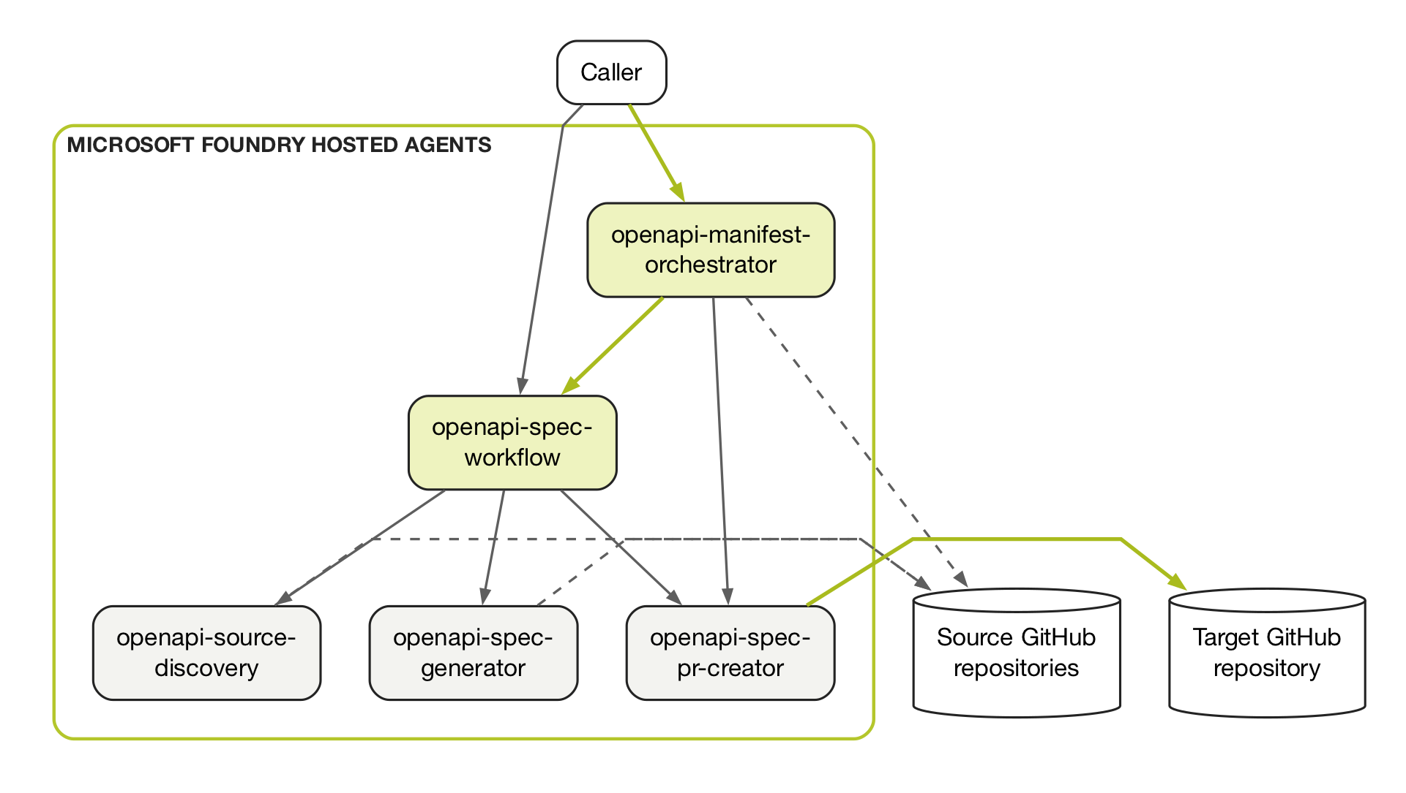
Agents work together as one publishing flow
Each agent has one clear responsibility, with review before information enters the catalogue.
Notes:
The manifest orchestrator identifies changed repositories, the workflow coordinates specialist agents, and the publisher creates the reviewable change.
[Sources]
- README.md — Agent interactions and dependencies
[/Sources]

Slide 5

AI turns source code into useful service knowledge
AI handles interpretation
It reads API and DTO code, follows related declarations and creates clear descriptions. Rules still control scope, validation, file locations and review.
Notes:
The approach is deliberately hybrid: AI handles semantic interpretation, while deterministic software controls selection, limits, validation, paths and publishing.
[Sources]
- README.md — pipeline and agent interactions
- agents/hosted/openapi-source-discovery/README.md
- agents/hosted/openapi-spec-workflow/README.md
- Generated editorial picture: ai-assistant.png
[/Sources]

Slide 6

Reusable processes let us build new catalogue journeys
Small capabilities, joined together
Discover. Interpret. Validate. Publish. Each process has a clear input and output, so we can reuse and chain it for APIs, data, events or ownership.
Notes:
The reusable asset is a library of dependable processes with clear contracts. Different journeys can chain the same capabilities without rebuilding the whole flow.
[Sources]
- README.md — current agent pipeline
- User-provided roadmap
- Generated editorial picture: process-library.png
[/Sources]

Slide 7

The same workflow can run when we need it
Manual today. Scheduled next.
We can run it on demand now. A routine can later check the manifest at an agreed cadence and process only repositories that changed.
Notes:
Manual invocation is the current model. Scheduling is the next step, using the same manifest comparison and review controls.
[Sources]
- README.md — manifest orchestrator
- agents/hosted/openapi-manifest-orchestrator/README.md
- Generated editorial picture: schedule.png
[/Sources]

Slide 8

The catalogue becomes a complete service picture
APIs are the first layer
Next we add shared data schemas, events and commands, and accountable ownership—using the same source-led approach.
Notes:
Position schemas, interactions and ownership as connected layers around the same service record, not separate documentation projects.
[Sources]
- User-provided roadmap: data schemas, events, commands and ownership
- Generated editorial picture: catalogue-layers.png
[/Sources]

Slide 9
One place to understand how services connect
Start with APIs. Add data, events, commands and ownership.
Notes:
Close by seeking agreement on a small pilot, the catalogue's core service record and named owners for the next layers.
[Sources]
- User-provided service catalogue objective and roadmap
[/Sources]

