Slide 1
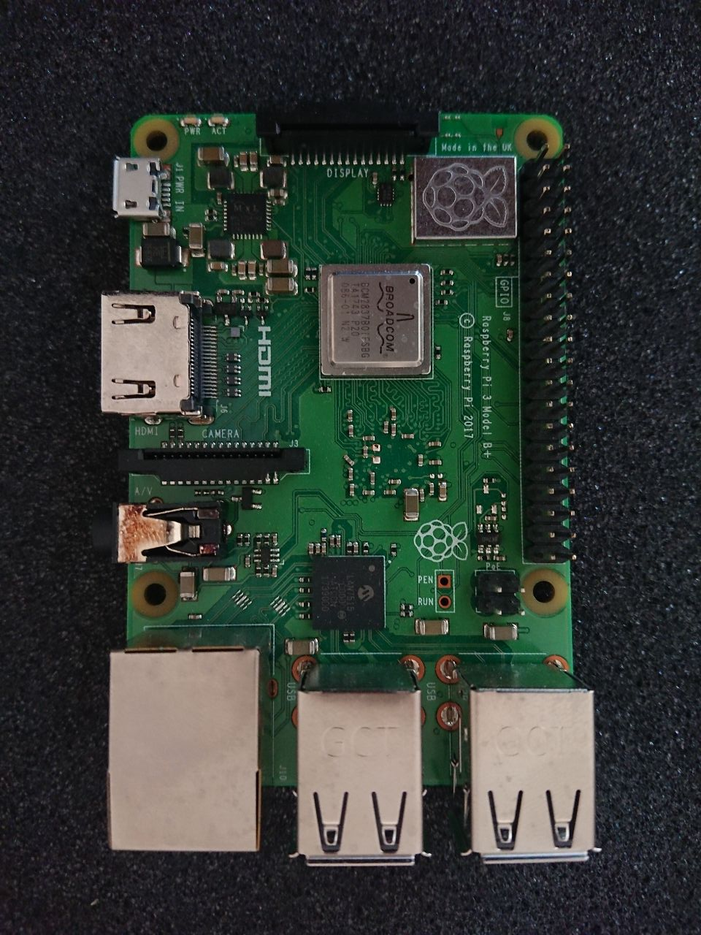
GPIO BCM
GPIO Board
3.3V PWR
1
2
5V PWR
GPIO 2
3
4
5V PWR
PWR StepUp Converter
GPIO 3
5
6
GND
GND StepUp Converter
GPIO 4
7
8
GPIO14
GND
9
10
GPIO 15
GPIO 17
11
12
GPIO 18
GPIO 27
13
14
GND
GPIO 22
15
16
GPIO 23
3.3V PWR
17
18
GPIO 24
GPIO 10
19
20
GND
GPIO 9
21
22
GPIO 25
GPIO 11
23
24
GPIO 8
GND
25
26
GPIO 7
Reserved
27
28
Reserved
GPIO 5
29
30
GND
Coin Input CoinAcceptor
GPIO 6
31
32
GPIO 12
GPIO 13
33
34
GND
GPIO 19
35
36
GPIO 16
GPIO 26
37
38
GPIO 20
GND
39
40
GPIO 21

Slide 2
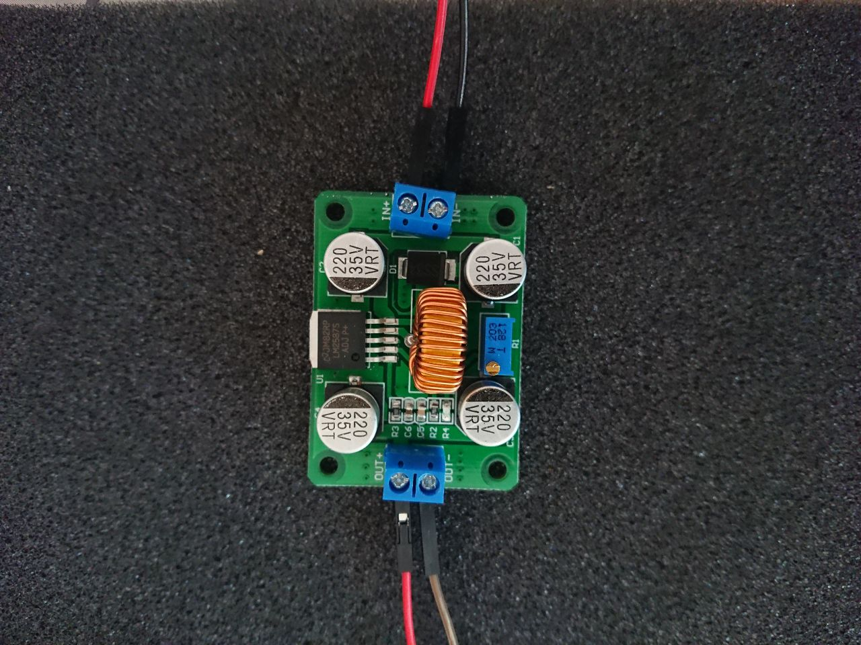
GPIO BCM
GPIO Board
3.3V PWR
1
2
5V PWR
GPIO 2
3
4
5V PWR
PWR StepUp Converter
GPIO 3
5
6
GND
GND StepUp Converter
GPIO 4
7
8
GPIO14
GND
9
10
GPIO 15
GPIO 17
11
12
GPIO 18
GPIO 27
13
14
GND
GPIO 22
15
16
GPIO 23
3.3V PWR
17
18
GPIO 24
GPIO 10
19
20
GND
GPIO 9
21
22
GPIO 25
GPIO 11
23
24
GPIO 8
GND
25
26
GPIO 7
Reserved
27
28
Reserved
GPIO 5
29
30
GND
Coin Input CoinAcceptor
GPIO 6
31
32
GPIO 12
GPIO 13
33
34
GND
GPIO 19
35
36
GPIO 16
GPIO 26
37
38
GPIO 20
GND
39
40
GPIO 21

Slide 3
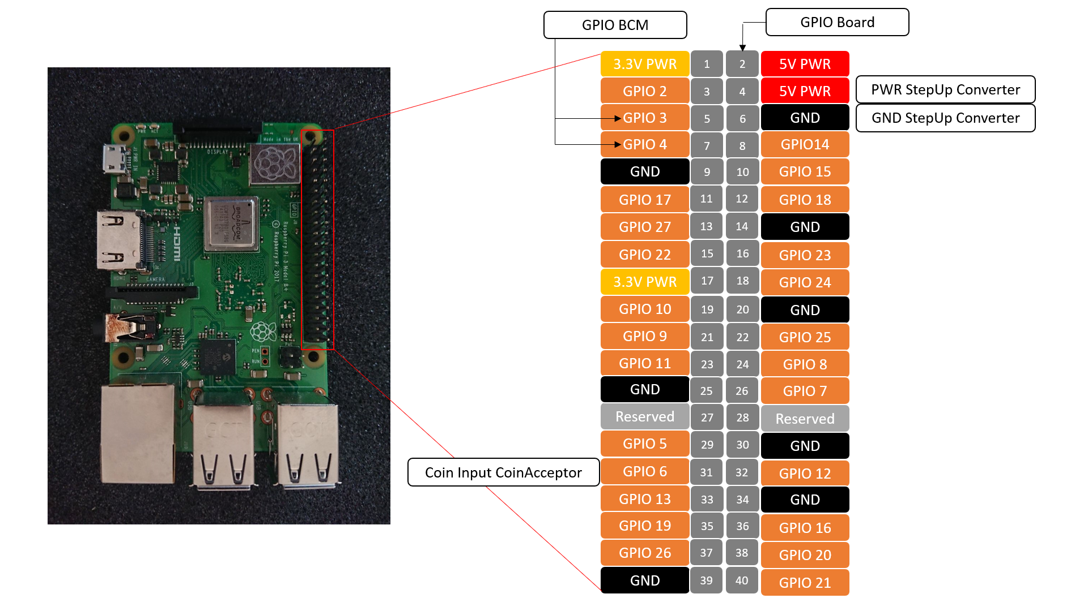
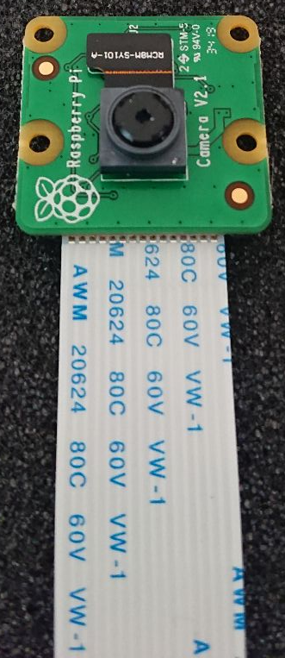
Screen
StepUp Converter
Button 1
Button 2
CoinAcceptor
+
AC12
COIN
GND
Count
-

Slide 4
Screen Manager
Start Page
Selection Page
Payment Page
QrCode
CoinAcceptor
PopUp
LndRest
Shared_values

