Slide 1
在安卓手机上打造瑰丽的光影世界
基于Android的OpenGL ES 开发
Presented by 胖胖小

Slide 2
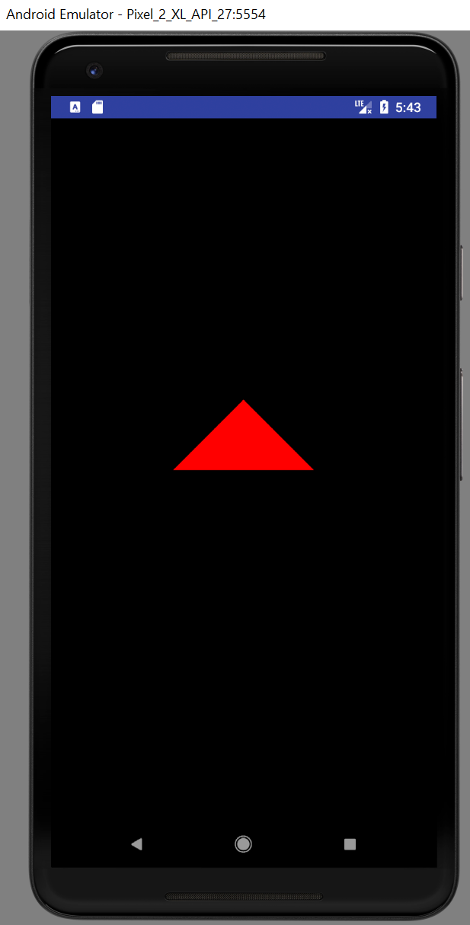
绘制第一个三角形

Slide 3
课程概要
设置环境
第一批OpenGL functions
矩阵运算
Shader 初窥

Slide 4
环境设置(1)
GLSurfaceView
setEGLContextClientVersion(2);
setEGLConfigChooser
setRenderMode
RENDERMODE_WHEN_DIRTY
RENDERMODE_CONTINUOUSLY
SetRenderer

Slide 5
环境设置(2)
GLSurfaceView.Renderer
onSurfaceCreated
初始化
onSurfaceChanged
设置摄像机相关参数
onDrawFrame

Slide 6
OpenGL functions
GLES20 前缀
glViewPort
设置渲染区域
glClearColor
设置背景颜色
glClear
清除缓存
GL_COLOR_BUFFER_BIT – 用背景颜色填充屏幕

Slide 7
Matrix functions(Model)
Matrix.setIdentity
Matrix.scaleM (缩放)
x,y,z
Matrix.translateM(平移)
x,y,z
Matrix.rotateM(旋转) ????

Slide 8
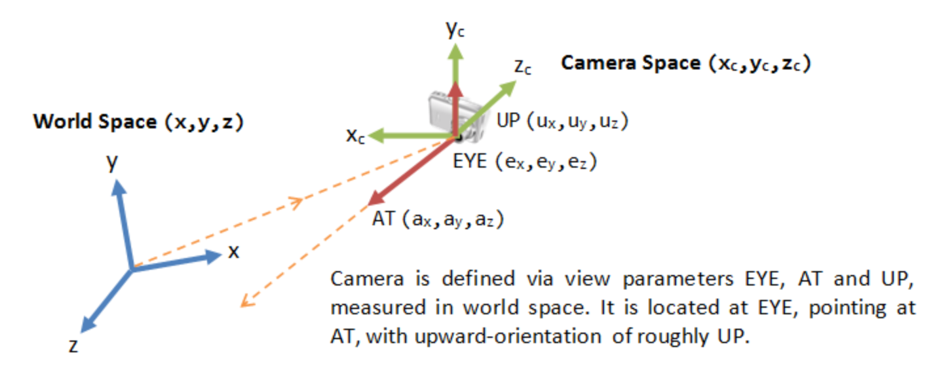
Matrix Functions (View)
Matrix.setLookAtM
eyeX,eyeY,eyeZ
lookX, lookY, lookZ
upX, upY, upZ

Slide 9
Matrix Functions (Projection)
Matrix.frustrumM (透视投影)
Matrix.orthM (正交投影)
Left,right,bottom,top,near,far

Slide 10
Matrix Functions
Matrix.multiplyMM
Projected_vertex = P*V*M*local_vertex
Matrix.multiplyMV

Slide 11
Shaders

Slide 12
课堂总结
OpenGL家族概要介绍
渲染流水线及坐标系
Notes:
https://developer.android.com/reference/android/opengl/GLSurfaceView.Renderer.html
https://developer.android.com/reference/android/opengl/GLSurfaceView.html

