Slide 1
在安卓手机上打造瑰丽的光影世界
基于Android的OpenGL ES 开发
Presented by 胖胖小

Slide 2
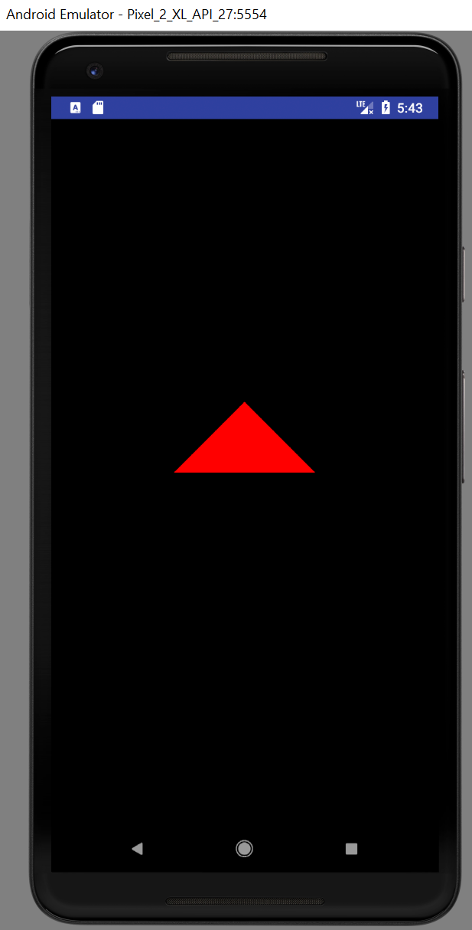
绘制第一个三角形

Slide 3
课程概要
设置环境
第一批OpenGL functions
矩阵运算
Shader 初窥

Slide 4
环境设置(1)
GLSurfaceView
setEGLContextClientVersion(2);
setEGLConfigChooser
setRenderMode
RENDERMODE_WHEN_DIRTY
RENDERMODE_CONTINUOUSLY
SetRenderer

Slide 5
环境设置(2)
GLSurfaceView.Renderer
onSurfaceCreated
初始化
onSurfaceChanged
设置摄像机相关参数
onDrawFrame

Slide 6
OpenGL functions
GLES20 前缀
glViewPort
设置渲染区域
glClearColor
设置背景颜色
glClear
清除缓存
GL_COLOR_BUFFER_BIT – 用背景颜色填充屏幕

Slide 7
Talk is cheap, let us code
一个黑屏

Slide 8
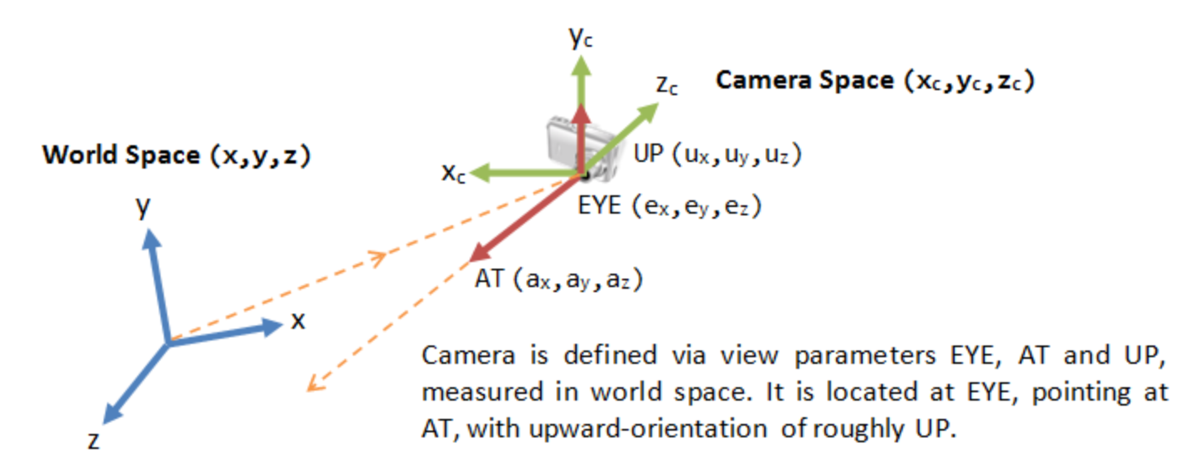
Matrix Functions (View)
Matrix.setLookAtM
eyeX,eyeY,eyeZ
lookX, lookY, lookZ
upX, upY, upZ

Slide 9
Matrix functions(Model)
Matrix.setIdentity
Matrix.scaleM (缩放)
x,y,z
Matrix.translateM(平移)
x,y,z
Matrix.rotateM(旋转)

Slide 10
Matrix Functions (Projection)
Matrix.frustrumM (透视投影)
Matrix.orthM (正交投影)
Left,right,bottom,top,near,far

Slide 11
Matrix Functions
Matrix.multiplyMM
Projected_vertex = P*V*M*local_vertex
Matrix.multiplyMV

Slide 12
Shader 初窥
最简单的Vertex Shader
最简单的Fragment Shader
precision mediump float;
uniform mat4 u_MVPMatrix; attribute vec4 a_Position;
void main(){ gl_Position = u_MVPMatrix * a_Position;
}
precision mediump float;
void main(){
gl_FragColor = vec4(1.0,0.0,0.0,1.0);
}

Slide 13
Shader的生命周期
glCreateShader
GL_VERTEX_SHADER/GL_FRAGMENT_SHADER
glShaderSource
glCompileShader
glGetShaderiv
glDeleteShader

Slide 14
Shader与Program
Program绑定了Vertex Shader与Fragment Shader
glCreateProgram
glAttachShader
glLinkProgram
glGetProgramiv
glDeleteProgram
glUseProgram

Slide 15
Attribute,Uniform,Attribute变量
uniform变量
对每个顶点都一样的变量
可用于Vertex Shader+Fragment Shader
Attribute 变量
在每个顶点上变化的变量
只能用于Vertex Shader
Varying 变量
用于在Vertex Shader和Fragment Shader之间传值

Slide 16
如何传值给Shader变量？
Uniform变量
glGetUniformLocation
glUniform Matrix4fv
Attribute变量
glGetAttributeLocation
glVertexAttribPointer
glEnableVertexAttribArray
glDisableVertexAttribArray

Slide 17
Draw it!
glDrawArrays
书上学来终觉浅
得知此事要躬行

Slide 18
课堂总结
写Shaders
Vertex Shader
Fragment Shader
赋值给Uniform/Attribute变量
mvpMatrix
vertices and buffer
Notes:
https://developer.android.com/reference/android/opengl/GLSurfaceView.Renderer.html
https://developer.android.com/reference/android/opengl/GLSurfaceView.html

