Slide 1
Prioritized memory access explains planning and hippocampal replay
Mattar and Daw (2017)
UCL CompHip. Journal Club
December 13, 2017

Slide 2
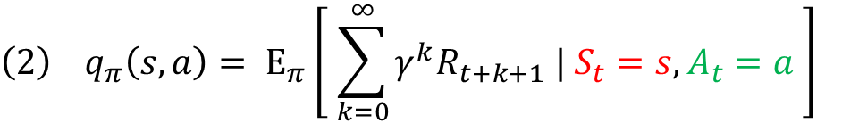
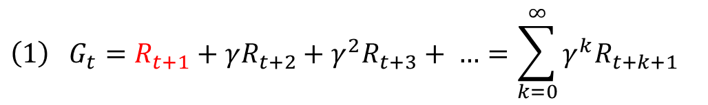
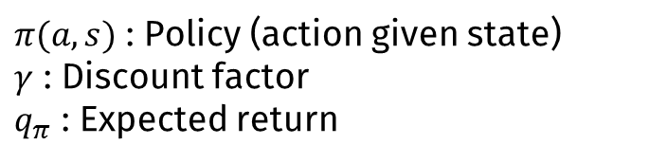
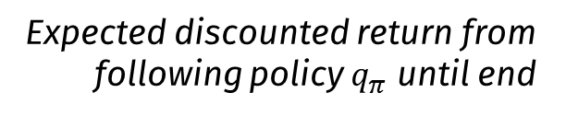
Intro: Reinforcement learning recap
s : State
a : Action
R : Reward
$π(a,s)$ : Policy (action given state)
$γ$ : Discount factor
$q_{π}$ : Expected return
Goal: To select actions that maximize the expected cumulative discounted reward
$${\left(1\right) G}_{t}=R_{t+1}+γR_{t+2}+γ^{2}R_{t+3}+ …=\sum_{k=0}^{∞}{γ^{k}R_{t+k+1}}$$
Cumulative discounted return
Reward at time t+1
State at time t = s
$${\left(2\right) q}_{π}\left(s,a\right)= Ε_{π}\left[ \sum_{k=0}^{∞}{γ^{k}R_{t+k+1} | S_{t}=s, A_{t}=a} \right]$$
Expected discounted return from following policy $q_{π}$ until end
Action at time t = a
$$\left(3\right) Q\left(S_{t},A_{t}\right)←Q\left(S_{t},A_{t}\right)+α\left[R_{t}+γ\max_{a∈A} Q\left(S_{t+1},a\right)−Q(S_{t},A_{t})\right]$$
Update policy towards action that produces max. return
Learned action-value function
New value
Old value

Slide 3
Intro: Reinforcement learning recap
s : State
a : Action
R : Reward
$π(a,s)$ : Policy (action given state)
$γ$ : Discount factor
$q_{π}$ : Expected return
Goal: To select actions that maximize the expected cumulative discounted reward
Choose action A given state S
Repeat until end:
Update Q(S,A)
Take action A and observe R, S’

Slide 4
Intro: DYNA
s : State
a : Action
R : Reward
$π(a,s)$ : Policy (action given state)
$γ$ : Discount factor
$q_{π}$ : Expected return
Goal: To select actions that maximize the expected cumulative discounted reward
Model-Free RL:
No model
Learn value function (and/or policy) from experience
Fast
Can’t update policy to reflect change in environment
Model-Based RL:
Learn a model from experience
Plan value function (and/or policy) from model
Slower than model-free
Changes in the environment reflected in planning
Dyna:
Learn a model from real experience
Learn and plan value function (and/or policy) from real and simulated experience
Fusion of model-based / model-free methods

Slide 5
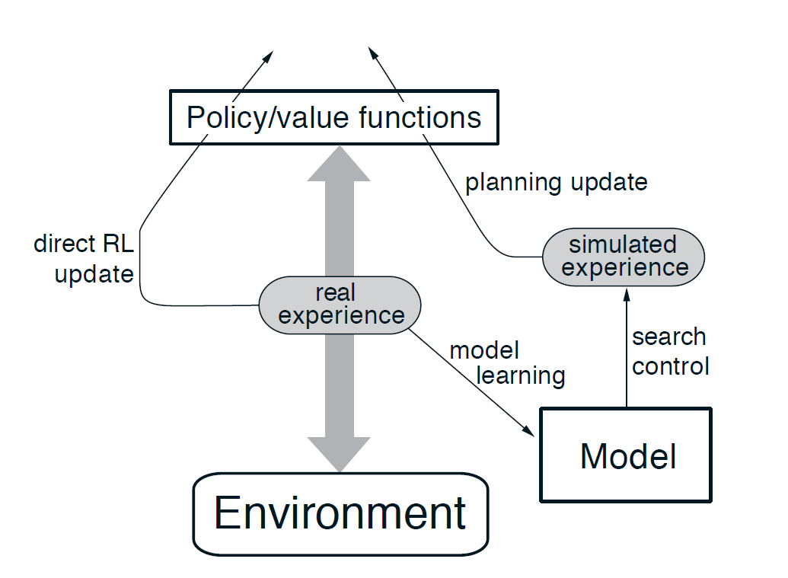
Intro: DYNA
s : State
a : Action
R : Reward
$π(a,s)$ : Policy (action given state)
$γ$ : Discount factor
$q_{π}$ : Expected return
Goal: To select actions that maximize the expected cumulative discounted reward
Learn from two sources:
Real experience (animal movement)
Simulate experience (replay) from learned model
Model = transition structure of environment

Slide 6
Intro: DYNA
These two modes of learning can operate in parallel, or sequentially:
One run is equivalent to a two-state ‘replay event’
Direct Experience
Simulated experience using model
Choose action A given state S
Repeat:
1. Choose random previous state S
2. Choose random action A previously taken at S
3. Transition to S’ given model
Update Q(S,A)
Take action A and observe R, S’
4. Update Q(S,A)

Slide 7
Intro: DYNA
s : State
a : Action
R : Reward
$π(a,s)$ : Policy (action given state)
$γ$ : Discount factor
$q_{π}$ : Expected return
One run is equivalent to a two-state ‘replay event’
Simulated experience using model
Repeat:
- Mattar and Daw propose a better way to select which states are updated
1. Choose random previous state S
2. Choose random action A previously taken at S
- Instead, prioritize states based on gain and need
3. Transition to S’ given model
4. Update Q(S,A)

Slide 8





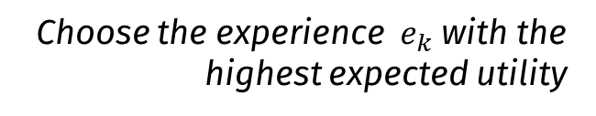


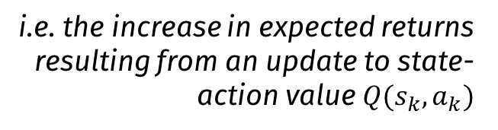
Intro: Prioritized memory access (PME)
s : State
a : Action
R : Reward
$π(a,s)$ : Policy (action given state)
$γ$ : Discount factor
$q_{π}$ : Expected return
Goal: To select actions that maximize the expected cumulative discounted reward
$$e_{k}=(s_{k},a_{k},r_{k},s_{k+1})$$
A single experience (replay event)
Choose the experience $e_{k}$ with the highest expected utility
$$Utility(s_{k},a_{k})=Gain×Need$$
$$Expected returns \\ under updated policy$$
$$Expected returns \\ under old policy$$
i.e. the increase in expected returns resulting from an update to state-action value $Q(s_{k},a_{k})$
$$Gain\left(s_{k},a_{k}\right)=$$
$$−$$
(This can be approximated by the successor representation)
$$Need\left(s_{k}\right)=$$
$$Discounted number of future visits to state s_{k}$$

Slide 9
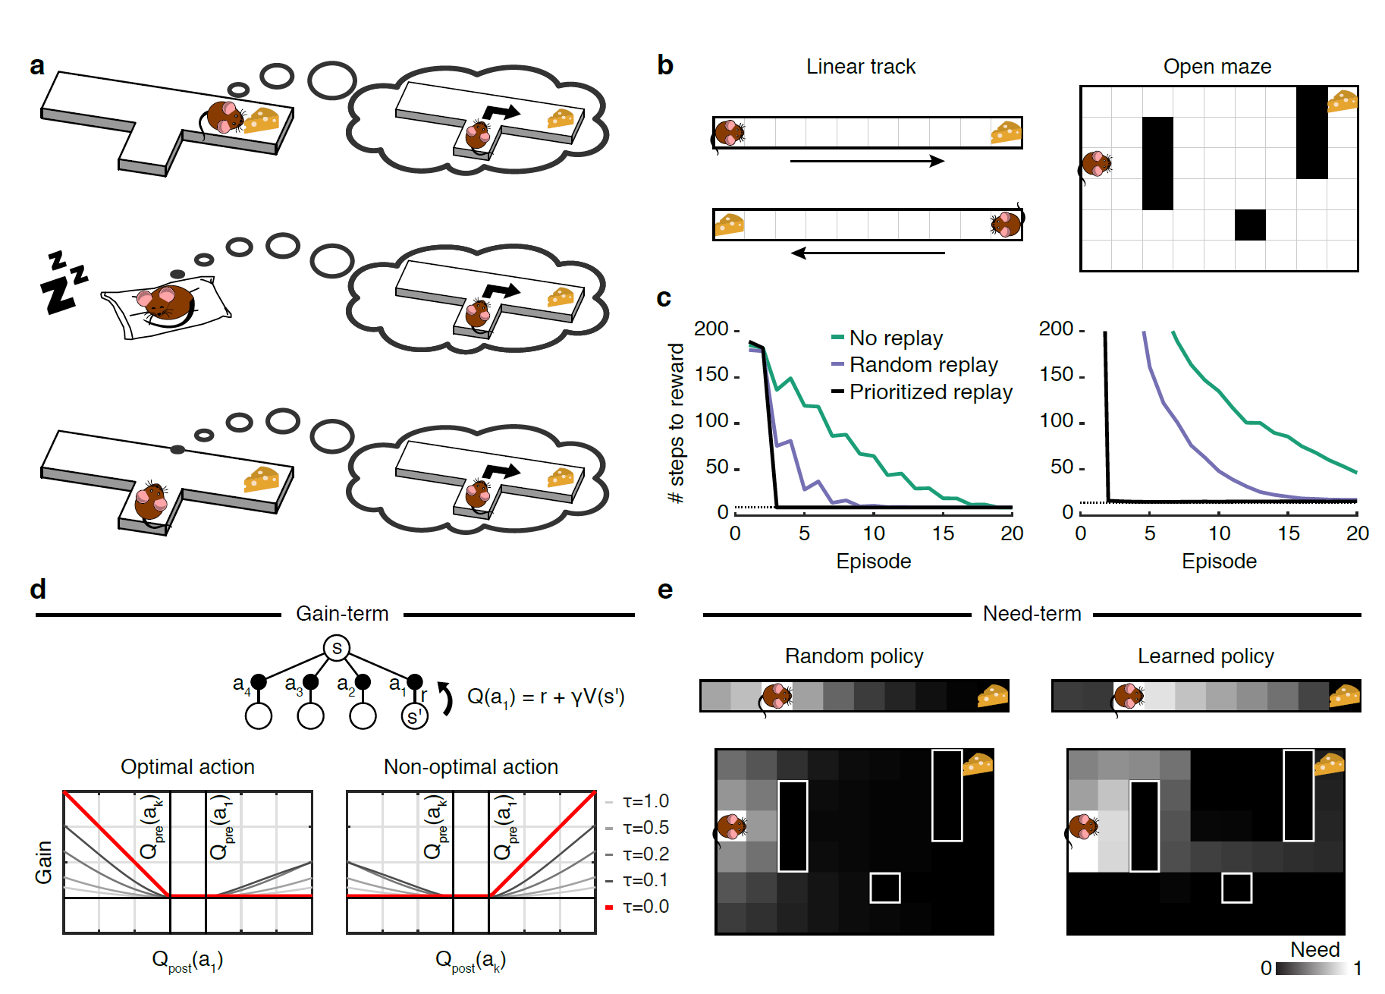
Results 1: PME access improves learning speed
‘Grid-world’ environments – move UP, DOWN, LEFT, RIGHT
Environment 1: Linear track with end reward
Environment 2: 2D room with objects and reward
Softmax action decisions at each state (balance of exploration vs. exploitation)
Reverse replay after reward
Three ways to learn:
‘Offline’ reactivation
Prospective activation before choice

Slide 10
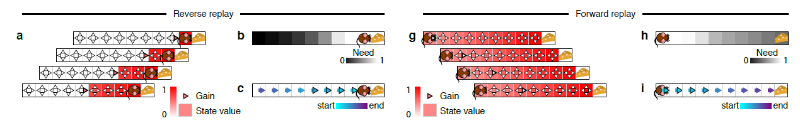
Results 2: Forward and reverse replay
Prediction errors (unexpected / changed reward) cause large gain term directly behind the animal
Need term larger in states ahead of the animal
Need term (expected discounted visits) related to previous trajectories, which tend to lead to the goal as policies improve
Changes to this state directly affect the probability of collecting the reward in the future
After first state is updated, choose two steps back, three steps back… = reverse replay
When need > gain, greatest utility in states ahead producing forward sweeps

Slide 11
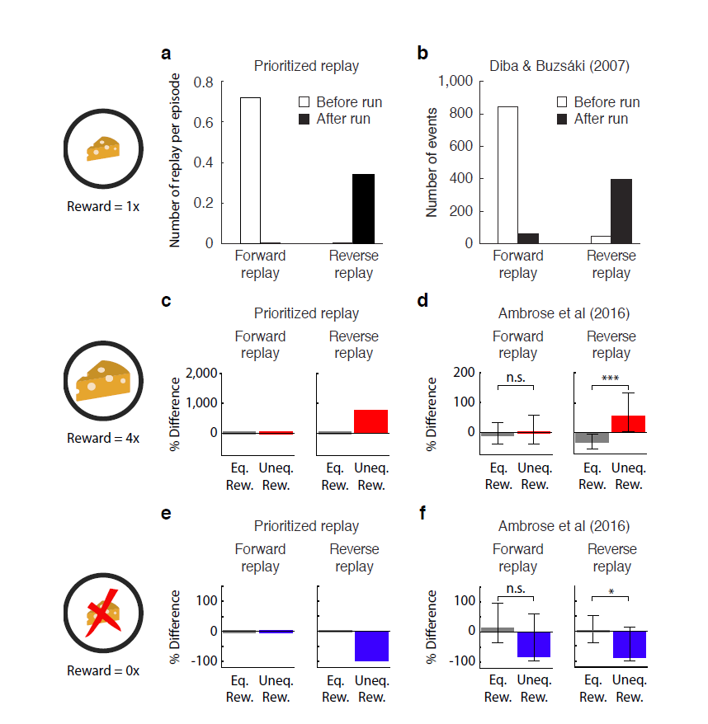
Results 2: Forward and reverse replay
Compare to Diba and Buzsaki (2007):

Slide 12
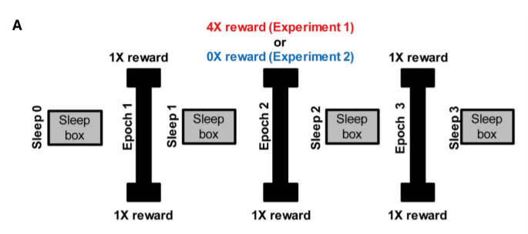
Results 3: Asymmetric modulation of replay events
Ambrose et al. (2016): Repeated trials with either 4x or 0x reward on linear track Forward events not affected by changing reward
Rate of reverse replay increases in response to unexpectedly large rewards (positive prediction errors; Ambrose et al., 2016)
Rate of reverse replay decreases for unexpectedly small reward (negative prediction error; Ambrose et al., 2016)
Note small increase in reverse replay events in response to conventional 1x rewards in 0x reward trials

Slide 13
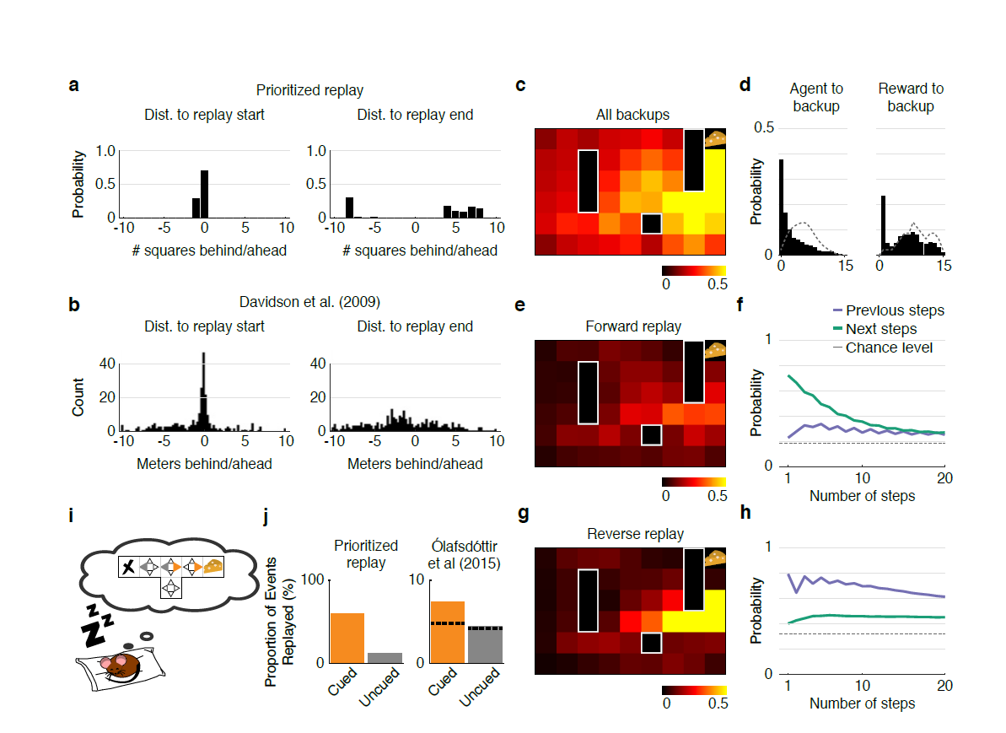
Results 4: Statistics of replay locations
Distribution of start and end locations
Effect on simulated behaviour
Effect on offline reactivations
Beginning of replay trajectories biased towards animal and goal locations…
Simulated T-maze with reward on one arm (Olafsdottir et al., 2015)
Updated states over-represent reward location
…no bias for the end of the trajectories (at least for animal location)
Forward events predict future occupancy:
Backward events predict past occupancy:

Slide 14
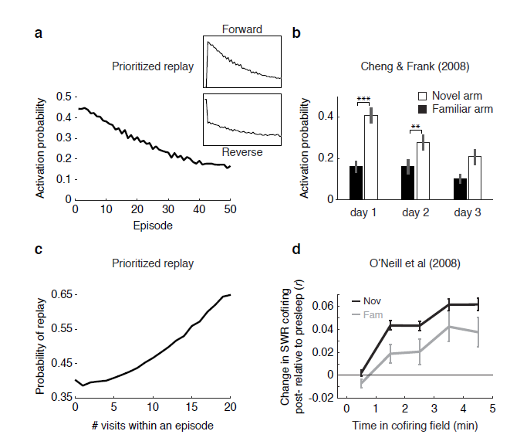
Results 5: Replay frequency decreases with learning
Gain term decreases with experience since its related to predictions errors, which also decrease due to improving policy
Need term increases since trajectories become more stereotyped
Decreasing gain leads to fewer overall replay events (i.e. there are still replayed states, but they are no longer contiguous in space)
But, increasing need term increase probability that a given state is included in a significant replay event

Slide 15
End
Thanks!

