Slide 1
WEEK 11 DELIVERABLES
Group Name: Data Bank
Tevfik SASTIM, talfik22@gmail.com, Turkey, Self- Employed, Data Science
Marelly Escelade, idemany1@gmail.com, Peru, Self- Employed, Data Science

Slide 2
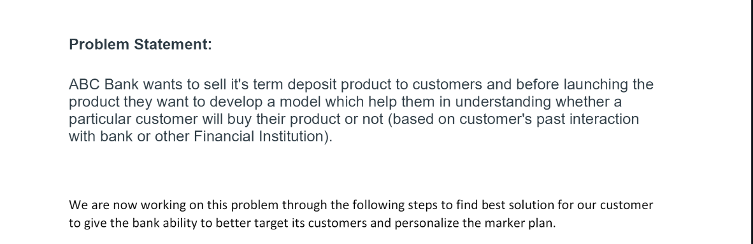

Slide 3
Github Repo Link
Github Repo link: https://github.com/talfik2/Data-Glacier-Data-Bank-Bank-Marketing-Group-Project
Link for Step 5: https://github.com/talfik2/Data-Glacier-Data-Bank Bank-Marketing-Group-Project/tree/Step-5-Model-evaluation

Slide 4
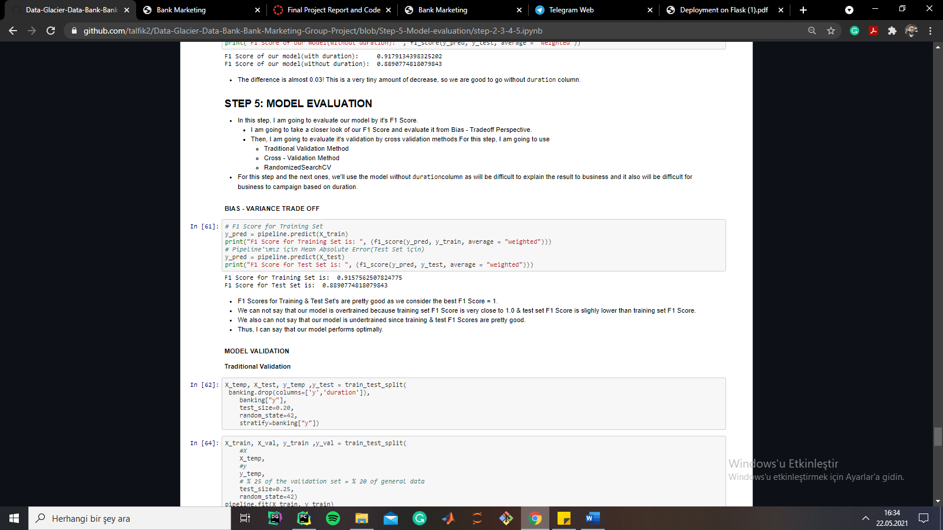
EDA Presentation and proposed modeling technique
This step is completed by Tevfik SASTIM. In this step, Model’s measure metric is set as F1 Score as our data is highly imbalanced.
Moreover, model is evaluated by Bias – Variance Tradeoff,

Slide 5
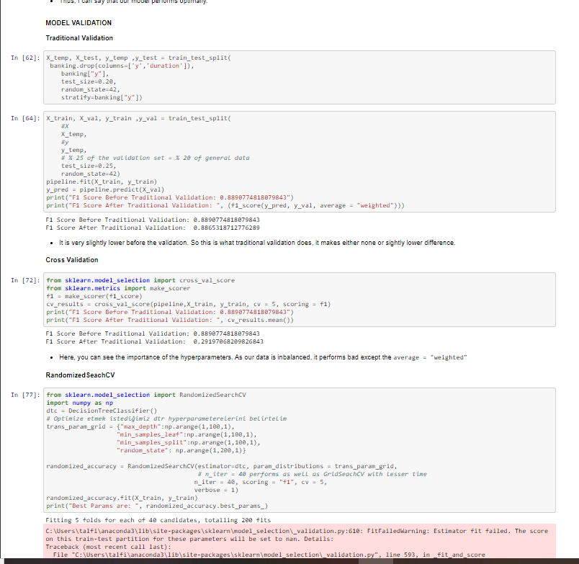
EDA Presentation and proposed modeling technique
And it is validated by Traditional Validation, K – fold Cross Validation & Randomized Search CV.

Slide 6
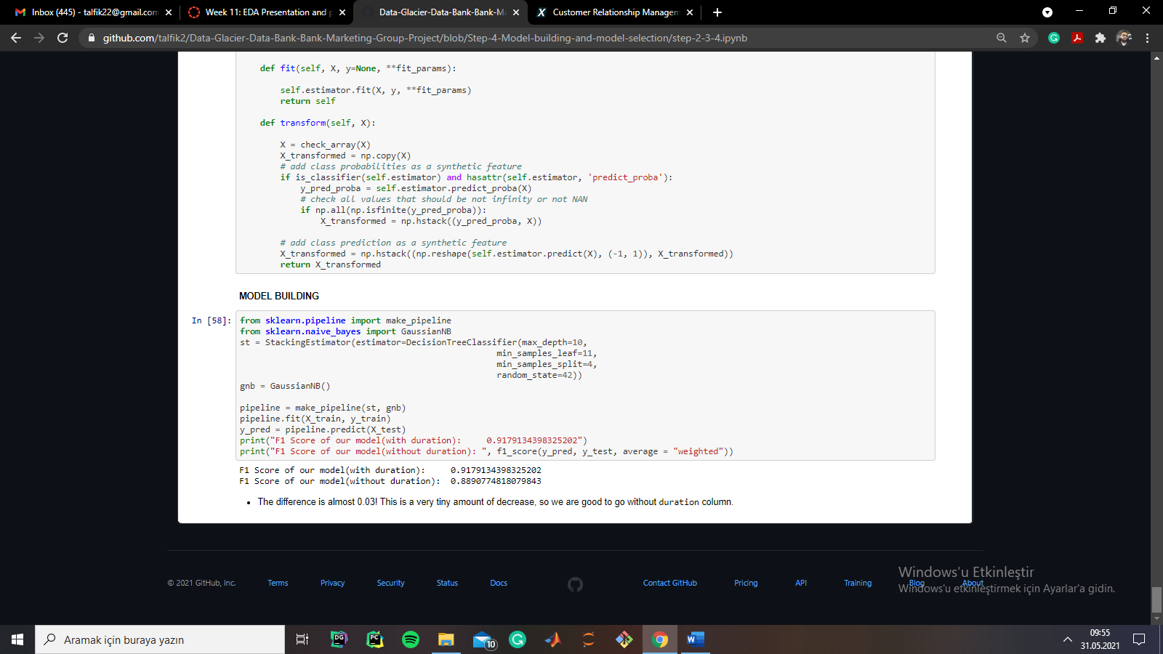
Final Recommendation
Recommended models for this dataset are:
Recommended Model without Randomized CV:

Slide 7
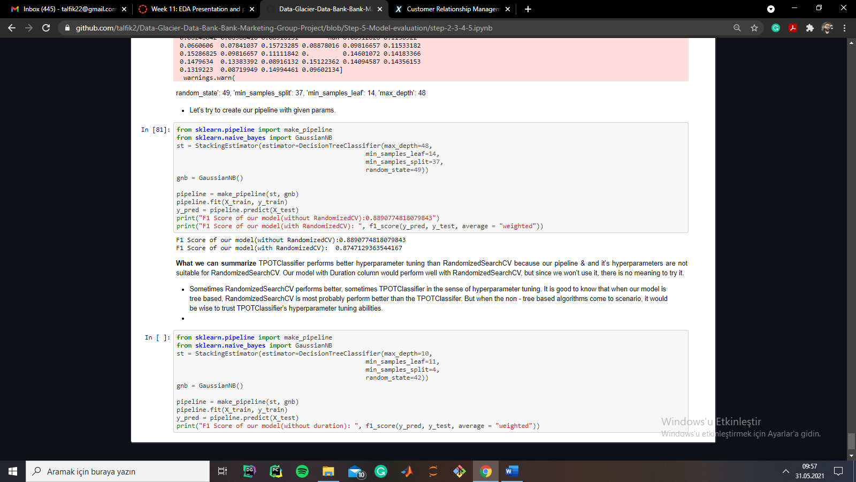
Final Recommendation
Recommended Model with Randomized CV

Slide 8
Final Recommendation
As I stated on the previous slide, because F1 Score without Randomized CV performed better, my final recommendation is the pipeline without Randomized CV.

