Slide 1

Classification Model Hotel Cancellation Predication
Nadav Gordon-Bar and Tal Gottfeld
November 15th , ‘21

Slide 2
Content
The Business Problem
The Data
EDA Stage
Preprocessing Stage
Data Engineering Stage
Models Deployment Results
Wrap-Up

Slide 3
The Business Problem
How can we reduce a ~33% cancellation rate and protect our revenue flow.

Slide 4
The Data
Data source: Kaggle website https://www.kaggle.com/jessemostipak/hotel-booking-demand
Period Reviewed, 2015- 2017
Technical Environment -
Kaggle API’s tool
# upload data via kaggle API
! pip install kaggle
! mkdir ~/.kaggle
!cp /content/drive/MyDrive/HotelCancellation_Proj4/Tal/kaggle.json ~/.kaggle/kaggle.json
! kaggle datasets download jessemostipak/hotel-booking-demand
! unzip hotel-booking-demand.zip
os.listdir('/content/’)
data = pd.read_csv('/content/hotel_bookings.csv')
data.head()
Accessible and economic

Slide 5
Our DataSet
Getting to know our data:
32 features
119,390 rows, 17MG
Data types: Int, str – Categorical and numeric
Business diversity - Splitting the data?
-Market segment
-Distribution channel -Distribution channel
-Previous cancellations
--Booking changes
- Country
-Hotel
-Leadtime
-Leadtime /Week/day -Leadtime/ weekend nights -Adults
-Price
-Meal
-Booking changes -Company -Agent -Booking changes
-Customer type -Reservation status
Example of features

Slide 6
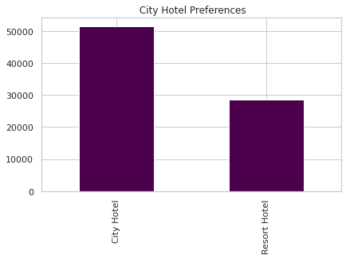
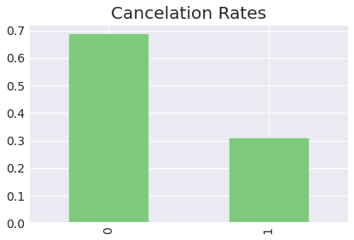
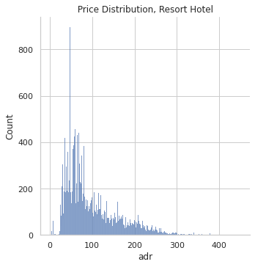
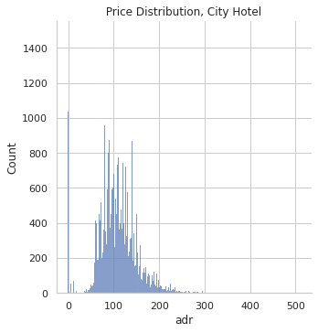
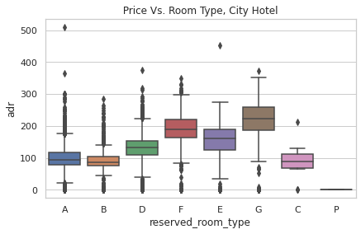
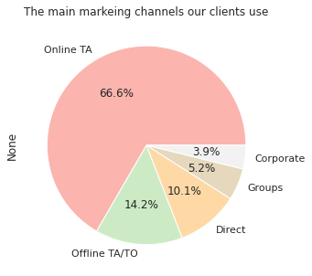
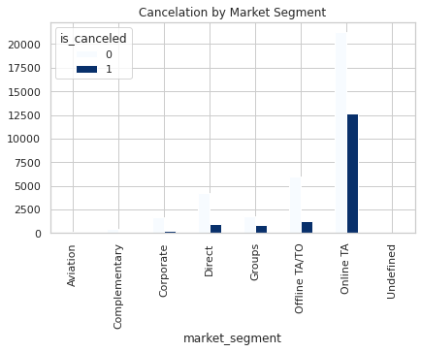
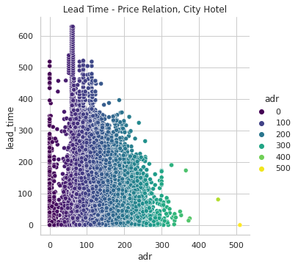
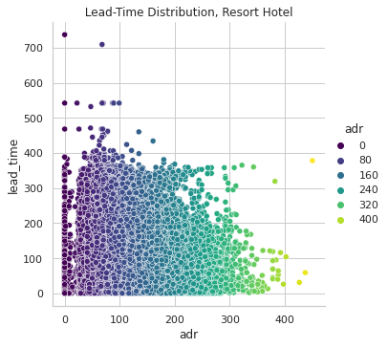
The Data – EDA
Method: Feature analysis, trends review, outliers, statistics, unique inner relation to other features and to the use-case target.
Dataset
Objective
Repeated guest impact cancellations
Time spent changes by hotel type
The more specific requests, the lower the cancellations
Lead time and cancellation
Customer types / Distrusting channel and cancellations
Price
Marketing Efforts

Slide 7
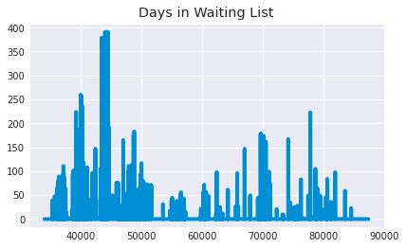
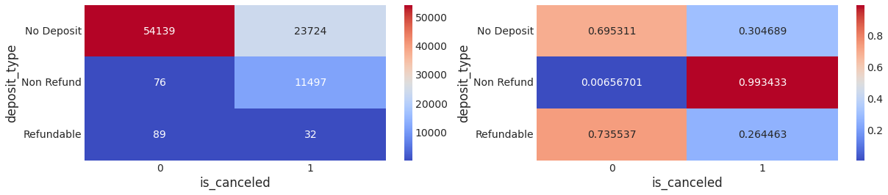
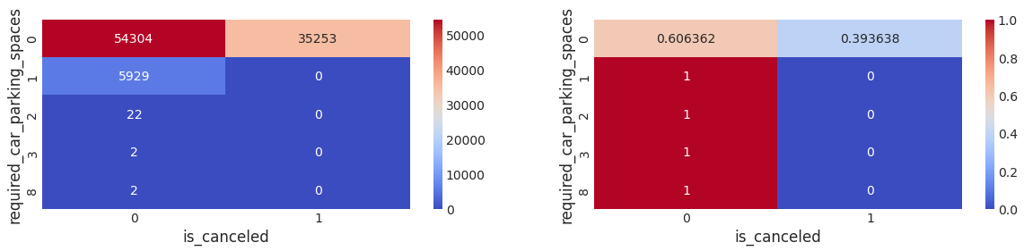
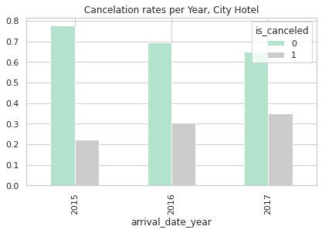
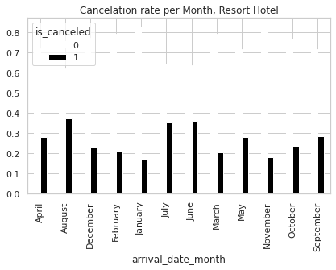
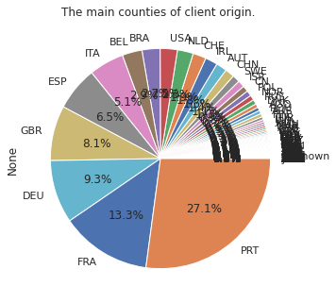
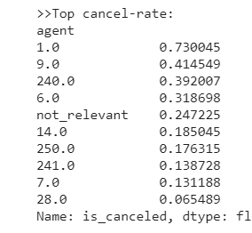
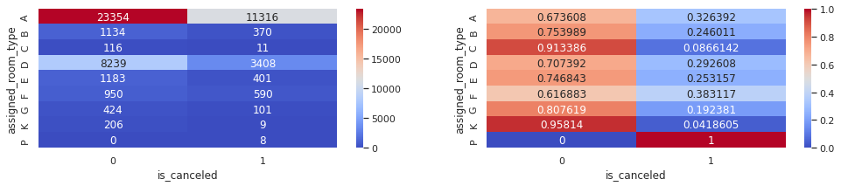
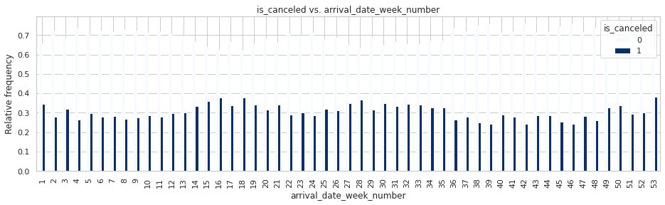
The Data – Features & Leading Challenges
Method: Feature analysis, trends review, outliers, statistics, unique inner relation to other features and to the use-case target.
Deposit
Parking
Time Scale – Multiple Features
Country
Agent
Assigned R

Slide 8
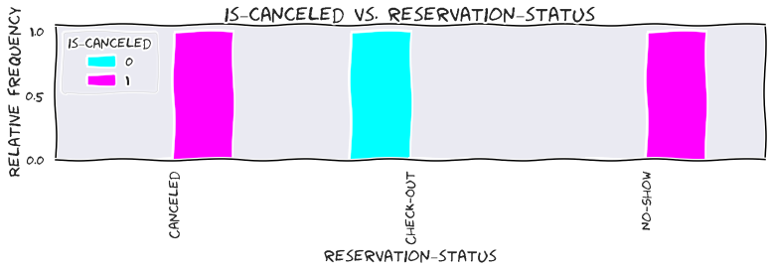
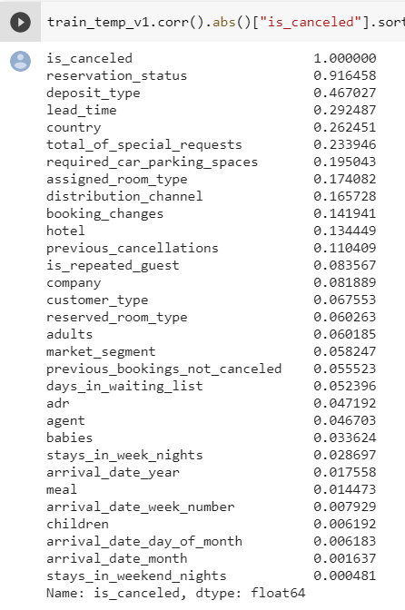
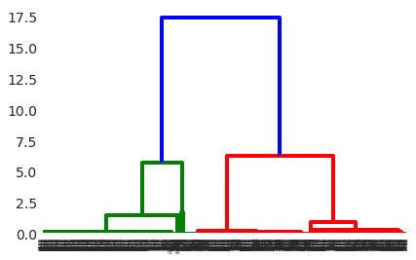
Preprocessing & Data Engineering
Identifying leakages! – Reservation Status & Date, Agent
Handling missing values : Simpleimputer- object
Handling features –
Ohe - ('market segment', 'customer_type', 'assigned_room_type’, 'arrival_date_month', 'arrival_date_year', 'meal’
Fix – Cancel Ration, Family (Scale, BinningE)
Drop – (arrival_date_week_number/day, Country, distribution_channel, 'agent','company’, 'days_in_waiting_list'
Correlation between the features
Last arrangements before design – Combining it all - Rules, fill na, transformers and final score
Point to consider: Why we choose TreesAlgos and why we didn’t use scalers

Slide 9
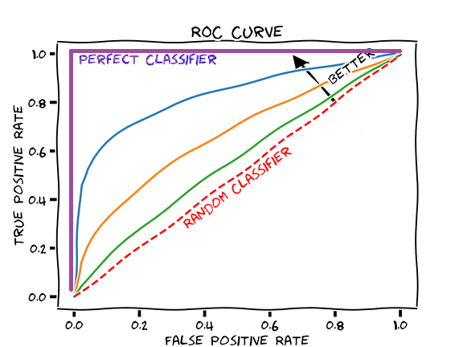
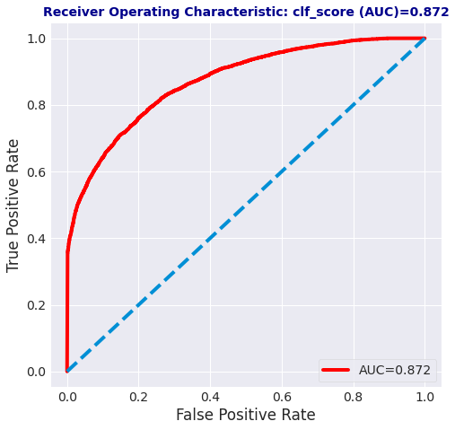
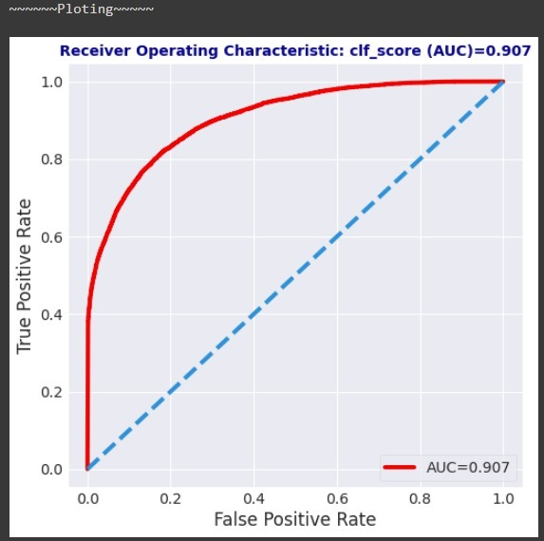
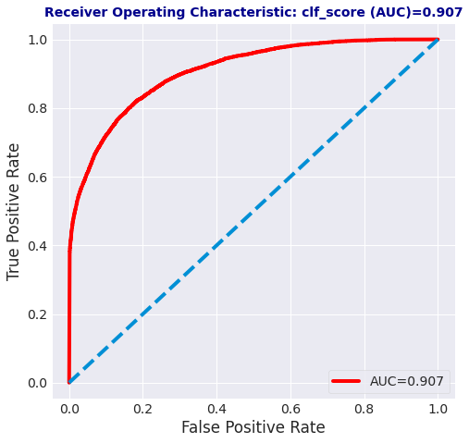
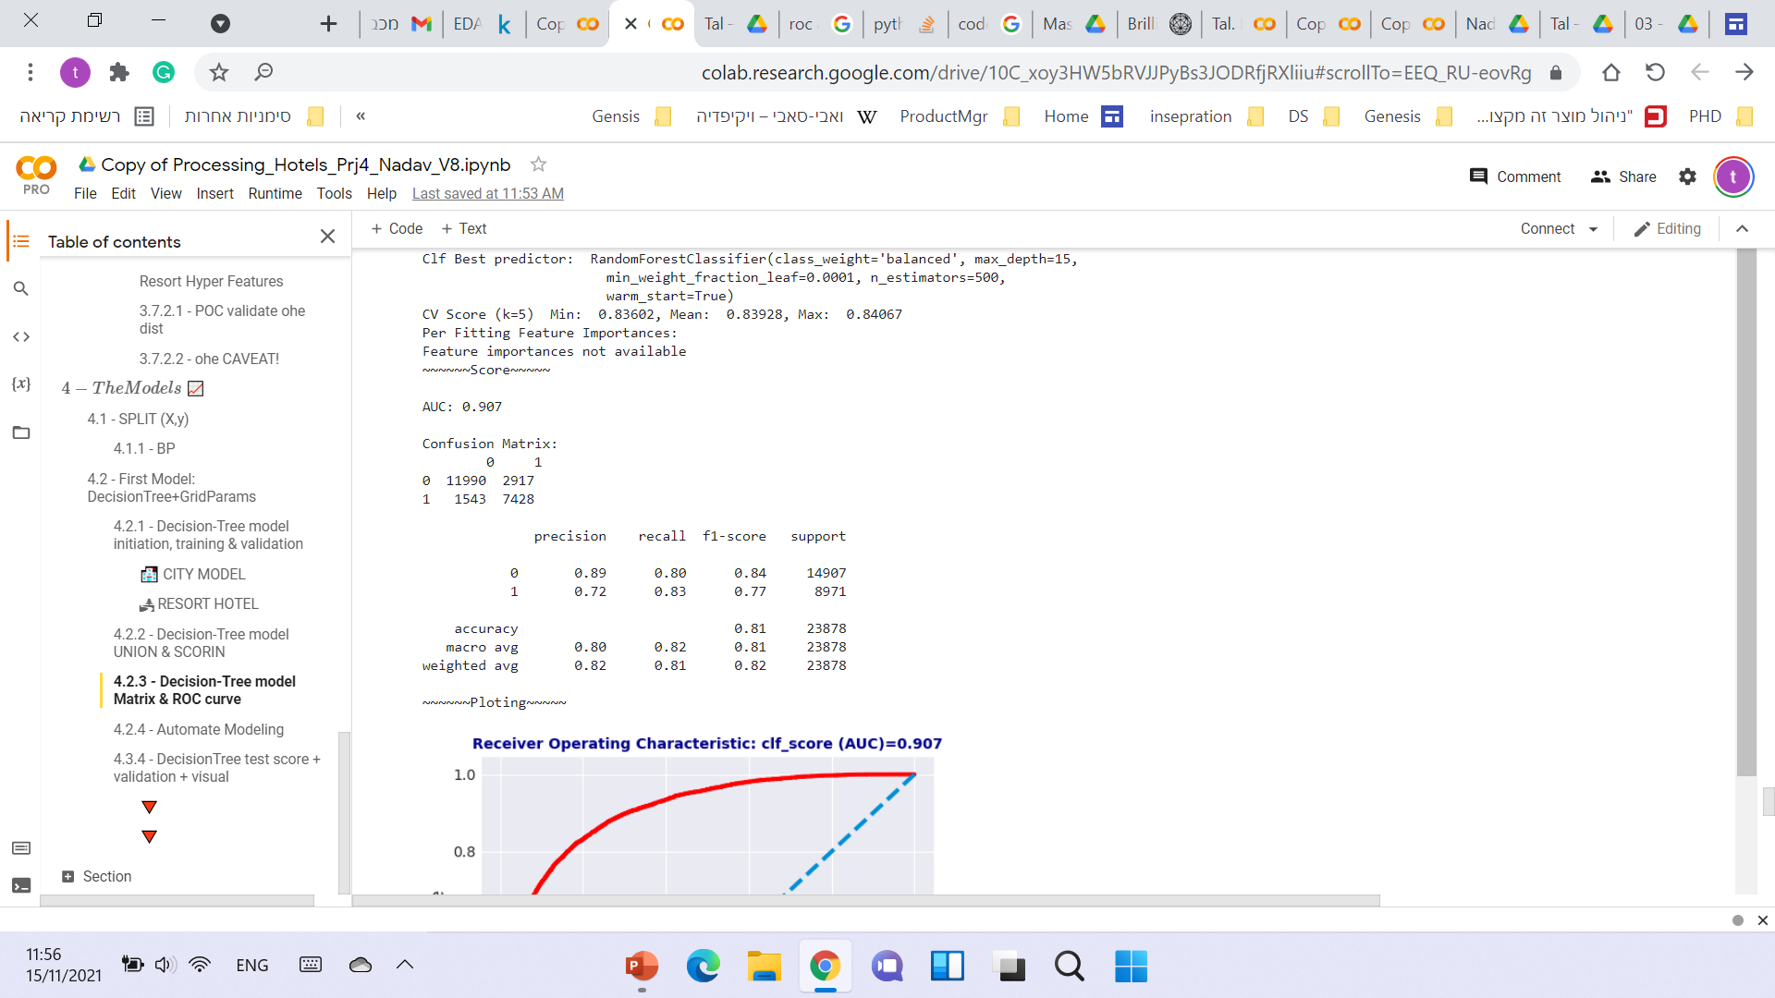
Model – Deployment & Scores
Method: 1. We keep it clean! 2. Pipeline design. One flow 3. Work in iteration- Feature-Model – feature - Model
Decision Model I Random Forest I XGB I LightGBM
Decision Tree
Random Forest
XGB
AUC= 0.872
AUC= 0.907
AUC= 0.907

Slide 10
Conclusion - Key take-aways
Keep it Clean as early as you can!
Don’t try to round corners. E.g. ‘Other’
Look for leakage

Slide 11
Thank You for you time!

