Slide 1

Web scraping to gain company insights
Prathmesh Lonkar, Junior Data Scientist
12/25/2023

Slide 2
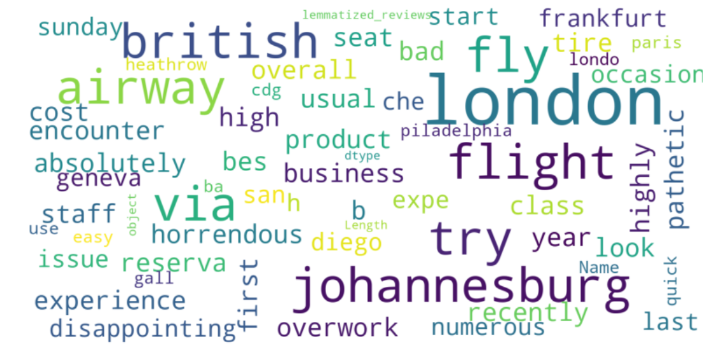
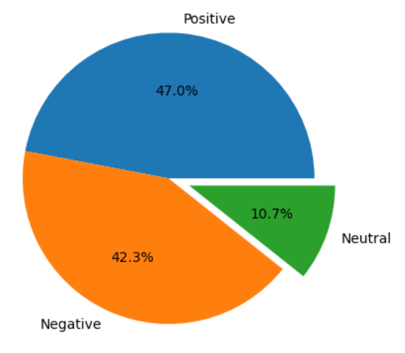
Insights FROM CUSTOMER REVIEWS
From cleaning 1000 reviews given by the customers, we obtained
Positive Reviews - 470
Negative Reviews - 423
Neutral Reviews - 107

