Slide 1

Predicting Customer Buying Behavior
Prathmesh Lonkar, Junior Data Scientist
12/26/2023

Slide 2
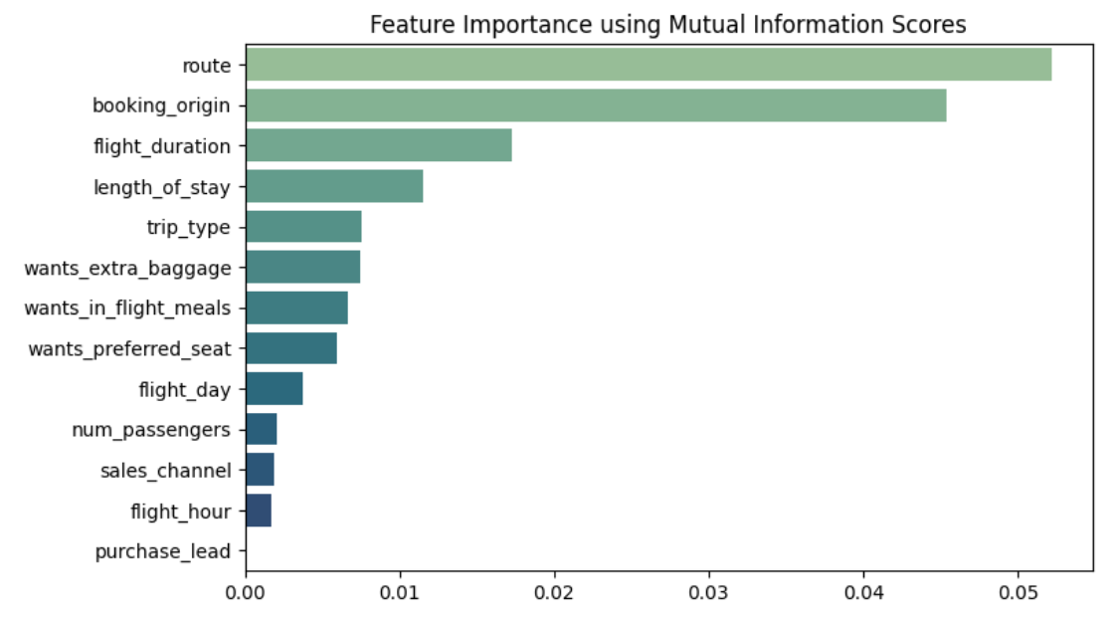
predictive model to understand factors that influence buying behavior
We have trained the data set with Random Forest Classifier model and received
Training Accuracy: 99.98
Validation Accuracy: 85.17
Top 5 features which influence
Customer buying behavior:
route
booking_origin
flight_duration
length_of_stay
trip_type

