Slide 1

1
Understanding filesystem structure

Slide 2
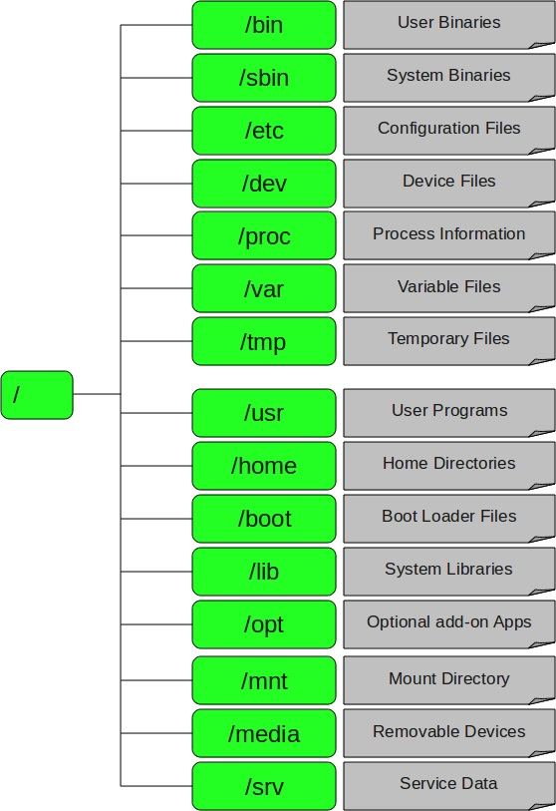

Slide 3

Identifying Linux File types
When navigating the Linux file system you are sure to encounter different file types.
The most used and obvious file types are regular files and directories.
However, the Linux operating system has more to offer in terms of file types as it also includes another 5 file types. This short article will help you to recognize all the 7 different file types within the Linux operating system.

Slide 4

Identifying Linux File types
Let us have a look at a short summary of all the seven different types of Linux file types and ls command identifiers:
- : regular file
d : directory
c : character device file
b : block device file
s : local socket file
p : named pipe
l : symbolic link

Slide 5

Identifying Linux File types
Regular file
The regular file is a most common file type found on the Linux system. It governs all different files such us text files, images, binary files, shared libraries, etc. You can create a regular file with the touch command:
$ ls -ltr linuxserver.com
-rw-rw-r-- 1 john students 0 Jan 17 12:52 linuxserver.com

Slide 6

Identifying Linux File types
Directory
Directory is second most common file type found in Linux. Directory can be created with the mkdir command:
$ mkdir FileTypes
$ ls -ld FileTypes/
drwxrwxr-x 2 john students 4096 Jan 17 13:14 FileTypes/

Slide 7

Identifying Linux File types
Character device
Character and block device files allow users and programs to communicate with hardware peripheral devices. For example:
$ ls -ld /dev/vmmon
crw------- 1 root root 10, 165 Jan 4 10:13 /dev/vmmon
Block Device
Block devices are similar to character devices. They mostly govern hardware as hard drives, memory, etc.
$ ls -ld /dev/sda
brw-rw---- 1 root disk 8, 0 Jan 4 10:12 /dev/sda

Slide 8

Identifying Linux File types
Local domain sockets
Local domain sockets are used for communication between processes. Generally, they are used by services such as X windows, syslog and etc.
$ ls -ld /dev/log
srw-rw-rw- 1 root root 0 Jan 4 10:13 /dev/log
Sockets can be created by socket system call and removed by the unlink or rm commands.

Slide 9

Identifying Linux File types
Named Pipes
Similarly as Local sockets, named pipes allow communication between two local processes. They can be created by the mknod command and removed with the rm command.

Slide 10

Identifying Linux File types
Symbolic Links
$ ls -ld file2
lrwxrwxrwx 1 lubos lubos 5 Jan 10 14:42 file2 -> file1
$ ls -ld /etc/services
-rw-r--r-- 1 root root 19281 Feb 14 2012 /etc/services.

